Slide 1
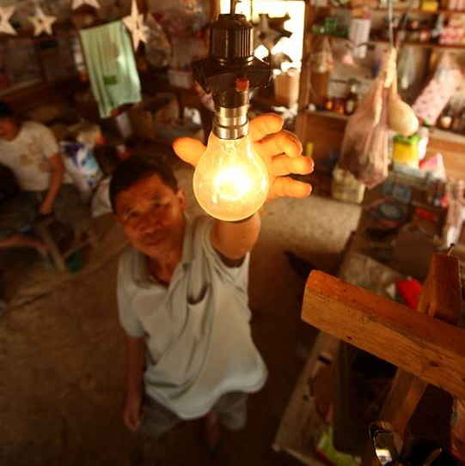
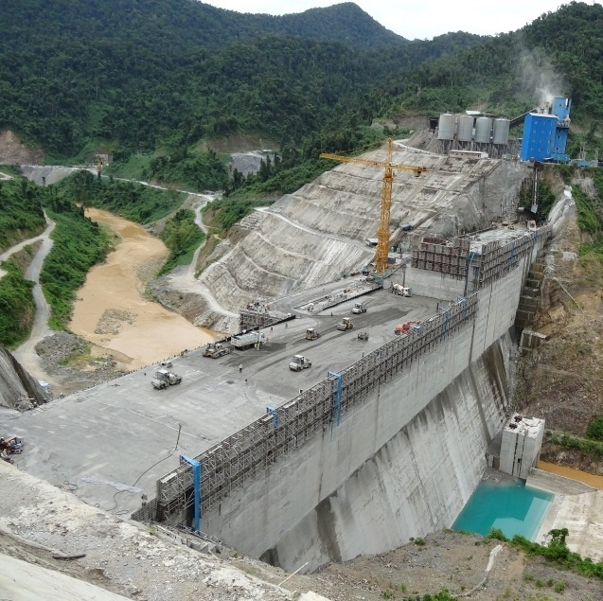
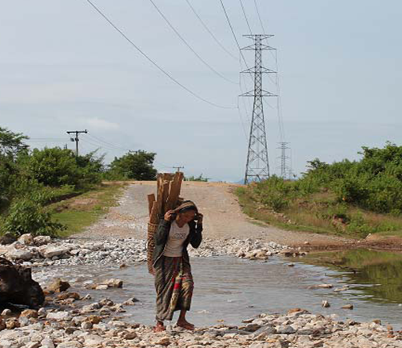

Example course:
Environment & Development
Mattijs Smits

Slide 2
Profile of the course
MSc course at Wageningen University
Around 40 MSc students
  ~50% Dutch
  ~50% International
Different disciplines, e.g.:
  Environmental Science
  Development Studies
  Economics
  Aquaculture and Food Science

Slide 3
Learning outcomes
After this course, students are expected to be able to:
To understand the history and background to contemporary causes and solutions to environmental problems in developing nations
To apply key concepts to a relevant event that occurred during the simulation that explains the dilemmas and solutions to environmental problems in developing countries
To evaluate key concepts and theories that help to explain the relationship between environment and development
To practice analytical skills for critical social science through individual and collaborative academic writing

Slide 4
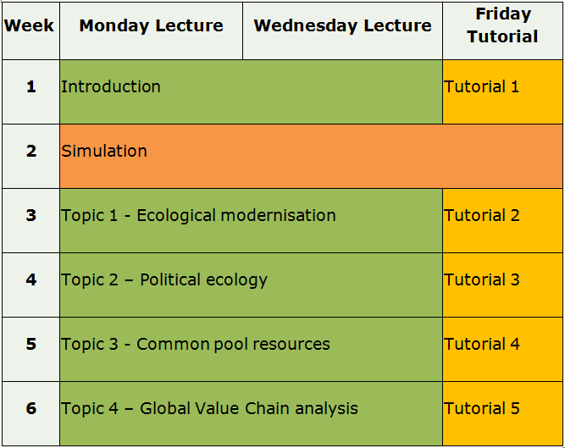
Organisation of the course
Notes:
Theme 1 - established concepts and normative understanding of development and environment. In addition, terms such as developing, underdeveloped and transitional will be examined. Issues relating to classic economic development, cultural and social development and ecologically sustainable development will be presented.
Theme 2 – focuses on 4 key areas of theory that help us to critically examine the themes of environment and development.
The main points are: Globalization; Power and knowledge; Politics, conflict and resolution over the environment; Environmental governance
Theme 3 – Grounds us in some contemporary debates surrounding ‘real world’ debates over environment and development.
Water development in Southeast Asia
Soil degradation in Sub Saharan Africa
SME and foreign investment in Africa
Biodiversity and nature conservation in Asia and South America
Theme 4 – The last 2 lectures in Theme 4 focus on reflecting on what you have learnt in the course. The aim is, by reflecting on the theories and case studies, reformulate some ideas on the future of environment and development. Lectures will cover issues of new forms of development including post-development and the future of the environment in a globalized world. We also take a look at the process of doing development, reflecting on our own positions within the debates as researchers from different countries with different agendas.

Slide 5
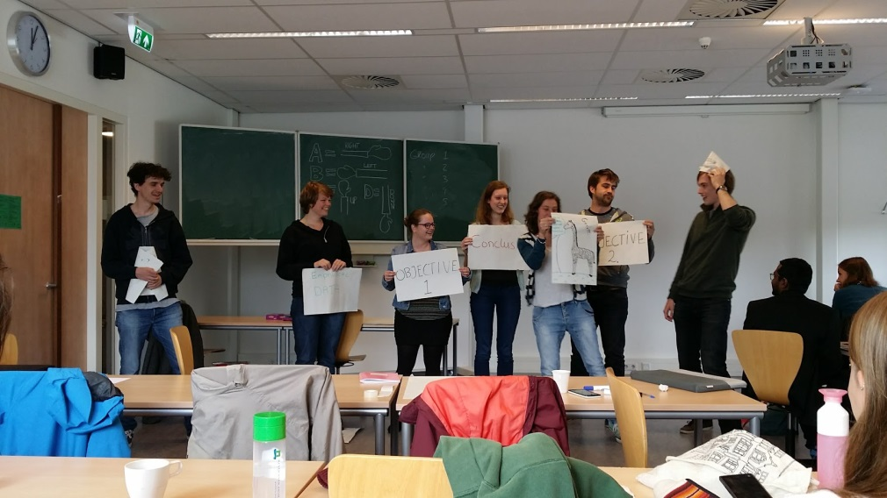
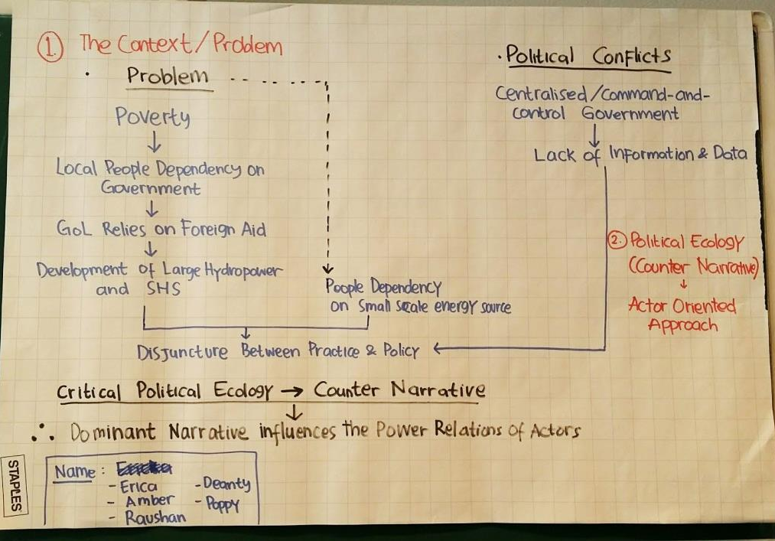
Learning activities
Lectures
Reading
Weekly assignments
Tutorials (group work/discussions)
Simulation (role play)
Paper writing

Slide 6
SIMULATION
(= role play)

Slide 7
Simulation – what and why?
What is a simulation?
Interactive learning activity designed to put theories around the challenges of environment and development into practice through a real and ongoing debate
Why do it?
Better understand the complexities of the development process and trade-offs with environment
Gain a greater understanding of the complexities of relationships and interactions between stakeholders in real life – skills for professional careers

Slide 8
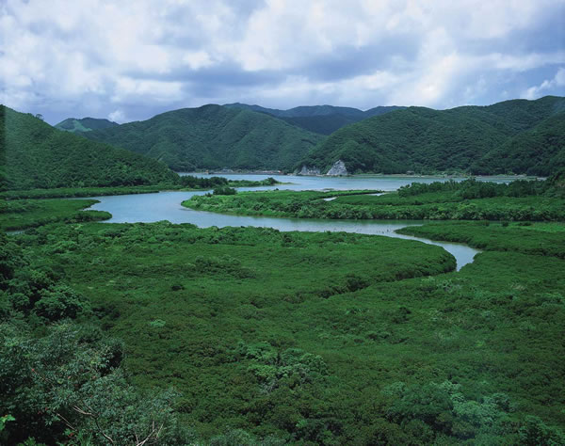
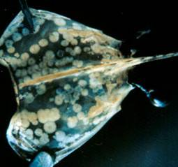
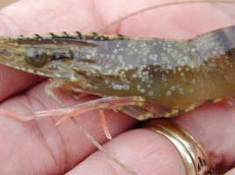
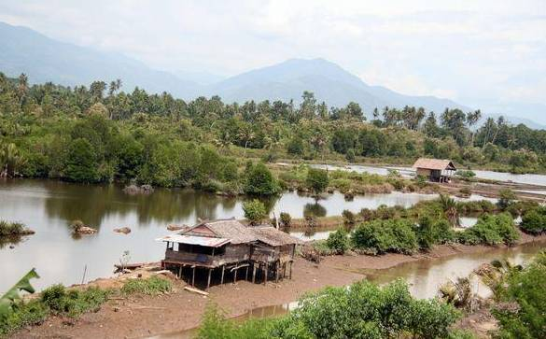
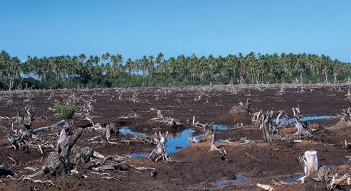
Simulation case: standards for sustainable shrimp in Ecuador
$ € ¥
State
?
Market
Society

Slide 9







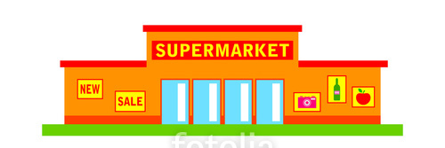
Different stakeholders

Slide 10
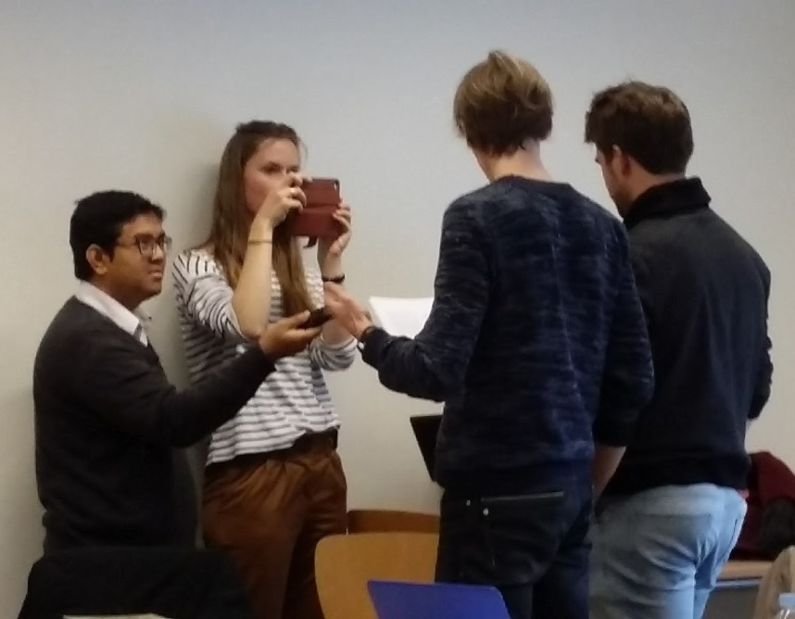
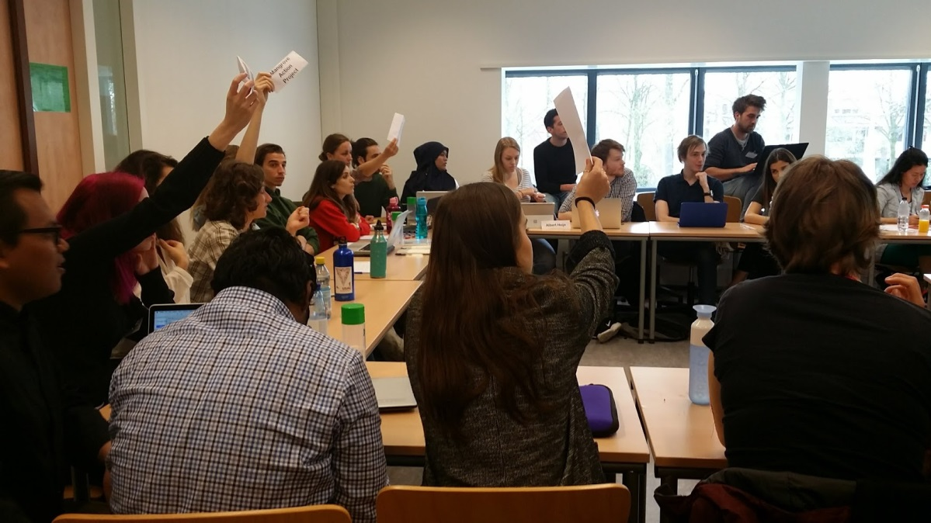
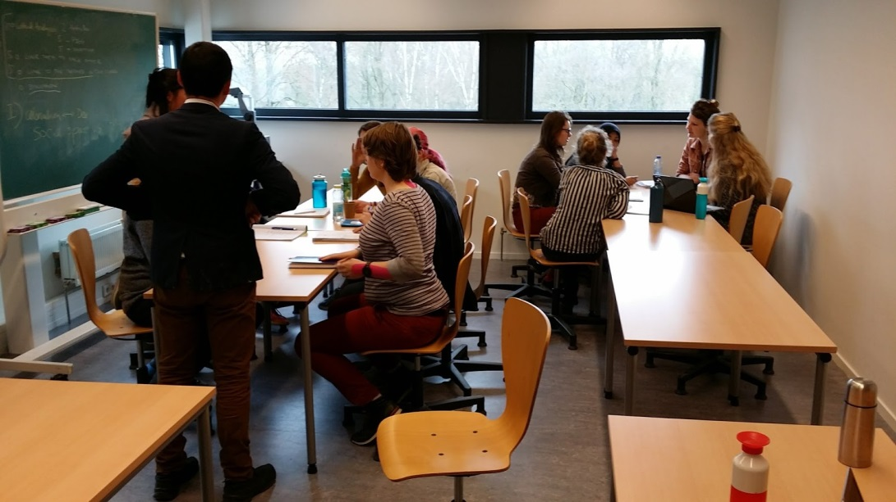
Simulation in pictures

Slide 11
ASSESSMENT

Slide 12
Assessment
+
+
TUTORIAL ASSIGNMENTS
RESEARCH
ESSAY
SIMULATION
30%
30%
40%
Notes:
Final grade is the weighted total of the different elements of the simulation (30%), three assignments (30%) and the essay (40%). The assignments and the essay will be marked out of 10.
For passing the course your individual grade of each assignment has to at least 5.5 and your grade of the essay has to be at least 5.5.

Slide 13
Weekly assignments (30%)
Problem description
Theory
A1 - Analysis of structure/argumentation
A2 - Analysis of problem framing
Research assumptions
Research objective & question/s
A3 - Analysis of research assumption & question
Research methodology
Results
A4 - Analysis of drawing a conclusion
Discussion
Conclusion
Notes:
Explain how to get the results
Discussion is a key part!

Slide 14
Simulation (30%)
Preparation (group mark)
  Stakeholder position statement
  Strategy document
Active participation (individual)
Debriefing paper (individual)
  Reflection on simulation
  Identifying key issues related to environment and development

Slide 15
Individual Research Paper (40%)
Demonstrate an understanding of how the concepts and theories presented in the course can help you to analyse the events in the simulation and why these events occurred;
Discuss what implications these events may have for finding solutions in terms of both environment and development.
4000 words

Slide 16
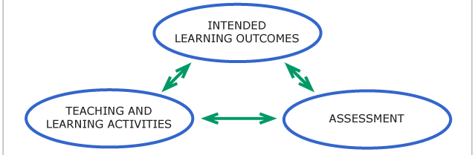
Any questions?

