Slide 1
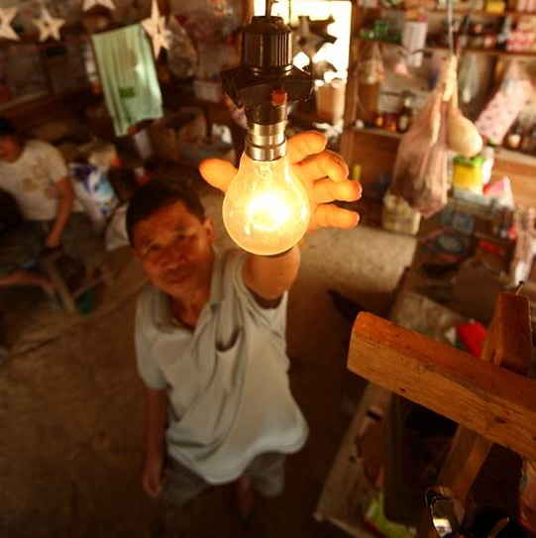
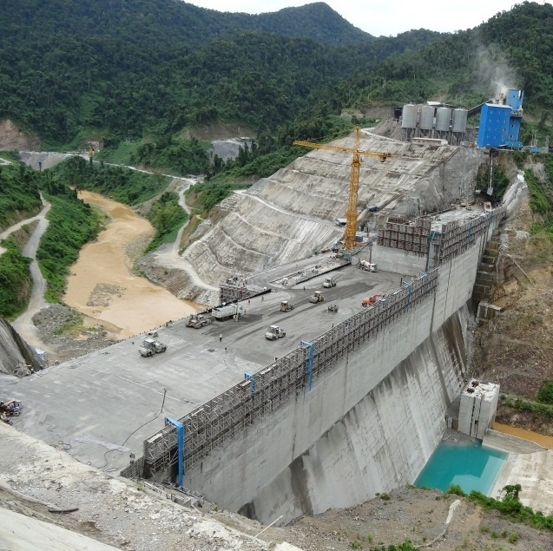
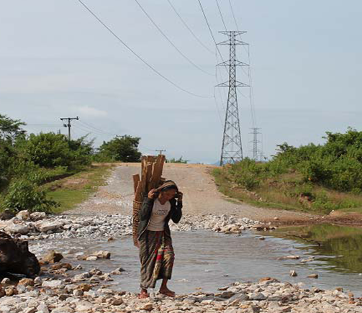

Thesis – overview and examples from Wageningen University
Wageningen DEEM team
Mattijs Smits, mattijs.smits@wur.nl
Omid Noroozi, omid.noroozi@wur.nl
Hansje Eppink, hansje.eppink@wur.n

Slide 2
Contents
What is a thesis?
Types of theses
Constructive alignment for thesis
  Learning outcomes
  Learning/teaching activities
  Assessment (criteria + rubrics)
Picking a topic, timeline, activities and products
Thesis guidelines
Exercise: develop overview of (your own) thesis trajectory
Optional:
  first meeting
  thesis rings (peer feedback)

Slide 3
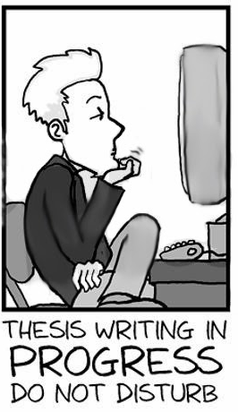
What is a thesis?
Independent (or group) academic work
Focus on theoretical and empirical application/innovation
Usually in the final phase of an academic programme

Slide 4
What is a thesis?
Is a thesis:
  A proof of competence? (show a student masters certain research skills)
  A learning activity? (a part of the student curriculum)
  A research activity? (doing a (small) research project)
Discuss in small groups

Slide 5
Types of theses
Different phases of a programme:
  BSc thesis (2 months)
  MSc
    Major thesis (6 months)
    Minor thesis (3-4 months)
  PhD thesis
Place for thesis work:
  At university
  In company

Slide 6
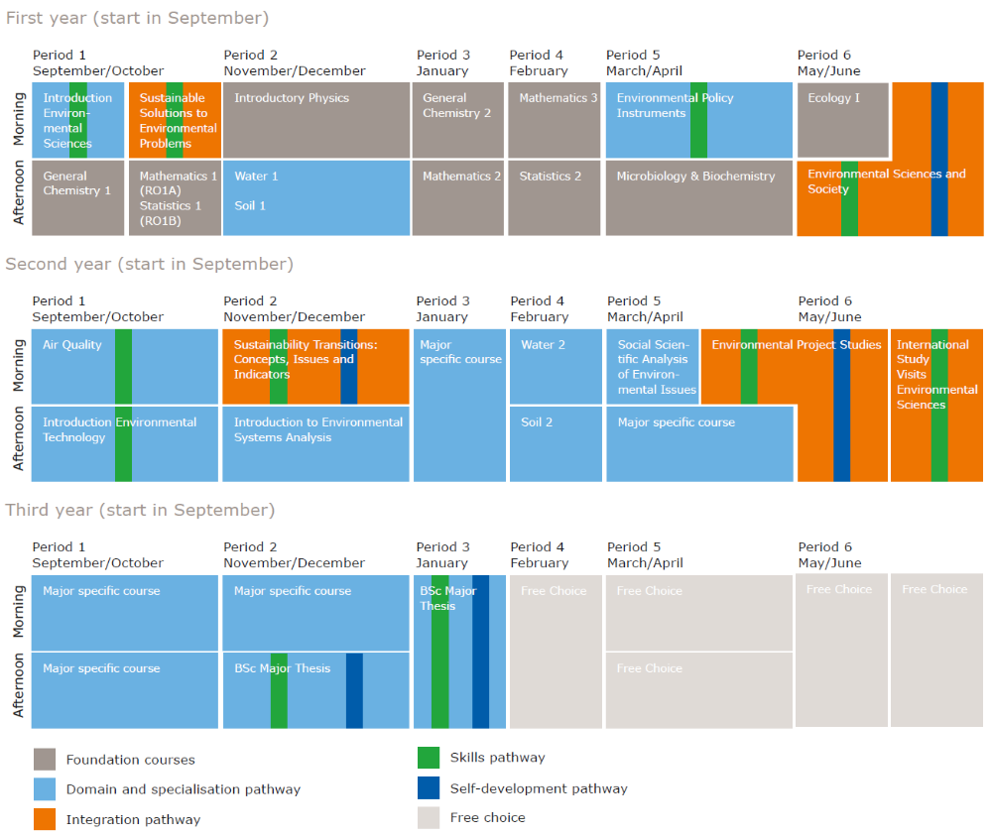
Position of thesis in BSc curriculum (example BSc Environmental Science)

Slide 7
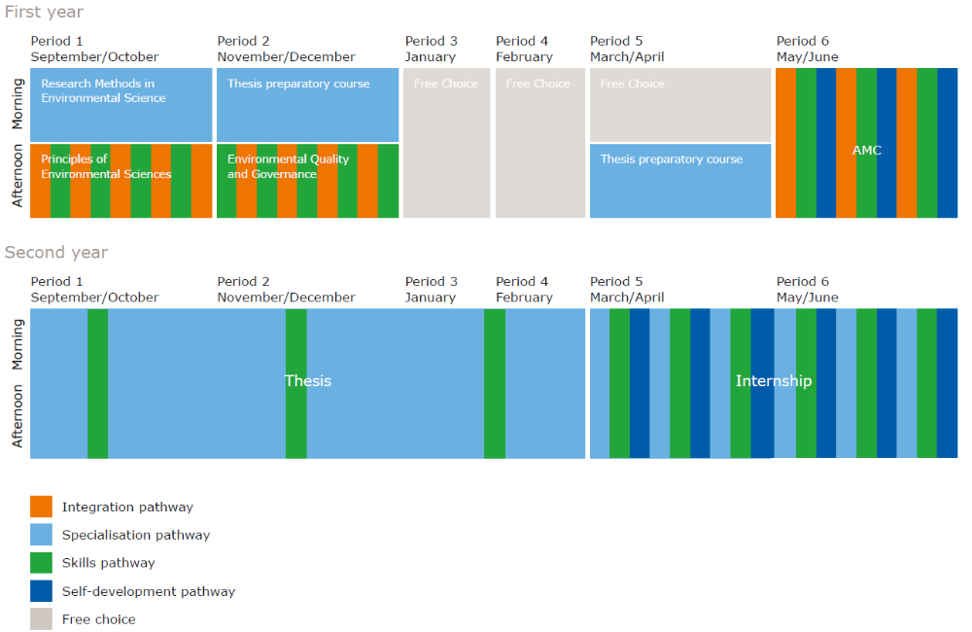
Position of thesis in MSc curriculum (example MSc Environmental Science)

Slide 8
Recap: teacher/student-centred
Teacher-centred approach
Learner-centred approach
Teacher–centred
Learner-centred
Teacher determines content and process thesis
Student is passive and carries out the work
Teacher is facilitator and co-learner
Student takes lead in determining thesis project
Responsibility for progress lies (mainly) with student

Slide 9
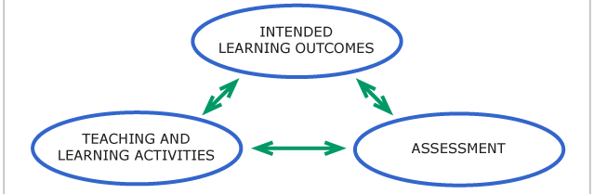
Recap: constructive alignment
Can be applied to all courses/parts of curriculum, including thesis and internship

Slide 10
Intended learning outcomes
Learning goals (example from BSc thesis):
After finalising the thesis / extended essay, students are able to:
  formulate a research problem and do (literature) research according to scientific standards;
  integrate and apply theoretical knowledge obtained in the study;
  work individually and independently in scientific research (under supervision);
  plan and carry out the work within the available time;
  write a state-of-the-art paper on an environmental policy issue, on the basis of information from scientific literature;
  present and defend the results of such work for an audience of staff and students.

Slide 11
Learning objectives of a MSc thesis at WUR
1. The ability to approach research creatively and systematically, including formulating questions, arriving at conclusions, answers, descriptions and /or designs.
Implement various states of a research project.
Apply previously gained knowledge and skills to the questions, results obtained and conclusions formulated.
Indicate the social implications of possible solutions.
Work efficiently with a lot of data and/or in a complex situation.
Make use of writing as an aid to research.
Use other means of being creative.

Slide 12
Learning objectives of a MSc thesis at WUR
2. The ability to set up and carry out the ‘technical side’ of the research.
Acquire specialist-level knowledge of a subject in a reasonable time.
Collect relevant literature from various sources.
Apply a range of experimental techniques with skill.
Apply methodological knowledge.
Consider safety, environmental, economical and /or technical aspects.
Work out the implications of a project for the organization or society.
Make a choice of apparatus, techniques suitable for the problem.
Maintain and use the apparatus and research material.
Work out the research data numerically.

Slide 13
Teaching and learning activities
Learning activities (student)
  Self-study (literature)
  Conduct research (lab, modelling, interviews, etc)
  Report writing
Teaching activities
  Regular meetings
  Expert input (literature/methods)
  Carry out formative and summative assessment
  (organise peer feedback with other students: thesis rings)

Slide 14
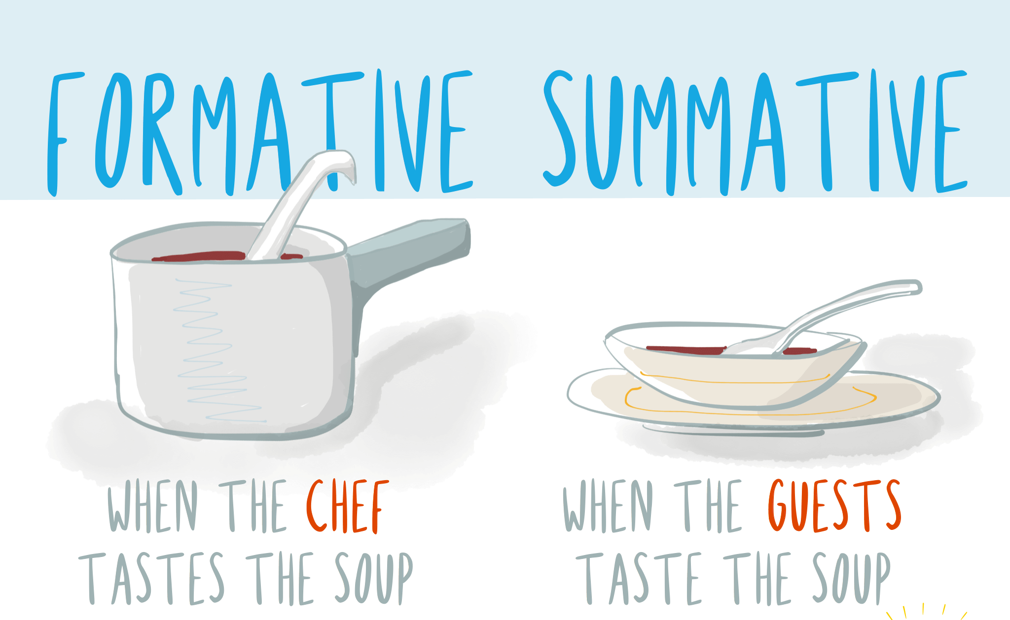
Assessment
Formative assessment
  Feedback on intermediate products
Summative assessment
  Thesis report
  Presentation
  Research skills/
  competences

Slide 15
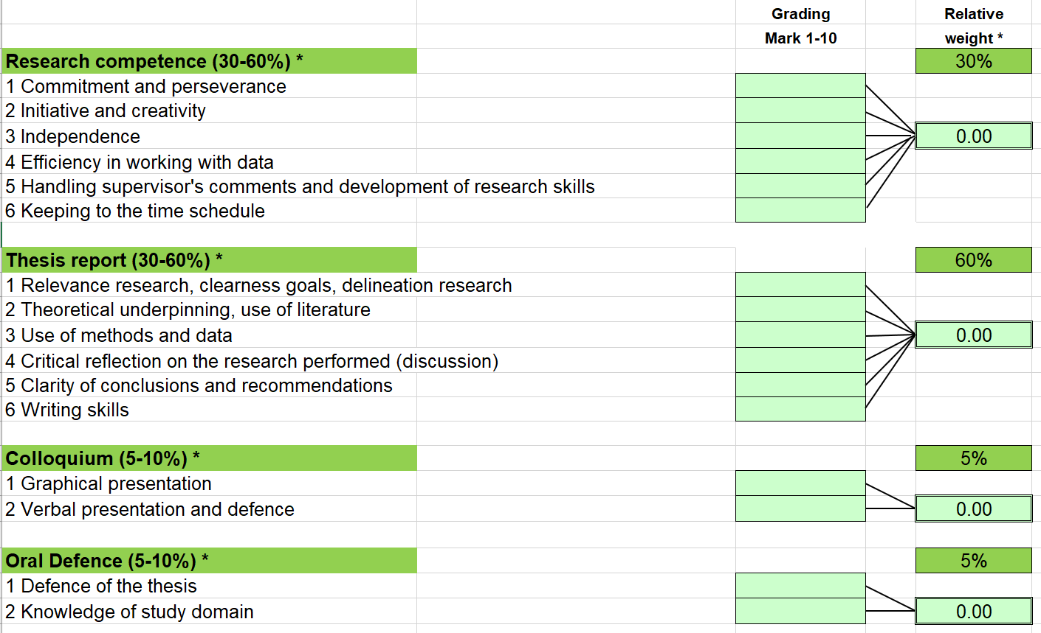
Assessment criteria MSc thesis

Slide 16
Discuss criteria
Discuss in small groups
Are the criteria similar or different from your programme/institution? How?
How to grade each of these criteria?

Slide 17
Assessment rubric (part!)
Item
 | 4-5 | 6 | 7
1. Research competence (30-60%) *
1.1. Commitment and perseverance | Student has little motivation. Tends to be distracted easily. Has given up once or twice | Student is motivated at times, but often, sees the work as a compulsory task. Is distracted from thesis work now and then. | The student is motivated. Overcomes an occasional setback with help of the supervisor.
1.2. Initiative and creativity | Student picks up some initiatives and/or new ideas suggested by others (e.g. supervisor), but the selection is not motivated. | Student shows some initiative and/or together with the supervisor develops one or two new ideas on minor parts of the research. | Student initiates discussions on new ideas with supervisor and develops one or two own ideas on minor parts of the research.
1.3. Independence | The student needs frequent instructions and well-defined tasks from the supervisor and the supervisor needs careful checks to see if all tasks have been performed. | The supervisor is the main responsible for setting out the tasks, but the student is able to perform them mostly independently | Student selects and plans the tasks together with the supervisor and performs these tasks on his own
 | No critical self-reflection at all. | Student is able to reflect on his functioning with the help of the supervisor only. | The student occasionally shows critical self-reflection.

Slide 18
Rubric – exercise/questions
Read/skim through the rubric
Ask quick questions for clarification
NB: Rubrics can be used for many (parts of) courses!

Slide 19

Picking a topic (at my group)
Different ways people pick a topic (and different rules at different departments!)
Thesis topic brochure
Own topic
  Example in course
  News
Important:
ownership and motivation!

Slide 20
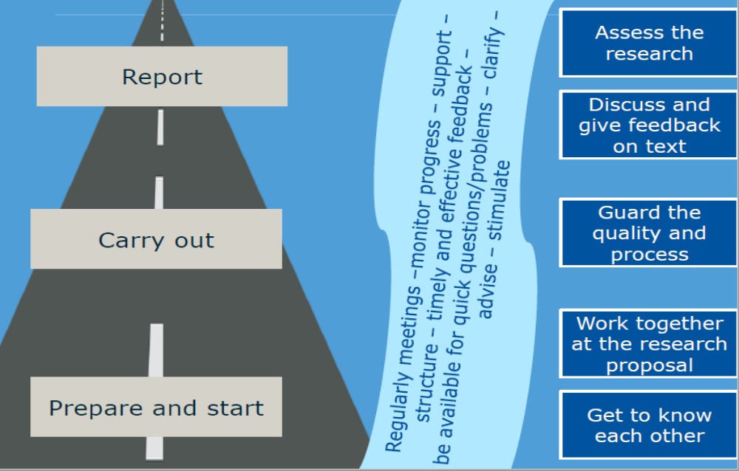
Phases of a thesis supervision

Slide 21
Time line Master thesis
Proposal writing: 5-6 weeks
Presenting proposal for staff with peer reviews from fellow students
Field/lab work 1-2 months (may include analysis
Writing 2-3 months
Final Colloquium and defence
Joining thesis ring throughout (peer-group discussions with 6-8 thesis students)

Slide 22
Supervision time/moments
Proposal writing: 5-6 weeks
  Every 1-2 weeks
Field/labwork 1-2 months
  On demand
  At the end of field/labwork
Analysis/writing 2-3 months
  Meeting to discuss each draft chapter
  Meeting to discuss final draft

Slide 23
Teacher roles during thesis supervision
Expert
  Input on topic: literature, methods, analysis, etc
Advisor
  Advise on procedures (registration, contract, etc)
  Share information on solutions to various problems
Coach
  Feedback on products and process
  Questions about choices (reflection)
  Pushing the student to go further
Mentor
  Provide support when in need on personal issues

Slide 24
Products
At Wageningen University, we require the following products:
Registration form
Thesis contract
Thesis proposal
Data (+ analysis)
Thesis report
Presentation/defence

Slide 25
Thesis guidelines/course guide
Why use guidelines for students?
Guidelines help to structure processes
Provide transparency to students (and teachers)
Can be referred to in case of doubt/conflict
Exceptions are possible (to a certain extent)

Slide 26
Contents thesis guidelines (example from Environmental Policy group)
Preparatory steps: topics, finding supervisor, etc.
Writing and presenting a proposal: outline, etc.
The actual research: supervision, facilities, etc
Writing the report: outline, sharing drafts, etc.
Thesis presentation and grading: presentation, publication, grading, data management
Appendices: registration form, proposal/thesis outline, rubric, title page format

Slide 27
Exercise
Develop table with different phases of the thesis process
For each phase, identify (as specific as possible!)
  Timing (roughly which week/month)
  Activity student (what does the student do?)
  Activity supervisor (what does the supervisor do? In which role?)
  Products (are there any (intermediate) products associated with this phase?)
  Feedback on the products (how often and what type of feedback?)

Slide 28
Phases | Weeks | Activity student | Activity supervisor | Products | Feedback on products
Intake/start-up
Proposal
Data collection (lab, field, etc)
Data analysis
Writing/finalizing thesis

Slide 29
Phases/ weeks | Activity student | Activity supervisor | Products | Feedback on products
Intake (1) | Admin, expectation management | Expectation management, logistics, admin | Thesis contract | Oral, 1-2 meetings
Proposal (1-6) | Literature review, write proposal, planning | Guidance, help finding literature, brainstorming | Proposal + presentation (or intermediate) | Oral and written (on proposal), weekly meetings
Data collection (lab, field, etc) (7-17) | Lab/field work, informing supervisor (any issues), data management | Lab/field introduction, monitoring, advice (including practical/direct), problem solving | Data set | Oral mainly, biweekly meetings, e.g. on data
Data analysis (18-20) | Analyse and interpret data, preliminary conclusions (based on proposal/objectives) | Guidance, problem solving | Manageable/presentable data, from data to information/knowledge | Oral mainly, weekly meetings
Writing thesis (10-26) | Write! And make figures, etc. If necessary, find resources/help/additional literature | Guidance, problem solving, review, help structuring/editing the report | Thesis + presentation | Oral and written (main), meetings when needed
*continuous monitoring (1-26) | Informing supervisor in case of problems, adapting | Monitoring |  | When needed

Slide 30

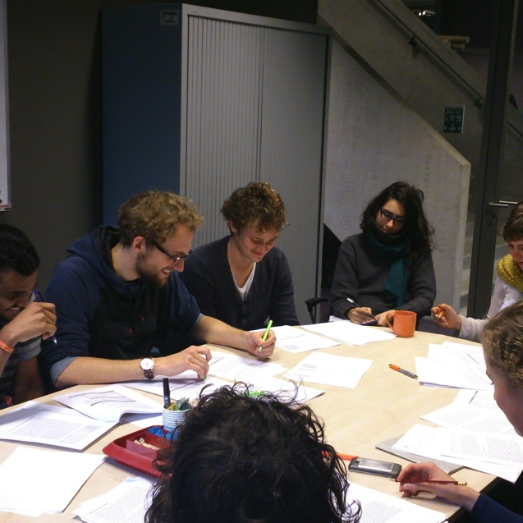
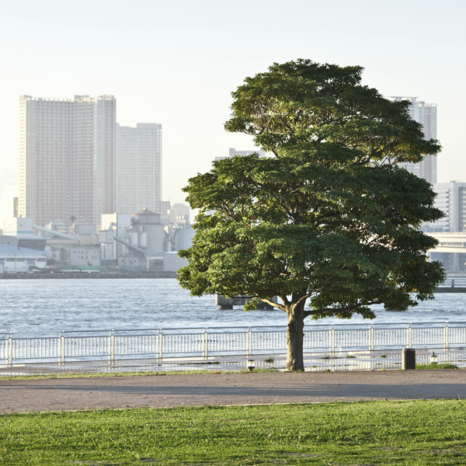
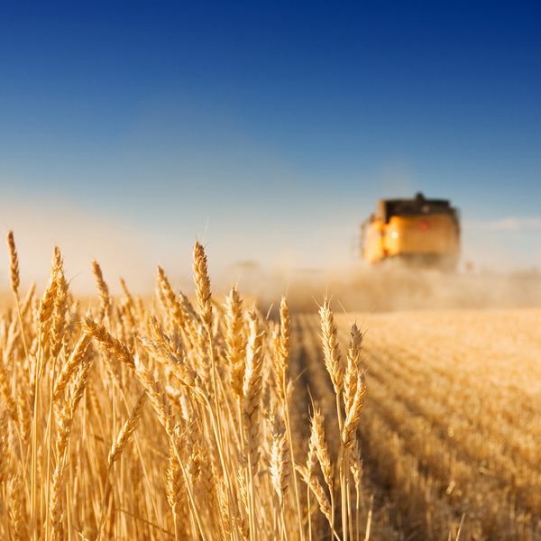

Thesis rings: a peer review mechanism for thesis students

Slide 31
Key question
How can we handle more thesis students
without increasing the workload
and maintain, or even increase, the quality of supervision?

Slide 32


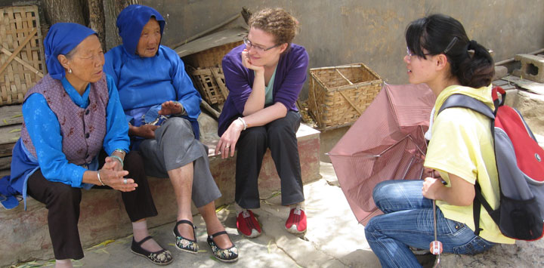
Thesis rings
Organised peer feedback for thesis students
Now adopted by many groups within Wageningen University (and other universities)

Slide 33
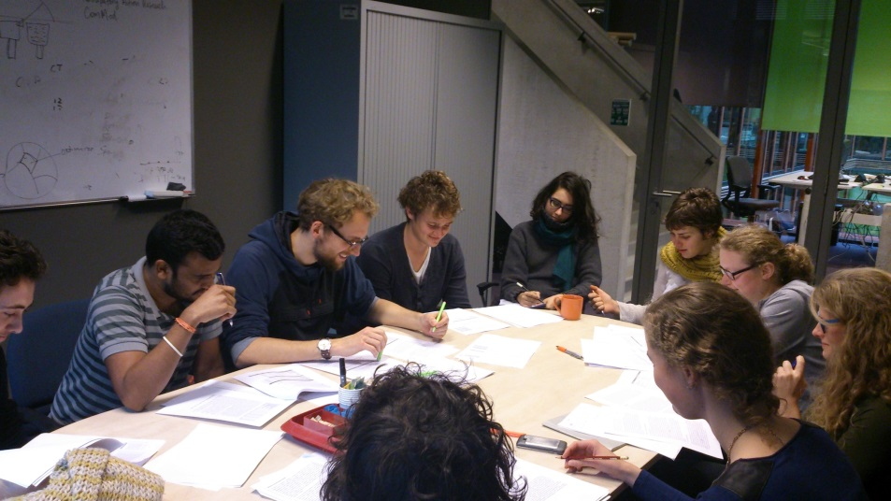
Thesis rings @ WUR
Why a peer review system for thesis students?
Handle increasing student numbers
But also a learning experience for the student:
Role of peer reviewer
Identification common issues
Higher level of draft reports
The importance of giving and
receiving feedback
(safe environment)

Slide 34
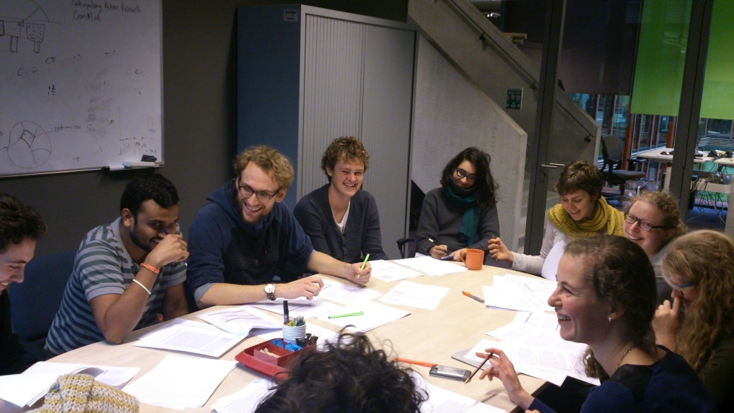
Set-up thesis rings
Organisation:
± 7-10 students per ring
Proposal and report reviewed once by supervisor
Weekly/biweekly meetings of 1-1.5 hr.
Ring supervisor (staff member) is chairman
Supervisor is still
responsible (!!)

Slide 35
Procedure meeting
Students register and upload documents (submitters)
Other students review (instructions categories)
Staff member only facilitates discussion and process
Meeting:
Discuss 2-3 documents (e.g. proposal, chapter)
For each document (~30 mins)
  Short introduction by author (student)
  Each participant gives feedback (on style, structure, figures, analysis, etc)
  Summary by author

Slide 36




Positive points (based on student evaluation)
Most helpful aspect: Reviewing
Atmosphere: Safe, fun, relaxed.
Ring supervisor necessary? Yes! → Safety, solving disagreements, general advice scientific writing, structure, timekeeping.
Extra effects: Getting to know other students and subjects better → visible cohesion
Recommend to other students: Yes!!

Slide 37
Challenges
Timing of documents requires flexibility
Clarity role thesis supervisor vs. thesis ring
Balance in feedback should be actively guarded by ring supervisor
Coordination and organization required!

Slide 38

Are thesis rings THE solution to ‘handle’ larger numbers of students?
No, it can be part of the solution
The general organization is a key aspect
  Intake by supervisor
  Intake by lecturer
  Intake by secretary
  Desks/PCs etc
‘Logistics’ should be well-thought through
Proper supervision and organisation of practical (lab) work is also required

Slide 39
Discussion
Could this work for your university? Why or why not?
What could be the set-up?
  Which groups of students?
  How to organize?
  Any support needed?
How could you evaluate the success?

Slide 40
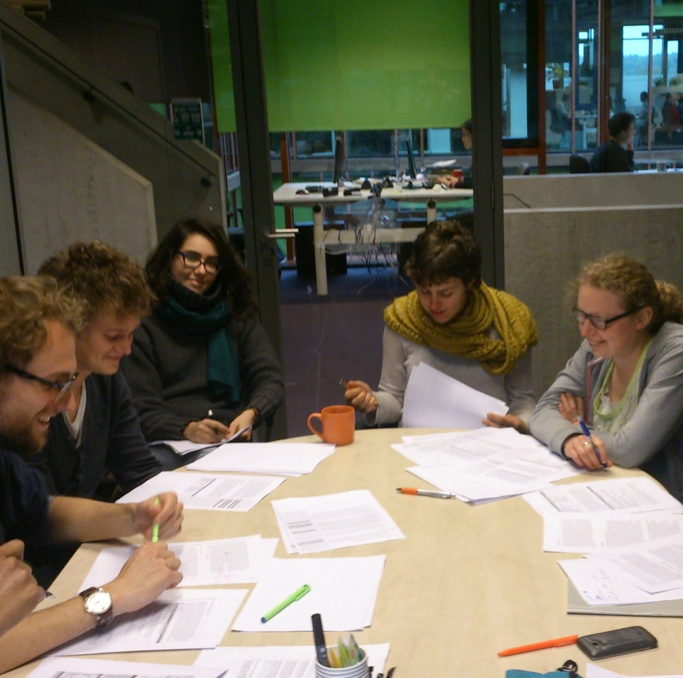
Thank you!
Acknowledgements:
Arjen Schots
Jet Vervoort
Other Staff Nematology
Education staff support
(Wageningen)

Slide 41

First meeting - A good beginning is half the battle

Slide 42
First meeting: What to do?
Build a good relationship with student
Synchronize expectations (supervision, role, examining)
Discover strong/weak points of student
Formulate personal learning objectives
Discuss phasing and planning of thesis
Explain assessment procedure

Slide 43
Critical issues that come up if not sorted out at the start
Expectations do not meet
Lack of planning, no timetables agreed
Lack of sufficient communication
Disrespectful attitude
Responsibilities not shared
Other hidden problems

Slide 44
Meeting in progress: What to do?
Social talk
Planning: Goal, agenda, time, minutes
Theme: Progress, specific points
Closing: Looking back to planning, appointments

Slide 45
Completion: What to do?
Discuss and give feedback on text
Making global revisions
Making sentence-level revisions, punctuations, grammar
Proofreading

Slide 46
Students expect their supervisors to:
Light & Cox 2001
Read their work
Be available for consultation
Be friendly, open and supportive
Be constructively critical
Have good knowledge of the research area
Structure the meeting – exchange ideas
Have interest to give more information
To be sufficiently involved
Monitor, not control

Slide 47
First meeting exercise: What to do?
In pairs of two
One person is student
One person is supervisor
First meeting with preparation in mind
Debrief plenary

