Slide 1
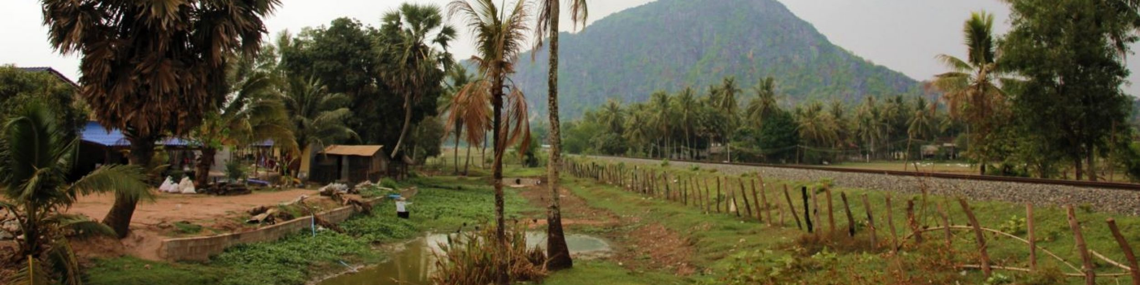
Development of Energy Education in the Mekong Area (DEEM)
Introduction
July 2017
Notes:
Questions anytime

Slide 2

Introduction: Who is who?
3 questions
Start with a brief introduction: name, field of study, position
Something that made me really happy in the past week
Something that I really enjoy being a teacher
My expectations for this workshop
Notes:
First letter of your first name. If this letter is the same then the second letter. Alphabetic order of your first name.
On length. Who knows a third question? Otherwise shoe size

Slide 3
Individual Learning Journal
Outcomes
Stimulate your reflection in a more systematic way.
Help you to keep track of ideas for your personal action plan.
Note: the individual learning journal is for personal use.
Procedure
At the end of every day: We will give you the opportunity to write down some reflections on the day
At the beginning of each day: We will invite you to share your learning points and we will give you the opportunity to ask for clarification of concepts or ideas, which are still puzzling you.
Expectations

Slide 4
Training program
Teaching and Learning activities
Assessment method
Examples of Wageningen University
Learning outcomes
Platform
Reflecting and development of an individual action plan
Exploring current teaching practices and curriculum design processes
Setting the ground rules
Notes:
Listen actively -- respect others when they are talking.
Speak from your own experience instead of generalizing ("I" instead of "they," "we," and "you").
Do not be afraid to respectfully challenge one another by asking questions, but refrain from personal attacks -- focus on ideas.
Participate to the fullest of your ability -- community growth depends on the inclusion of every individual voice.
Instead of invalidating somebody else's story with your own spin on her or his experience, share your own story and experience.
The goal is not to agree -- it is to gain a deeper understanding.
Be conscious of body language and nonverbal responses -- they can be as disrespectful as words.

Slide 5
Training approach
Teacher-centred approach
Learner-centred approach
Instructor Coaches Facilitator & co-learners
Trainers
Passive/Neutral receivers Active Receivers Active leaners
Participants
Lectures
Group discussions
Reflection team
Based on Samuelowicz, K., Bain, J.D. 2001
Notes:
Setting up rules for the training and forming the reflection team. Explain that they can ask questions any time. Introduce the parking lot?

Slide 6
Program of today
Interactive presentation and Group exercise: Exploring current education practices at your HEIs
Lunch break
Interactive presentation: A course offered at Wageningen University
Interactive presentation: Formulating learning outcomes
Coffee break
Individual exercise: Formulating and discussing learning outcomes for your own course
Reflections: Writing in your learning journal

Slide 7
Development of Energy Education in the Mekong Area (DEEM)
Getting started: curriculum development and teaching practices
July 2017

Slide 8
What are we going to do....
Creating a shared understanding of your current curriculum development and teaching and learning practices
Critically think about future ambitions regarding curriculum development and teaching and learning practices

Slide 9
Curriculum development
Phase 1: Open Exploration:
Exploring societal needs/trends and needs of labour market
Phase 5: Implementation & evaluation
Activating new curriculum, monitoring and evaluation of its effectiveness & efficiency in achieving the newly set goals.
Phase 2: In-depth Investigation
Determining key competencies needed in the labour market today and in the future
Phase 4: Curriculum (re)design
Determining changes needed in the curriculum in order to bridge the gap (learning outcomes, pedagogy, didactics, and contents)
Phase 3: Mediated Confrontation
Between the outcomes of Phase 2 and existing curriculum/courses/structure
based on A. Wals 2004
Notes:
Brainstorm together of the professional jobs of future graduates (i.e. Researcher, University teacher, Engineer, Own consultancy, Government employee, Entrepreneur, working at an NGO
Taking one of those as an example – NGO forum on Cambodia – program manager – What are the professional task this person needs to be able to do to be successful?
Writing project proposal, Collecting research data, Planning activities, Identify problems/needs, to be able to collaborate with different people.
Knowledge:
Skills:
Attitude:
QA acitivities: a systematic review of education activities to ensure that acceptable standards are met. Internal and external review activities or committees for accreditation. Reviewing the studyprogram, content and the learning and teaching process.

Slide 10
Teacher-centred and Learner-centred approach
Teacher-centred approach
Learner(student)-centred approach
Teacher–centred
Transfer of knowledge
Coverage of content
Teacher is instructor
Students are passive
Learner-centred
Understanding of concepts
Knowledge constructed by students
Teacher is facilitator and co-learner
Students are active (problem solvers and questioners)

Slide 11
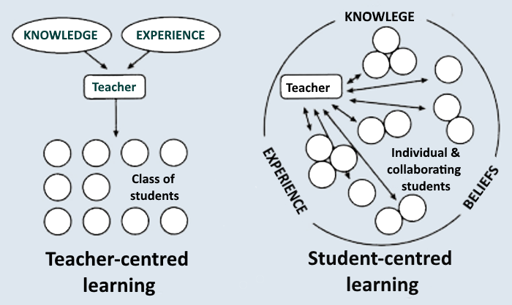
Teacher-centred and Learner-centred approach
Teacher-centred approach
Learner-centred approach
Learner-centred
Understanding of concepts
Knowledge constructed by students
Teacher is facilitator and co-learner
Students are active (problem solvers and questioners)
Source: https://lo.unisa.edu.au/mod/book/view.php?id=610988&chapterid=102030

Slide 12
A matrix
1. Prepare a flipchart with the matrix:
2. Place a cross on the matrix which indicates your opinion about how curriculum development and teaching and learning currently takes place
3. After a short discussion about the outcome, decide on a place on the matrix that indicates how you would like the situation to be in five years’ time. Place a circle that indicates the situation
Follow government regulations
Methods of teaching and learning
Able to design course content, assessment methods, learning approach
Teacher-centred
Curriculum change
No responsibility in curriculum/course development
Full responsibility in curriculum/course development
Student-centred
Notes:
Plenary discussion, ask participants to compare the patterns of crosses and dots. Is this a realistic view or an idealistic view?

Slide 13
Development of Energy Education in the Mekong Area (DEEM)
Learning outcomes
July 2017

Slide 14
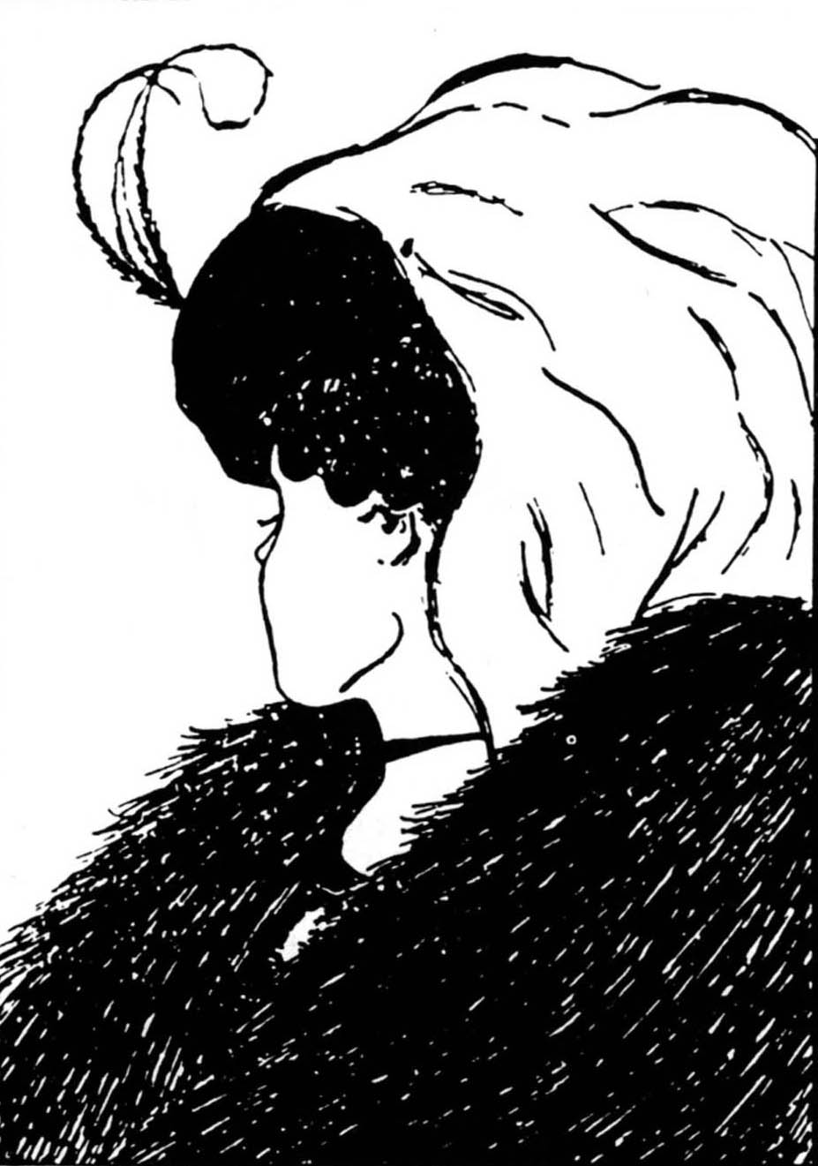

Slide 15
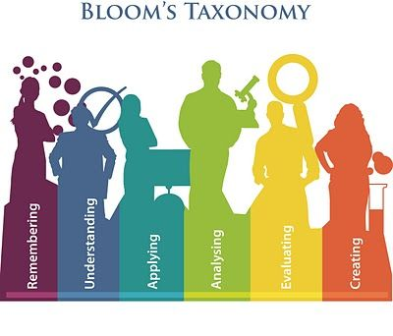
After this session you:
Are able to (re)formulate learning outcomes while using the Bloom taxonomy

Slide 16
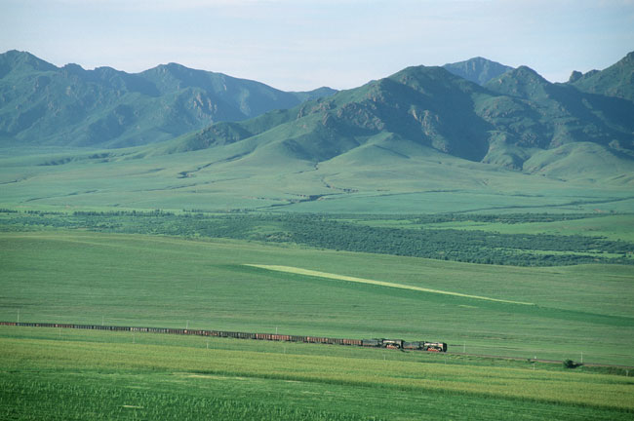
Why do we design learning outcomes?
Notes:
5 min discuss with your neighbour

Slide 17

Learning outcomes
Provide a basis for a dialogue in a team of lecturers about the purpose of the course
Help lecturers to define the teaching/learning activities and assessment method
Give clear indications to students about what the course entails
Notes:
i.e. your learning outcome is after this course a students are able to write a sound research proposal in the field of environmental science. It gives you guidelines about what you need to teach your students and how.
To select appropriate teaching and learning activities and assessment methods
Sharing those learning outcomes with your students increases transparency. Students know what they will learn in your course and what they should know or be able to do to pass your course.

Slide 18
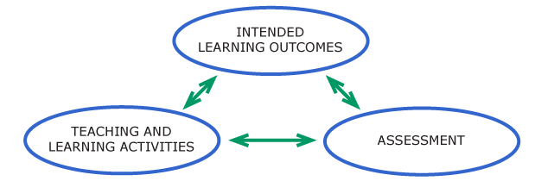
Constructive alignment
(Be measurable and observable,
Specify what the learner (not the teacher) does
Biggs (2001)
Notes:
Clear learning outcomes guides your instructional design and supports you to choose appropriate teaching methods. And therefore helps learners to achieve the desired learning outcomes.

Slide 19
Constructive alignment: Presentation skills
Show different tools to make a scientific 7 minute presentation interesting for an audience
Interact with the audience
Give a well-structured presentation
Use visual aids that support a presentation
Show responsibility for his/her own learning process
Contribute to the learning process of other students
Learning outcomes
Interactive lecture on presentation theory
Group work
Presentation in groups
Reflection on own learning process
Giving and receiving feedback
Presentation
Reflection paper
teaching/learning
activities
assessment
situational factors
30 students, room with moveable furniture
Notes:
Constructive alligment

Slide 20
Course design
Assessment
Student characteristics
HOW
Learning processes
Learning outcomes
Teaching and
Learning
activities
Intended
learning
outcomes
Expertise /
competencies of the teacher
Input-based education
(= content driven)
WHAT = goals
Outcome-based education (= goal driven)

Slide 21
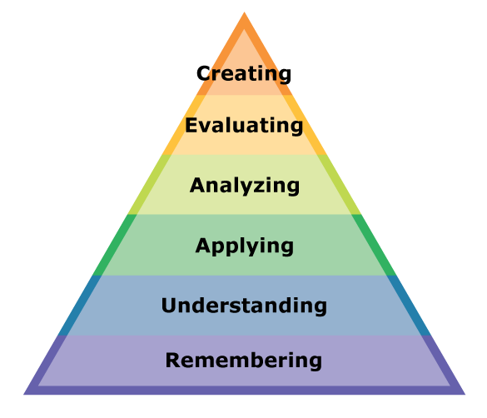
Taxonomy of Bloom
Higher order thinking skills
Produce new or original work
Justify a stand or decision
Draw connections among ideas
Use information in a new situation
Explain ideas or concepts
Recall facts and basic concepts
Lower order thinking skills
Notes:
A taxonomy is a classification of things, concepts etc. For example the evolutionary taxonomy of Darwin, that seeks to classify organisms like plants animals.
Bloom taxonomy: Bloom's Taxonomy was created in 1956 under the leadership of educational psychologist Dr Benjamin Bloom in order to promote higher forms of thinking in education, such as analyzing and evaluating concepts, processes, procedures, and principles, rather than just remembering facts (rote learning).
The taxonomy consists of a hierarchy of increasingly complex processes which we want our students to acquire.
There are six major categories of cognitive an processes, starting from the simplest to the most complex
Provides the structure for writing learning outcomes
The base of the pyramid (remembering) is the foundation of all cognition, knowledge. Each ascending level depends on the one below it: For example, learners must understand basic theories of argumentation skills before they are able to apply this.
Do your students have a solid foundation in much of the terminology and processes you will be working with in your course? If so, then you should not have many remembering and understanding level objectives. You may need a few, for any radically new concepts specific to your course. However, these advanced students should be able to master higher-order learning objectives. Too many lower level objectives might cause boredom or apathy.
Remembering is about the ability to remember information/theories. So verbs that can be used writing learning objectives at this level are list, recall, repeat. An example could be students are able to recite
The most important ability at the skills level is processing of new information. Students are able at this level to explain ideas and concepts.
Applying the students should be able to use their knowledge to solve new problems.
Analysing is about recognize relationships among parts. To compare and differentiate certain theories.
Evaluation is about justifying own ideas and opinions and creation is about using those ideas to create new theories or a product.
Remember and understanding are often referred to as lower-order thinking skills. The skills above them are termed higher-order or critical thinking skills.
Lower-thinking skills are very important, as they are foundational to understanding additional materials. However, designers tend to write too many knowledge-level objectives because they are probably the most easy ones to write.
Instruction that stops too low on the taxonomy doesn’t give learners the chance to think critically enough about what they are learning. When objectives focus solely on remembering and understanding, learners may understand what they have learned but fail to recognize when to apply their knowledge.
Higher-order objectives require learners to use what they have learned and can give them practice in developing new approaches to problems, and making needed judgments.
Are lots of your students freshman? Is this an “Introduction to…” course? If so, many your learning objectives may target the lower order Bloom’s skills, because your students are building foundational knowledge. However, even in this situation we would strive to move a few of your objectives into the applying and analyzing level, but getting too far up in the taxonomy could create frustration and unachievable goals.

Slide 22
List of verbs in learning outcomes
‘After successful completion of this course students are expected to be able to’.
This start phrase is followed by one action verb, followed by the object of the verb and followed by a phrase that gives the context.
Verbs in learning outcomes must:
Be measurable and observable
Specify what the learner (not the instructor) does
Require the learner to apply the learning
Notes:
After this course the student is able to list the renewable energy and technology options available in Cambodia

Slide 23
Good writing learning outcomes
Active – it describes what students can do
Attractive – students want to achieve it
Comprehensible – students and other lecturers know what it means
Appropriate – to the student’s current goals and career plans
Attainable – most students will mostly meet it, with due effort
Assessable – we can see if it has been achieved
Visible – in the course guide and Study Handbook

Slide 24
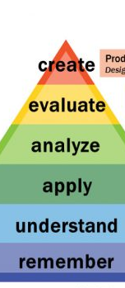
Examples
After successful completion of this course students are expected to be able to...
Remembering
List the renewable energy and technology options available in Cambodia
Calculate the power generated by a water turbine
Share their opinion about the challenges facing a clean energy future for Cambodia
Explain the basic physics of the greenhouse effect
Apply
Evaluate
Understanding
Notes:
Buzz group – identify the bloom level

Slide 25
Another example
Course aim: students are able to evaluate the social and environmental impact of the Sambor hydropower dam in Cambodia.
Learning outcomes
  To recall all possible environmental impacts of a hydropower dam
  To explain all possible social impact of a hydropower dam
Notes:
Flaw: outcomes are limited to the lower levels of the taxonomy. To know if the participants are able to perform an evaluation it is critical to construct learning outcomes at the higher levels of the taxonomy

Slide 26
How many?
course number: 5 - 8
Study programme number: 8 – 12
  Domain specific (3-4)
  Scientific skills (2-3)
  Societal awareness (1-2)
  General professional skills (2-3)
Integrate and apply the knowledge of engineering science in the context of sustainable energy production
Execute a carefully chosen and societally relevant research design
Contribute scientific knowledge and understanding in interactive multi-stakeholder change processes aimed at innovating and improving the energy sector
Analyse and evaluate the ethical, environmental, societal and economic consequences of research and reflect on the different roles of the scientist in energy transition processes

Slide 27

While designing, keep in mind...
While designing, keep in mind...
The characteristics of the students – their backgrounds, prior knowledge and competencies, talents and learning styles
The needs in the specific sector and the wider society
The requirements of accrediting agencies
Available time and resources

Slide 28
Assignment course learning outcomes
Individually
Formulate at least 3 learning outcomes for a course
Use different levels of the taxonomy of Bloom
Notes:
Not starting with a topic list but identifying desired results!
What relevant goals will this course address?
What key knowledge and skills will students acquire?
What should they eventually be able to do?
→ Intended learning outcomes

Slide 29
Assignment course learning outcomes
(Re)formulate learning outcomes for your own course
Selecting the cognitive level of the learning outcome
Choose a verb from the Bloom taxonomy
Finish this sentence:
‘After successful completion of this course students are expected to be able to’.
This start phrase is followed by one action verb, followed by the object of the verb and followed by a phrase that gives the context.

Slide 30
Assignment
Individually: Write three learning outcomes and write those on a flipchart (15 min.)
In 3 groups share and discuss your initial learning outcomes and receive feedback (20 min.)
Plenary: The opportunity to ask for clarification of concepts or ideas, which are still puzzling you (15 min.)

Slide 31
Summary
Bloom’s taxonomy provides a structure for writing learning outcomes
A learning outcome offers a description of what a student should be able to know/do and so it guides you to select appropriate teaching/learning and assessment methods
It is important to integrate some higher-order thinking skills learning outcomes in your course (find a good balance)

Slide 32
Individual Learning Journal
Outcomes
Stimulate your reflection in a more systematic way.
Help you to keep track of ideas for your personal action plan.
Note: the individual learning journal is for personal use.
Procedure
At the end of every day: We will give you the opportunity to write down some reflections on the day
At the beginning of each day: We will invite you to share your learning points and we will give you the opportunity to ask for clarification of concepts or ideas, which are still puzzling you.
Expectations

Slide 33
What was yesterday’s session about?
What are the most important issues, according to you, in this topic?
What was the most important learning point that you gained from yesterday’s session?
How can you link this to your own experience?

