Slide 1

Energy Outlook of Laos
Khamso Kouphokham
Deputy Director General
Department of Energy Policy and Planning, Ministry of Energy and Mines, Laos
19 Oct 2017

Slide 2
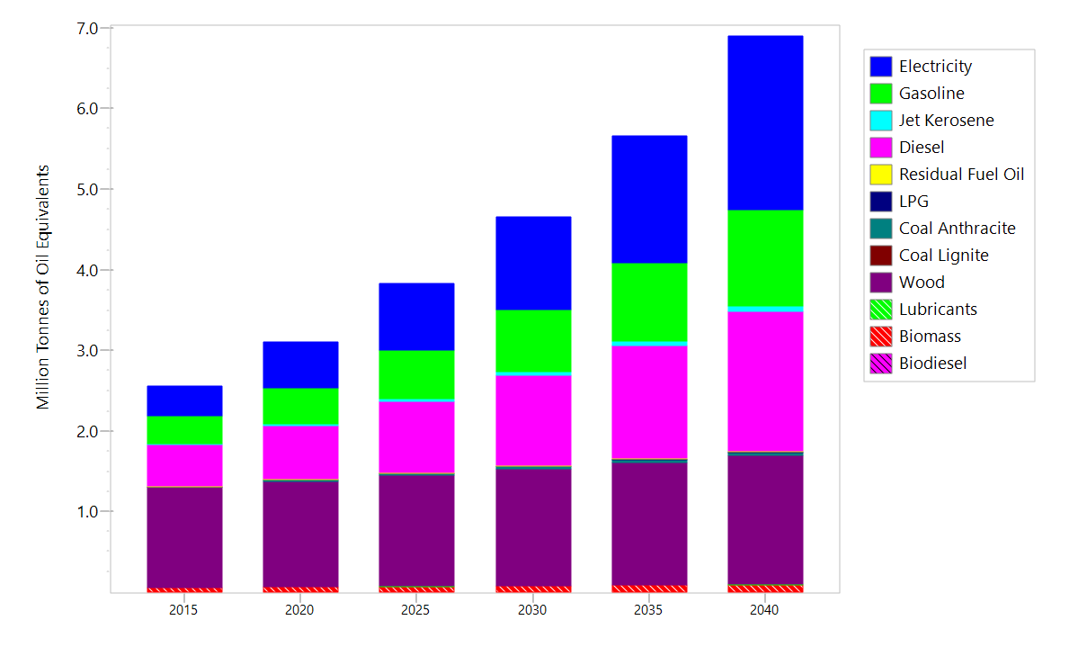
Energy Demand Final Units
BAU Scenario

Slide 3
Energy Demand Final Units
BAU Scenario
 |  |  |  |  |  |  | Ann. Avg
 |  |  |  |  |  |  | Growth (%)
Fuels | 2015 | 2020 | 2025 | 2030 | 2035 | 2040 | 2013-40
Electricity | 0.4 | 0.6 | 0.8 | 1.2 | 1.6 | 2.1 | 0.1
Gasoline | 0.3 | 0.4 | 0.6 | 0.8 | 1.0 | 1.2 | 0.1
Jet Kerosene | 0.0 | 0.0 | 0.0 | 0.0 | 0.1 | 0.1 | 0.1
Diesel | 0.5 | 0.7 | 0.9 | 1.1 | 1.4 | 1.7 | 0.1
Residual Fuel Oil | 0.0 | 0.0 | 0.0 | 0.0 | 0.0 | 0.0 | 0.0
LPG | 0.0 | 0.0 | 0.0 | 0.0 | 0.0 | 0.0 | 0.0
Coal Anthracite | 0.0 | 0.0 | 0.0 | 0.0 | 0.0 | 0.0 | 0.1
Coal Lignite | - | - | - | - | - | -
Wood | 1.2 | 1.3 | 1.4 | 1.4 | 1.5 | 1.6 | 0.0
Lubricants | 0.0 | 0.0 | 0.0 | 0.0 | 0.0 | 0.0 | 0.0
Biomass | 0.1 | 0.1 | 0.1 | 0.1 | 0.1 | 0.1 | 0.0
Biodiesel | - | - | - | - | - | -
Total | 2.6 | 3.1 | 3.8 | 4.7 | 5.7 | 6.9 | 0.0

Slide 4
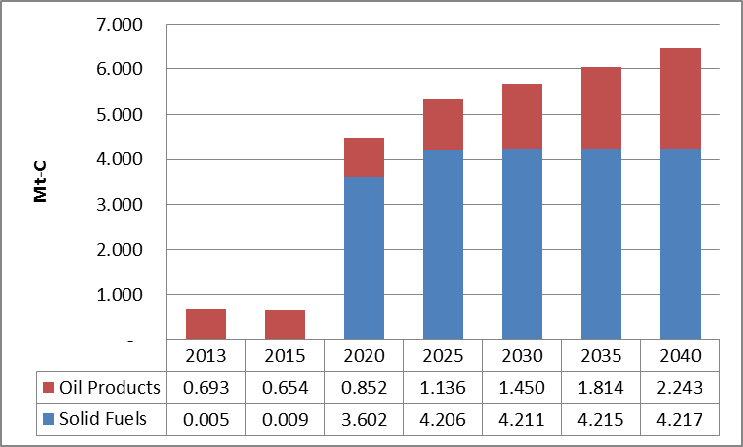
CO2 Emission Outlook 2016 (BAU)
CO2 Emission is expected to increase from 0.7 Mt-C in 2013 to 6.48 Mt-C in 2040, because from 2016 onward the Hongsa and other coal fired power plants will be in operation and constructed respectively.

Slide 5
APS
APS1: Improved Efficiency of Final Energy Demand
APS2: More Efficient Thermal Power Generation
APS3: Higher Contribution of Renewable Energy to Total Supply
APS4: Contribution of Nuclear Energy to Total Supply
APS5: Combined Effects of APS1, APS2, APS3, APS4 and APS5
This study of Lao PDR Energy Demand Forecast has been carried out the same as all members of the working group which to estimate the energy demand in absolute values and growth rates of energy demand for 2015, 2020, 2025, 2030, 2035 and 2040 in different scenarios such as BAU, APS1, APS2, APS3, APS4, APS5. Unlike some other members, Laos is using only APS1, APS3 and APS5.
BAU to calculate the normal energy demand and APSs to calculate the savings if applying the energy policies.

Slide 6
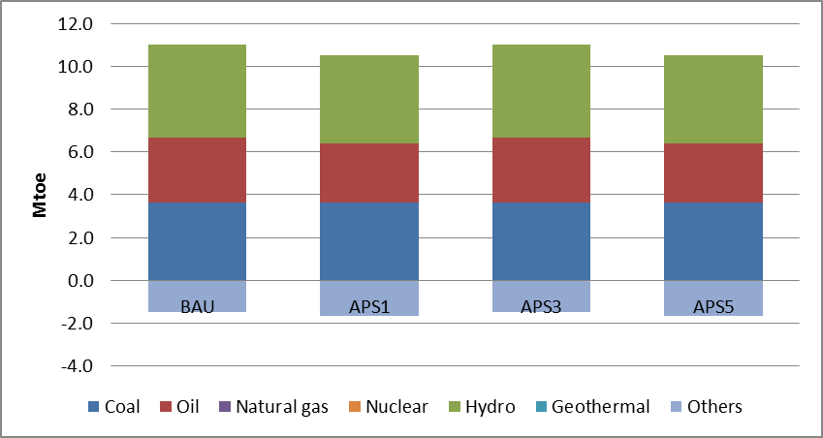
Primary energy supply, MTOE (2040)
 | BAU | APS1 | APS3 | APS5
Coal | 3.653 | 3.649 | 3.653 | 3.649
Oil | 3.018 | 2.727 | 3.018 | 2.727
Natural gas | - | - | - | -
Nuclear | - | - | - | -
Hydro | 4.349 | 4.123 | 4.349 | 4.123
Geothermal | - | - | - | -
Others | (1.496) | (1.657) | (1.496) | (1.657)
Total | 9.523 | 8.842 | 9.523 | 8.842
Primary energy of Lao PDR consists of coal, oil, hydro and others. Others include biomass and exported electricity. Total primary energy supply was 2.47 MTOE in 2013 and expected to increase to 9.523 MTOE in 2040. The annual average growth rate is 5.1%. In 2040, the hydro is expected to be supplied with 4.349 MTOE which more than other as it to be shared by 45.7% .
By carrying different APS (APS1 and APS5), the supply is expected to decrease from BAU figure to 8.842 MTOE, reduced by 0.68 MTOE and 7.1%.

Slide 7
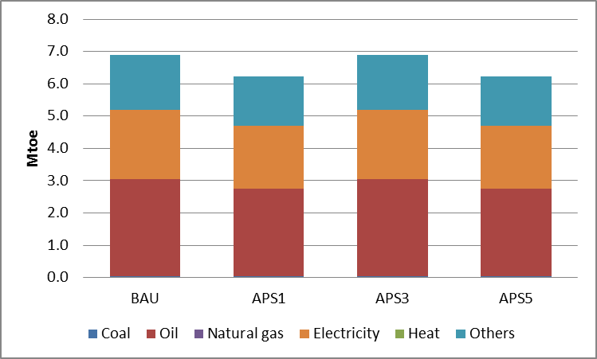
Final energy demand, MTOE (2040)
By fuel
 | BAU | APS1 | APS3 | APS5
Coal | 0.037 | 0.033 | 0.037 | 0.033
Oil | 3.018 | 2.727 | 3.018 | 2.727
Natural gas | - | - | - | -
Electricity | 2.144 | 1.930 | 2.144 | 1.930
Heat | - | - | - | -
Others | 1.693 | 1.533 | 1.693 | 1.533
Total | 6.892 | 6.223 | 6.892 | 6.223
Final energy of Laos consists of coal, oil, electricity and others (biomass).
Total final energy demand in BAU was 6.892 MTOE and expected to decrease to 6.223 MTOE in APS1 and APS5.
Oil is used more than other both in BAU and APS. In APS1, it is used 2.727 MTOE which has a share of 43.8% in total.

Slide 8
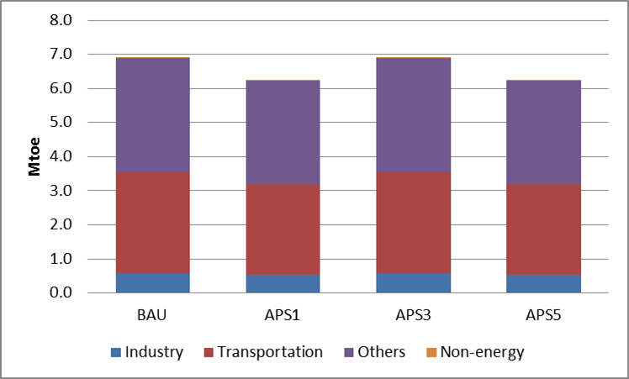
Final energy demand, MTOE (2040)
By sectors
 | BAU | APS1 | APS3 | APS5
Industry | 0.571 | 0.524 | 0.571 | 0.524
Transportation | 2.968 | 2.678 | 2.968 | 2.678
Others | 3.348 | 3.016 | 3.348 | 3.016
Non-energy | 0.005 | 0.005 | 0.005 | 0.005
Total | 6.892 | 6.223 | 6.892 | 6.223
This is to compare BAU with APS results. In BAU, Other still has a larger share in total energy demand which stands at 48.6%, followed by Transport stands at 43.1%.
In BAU, total energy demand was 6.892 MTOE and decreased to 6.223 MTOE in APS1 and APS5, while it was not changed in APS3. The demand was lowered by 9.7% from BAU to APS.

Slide 9
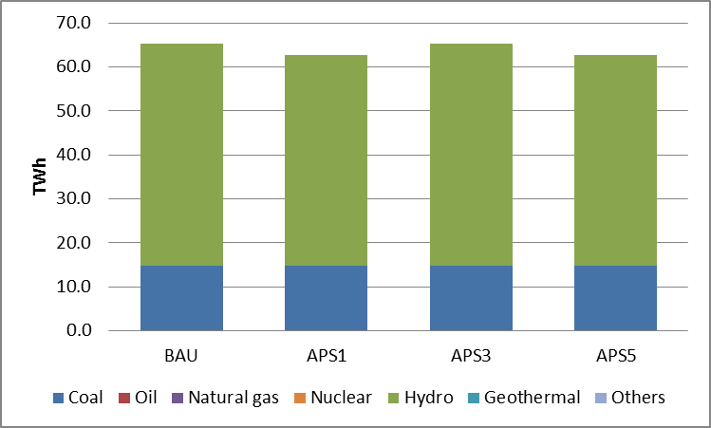
Power Generation, TWh (2040)
 | BAU | APS1 | APS3 | APS5
Coal | 14.717 | 14.717 | 14.717 | 14.717
Oil | - | - | - | -
Natural gas | - | - | - | -
Nuclear | - | - | - | -
Hydro | 50.579 | 47.954 | 50.579 | 47.954
Geothermal | - | - | - | -
Others | - | - | - | -
Total | 65.296 | 62.671 | 65.296 | 62.671
In Laos, electricity is mainly produced from hydro and coal. However in 2013 all 15.51 TWh of electricity was still produced by hydro, then in 2016 the first coal fired power plant started operation. In 2040, electricity from coal is 14.717 TWh and from hydro is 50.579 TWh.
The total electricity generation was reduced from 65.296 TWh in BAU to 62.671 TWh.

Slide 10
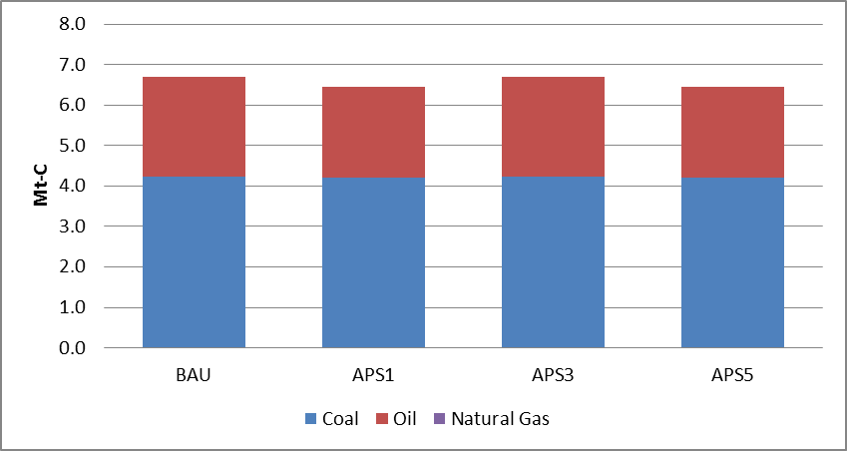
CO2 Emission, Million tons of Carbon Equivalent (2040)
 | BAU | APS1 | APS3 | APS5
Coal | 4.222 | 4.217 | 4.222 | 4.217
Oil | 2.482 | 2.243 | 2.482 | 2.243
Natural Gas | - | - | - | -
Total | 6.704 | 6.460 | 6.704 | 6.460
Green House Gas emission was reduced from 6.704 Mt-C in BAU to 6.460 Mt-C in APS1 and APS3.
Thank you for your kind attention

