Slide 1


Slide 2



Energy scenario construction for a village
DEEM training
Jyrki Luukkanen, Mika Korkeakoski
Research Director
Finland Futures Research Centre
jyrki.luukkanen@utu.fi

Slide 3
Village electricity use
How to construct a scenario
What are the factors which affect the electricity use?
How these factors can be assessed?
What are the important factors from the point of view of electricity system planning?
How the factors may change in the future?

Slide 4
Electricity system planning
Different programmes available for electricity system planning
HOMER is a system for small scale village level system planning
To be able to use the planning models you have to know about the electricity demand and different aspects related to it (like load curve)

Slide 5
Electricity demand
Factors affecting the demand:
  Size of the village
  Number of households
    Household is usually seen as the energy consuming unit
  Household activities that need electricity
    Equipment and their properties
    How long they are used (per day)
  Industrial activities (carpenter, rice miller, etc.)
  Service activities (cafe, hairdresser, school, health center, etc.)

Slide 6
Electricity system properties
Electricity supply must always match the consumption
Production must be controlled to equal the demand in order to keep the frequency and voltage at constant level (not to damage devices)
Demand varies considerable during the day, week and season

Slide 7
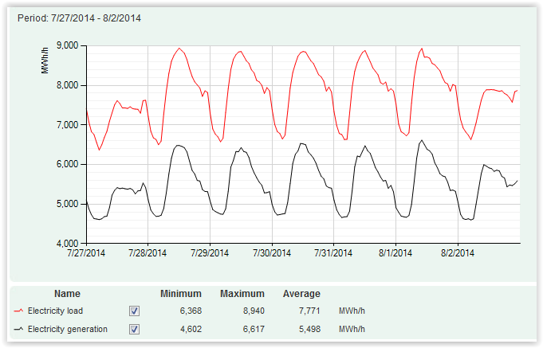
Electricity demand in Finland in one week

Slide 8
Load curve for a group of villages in Cambodia

Slide 9
Load curve for a small village

Slide 10
Factors affecting investment planning
Peak load (highest demand in kW) and its duration
Base load or lowest demand and its duration
The load duration curve (LDC) is used in electric power generation to illustrate the relationship between generating capacity requirements and capacity utilization

Slide 11
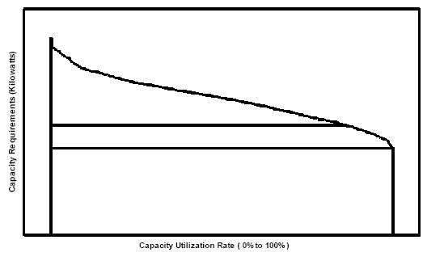
Load duration curve
A load duration curve illustrates the variation of a certain load in a downward form such that the greatest load is plotted in the left and the smallest one in the right. On the time axis, the time duration for which each certain load continues during the day is given

Slide 12
How to get information of electricity demand
Make assumptions of household (and other) consumption
If the electrification is in the planning phase you have to make assumptions (no data exists), but you can get information of already electrified villages
Carry out a survey, where energy use is asked in detail (survey will be discussed in next lectures)

Slide 13
Excel based calculation of potential electricity demand

Slide 14
Simple results

Slide 15
Simple results

Slide 16
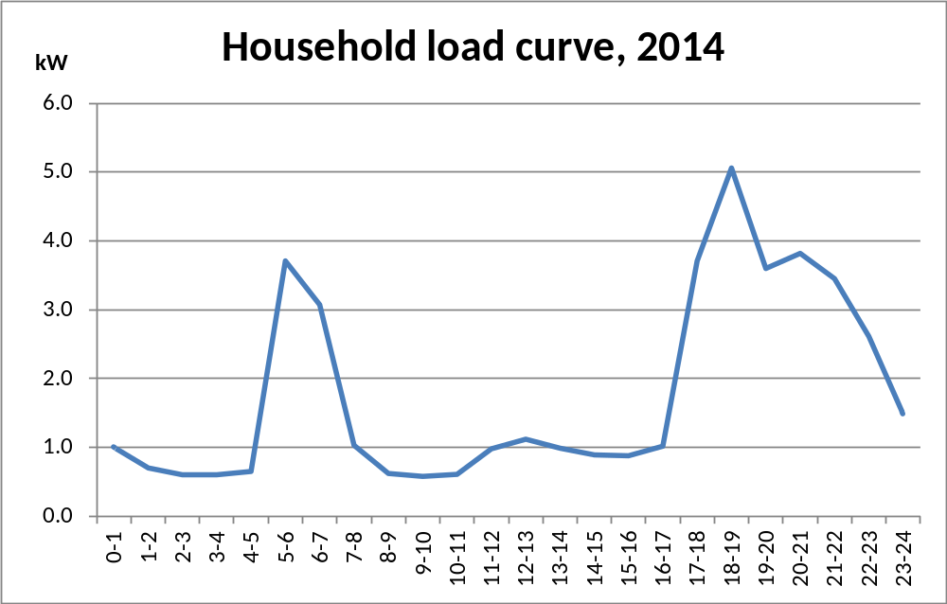
Household load curve

Slide 17
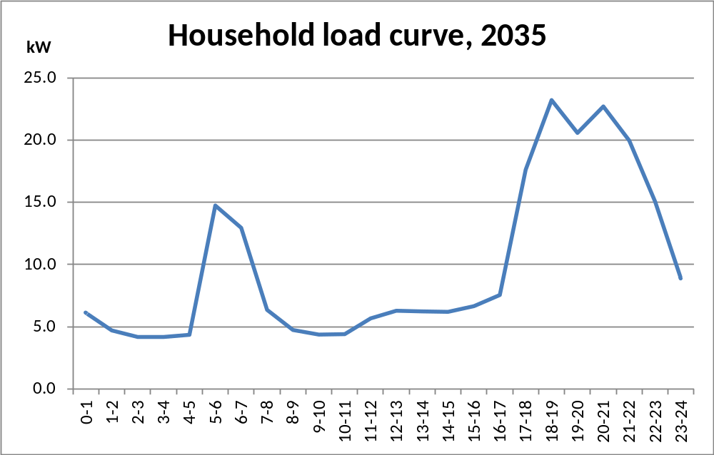
Household load curve

Slide 18
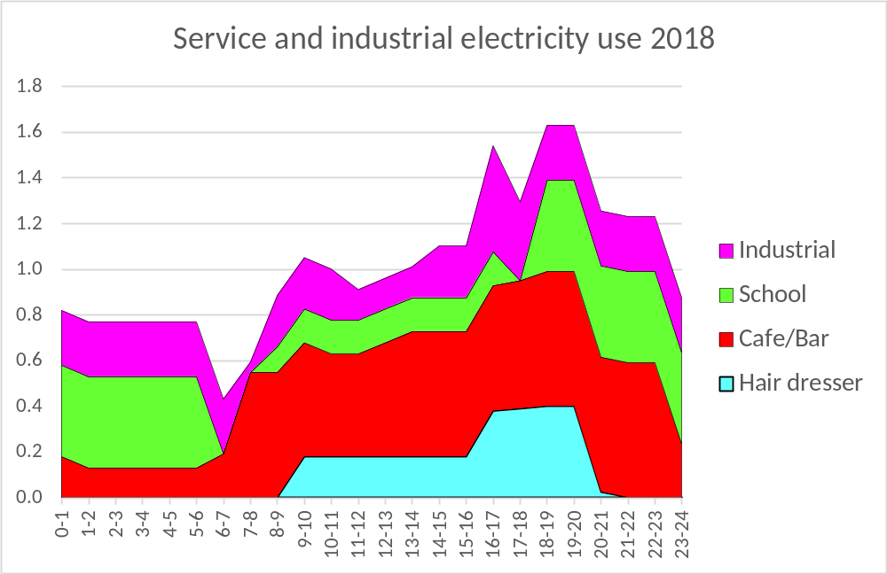
Village service and industrial load curve

Slide 19
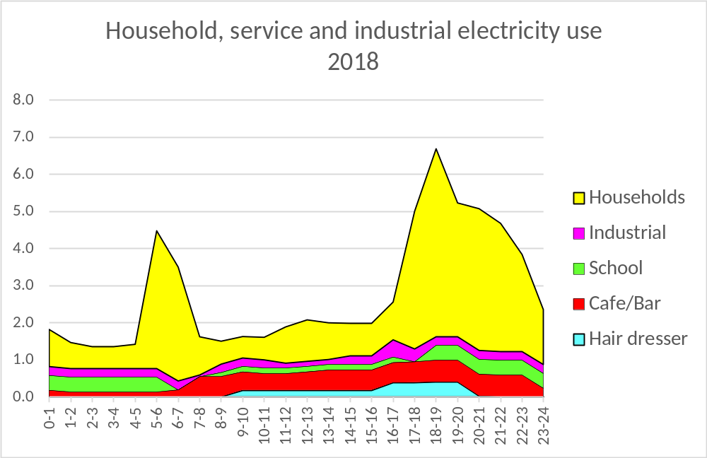
Household, service and industrial electricity load curve in a village

Slide 20
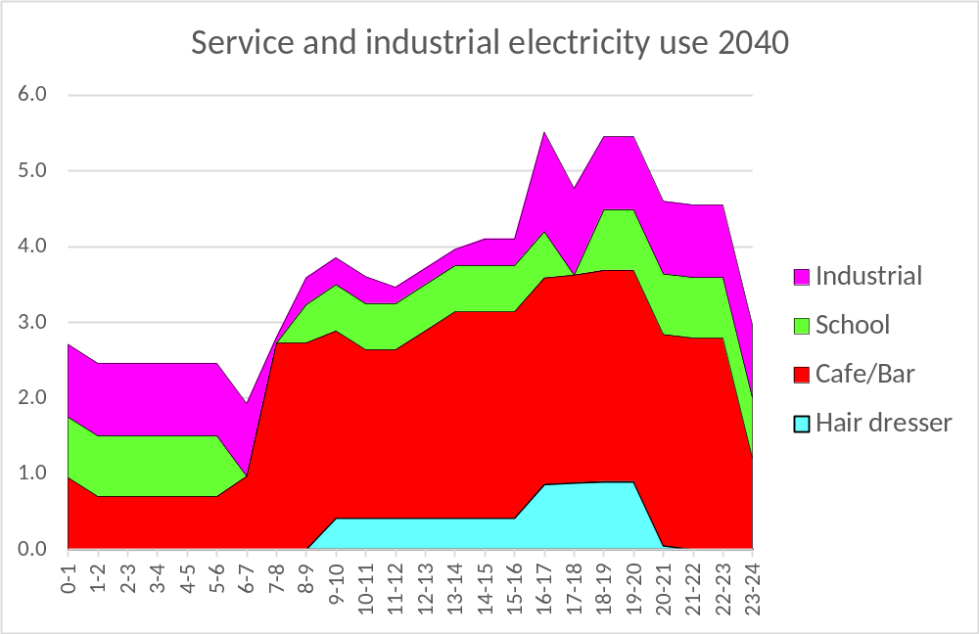
Village service and industrial load curve

Slide 21
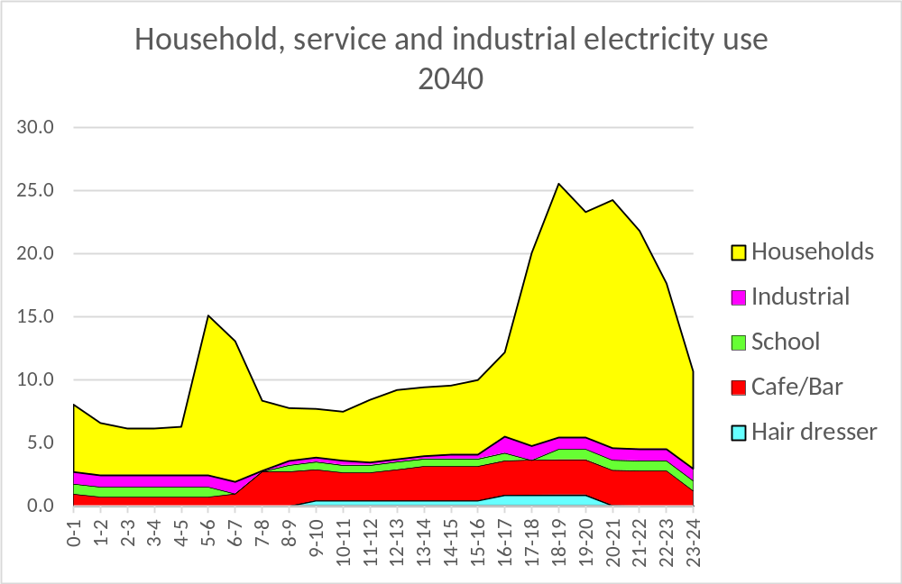
Household, service and industrial electricity load curve in a village

Slide 22
Case villages

Slide 23

Thank you

