Slide 1


Slide 2
Results Based Management:
INTRODUCTION
ERASMUS+ DEEM, Yangon December 2018
MIKA KORKEAKOSKI & NOORA VÄHÄKARI
mika.korkeakoski@utu.fi, noora.vähäkari@utu.fi

Slide 3
⁻ “Would you tell me, please, which way I ought to go from here?”
– “That depends a good deal on where you want to get to,” said the Cat.
– “I don’t much care where ...”, said Alice.
– “Then it doesn’t matter which way you go”, said the Cat
Notes:
Impact, goal, outcome, output
Indicators, baselines, targets and

Slide 4
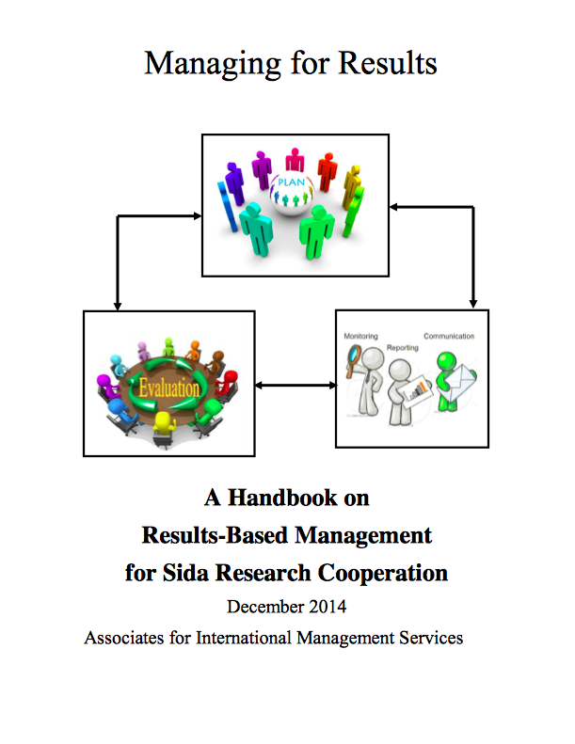
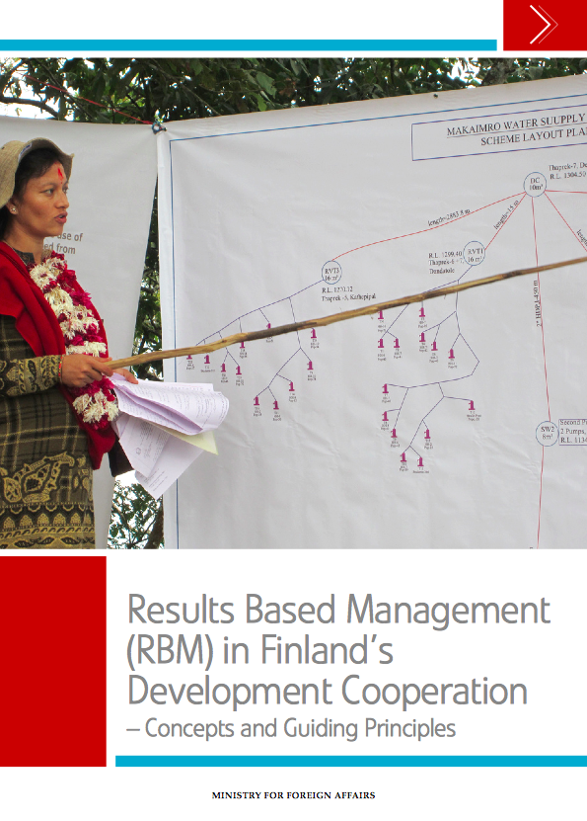
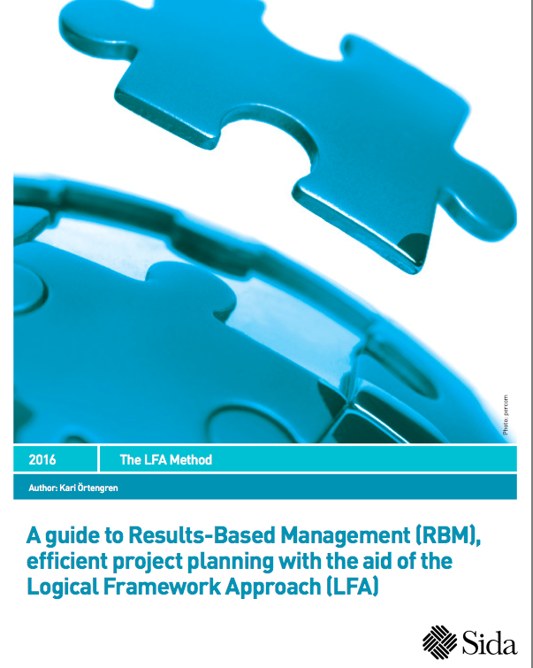

Notes:
Impact, goal, outcome, output
Indicators, baselines, targets and

Slide 5
Learning objectives & Outline
1) Understand the Project Cycle Management and Results Based Management concept and approach
What PCM and RBM is and why do we use them?
2) Differentiate the key RBM definitions and concepts, as well as their application in programming
Different levels of results and constructing the basis for M&E information
3) Apply Problem Tree and Objective Tree methods and analyse energy sector issues through them
Notes:
Impact, goal, outcome, output
Indicators, baselines, targets and

Slide 6
What is a Project?
Common characteristics:
- Has a start and a finish, involving series of phases in between
- Has a budget
- Includes aset of sequential, unique and non-repetitive
activities
- Uses resources, may require coordinating
- Includes Responsibilities for management and implementation
- Has defined roles and relationships for participants in the project

Slide 7
What is Project Cycle Management?
Project cycle management (PCM) is the process of planning, organizing, coordinating, and controlling of a project effectively and efficiently throughout its phases, from planning to implementation to completion and review achievement of pre-defined objectives to satisfy project stakeholders by producing the right deliverable at the right time, cost and quality
-modifed from Wikipedia

Slide 8
Expected Accomplishment
Input
Impact
Outcome
Specific objective
Sub-output
Activity result
MfDR
TOC
Milestone
Goal
Component
RBM
Objective
Overall objective
Aim
MoV
short term
TARGET
Purpose
LFA
Output
Intermediate
Result
Activity
long-term
OVI
Notes:
Although this looks complicated, This is not rocket science it is common sense!

Slide 9
What is Results-based Management (RBM)?
“A management strategy by which all actors on the ground, contributing directly or indirectly to achieving a set of development results, ensure that their processes, products and services contribute to the achievement of desired results (outputs, outcomes and goals). RBM rests on clearly defined accountability for results and requires monitoring and self-assessment of progress towards results, including reporting on performance.”- UNDG, RBM Handbook,2010
an ongoing process
RBM life cycle approach: planning, implementation, monitoring, reporting and evaluation
constant feedback, learning and improving.
is fundamental for organisations such as UN, WB, ADB, bilaterals (SIDA, MFA of Finland, EU) NGOs etc.
Notes:
RBM is an ongoing process. This means that there is constant feedback, learning and improving. We refer to this as the RBM life cycle approach. Results-based management is fundamental to the UN’s approach and practice in fulfilling its mandate and effectively providing assistance to developing countries. UN should systematically focus on results to ensure that financial and human resources are strategically deployed to achieve the greatest impact.

Slide 10
What is Results-based Management (RBM)?
RBM should also contribute to increasing
"efficiency" - making sure that inputs are used towards activities that contribute towards achieving outputs.
"effectiveness" that the achieved outputs contribute towards an intended development change described in the outcome.

Slide 11
Accountability
Accountability means being held responsible for decisions and actions towards desired results. It is important to make sure that we achieve the results we planned and committed ourselves to achieving.

Slide 12
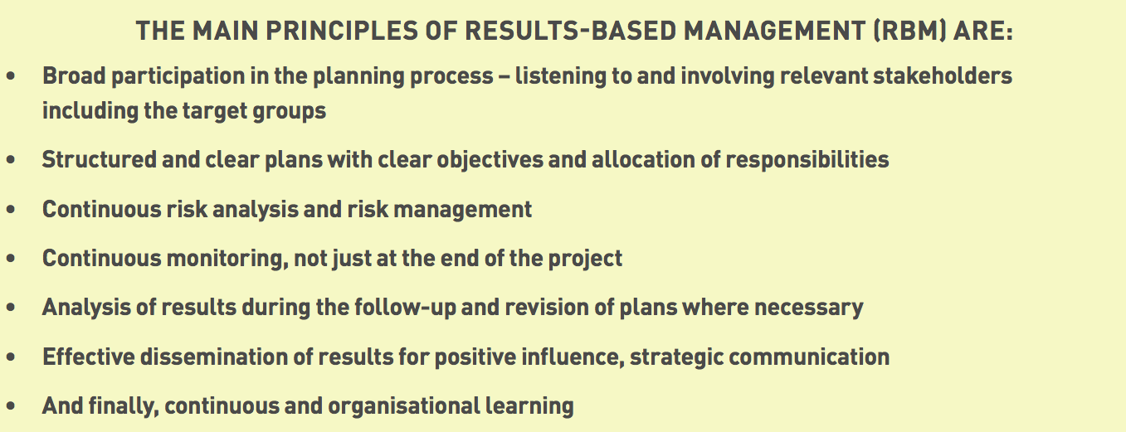
SIDA definition
Notes:
Impact, goal, outcome, output
Indicators, baselines, targets and

Slide 13
Why do you think it is important to use the RBM approach?
❑ A. We can check more efficiently whether we are working to solve the right problems
❑ B. We can have better understanding of when corrective actions are needed
❑ C. We are faced by intensified calls from donors for accountability on how resources are used and what results are achieved
❑ D. With the RBM approach we can have a better understanding of how our programme results could contribute to bringing about progress in the areas of our mandate
❑ E. It encourages us to work together with other agencies development partners, international organisations, bilaterals, NGOs
❑ F. It helps us to make informed decisions during the implementation of a programme and while preparing new programmes
Notes:
Give as handout – use as short group exercise

Slide 14
Why do you think it is important to use the RBM approach? ANSWERS
☑ A. We can check more efficiently whether we are working to solve the right problems
☑ B. We can have better understanding of when corrective actions are needed
☑ C. We are faced with intensified calls from donors for accountability on how resources are used and what results are achieved
☑ D. With the RBM approach we can have a better understanding of how our programme results could contribute to bringing about progress in the areas of our mandate
☑ E. It encourages us to work together with other agencies development partners, international organisations, bilaterals, NGOs
☑ F. It helps us to make informed decisions during the implementation of a programme and while preparing new programmes

Slide 15
Why RBM continues…?
RBM provides a coherent framework for
strategic planning and management, based
on learning and accountability
Notes:
15

Slide 16
Helps us move from the complexity of reality
Poor households are more frequently malnourished and suffer from diarrhoea in the lower basin
No knowledge of health system support, low utilisation
Children looked after by people who are poorly equipped to do so
Dumping of waste to the river
Lack of knowledge of adequate child care practices
Lack of clean water
Existence of harmful traditional practices
Diarrhea
No practice of preparing expectant parents for parenthood
One parent parent died
Orphanhood
Notes:
16
That’s why we bring in a conceptual framework.
A conceptual framework is a theoretical model, based on scientific evidence, research, evaluation and experience. While specific situations in different countries or environments differ, the conceptual framework gives us clues as to how to organize our problem tree, or which question to ask when we are conducting our causal analysis.

Slide 17
..to a clear Results Framework/LogFrame
Improved health conditions of lower basin communities
Impact
Outcome
Improved water quality in lower river basin
Outputs
Increased ability to control water contaminants
Activities
Installing control devices
training
Inputs
TA
Money

Slide 18
“Failing to Plan is planning to fail!”
Planning:
The process of establishing results frameworks, proposing strategies, outlining the implementation arrangements, identifying partners and allocating resources to achieve those goals
Reporting:
An essential element of an accountability process, where people accountable for performance report on what has been achieved compared to expectations.
Monitoring:
The ongoing process by which stakeholders obtain regular feedback on the progress being made towards achieving their results.
Evaluation:
A rigorous assessment of completed or ongoing programme to determine the extent to which it is achieving stated objectives and contributing to decision-making.
Without a clear plan how do you know what to achieve and monitor??

Slide 19
Exercise 2
For an efficient and effective planning process you shouldn’t involve many different stakeholders True  False
Planning is a pre-requisite for implementation, monitoring, evaluation and reporting True  False
To guarantee useful monitoring and evaluation results you carry out the same activities in both processes True  False

Slide 20
Exercise ANSWERS
For an efficient and effective planning process you shouldn’t involve many different stakeholders True  False ☑
Planning is a pre-requisite for implementation, monitoring, evaluation and reporting True ☑ False
To guarantee useful monitoring and evaluation of results you carry out the same activities in both processes True  False ☑

Slide 21
Theory of change
INPUTS
Investment
Time
Money
Partners
Equipment
Know-how
ACTIVITIES
Actions
Training
Workshops
Field visits
OUTPUTS
Delivery
Products, goods services
Publications
Knowledge, skills
Understanding
OUTCOMES
Short-term (changes in)
Attitudes
Skills
Knowledge
Motivation
Awareness
OUTCOMES
Medium-term (changes in)
Behaviour
Practices
Policies
Procedures
IMPACT
Long-term
(changes in)
Peoples lives
Environmental conditions etc.
What is the current situation that we intend to affect;
What will it look like when we achieve the desired situation or outcome;
What behaviours need to change for that outcome to be achieved;
What knowledge or skills do people need before the behaviour will change;
What activities need to be performed to cause the necessary learning; and
What resources will be required to achieve the desired outcome.

Slide 22
Results chain
= the causal or logical sequence of activities, outputs and outcomes illustrating how the intended results of the intervention or activity are expected to be brought about.
Inputs
Activities
Outcomes
Outputs
Goals

Slide 23
The different components of the results chain explain what we want to achieve in the short and medium term
Inputs
Activities
Outcomes
Outputs
Goals
What?

Slide 24
Why we want to do it: to achieve our goals in the medium and long term…
Inputs
Activities
Outcomes
Outputs
Goals
What?
Why?

Slide 25
and also how we are going to do it. What resources and activities are needed?
Inputs
Activities
Outcomes
Outputs
Goals
What?
How?
Why?

Slide 26
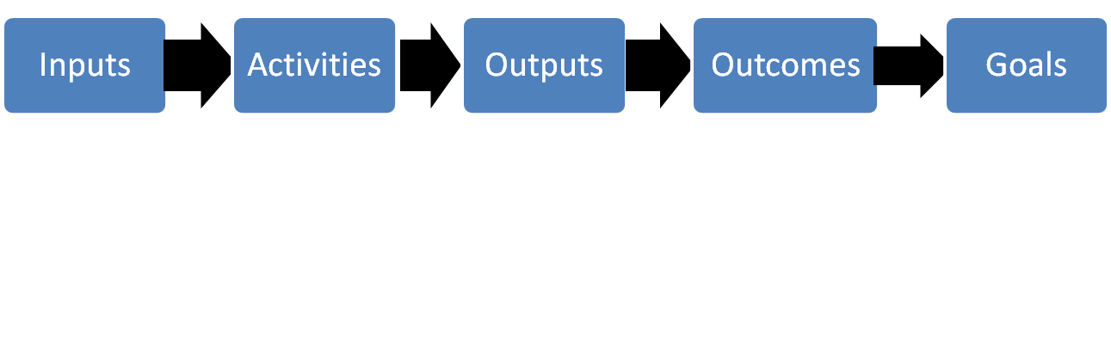
In reality
…achieving a "change" involves a non-linear process - i.e. "2 steps forwards and 1 step back or sideways"
IMPLEMENTATION
RESULTS
PLANNING
Monitoring is the key tool for success
IMPLEMENTATION

Slide 27
Key components of a Results and Resources Framework (RRF)
Articulates the chain of results, the resources available, and the monitoring and evaluation elements.
The RRF will enable you throughout the programme cycle to know:
what you are doing
why are you doing it
how you are doing it
what your resources are.

Slide 28
RRF format
National development goals or priorities. UNDAF Outcomes/ UNDP CP Outcomes
Results | Indicators, Baseline, Target | MoV | Risks and Assumptions | Implementing partners | Indicative resources by output (per annum, USD)
Outcome
Output
Notes:
Give RRF format as handout

Slide 29
The Logical Framework Analysis (LFA)
Tool following the principles of Results-Based Management (RBM)
Originates in the United States in the 1960s, today used in projects and sectors by public agencies, private companies, municipalities, regions and NGOs and international development organisations
Many other RBM methods e.g. the Balanced Scorecard, the SWOT Analysis, Total Quality Management Theory of Change, Outcome Mapping
Despite criticism LFA is a comprehensive planning model that covers all stages of the planning process, all the way to a completed project, programme and/or operation plan
Notes:
Give RRF format as handout

Slide 30
The Logical Framework Analysis (LFA)
What Makes a Good Logframe?
A sound problem summary statement key stakeholder agree upon (already covered)
Objectives focus on the problem to be addressed
Outcomes show short-term and intermediate changes needed to achieve the objective
Outputs lead to the outcomes
Performance indicators verify the change has happened
Notes:
Give RRF format as handout

Slide 31
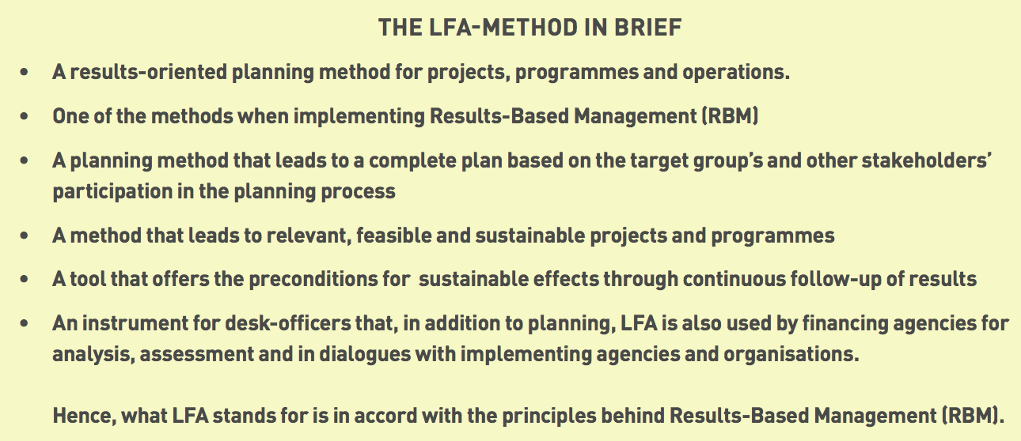
Notes:
Impact, goal, outcome, output
Indicators, baselines, targets and

Slide 32
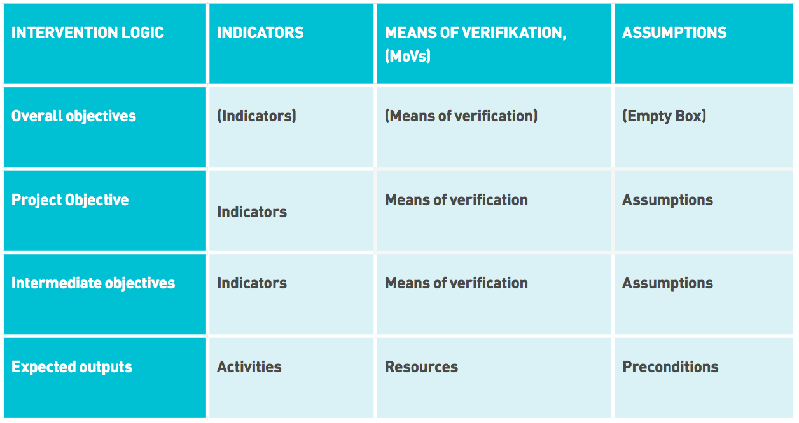
The Logical Framework Matrix/ LogFrame
Notes:
Impact, goal, outcome, output
Indicators, baselines, targets and

Slide 33
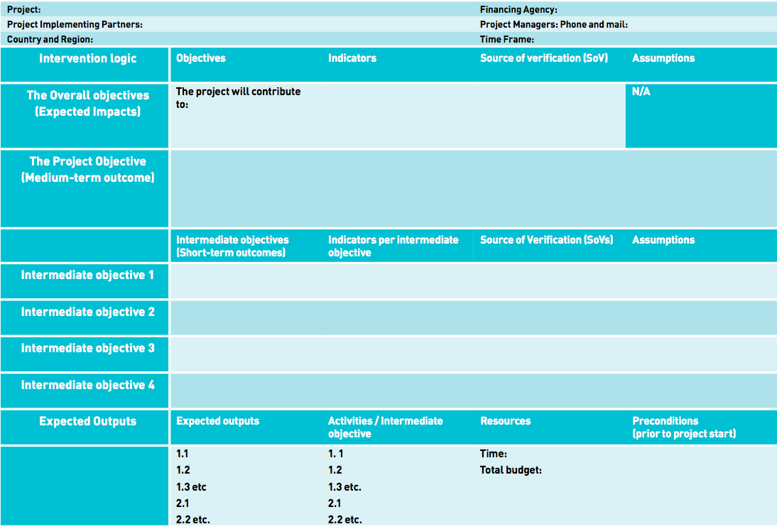
The Logical Framework Matrix/ LogFrame
Notes:
Impact, goal, outcome, output
Indicators, baselines, targets and

Slide 34
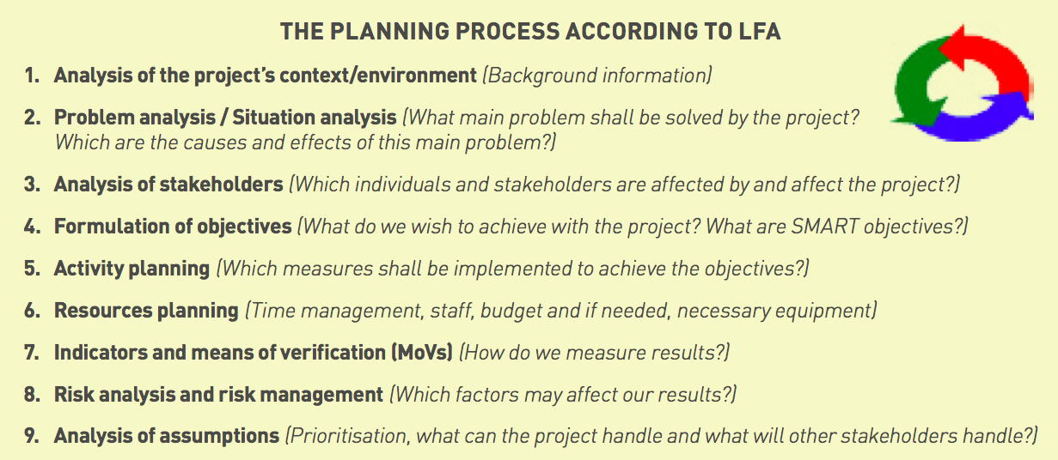
The LFA planning process
Notes:
Impact, goal, outcome, output
Indicators, baselines, targets and

Slide 35

Building a problem tree
Notes:
Impact, goal, outcome, output
Indicators, baselines, targets and

Slide 36
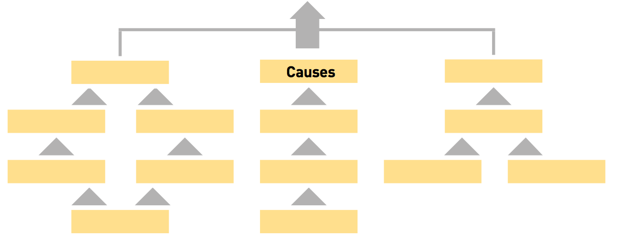
Notes:
Impact, goal, outcome, output
Indicators, baselines, targets and

Slide 37
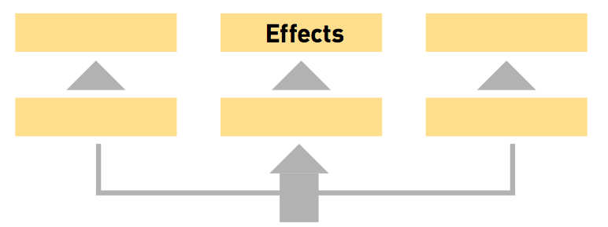
Notes:
Impact, goal, outcome, output
Indicators, baselines, targets and

Slide 38
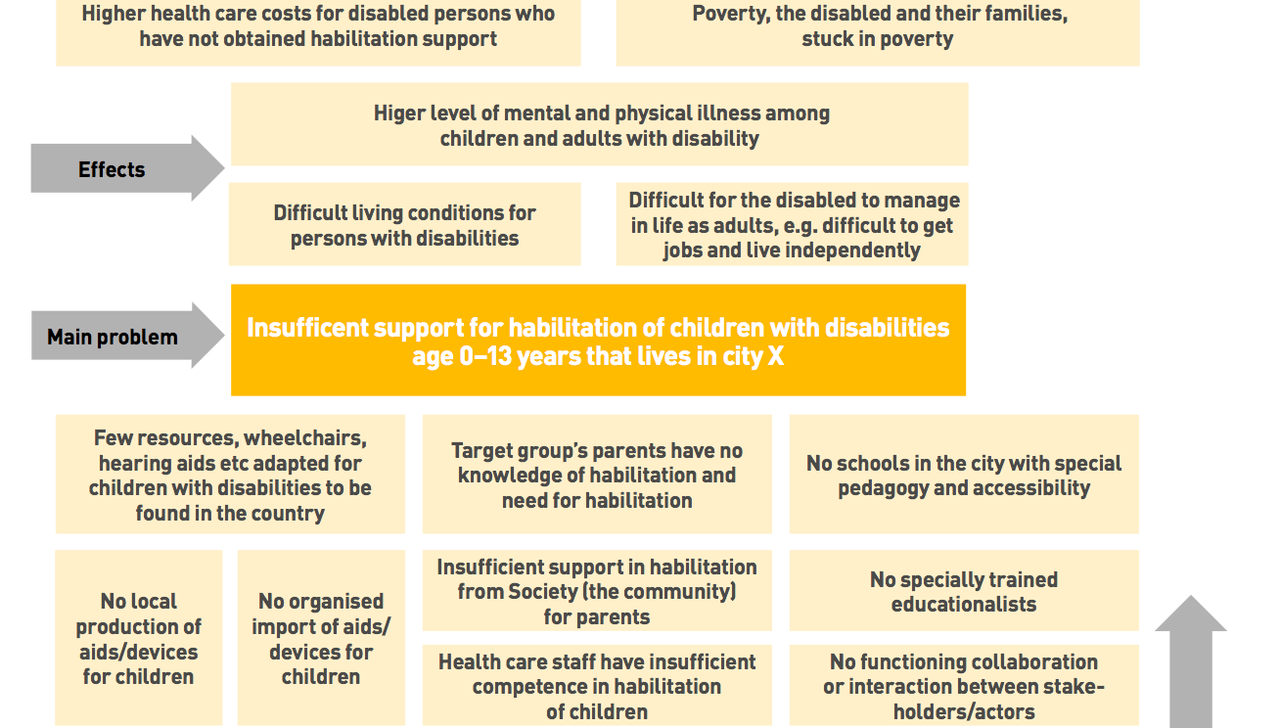
Notes:
Impact, goal, outcome, output
Indicators, baselines, targets and

Slide 39
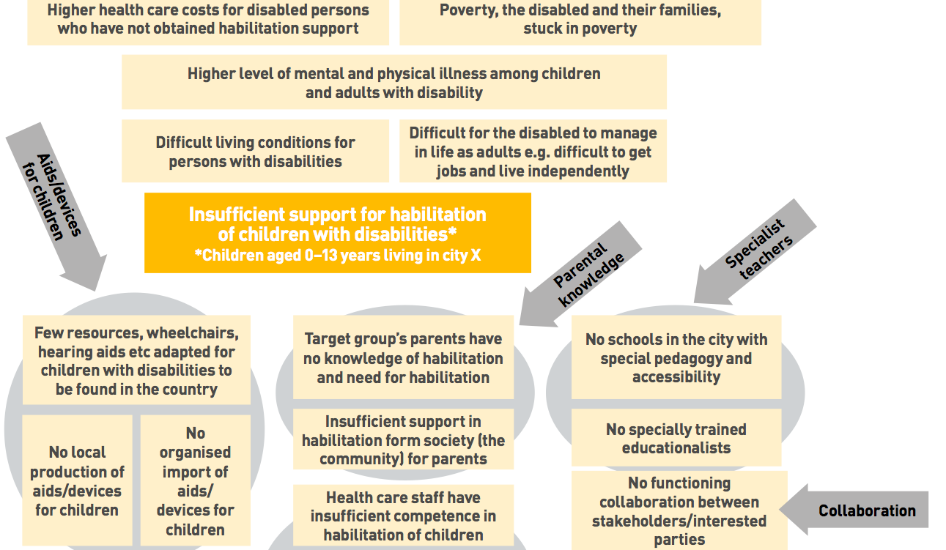
Notes:
Impact, goal, outcome, output
Indicators, baselines, targets and

Slide 40
OVERALL OBJECTIVE
GOAL/IMPACT
IMPACT ST/LT
EC
SIDA
UN/MFA/OECD
OBJECTIVE
WIDER OBJ.
OUTCOME (MT)
INTERMEDIATE OBJECTIVE
OUTCOME (ST)
PURPOSE/SO
DELIVERABLE
OUTPUT
OUTPUT
ACTIVITY
ACTIVITY
INPUTS
Notes:
Impact, goal, outcome, output
Indicators, baselines, targets and

Slide 41
Relation of Objectives and Results
At the highest level, a result is the achievement of the objectives that the Programme has set for itself to help address the problem when the objective is attained. This is what is often called impact.
To achieve that objective, certain outcomes have to be obtained as a consequence of the Programmes work.
The tangible direct results of that work are the outputs that are produced.

Slide 42
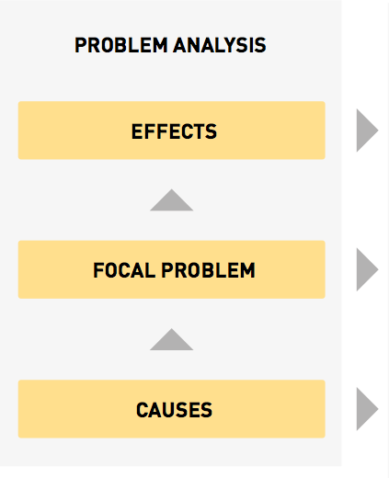
From Problems…
Notes:
Impact, goal, outcome, output
Indicators, baselines, targets and

Slide 43
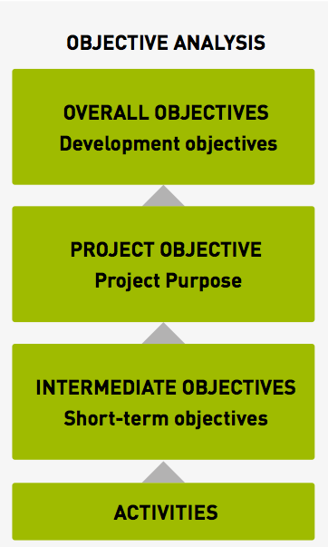
…to objectives…
Notes:
Impact, goal, outcome, output
Indicators, baselines, targets and

Slide 44
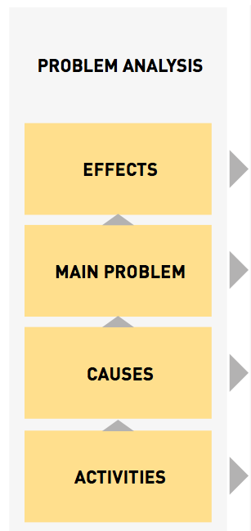
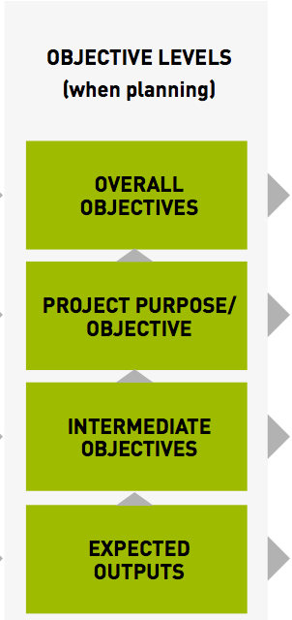
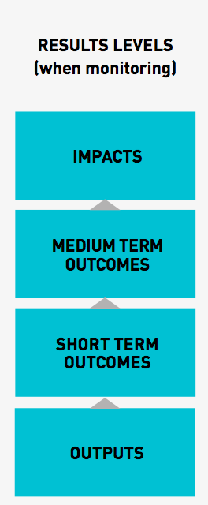
…to Results
Notes:
Impact, goal, outcome, output
Indicators, baselines, targets and

Slide 45
Results
A result is a development change arising from a cause and effect relationship.
  A RESULT IS NOT THE COMPLETION OF ACTIVITIES
A result has two components:
CHANGE
CAUSALITY

Slide 46
Causality: IF...THEN
IF modern energy sources are available, accessible and affordable, THEN there will be decreased time use of women and children in collecting the firewood and more productive time for other uses
THEN…
Notes:
This is a simplified example and of course there needs to be demand for the product. Cultural factors affect this or local customs. Remember did research in Nam Bak district and fuel wood is collected usually by men in a couple of days per month with the help of trucks and motorized saws

Slide 47
Change
A CHANGE is a development transformation that can be measured or described, e.g.
  in quality & availability of services
  in status/condition (e.g. poverty, environment)
  in knowledge or skills
  of beliefs, behaviors and practices
  in institutional performance…

Slide 48
Different levels of results
RESULTS=“changes in a state or condition that derive from a cause-and-effect relationship (intended or unintended, positive and/or negative) – outputs, outcomes and goals” -UNDG RBM Handbook
Different levels of results seek to capture the different development changes. These results are linked together into the results chain (RRF).
In RBM we distinguish between three levels of results:
  Goals/Impact
  Outcomes
  Outputs
Notes:
Impact does not come under undaf

Slide 49
Different levels of results
2020
Graduation from LDC
7th NSEDP
National Socio-Economic Development Plan
2015
MDGs
UNDAF
UN Development Assistance Framework
UNDP CP
Country Programme
AWP (Annual Work Plan) Project Document
OUTPUTS
OUTCOMES
GOALS/IMPACT
Source: Khemphone Phaokhamkeo & Iori Kato, 2011
Notes:
49

Slide 50
Impact
“Positive and negative long-term effects on identifiable population groups produced by a development intervention, directly or indirectly, intended or unintended. These effects can be economic, socio-cultural, institutional, environmental, technological or of other types and should have some
relationship to the MDGs and national development goals.” - UNDG, RBM handbook

Slide 51
Goals
Goals are the specific end results desired or expected to occur as a consequence (at least in part) of the intervention or activity.
A goal refers to the ‘big picture’ changes over long time periods and represents the underlying aim of development work.

Slide 52
Goals
Satisfactory examples of goals are:
Advanced Gender equality in access to resources, goods and services and decision-making in rural areas
Ensure(d) environmental sustainability

Slide 53
Objectives
Objective, according to OECD/DAC Glossary of Evaluation Terms is:
1) “An overall desired achievement involving a process of change aimed at meeting certain needs of identified beneficiaries within a given period of time.” or
2) The situation you will observe at the end of a specific period.

Slide 54
Objectives
Examples (source: SIDA):
“Agricultural educational programmes in sub-Saharan Africa are in agreement with African priorities within a framework that will produce an adequate number of quality graduates working in the agricultural sector.”
“To improve context relevance through contextualized educational materials development and enhanced delivery for graduates to perform effectively in the agricultural sector, by 2014.” (at the regional research network level)

Slide 55
Outcomes
Outcomes are:
“The likely or achieved short- and medium-term effects of an intervention’s outputs” (OECD/DAC Glossary of Evaluation Terms)
Situations that will be observed when outputs make changes happen
Notes:
Resources, inputs

Slide 56
Outcomes
medium- term changes and effects of a programme or intervention
normally achieved beyond the timeframe of an intervention or programme
intervention/programme "contributes" to achievement of the Outcome along with other initiatives
intervention or programme should ideally not have more than one outcome statement
ASK : Where do we want to be at the end of the project? What must be in place in order for us to achieve our goals and have an impact?
Notes:
Resources, inputs

Slide 57
Satisfactory examples of outcomes
Increased implementation of national development plans and budgets that recognize pro-poor, and environmentally sustainable economic growth
Increased participation of vulnerable groups (e.g. dalits) in development planning processes at district level
Increased high-quality data disaggregated by gender available and used for evidence-based decision-making at national and subnational levels
“At least 50 % of the trained experts use skills learnt to produce learning resources by June 2014”
“Increased number of researchers linked to the organisation receive funding for new international interdisciplinary and comparative research by (time target) ” (global level)

Slide 58
Outcome statements
An outcome statement should:
avoid phrases such as “to assist/ support/ develop/ monitor/ identify / prepare”.
not describe how it will be achieved and should avoid phrases such as “improved through” or “supported by means of”
be measurable using indicators
ideally communicate change in institutional or individual behaviors or quality levels for people

Slide 59
Unsatisfactory examples of outcomes
To contribute to reducing GHG emissions through improving the access to modern energy sources
Families and communities are healthy and well educated with access to social protection mechanisms, and are able to contribute to national development
Government, civil society and community leaders enhance gender equality and promote the rights of women and girls
At least 50 % of the trained experts use skills learnt to produce learning resources by June 2014
At least 80% of people in endemic areas sleep under a long lasting insecticidal net
Exercise 3: What is wrong with each of these outcomes?

Slide 60
Unsatisfactory examples of outcomes ANSWERS
To contribute to reducing GHG emissions through improving the access to modern energy sources
Comment: the outcome should be results-oriented, not a process or action.
Families and communities are healthy and well educated with access to social protection mechanisms, and are able to contribute to national development
Comment: the outcome is too broad and contains multiple components
Government, civil society and community leaders enhance gender equality and promote the rights of women and girls
Comment: there is no clear relationship with our intervention and not results-oriented.
At least 50 % of the trained experts…..At least 80% of people….. Comment: the two latter ones are not outcomes, but targets

Slide 61
Outputs
Outputs are products, goods and services, systems, change in skills/capacities produced by an intervention or activity.
In general, if the result is mostly beyond the control or influence of the project/ programme, it cannot be an output
Intervention / programme is responsible to fully achieve the outputs within its time period and should ideally not have less then three outputs and not more than five.
Notes:
Too many can reflect an overly ambitious and poorly designed project that is trying to do too much.

Slide 62
Key features of an output
Clearly identify a product/service/skill/capacity change
What type of change is implied, what is expected to change (e.g. level of knowledge)
Who or what is the target for change
Achieved with resources provided and within time-period specified
Sufficient to contribute to achievement of the expected outcomes
Formulated in change language

Slide 63
Output statements
Avoid broad output statements. They make indicator identification difficult
Be clear about what is expected to change – a condition, level of knowledge, attitude?
Be clear about where change should appear – e.g. among individuals, counterpart organizations, communities, regions?
Specify who or what are the specific targets for change. What kind of individuals, organisations, communities, etc.?

Slide 64
BREAK ?

Slide 65
COMMON OUTPUT MISTAKES

Slide 66

Not specific
e.g.
Improved availability & utilization of disaggregated data and information
Notes:
- Questions: what information and for what purpose nationally , regionally, globally? who’s increased awareness, decision makers? Local communities, the poor (men/women), climate change impacts/disasters

Slide 67

Contains multiple results
Improved awareness of women’s rights at all levels and improved accountability of national policies and systems

Slide 68

Beyond the mandate
- scale and scope not within control
e.g.
Increased national and sub-national capacity to increase availability, accessibility, acceptability, affordability and utilisation of modern and clean energy resources to reduce forest degradation and indoor pollution

Slide 69

Too ambitious
e.g.
Policies of relevant sectoral ministries are revised to reduce institutional and social barriers to exercising rights and accessing services, for all excluded groups
Notes:
Ok, here we are catching stars e.g. can you remove the social barriers purely with sectoral policies, what about the different within and between societal/cultural/indigenous groups and systems

Slide 70

Too general –
could mean anything
e.g.
An improved multi-sectoral approach at the policy level
Improved management systems and practices for service delivery

Slide 71

Confusing means and ends
e.g.
Strengthen the protection of human rights through the creation of an enabling environment that promotes gender equality

Slide 72
Satisfactory output statements
Increased awareness of local communities on ecosystem based climate change adaptation options in the Panchase area in Nepal
Improved understanding of geographic information systems by technical staff of department of land use planning at the Ministry of Planning.
Increased evidence on linkages between poverty and environment available for decision makers in Myanmar

Slide 73
Unsatisfactory output statements
Contribute to implementing the national environmental law
Enhanced national expertise and transfer of technology
Exercise 4 – what is wrong with each of these outputs?

Slide 74
Unsatisfactory output statements - ANSWERS
Contribute to implementing the national environmental law
There is no clear accountability of THE ACTOR under this output.
Enhanced national expertise and transfer of technology
Too broad and too ambitious for an output, not specific

Slide 75
Exercise 5 – match the examples with the correct result level
Goal?
Outcome?
Output?
Population dynamics and its interlinkages with gender equality, sexual and reproductive health and HIV/AIDS incorporated in public policies, poverty reduction plans and expenditure frameworks.
Systematic use of population dynamics analysis to guide increased investments in gender equality, youth development, reproductive health and HIV/AIDS for improved quality of life and sustainable development and poverty reduction.
Improved capacity of national planning institutions on population dynamics and their relation to socio-economic development.

Slide 76
Matching examples with result level - ANSWERS
Goal:
Systematic use of population dynamics analysis to guide increased investments in gender equality, youth development, reproductive health and HIV/AIDS for improved quality of life and sustainable development and poverty reduction
Outcome:
Population dynamics and its interlinkages with gender equality, sexual and reproductive health and HIV/AIDS incorporated in public policies, poverty reduction plans and expenditure frameworks.
Output:
Improved capacity of national planning institutions on population dynamics and their relation to socio-economic development.

Slide 77
Activities vs Outputs
Activities are often confused with outputs.
Activities describe the actions taken or work performed through which inputs, such as funds, human resources and other types of resources are mobilized to produce specific outputs.
Outputs are the products, goods and services produced by an intervention or activity.

Slide 78
Exercise 6
Are these activities or outputs?
Improved availability of reliable poverty data, disaggregated by sex and age, at national and provincial levels.
Networking with village leaders in awareness raising campaign that targets vulnerable groups.
Introducing an information system to better monitor investments in Phongsaly.
Comprehensive health services available for all individuals in target areas
Activity 
Output 
Activity 
Output 
Activity 
Output 
Activity 
Output 

Slide 79
Exercise - ANSWERS
Are these activities or outputs?
Activity 
Output ☑
Activity ☑
Output 
Activity ☑
Output 
Activity 
Output ☑
Improved availability of reliable poverty data, disaggregated by sex and age, at national and provincial levels.
Networking with village leaders in awareness raising campaign that targets vulnerable groups.
Introducing an information system to better monitor investments in Phongsaly.
Comprehensive health services available for all individuals in target areas

Slide 80
Exercise 7 – suggest possible matching outputs and activities
Output | Activity
Improved availability of reliable poverty data, disaggregated by sex and age, at national and provincial levels.
 | Networking with village leaders in awareness raising campaign that targets vulnerable groups.
What could the specific/intermediate objectives be in this case?

Slide 81
Exercise 7 – suggest possible matching outputs and activities
Output | Activity
Improved availability of reliable poverty data, disaggregated by sex and age, at national and provincial levels. | Support the capacity of statistics department to collect detailed poverty data in the next national census
Increased awareness on climate induced disasters among vulnerable groups living in flood prone areas of Panchase sub-district | Networking with village leaders in awareness raising campaign that targets vulnerable groups.
E.G
- Improved knowledge of statistics department on national poverty situtation
- Better preparedness of low-land communities to prepare for climate related events

Slide 82
Inputs
Inputs are the financial, human and material resources used for the intervention or activity.

Slide 83
Exercise 8 – which of the following are inputs? Tick all that apply.
Available regular (core) and other financial resources
Professional staff and administrative staff
Offices and facilities
Information and Communications Technology (ICT) infrastructure
Transportation vehicles, especially in conflict and post-conflict areas
Related institutional knowledge and experiences
❑
❑
❑
❑
❑
❑

Slide 84
Exercise – which of the following are inputs? Answers.
Available regular (core) and other financial resources
Professional staff and administrative staff
Offices and facilities
Information and Communications Technology (ICT) infrastructure
Transportation vehicles, especially in conflict and post-conflict areas
Related institutional knowledge and experiences
☑
☑
☑
☑
☑
☑

Slide 85
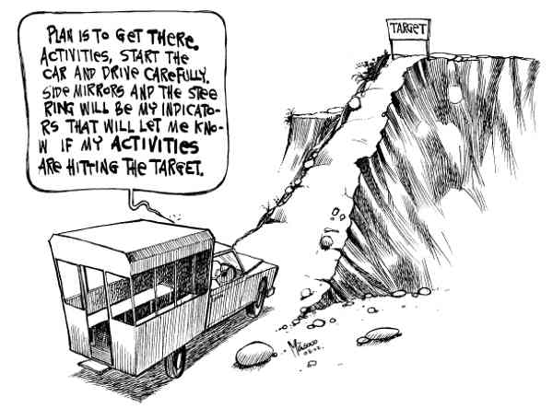
Constructing the M&E information

Slide 86
Indicators
Quantitative and qualitative variables that provide a simple and reliable means to measure achievement
Gives you and indication whether on track to achieve the planned results?
Output (YOU responsible) vs. Outcome indicator (source e.g. UNDAF, CPAP, national/sub-national plans, development programmes)
ASK:
As direct as possible to reflect the outcome/output (or proxy)
Sufficiently precise to ensure objective measurement?
The most practical and cost effective collection of data?
Is data available and who is responsible for collection of data?
Can national systems or indicators be used? (Outcome)

Slide 87
Indicators (2)
The CREAM of good INDICATORS
Clear precise and unambiguous
Relevant appropriate to the subject
Economic available at a reasonable cost
Adequate provide a sufficient basis to assess performance
Monitorable amenable to independent validation
The SMART of good TARGETS
Specific to the objective is supposed to measure
Measurable (quantitatively of qualitatively?
Attainable at a reasonable cost
Relevant to the information needs of the managers
Time-bound to know when the targets will be achieved
Notes:
Smart terminology comes across in the EC, UN and Bilaterals, Cream fro example in World bank definitions

Slide 88
Indicators (4)
Can be a mix of qualitative and quantitative indicator types (sometimes likely to be more effective)
Sufficient to measure the breadth of the changes happening
Piloting your indicators is essential!!!
The “BOTTOM LINE”, indicator must
Work: must show change if change occurs.
Be Objective: (“Objectively Verifiable”) and
Be Practical: can / will we “do” it.
Notes:
The demand for objective verification may mean that the focus is given to the quantitative or simplistic aspects at the expense of indicators that are harder to verify but may better capture the essence of change taking place.
Measuring change is very costly, so use as few indicators as possible. However, there must be indicators in sufficient number to measure the breadth of the changes happening and to provide cross-checking.
It is very risky to go to full implementation before testing data sources, collection and analysis plans and means of reporting. It is a way of learning what works and what does not.

Slide 89
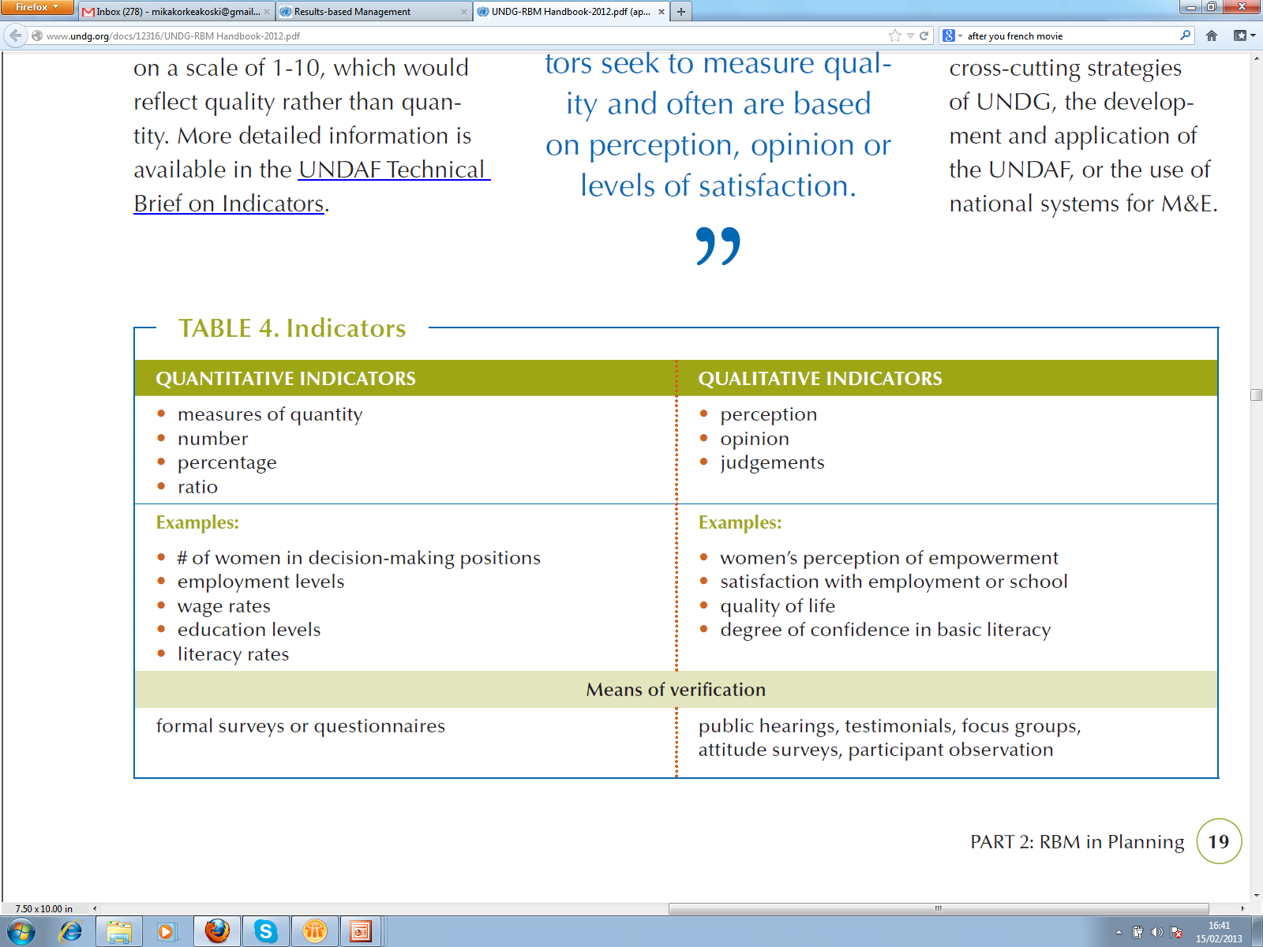
Indicators (4)

Slide 90
Baseline
“Information gathered at the beginning of a project or programme from which variations found in the project or programme are measured”-UNDG
HMM… in common sense baseline gives us the first measurement of an indicator and tells us where we are now in relation to the outcome we are trying to achieve
Notes:
Before the intervention has started.
90

Slide 91
Building baseline information
For each of the indicators, define:
1. Data to be collect
2. Source(s) of data
3. Method of collection
4. Who should collect the data
5. When to collect data

Slide 92
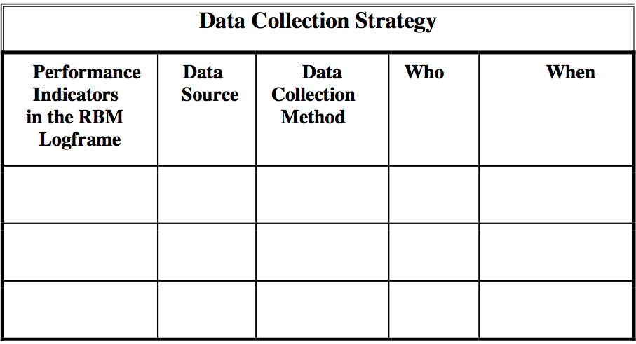
Building baseline information

Slide 93
Building baseline information
Data sources can include primary or secondary data:
Reports, internal and external that are generated by the programme
Policy statements related to the programme
Regular statistical series, including baseline data
Administrative documents of the programme
People who can be interviewed through surveys or focus groups
Observation on-site during missions

Slide 94
Building baseline information
Data Collection Methods can include e.g.
Content analysis
Use of existing statistical series Focus groups/interviews
Surveys
Field visits
Case studies …

Slide 95

Target
“Specifies a particular value for an indicator to be accomplished by a specific date in the future” - UNDG, RBM Handbook
Required for outcomes, outputs and main activities. Indicates what the situation is expected to be at set intervals or the end of a programme/activity (can be short (annual) or long term)
Photo: Alastair Bradstock, IIED
Notes:
95

Slide 96
Target
Baseline Desired Target
indicator + level of = performance
level improvement
For whom? Where? How much? By when?

Slide 97
Exercise 9 – Indicator, Baseline or Target? Tick the right one
I B T
❑  
❑  
❑  
❑  
❑  
❑  
❑  
1) In 2011, 55% of the local government plans do not address climate change
2) By 2008, at least 40% of stray cats vaccinated
3) Number of youth between 15-25 years who have access to free education
4) Level of institutionalised mechanisms in place
5) Inexistence of EIA guidelines in national language
6) Decrease the number of bad policies to combat climate change
7)By 2020, halve the proportion of people living in poverty

Slide 98
Exercise 9 – Indicator, Baseline or Target ANSWERS
I B T
❑ ☑ 
❑  ☑
☑  
☑  
❑ ☑ 
❑  (☑)
❑  ☑
1) In 2011, 55% of the local government plans do not address climate change
2) By 2008, at least 40% of stray cats vaccinated
3) Number of youth between 15-25 years who have access to free education
4) Level of institutionalised mechanisms in place
5) Inexistence of EIA guidelines in national language
6) Decrease the number of bad policies to combat climate change
7)By 2020, halve the proportion of people living in poverty

Slide 99
Building M&E information:
Outcome, indicators, baselines and targets
Outcome statement | Indicators | Baselines | Targets
1. Increased implementation of National and Provincial Investment strategies
2. Job opportunities for youth improved

Slide 100
Building M&E information:
Outcome, indicators, baselines and targets
Outcome statement | Indicators | Baselines | Targets
1. Increased implementation of National and Provincial Investment strategies | 1. Per cent of implemented activities of NIS/PIS action plan
2. Job opportunities for youth improved | 2. Per cent of school leavers are in full-time work

Slide 101
Building M&E information:
Outcome, indicators, baselines and targets
Outcome statement | Indicators | Baselines | Targets
1. Increased implementation of National and Provincial Investment strategies | 1. Per cent of implemented activities of NIS/PIS action plan | 1. In 2012, 0 per cent of activities identified in the action plan of NIS/PIS implemented
2. Job opportunities for youth improved | 2. Per cent of school leavers are in full-time work | 2. In 2009, 60 per cent of 18-26 year olds

Slide 102
Building M&E information:
Outcome, indicators, baselines and targets
Outcome statement | Indicators | Baselines | Targets
1. Increased implementation of National and Provincial Investment strategies | 1. Per cent of implemented activities of NIS/PIS action plan | 1. In 2012, 0 per cent of activities identified in the action plan of NIS/PIS implemented | By 2018, 80 per cent of the recommended NIS/PIS activities implemented
2. Job opportunities for youth improved | 2. Per cent of school leavers are in full-time work | 2. In 2009, 60 per cent of 18-26 year olds | By 2016, 70 to 75 per cent of 18-26 year olds

Slide 103
Analysis of Assumptions
a. What is the project’s relationship with other development efforts being made in the sector? What other relevant projects/operations are being implemented in the sector by the Government, by NGOs (non-governmental organisations) and other projects? Is there any danger of duplication or conflict?
b. Are the project’s results dependent on other projects or external actors’ actions? Are there any decisive assumptions, external actions needed, for the project’s success, such as a new legislation or regulations, financial support, staff assignments etc. from e.g. a local Government?
c. Can the project team monitor the assumptions, actions/ problems/situations which other stakeholders are assumed to be responsible to solve?

Slide 104
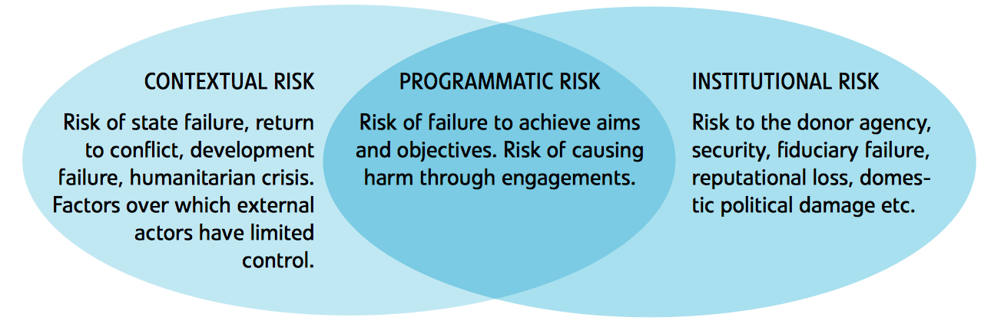
Analysis of risks

Slide 105
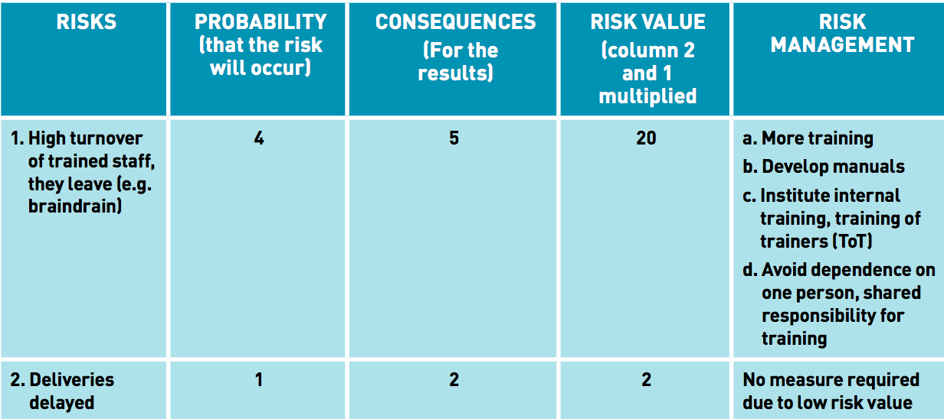
Analysis of risks

Slide 106
Group Exercise: Problem tree 30 minutes
Form three groups
Assign a secretary and rapporteur
Select an intermediate problem for the focal problem problem
Define key corresponding/related problems to your problem
PESTECV

Slide 107
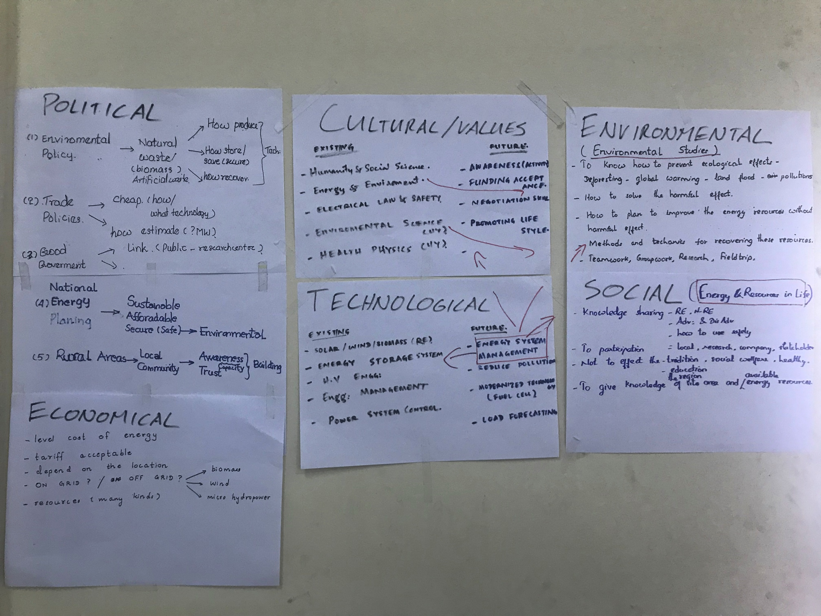

Slide 108
ENERGY EDUCATION IN HIGHER EDUCATION INSTITUTIONS DOES MEET FUTURE ENERGY SECTOR NEEDS IN MYANMAR
Notes:
Impact, goal, outcome, output
Indicators, baselines, targets and

Slide 109
OVERALL OBJECTIVE
GOAL/IMPACT
EC
SIDA
UN/MFA/OECD
OBJECTIVE
WIDER OBJ.
OUTCOME (MT)
INTERMEDIATE OBJECTIVE
OUTCOME (ST)
PURPOSE/SO
DELIVERABLE
OUTPUT
OUTPUT
ACTIVITY
ACTIVITY
INPUTS
Notes:
Impact, goal, outcome, output
Indicators, baselines, targets and

Slide 110
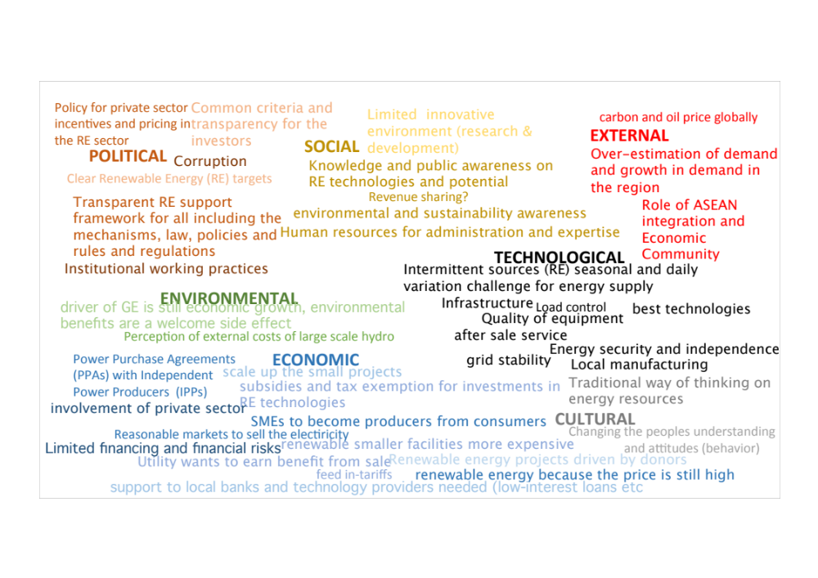
Group Exercise: Problem tree

Slide 111
Group Exercise: Objective tree (45 minutes)
Transform your focal problem into a project Objective
Define at least intermediate objectives to reach to the focal objective
Define key activities and inputs needed you to achieve the intermediate objectives
What are your long/medium/ short term outcomes and outputs?
What happens if you are able to reach to your project objective (overall objective, impact)

Slide 112
Summarizing findings (30 mins)
Present your work to other groups showing your intermediate problem and respective objectives, outcomes and outputs, activities and inputs
Present at least one long-term outcome/impact that you have a contribution to when reaching your core objective

Slide 113
Summary: Doing it right from the beginning
Planning (with involvement of stakeholders) and a clear RRF/LogFrame articulating the chain of results is the key to achieving outputs, outcomes, goals and impact
Outcome & and Outputs statements tell you what the success/achievement/result will look like and whether you reach your intended objectives YOU can’t develop indicators, targets and baselines without them
Indicators need baselines and targets, without them they are irrelevant

Slide 114
IF YOU CAN MEASURE IT ,
YOU CAN MANAGE IT
THANK YOU, ကျေးဇူးတင်ပါတယ် Je zu tin ba deh

Slide 115
Useful and Used References:
A Handbook on Results-Based Management for Sida Research Cooperation:
https://www.sida.se/globalassets/sida/eng/partners/research-cooperation/guidelines-for-partners/rbm-handbook.pdf
United Nations Development Group Results-Based Management Handbook, 2010 available at: http://www.undg.org/docs/12316/UNDG-RBM%20Handbook-2012.pdf
UNDP Handbook on Planning, Monitoring and Evaluating for Development Results, 2009, available at: http://web.undp.org/evaluation/handbook/documents/english/pme-handbook.pdf
A guide to Results-Based Management (RBM), efficient project planning with the aid of the Logical Framework Approach (LFA):
https://www.sida.se/contentassets/9d257b83f4124113a324c61715150722/21920.pdf
Results Based Management
(RBM) in Finland’s Development Cooperation – Concepts and Guiding Principles:
https://um.fi/documents/35732/48132/results_based_management__rbm__in_finland_s_development_cooperation

Slide 116
Group 4 Exercise: Problem tree
Number of seminars per year
Percepcion of alumni of their current work
Number of submitted papers
INDICATORS
Students feedback
Energy education in HEIs does meet future energy sector needs in Myanmar
Alumni are satisfied with job opportunities and they meet the national needs
INTERMEDIATE OBJECTIVE
More skillful students and staff
Workshops for staff and students by ministries and other experts
Qualified research
Training on current challenges
Use of updated teaching methodology
ACTIVITIES
Fieldtrips
Lab experiments
INPUTS
Funding
Internet access
Skillful staff and labs assistants
Infrastructure
Reference book/course materials

Slide 117
Group 5 Exercise: Problem tree
Percentage of new courses that support research work
Level and number of modern software and technology in use
INDICATORS
Energy education in HEIs does meet future energy sector needs in Myanmar
INTERMEDIATE OBJECTIVE
Knowledge of energy sector policies and regulations in education
Increase awareness of energy education in all sector
To apply modern technology in education and R&D
Capacity building in HEIs on RE technologies
Practical training and fieldwork for BE students
Update the curricula
ACTIVITIES
R & D courses for post grads
Collaboration with stakeholders
INPUTS
Students participation
Coordination
Lab facilities
Skillful teachers
Support from administration

