Slide 1

Vision of the power system in 2035
PhD Jenni Rekola
Tampere University of Technology
Finland
jenni.rekola@tut.fi

Slide 2
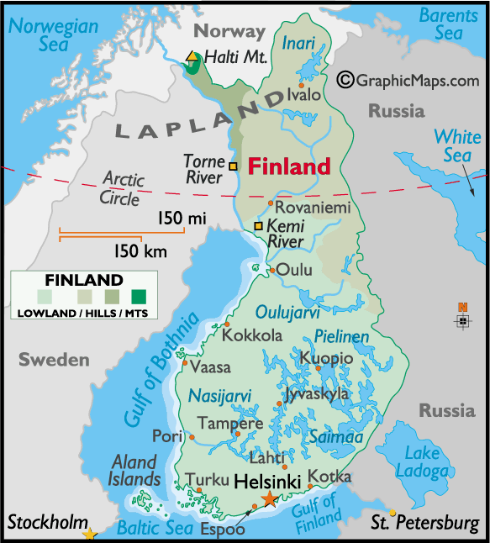


Established in 1965
7900 students and 1600 employees, including 1700 international students + employees from 80 countries
Research combines natural sciences, fields of engineering and business to strengthen export industry of Finland
Key research areas
Digital operating environment
Energy- and eco-efficiency
Health technology
Light-based technologies
www.tut.fi/en

Slide 3
Target of the training
The objective of the training is to create a vision of the future power system in Laos.
The conventional power system will change toward the so-called Smart Grid due to increased amount of renewable power generation, electric vehicles, improved ICT devices etc.
People are more dependent on uninterrupted power supply. However, due to climate change the difficult weather conditions increase, e.g. strong storms and raining which cause problems to the reliable electric power supply.
One solution might be the island operation of the grid and so called microgrids.
The attendees discuss about the possibilities and challenges of the future power system. Finally, they will create the own vision about the future power system in Laos.

Slide 4
Agenda: Day 1
Time | Topic
9.00-9.45 | Introduction Discussion and description of the present power system in Laos, main strengths and challenges
9.45-10 | Coffee break
10-12 | Changes in the future power system Change in power production: use of renewable energy Possibility to use energy storages (battery, water storage) Change in power consumption: increased amount of electric home devices, electric vehicles. Energy use in industry? Automation, remote control Climate change: stronger wind and raining Urbanization
12-13 | Lunch
13-15 | Discussions in groups about the future power system in Laos
15-15.15 | Coffee break
15.15-17 | Presentation of the group works and discussions

Slide 5
Introduction

Slide 6
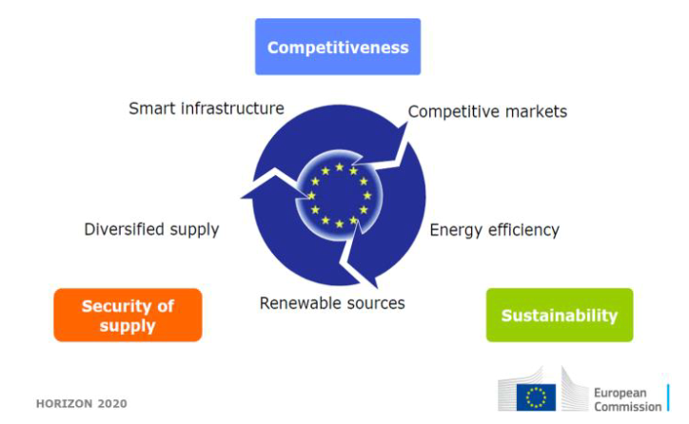
Global changes, which affect to power system

Slide 7
Global changes, which affect to power system
Urbanization
Climate change -> changes in weather and need to use renewable energy
Increased amount of electronic loads -> need of high power quality
Need to improve energy efficiency
People are dependent on uninterruptable power supply
Customer will be active part of energy business (or automation controls activity)
International regulation
New business models and service business related to renewable energy
Digitalization, automation, remote control, cyber security
Security, safety, energy self-sufficiency
Energy storages (battery, water storage)
Electric vehicles
Bio fuels
Power electronics as a part of power system
New protection devices and protection methods
Notes:
Analog and digital circuits in mobile applications require low-power DC-DC converters
Laptop chargers are typically 100 W
Electrical drives vary from 0.55 kW to 160 kW
Power transmission systems include high-voltage dc-links which utilize modern high-power converters

Slide 8
Global changes, which affect to power system
Increase of renewable energy -> solar and wind power depends on weather, not possible to control -> power balance -> grid stability?
Business models, services, regulation
Small-scale renewable energy, demand response, energy storages, customer interface
Import and export of electric energy
Varying power production -> energy storages and demand response
Energy market models
Frequency control, energy reserve markets
Nordic energy market -> European energy market -> Asian energy market?
AMR measurement -> varying electricity price every hour
Micro-grids, island operation
Notes:
Analog and digital circuits in mobile applications require low-power DC-DC converters
Laptop chargers are typically 100 W
Electrical drives vary from 0.55 kW to 160 kW
Power transmission systems include high-voltage dc-links which utilize modern high-power converters

Slide 9
Discussion and description of the present power system in Laos, main strengths and challenges

Slide 10
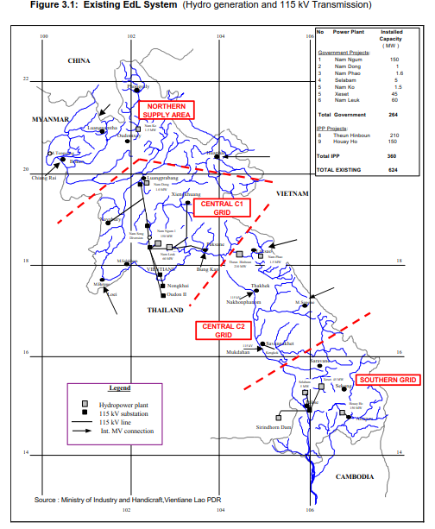
Grid structure
EDL operates the transmission and distribution network in the 3 regions of central, northern and southern Lao PDR.
The Central 1 and Central 2 regions were integrated into a single region in 2011
However, the three regions (115 kV systems) remain isolated from each other.
In addition to the main grid operated by EDL, provincial authorities operate some 85 mini grids that are supplied by diesel generators or small-scale hydro power stations in remote areas. These facilities primarily serve remote areas that are not yet part of the national grid.
OLD MAP

Slide 11
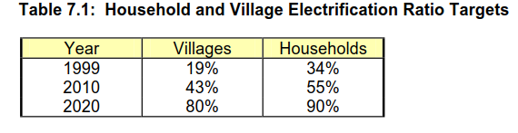
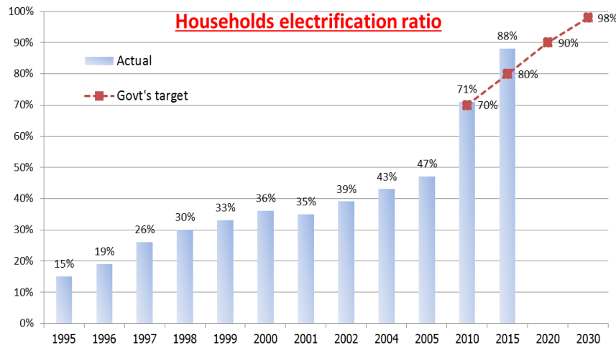
Fast electrification of all households
More than 92% of households now have electricity
Grid extension
Off-grid development: solar + village hydro/diesel mini grids, 150 000 household
A rational development plan is needed to guide development to the maximum advantage of the country, and to forecast the capital investment and revenue implications of this development.

Slide 12
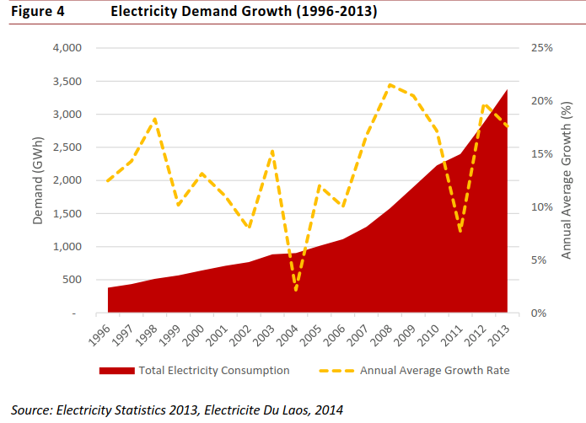
Electricity demand growth
Domestic demand has been growing rapidly. Annual electricity consumption increase 15%/year
Electricity consumption has been traditionally dominated by residential consumption, which made up 40%.
Industry consumption as at 2013 accounted for 33% of total electricity consumption, will increase in the future
Commercial sector 20 %

Slide 13
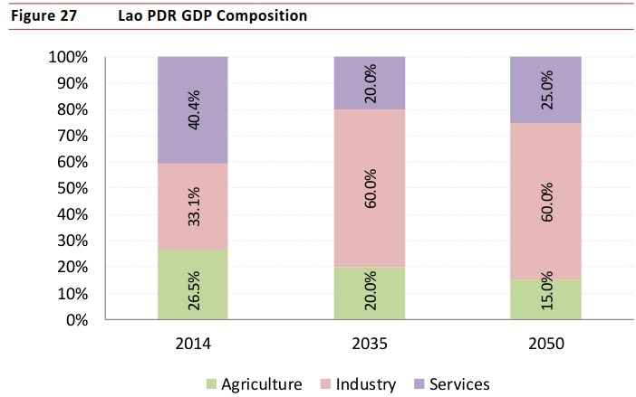
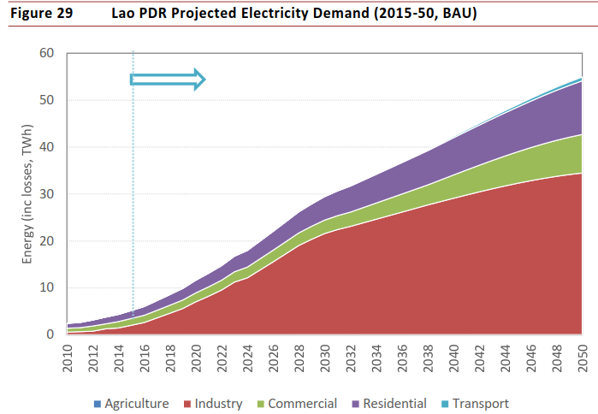

Slide 14
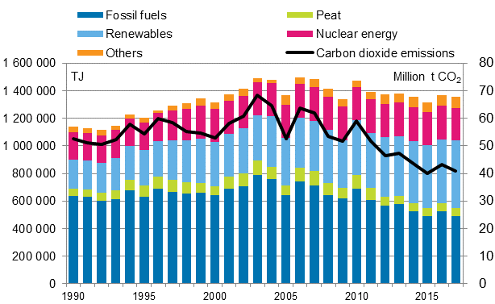
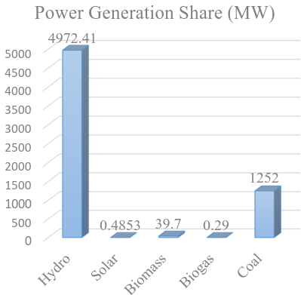
Power consumption and generation share in Laos and in Finland
Low electric power consumption 500 kWh/person/year in Laos compared to 15 250 kWh/person/year in Finland
High transmission and distribution power losses > 10% in Laos and 3-5 % in Finland
80%
20%
Finland
Laos

Slide 15
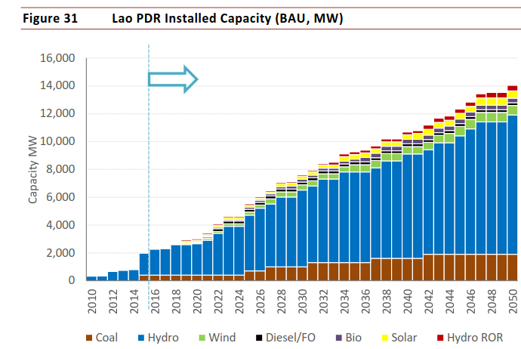

Slide 16
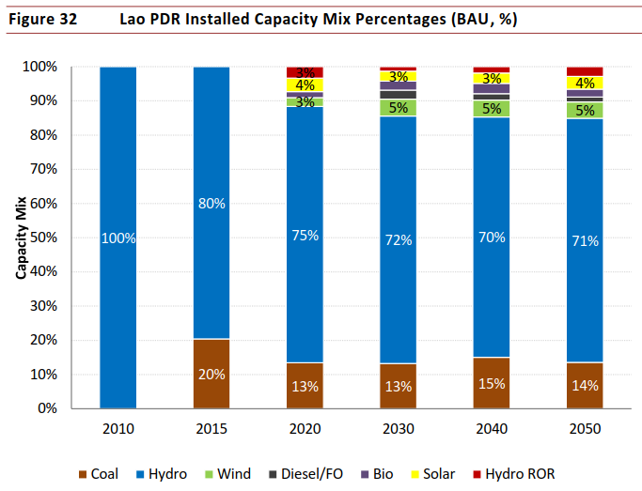

Slide 17
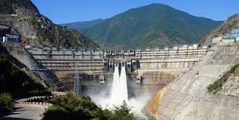
Export market of electrical energy
Increase of hydropower generation capacity
Cooperation between ASEAN/GMS countries is increasing, 500 kV international grid interconnections are planned, and in the longer term competitive markets may emerge.

Slide 18
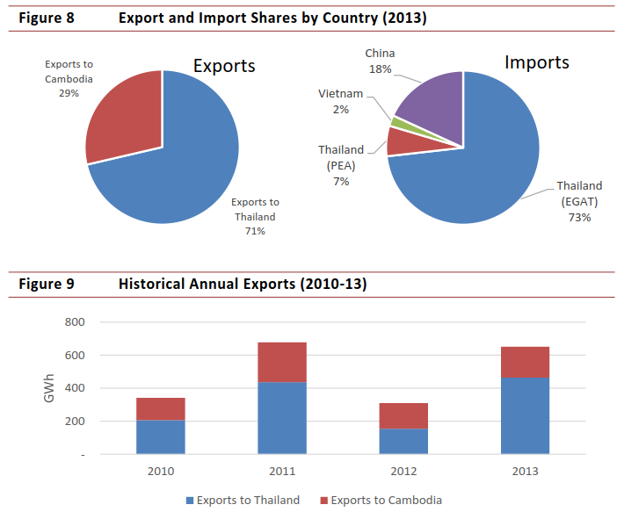
Export and import shares
Lao PDR exports a large amount of hydropower to Thailand, but in exchange imports electricity to supply provinces that are not connected to the national power grid.
These demand points include copper and gold mining operations, which consume significant amounts of power.
Lao PDR also has 4 interconnections with China, with capacity of 2,000 MW to ensure adequate power supplies in Luang Prabang and the Northern provinces.

Slide 19
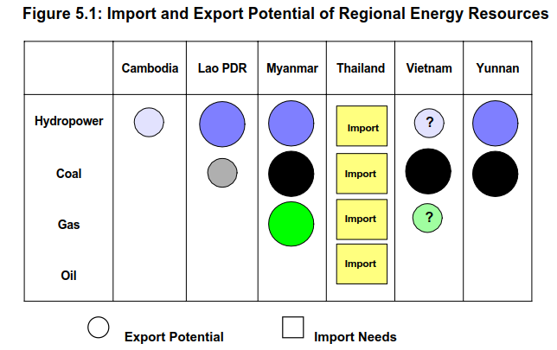
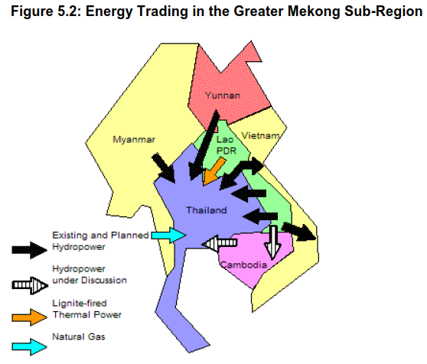
Imports of around one-third of its total electricity requirements and exported 690 GWh

Slide 20
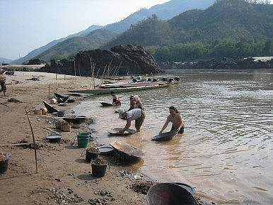
Export market of electrical energy
Electricity exports have also soared: most of Laos’ hydropower goes straight to neighboring countries.
This development comes with significant environmental and social risks
Dams can block the migrations of fish, alter a river’s flow and degrade wildlife habitat.
They can also introduce new risks to river communities; last year, for example, a dam broke along Laos’ Nam Ao River, unleashing a torrent of water that flooded seven villages and ruined acres of farmland.
The uncertainties and risks of the future – including those related to climate change. Changes in rainfall and extreme weather, for example, could pose a risk to Laos’ hydropower-dominated electricity system.

Slide 21
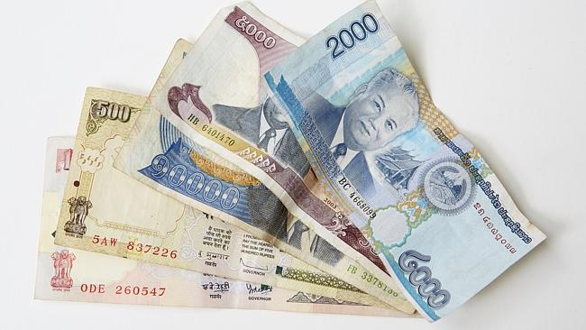
Energy market
Extent of private sector involvement and the private power procurement models
Setting of wholesale and retail tariffs in Lao PDR and neighboring countries.
In the longer term, establishment of a competitive power market within the region and the emergence of merchant plants.

Slide 22
Renewable energy
Target to increase a share of renewable energy to 30 % in the total energy mix by 2025
The potential role of energy resources beyond hydropower in the future?
Solar
Home solar systems 50-100 W
700 kW grid connected demonstration project by Japanese grant
500 MW solar farm under study, 100 MW solar and wind hybrid project
10 MW solar farm under construction
Wind
600 MW under negotiation for development in Sekong province (1st phase 250 MW)
3 additional projects under field investigation, target 2 000 – 3 0000 MW
Biomass
39 MW in operation, 20 MW under construction, target 1000-2500 MW
Biogas
10 000 kg/day to replace the LPG import, livestock farms

Slide 23
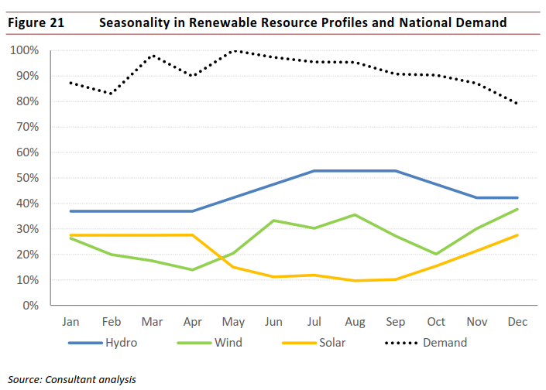
Seasonality in renewable resource profiles
There is some natural seasonal / monthly diversification between resources: demand in Lao PDR is highest peaking between March to May which coincides with reduction in wind speeds in Lao PDR.
The solar intensity drops towards the middle of the year and wind speeds and hydro inflows start to increase.
The greatest potential for solar lies in the central region of the country, covering the main load center of Vientiane.
The hydro inflows fall into reservoirs, some with significant amount of storage, which enables smoothing out generation throughout the year

Slide 24
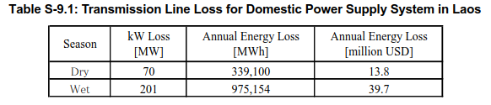
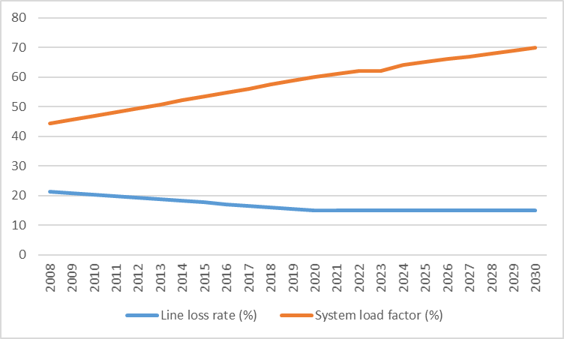
Transmission and distribution losses

Slide 25
Targets
Increase electrification ratio to 98 % by 2025
Increase energy efficiency, reduce 10 % of energy consumption in 2030
Increase energy export 12 000 MW by 2020: 7 000 MW to Thailand and 5 000 MW to Vietnam
Reserve coal for domestic use and power generation
Increase a share of other renewable energy to 30 % by 2025 (bio-fuel 10 %)
Ensure energy security, sustain socio-economic development and enhance environmental and societal sustainability
-> financial incentive for investors (subsidies)
-> develop and modify legal documents (laws, regulations, guidelines)
-> establish renewable energy fund
-> financial mechanism: import duty free on production machinery, equipment, raw materials

Slide 26
Challenges related to renewable energy
Lack of information on resources available and sustainability
Capacity building among technical level and community level about renewable energy
Geographic location, no access road during rainy season
Limited budget
Several renewable energy technologies have been tried in the Lao PDR, with varying experiences in terms of unit size, unit sourcing, scale of deployment, safety aspects, and ease of maintenance.
Imported pico hydropower systems (of up to 1 kW) have flourished, even though they are not entirely safe to operate and are difficult to maintain.
The common rule (Grid Code) applied to all the power system users is urgently required to be established that determines the technical requirements of connecting the EDL power system and the types of the information provided with the power system operator.

Slide 27
Challenges related to power system
The electric load has grown faster than eDl could upgrade its electrical system, resulting in frequent, prolonged power outages. A major cause of the problem was that the electrical system was not automated. The only way the operators could learn of outages was when they were reported by customers; they then had to send out crews to manually find and repair them, which made for longer outages and was an inefficient use of personnel.
Increase system reliability— ensure a continuous and stable electrical supply
Minimize prolonged power outages that cause economic loss to the country.
Modernize the system—use the latest automation technology to maintain a modern electrical grid for the future (SCADA DMS, re-closers and pole-mounted load break switches)
Allow for future system expansion
Ensure power quality
Limit economic cost
Maximize supply security—use the latest safety and security standards to maximize the security of supply.

Slide 28
Main changes in the power system
Notes:
Analog and digital circuits in mobile applications require low-power DC-DC converters
Laptop chargers are typically 100 W
Electrical drives vary from 0.55 kW to 160 kW
Power transmission systems include high-voltage dc-links which utilize modern high-power converters

Slide 29
Main changes in the power system
Change in power production: use of renewable energy
Possibility to use energy storages (battery, water storage)
Change in power consumption: increased amount of electric home devices, electric vehicles. Energy use in industry?
Automation, remote control
Climate change: stronger wind and raining
Urbanization
Increased amount of electronic loads -> need of high power quality
Notes:
Analog and digital circuits in mobile applications require low-power DC-DC converters
Laptop chargers are typically 100 W
Electrical drives vary from 0.55 kW to 160 kW
Power transmission systems include high-voltage dc-links which utilize modern high-power converters

Slide 30
Global changes, which affect to power system
Urbanization
Climate change -> changes in weather and need to use renewable energy
Energy self-sufficiency
Customer will be active part of energy business (or automation controls activity)
International regulation
Need to improve energy efficiency
New business models and service business related to renewable energy
Digitalization, cyber security
People are dependent on uninterruptable power supply
Security, safety
Energy storages
Electric vehicles
Bio fuels
Power electronics as a part of power system
New protection devices and protection methods
Microgrids

Slide 31
Global changes in power system
Decreased use of fossil fuels
Increase of renewable energy -> solar and wind power depends on weather, not possible to control -> power balance -> grid stability?
Automation, ICT, big data, digitalization
Business models, services, regulation
Small-scale renewable energy, demand response, energy storages, customer interface
Import and export of electric energy
Closing nuclear power plants
Varying power production -> energy storages and demand response
Energy market models
Frequency control, energy reserve markets
AMR measurement
-> varying electricity price every hour

Slide 32
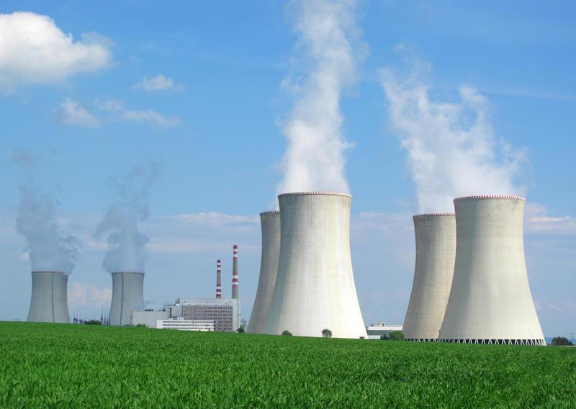
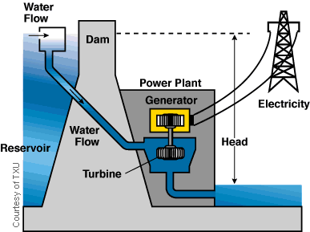
Conventional Power Generation
Mechanical or potential energy is transformed into electrical energy by using a synchronous generator
Frequency of the grid is determined by the synchronous generators
No power electronics is needed in conventional power generation
www.victoriaadvocate.com
www.luminant.com
Notes:
Conventionally electricity has been generated by synchronous generators which rotate at the grid frequency.
Mechanical or potential energy is transformed into electrical energy.
AC voltage can be stepped up or down with transformers.
Such grid can operate without power electronics.
However, the situation has become more complex.

Slide 33
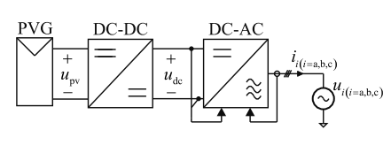
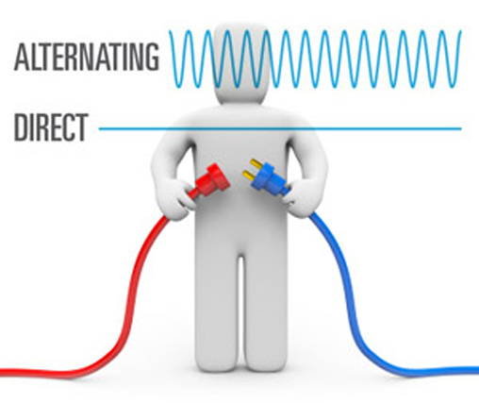
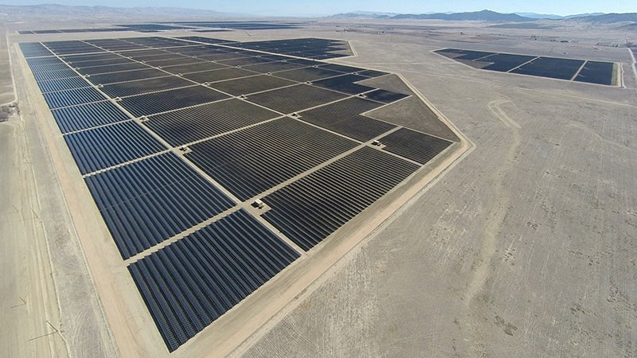
Renewable Power Generation
Power electronics is needed to interface renewable sources with the grid
Photovoltaic power plants produce DC current -> needs to convert to DC with correct amplitude by a DC/DC converter or AC by an inverter
www.abb.com
topazsolar.com
Notes:
Wind turbine rotates with a frequency that is independent of the grid frequency.
Power electronics is used to change the amplitude and frequency of the AC voltage.
Such a device is called a frequency converter.
Photovoltaic power plants produce DC electricity which has to be transformed into AC to be fed into the grid.

Slide 34
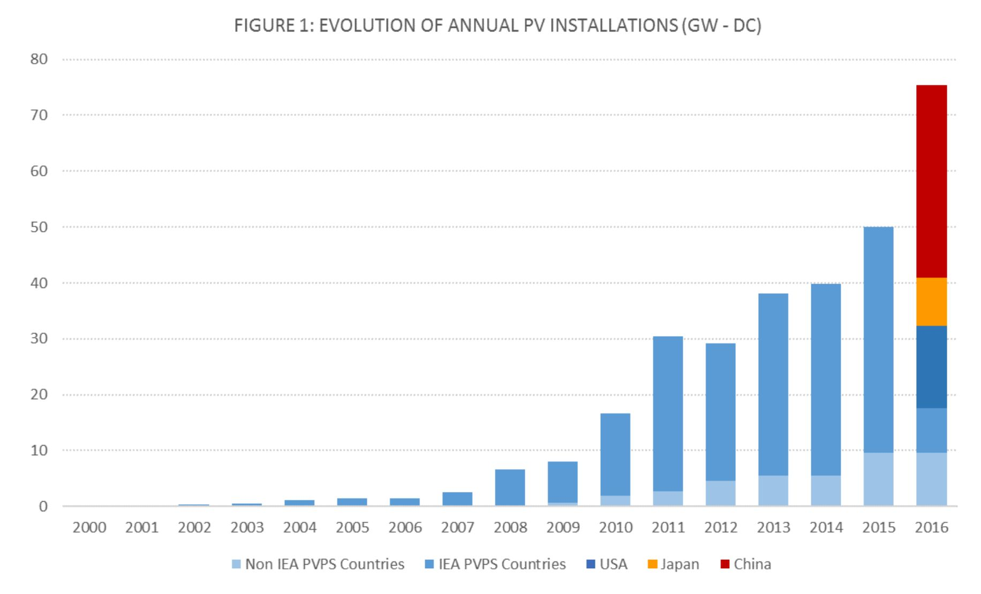
Renewable Power Generation
Varying output power, not possible to control
Multiple generators connected in series + parallel -> controllability, stability?
topazsolar.com
Notes:
Wind turbine rotates with a frequency that is independent of the grid frequency.
Power electronics is used to change the amplitude and frequency of the AC voltage.
Such a device is called a frequency converter.
Photovoltaic power plants produce DC electricity which has to be transformed into AC to be fed into the grid.

Slide 35
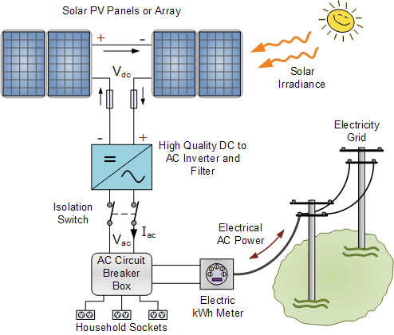
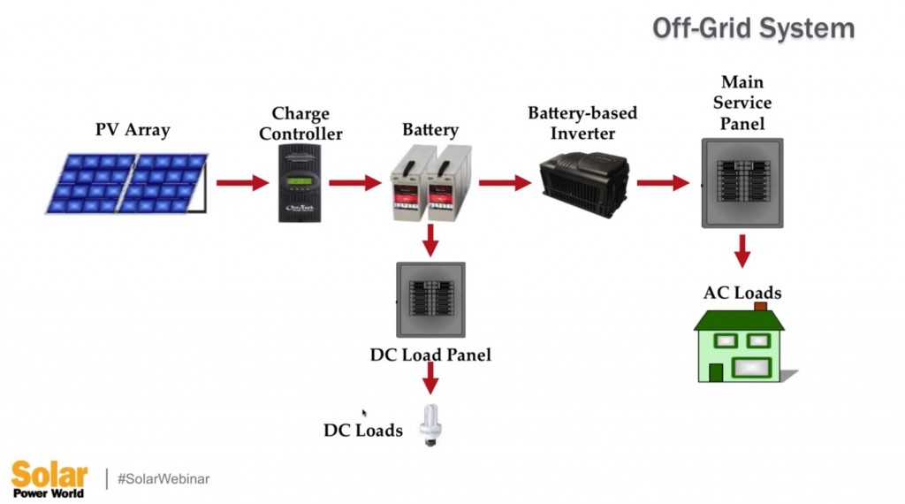
PV power plant concepts
1. PV panel supplying DC loads 2. Grid-connected PV power plant concepts
and/or battery

Slide 36
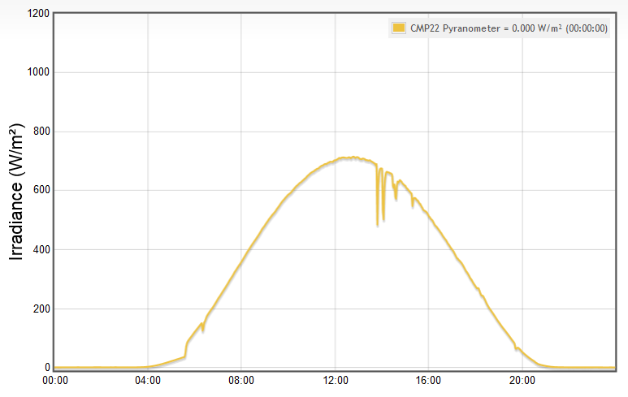
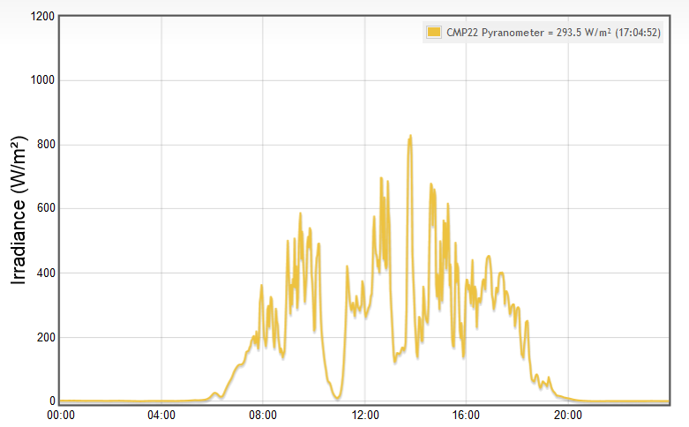
Battery storages
Energy output from renewables is not constant (clouds, shading by buildings etc)
The amount of available energy may be hard to predict
Excess energy can be stored in batteries using power electronic converters
Constant power output of a renewable energy source can be achieved
Irradiance at TUT in 5.8.2014.
Irradiance at TUT in 3.9.2014.

Slide 37
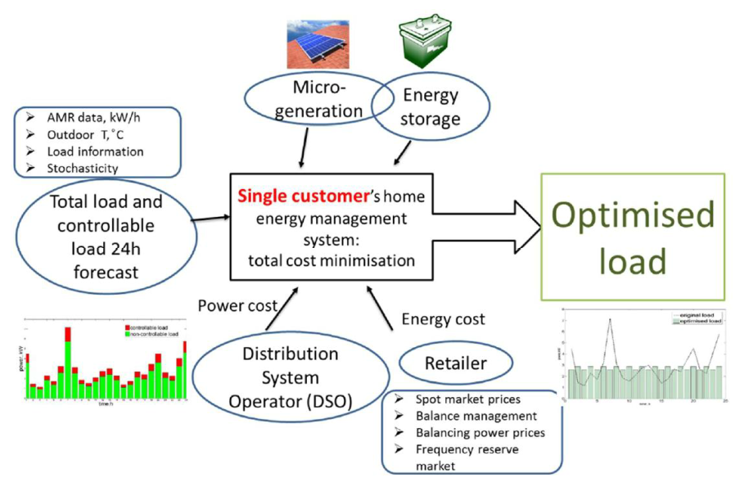
Change in load profile
Change in load profile: electric vehicles, heat pumps and renewable power production
Possibility to predict the load profile
Possibility to control the load profile (demand response)
Who controls the system? Customer, electricity supplier or someone else?

Slide 38
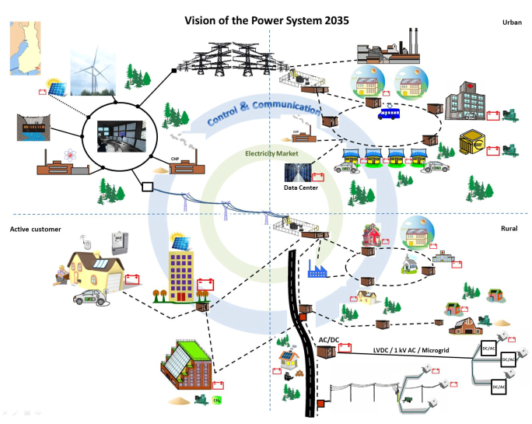

Slide 39
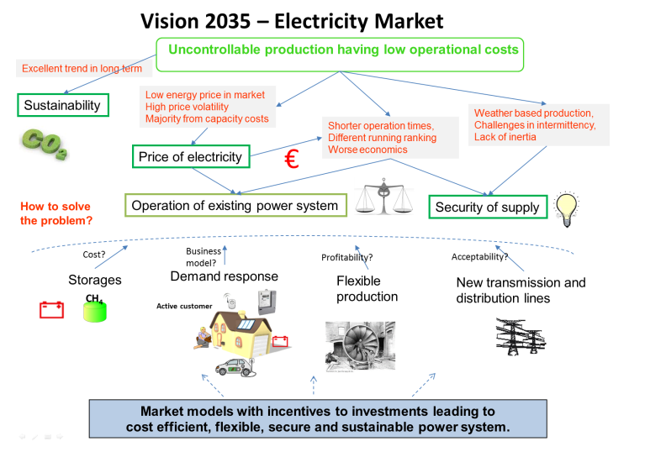

Slide 40
Vision -> roadmap
Vision about the future grid
Analyzing present grid
Compare to other countries
Future changes in operational environment
Future changes in technology
Future changes in business models and services
Evaluating alternatives
Roadmap toward the future grid
Defining the research and development projects
Co-ordination of the projects
Networking

Slide 41
Discuss in groups about the future power system in Laos
Group: mechanical and electrical engineering
Group: environmental engineering
Group: policy, regulation, management

