Slide 1

Vision of the power system in 2035
PhD Jenni Rekola
Tampere University of Technology
Finland
jenni.rekola@tut.fi

Slide 2
Agenda: Day 2
Time | Topic
9-10 | Recap of day 1 Tools for grid design
10-10.15 | Coffee break
10-12 | Discussion about power quality and reliability in the future power system
12-13 | Lunch
13-14 | Discussion about the electricity price Tariff models Regulation
14-14.15 | Coffee break
14.15-15 | Possibilities related to the future power grid How the curricula needs to be changed in the university? Research topics?
15-16 | Conclusion, discussion, comments and feedback

Slide 3
Recap of day 1 – Discussions

Slide 4
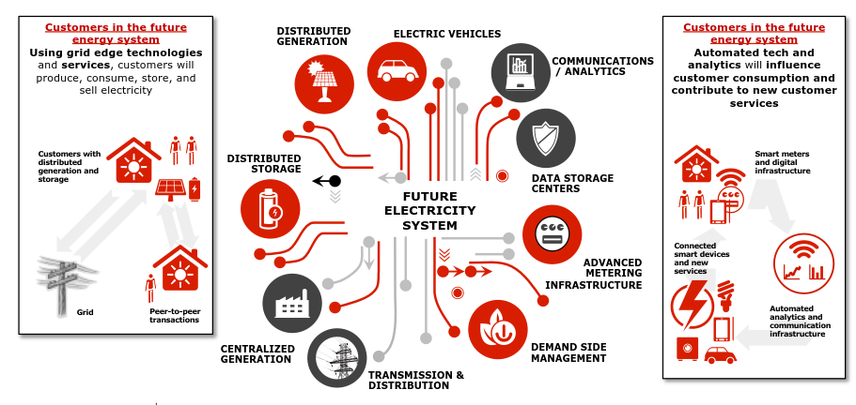

Slide 5
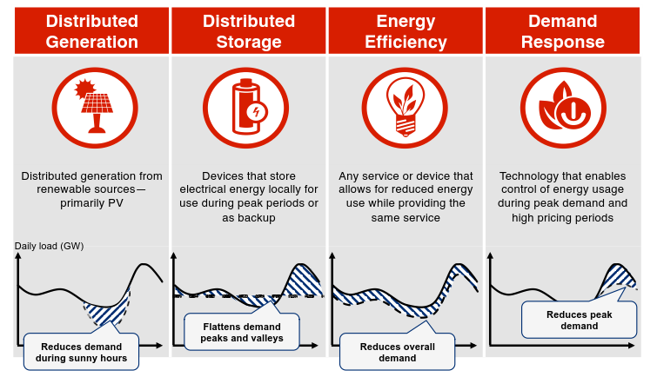

Slide 6
Tools for grid design

Slide 7
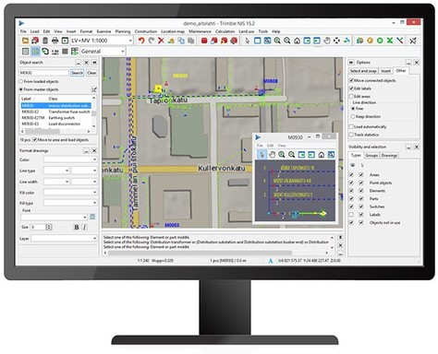

1. Design in electricity distribution company e.g. Trimble NIS
Provides geographically based network views
The customer information can be integrated
Used for grid design the electric grid, for property management, for handling grid investments and for maintenance
Dimensioning of transformers, cables etc.
Calculation of short-circuit levels and ground-fault current levels to design protection devices
The supposed components lifetimes are integrated into the model

Slide 8
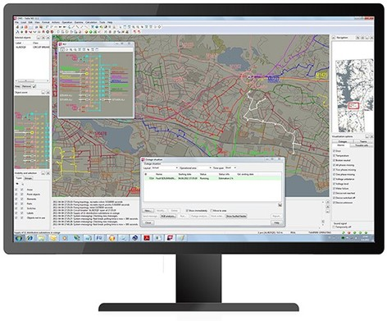
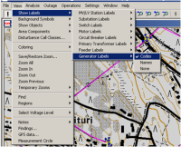

2. Use in electricity distribution company
DMS SCADA
Distribution Management System (DMS) integrated to supervisory control and data acquisition (SCADA)
Provides geographically based network views and distribution management functions over the entire distribution network -> remote control of substation automation and AMR-measurements
Assist the operation's personnel of electric companies in monitoring and operating their networks.
Strengthens control procedures, improves supply and customer service quality, and saves costs in network operation -> ensure safe network operation in outage situations (faults and maintenance)
The effects of distributed generation to voltage levels and relay protection can be analyzed
Smart meters can be used for outage management and power quality monitoring.

Slide 9
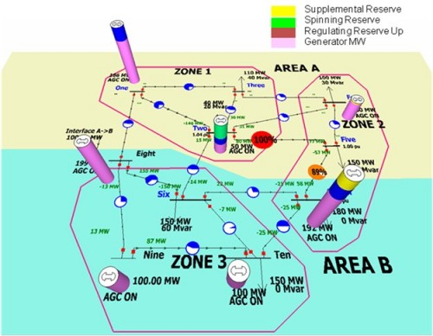
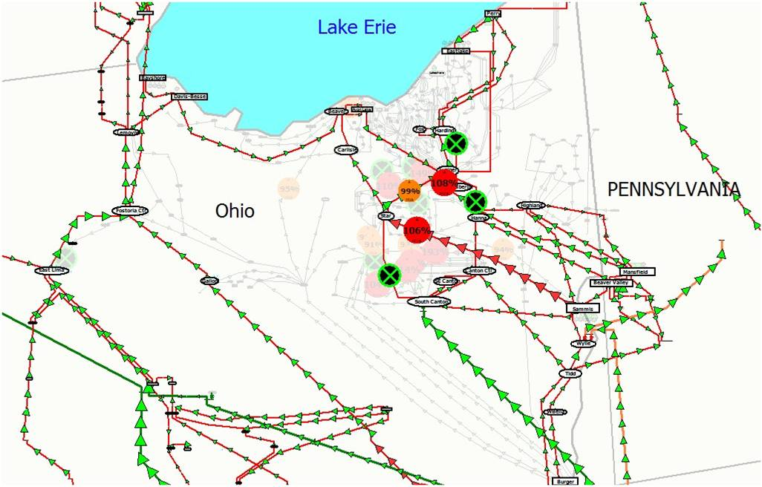
3. Use in research and planning of power systems
Power World
PowerWorld's products provide the tools needed by transmission planners, power marketers, system operators and trainers.
PowerWorld Transmission Line Parameter Calculator compute characteristic line parameters given the type of conductor and the tower configuration of a three-phase overhead transmission line. The parameters computed are the resistance R, reactance X, susceptance B, and conductance G.
The effects of distributed generation to voltage levels can be analyzed

Slide 10
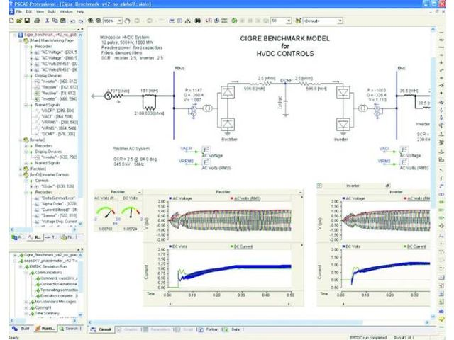
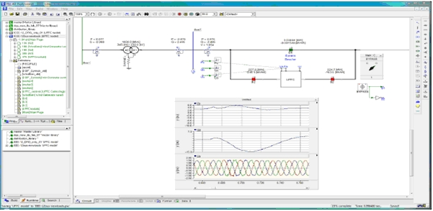
4. Use in research and planning of power systems
PSCAD
Ready-made, validated models for components of electric grid (synchronous generators, transformers, cables…)
Models of renewable power generation included
Calculation optimized to be fast and accurate for power system calculations

Slide 11
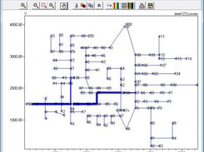
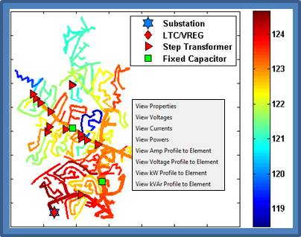
5. Use in research and planning of power systems
Open DSS
OpenDSS is extensively used for Quasi-Static Time Series studies, where the distribution system dynamics can be observed over any required time period.
This is especially important in the smart grid paradigm because power flow will change based on factors such as temperature and solar irradiation level. Additionally, the impact of slow controllers such as voltage regulators and fast inverter-based distributed grid ancillary services such as volt-VAr control will have a significant impact on the temporal variation of the system state.
Graphical user interface (OpenDSS-G).
https://www.facebook.com/events/237122813499171/
http://sites.ieee.org/pes-day-2018/pes-yp-cep-online-course/

Slide 12
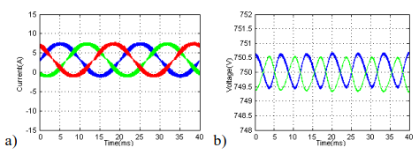
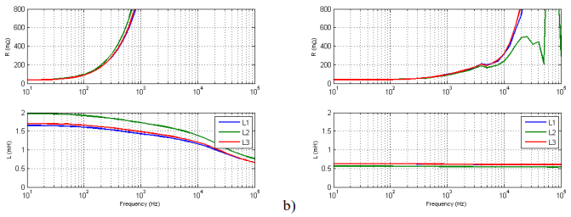
6. Use in research and design of Power Electronics
Matlab
Analyze in time and frequency domain
Able to simulate power electronics as well as control systems very accurately
The ready-made models for power system are not validated as in PSCAD
Calculation is not optimized for power system calculations. The user needs to have the knowledge about the correct solver-type and maximum calculation time step

Slide 13
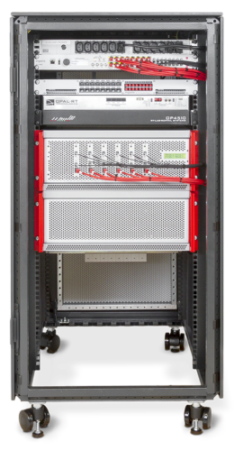
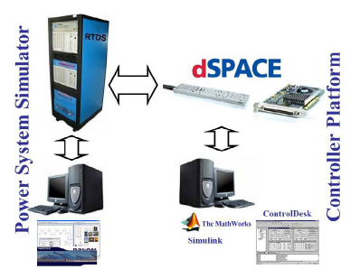
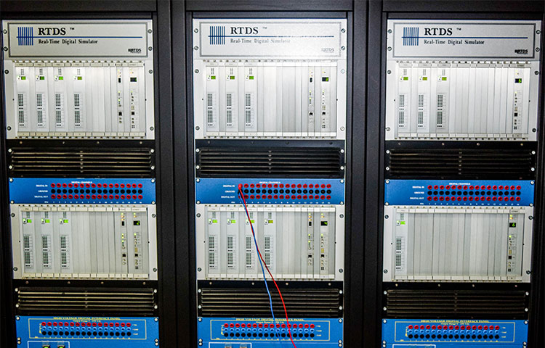
7. Use in combined research of Power Electronics and Power System
RTDS real time simulator and OPAL RT
The power system can be modeled in real time by using RTDS or Opal RT
The real hardware, e.g. relays can be connected to the system
The power electronics can be modeled in PSDAD (RSCAD with RTDS) or dSPACE/Typhoon HIL can be connected to the system

Slide 14
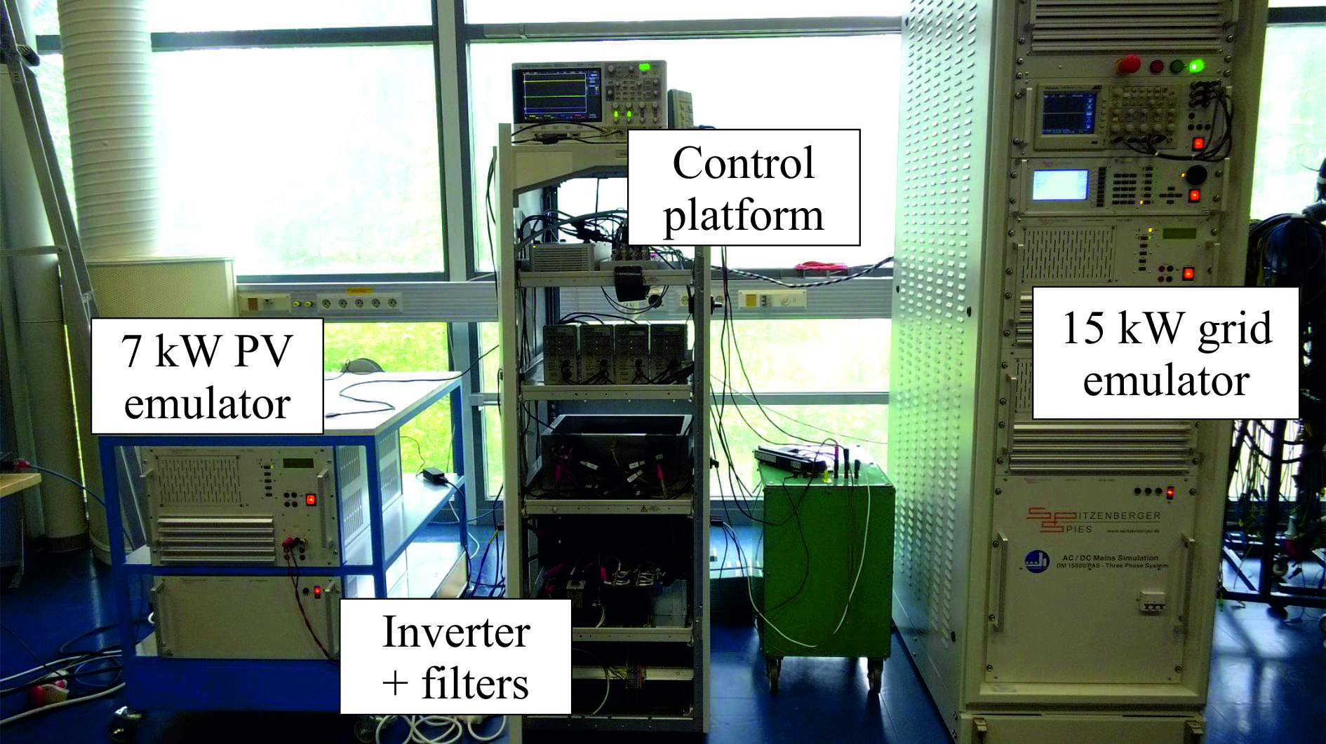
Example: Grid-Connected Inverter

Slide 15
Discussion about power quality in the future power system

Slide 16
The subject of power quality
The subject of power quality is very broad. It covers all aspects of power system engineering from transmission and distribution level analyses to end-user problems.
Deviations in voltage, current, frequency, temperature, force, and torque of particular supply systems and their components.
Good power quality = maintain sinusoidal waveform of power distribution bus voltages and currents at rated magnitude and frequency.
Note the difference between power quality and power system reliability (reliability of electric power supply)
Reason to increased power quality problems
the increased use of power electronic components within the distribution system
Increased renewable power generation
Open electricity markets, not local production and consumption
Increased use of microprocessors etc. which are sensitive to power quality

Slide 17
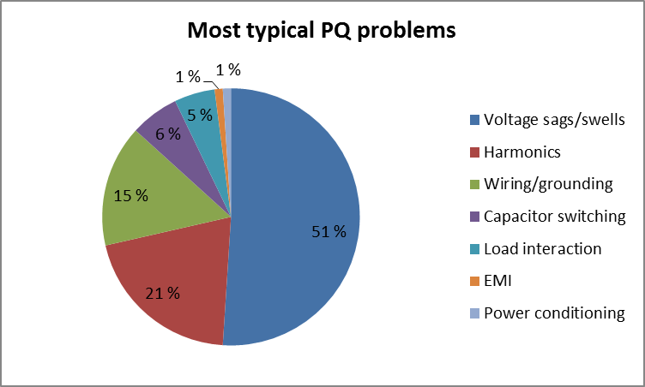
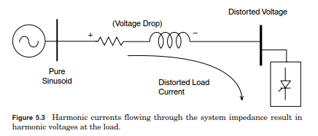
Reasons of poor power quality – an overview
Natural pollution (60%): lightening, flashover, equipment failure, and faults
Forced pollution (40%): voltage distortions and notches
Harmonic currents along with the grid impedances cause harmonic voltages
-> Non-sinusoidal voltage: extra heating, misoperation of other devices, early aging of the devices, extra losses
Andreas Ebernhard: Power Quality, 2011

Slide 18
Power quality concerns
Power quality
Grounding and
bonding
Power frequency
disturbances
Power
factor
Electromagnetic
interference
Power system
transients
Electro static
discharge
Power system
harmonics
Power flow
control
Voltage flicker
Load balancing
Voltage regulation

Slide 19
The subject of power quality
Voltage stability refers to the ability of a power system to maintain steady voltages at all buses in the system after being subjected to a disturbance from a given initial operating condition. It depends on the ability to maintain/restore equilibrium between load demand and load supply from the power system. Instability that may result occurs in the form of a progressive fall or rise of voltages of some buses.
Frequency stability refers to the ability of a power system to maintain steady frequency following a severe system upset resulting in a significant imbalance between generation and load. It depends on the ability to maintain/restore equilibrium between system generation and load, with minimum unintentional loss of load. Instability that may result occurs in the form of sustained frequency swings leading to tripping of generating units and/or loads.

Slide 20
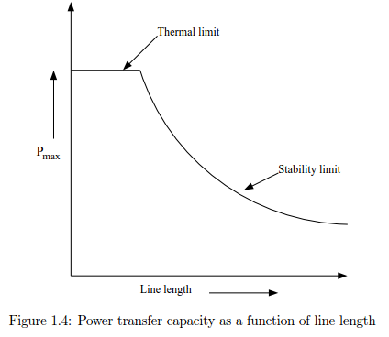
Challenges in today’s power grids
The construction of new power lines is very expensive, time-consuming and often complicated by legal and land proprietary issues.
-> FACTS devices are used to increase the controllability and transfer capacity of the power system by controlling power ﬂows and improving the stability
The factors which limit the line loadability of a power line:
1. Thermal limits, the limiting factor for lines up to about 80 km.
2. Voltage limits, the limiting factor for lines between approximately 80 km and 320 km.
3. Stability limits, the limiting factor for lines longer than about 320 km.

Slide 21
Renewable energy production connected to distribution network
The integration of renewable electricity production in the grid is the main new challenge for many network operators, at distribution as well as at transmission level
Connecting limited amounts of renewables improves the grid performance as the production compensates for the consumption and in that way reduces the actual loading of the grid.
Challenges
The injection of active power will reduce the voltage drop and may result in an overvoltage especially in rural networks
The grid can become overloaded when the amount of local generation becomes bigger than the sum of maximum and minimum consumption especially in rural areas with low consumption.
Uncontrolled island operation becomes a possibility. After the disconnection of a feeder (due to a fault or for maintenance purposes), the generators connected to the feeder may be able to supply the local consumption.
The protection coordination can be endangered.
Distributed generation could result in an increase of the harmonic levels.

Slide 22
Renewable energy production connected to transmission network
Compared to distribution networks, the integration of renewable electricity production in transmission networks is easier because the transmission network is built for having production connected
HVAC or HVDC transmission grids?
Challenges
The transmission system has high reliability requirements compared to distribution network
New production units -> new power ﬂows that can result in an overload or insufﬁcient operating reserves (uncertainty)
Large renewable electricity production units are often located in less-populated parts of the country where the transmission grid is weak -> the power-system stability?
Fault-ride-through: the ability of production units to remain connected and support the grid during large disturbances associated with serious drops in voltage or frequency.

Slide 23
Renewable energy production – solutions
Add more primary components to the network: lines, cables, transformers and substations.
Shunt and series compensation along the feeder
Line voltage drop compensation on the transformer tap-changer, and automatic tap-changers for distribution transformers.
SVC or STATCOM connected in PCC of wind-farm
Passive compensation (passive filters to limit harmonics, shunt reactors to limit voltage rise)
3. Protection coordination: directional protection, distance protection and anti-islanding protection
4. Improved control of renewable energy production itself!
Source: Math H.J. Bollen, The Smart Grid, Adapting the Power System to New Challenges

Slide 24
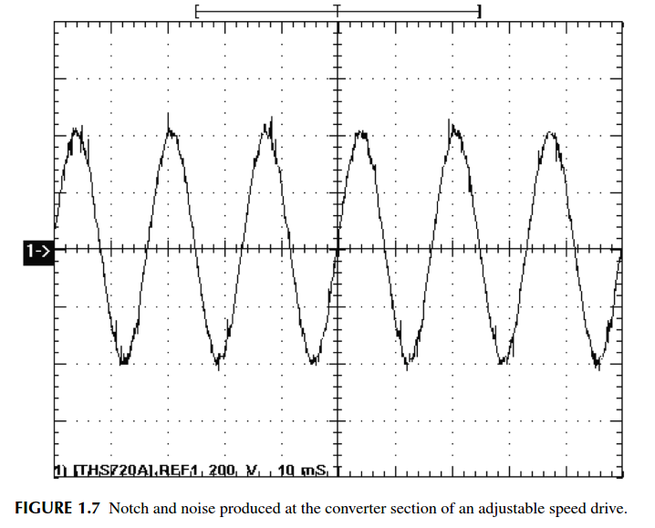
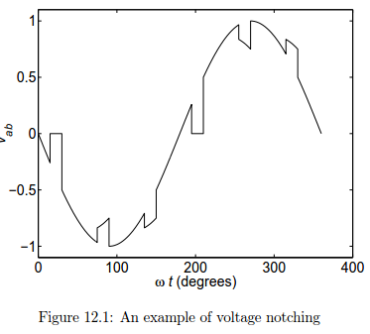
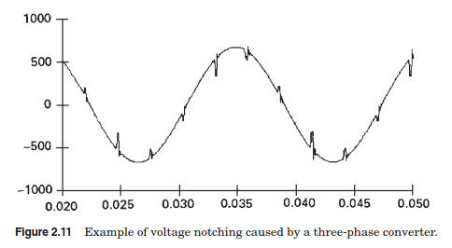
Waveform distortion: Notching and noise, harmonics
Caused by power electronic converters, arcing equipment (arc furnaces and welding equipment), improper customer wiring or grounding.
Depends on impedance, stronger in weak grid
Cause damage to capacitive components and disturbances to appliances. Increase rms value of the supply current -> increased power losses. Resonance (series/parallel) -> over voltage and overcurrent -> overcurrent protection. Poor power factor -> increased power losses
Solutions: grounding and shielding, neutral wire size, filtering
Source: Dugan: Electrical power systems quality

Slide 25
Waveform distortion: Harmonics
Defined by THD and TDD (IEEE Std 519-1992)
According to International standard IEEE Std 519-2014 and GB/TI 14595-93 (China) the voltage THD < 5% and current THD < 5-20 %
Main sources
Non-linear loads (e.g. adjustable speed drives, welders, UPS, computers and lighting), semiconductor based power supply systems (battery chargers, inverter fed AC drives, thyristor controlled reactors, AC regulators).
Magnetization nonlinearities of transformer (normal excitation -> 3rd harmonic, symmetrical over excitation i.e. core saturation -> 5th, 7th and 11th harmonic, inrush current harmonics (strart/stop) -> 2nd harmonic, DC magnetization -> odd and even harmonics)
Rotating machines (magnetic nonlinearities of the core material, non-uniform flux distribution in the air gap, slot harmonics, reluctance etc.)
Arcing devices (electric arc furnaces, discharge type lighting, arc welders)

Slide 26
Effects of harmonics on electrical components
Dugan et al.: Electrical power systems quality
Name of component | Effect of harmonics
Motor and generator | Increased core and copper losses (harmonic losses) -> need to be oversized 5-10% Pulsating or oscillating torque -> torsional oscillations and heating (power losses) Increased voltage stress of insulators Increased leakage flux Noise and vibrations (resonance) Negative sequence currents, especially rotor heating
Transformer | Increased core and copper losses (no-load losses, harmonic losses)-> need to be oversized 5-10% core vibration (resonance), noise Increased voltage stress of insulators Saturation
Protective devices (relays and breakers) | Mal-tripping, inaccurate metering
Capacitor | Increased reactive power, heating, resonance, overvoltage, reduced lifetime, overload
Cables | Increased skin and proximity effects –copper losses - heating Voltage drop, dielectric stress, corona Overheating of neutral conductors -> unbalance
Consumer equipment (sensitive loads) | Malfunctions, decreased lifetime and efficiency, visual flicker in display devices
Communication circuits | Noise, interference

Slide 27
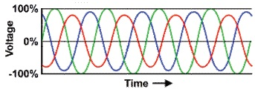
Problems caused by PV: Voltage unbalance
Caused by single-phase loads (domestic loads and lighting), single-phase power production (PV), overhead transmission lines that are not transposed and blown out fuse in one phase
Unbalance may cause
- unbalanced heating and oscillation of motor drives -> shortened life-cycle of devices
- excessive drawl of reactive power -> reduce the transmission efficiency, increase power loss and temperature of transformers etc.
- mal-operation of measuring instruments and other equipment
Solutions
Symmetrical connection of load/production
4-wire STATCOM/active power filter

Slide 28
Problems caused by PV: Long duration overvoltage
Increase in the rms ac voltage > 110 % at the power frequency > 1 min
Caused by increased amount of distributed power generation in weak grid, switching off a large load or switching on a large capacitor bank(capacitor energization), incorrect tap settings on transformer, fault on another phase, load rejection
Stress household appliances, computers, electronic controllers and motors
Solution:
tap-changer transformer
SVC
passive shunt-connected inductor to limit voltage increase

Slide 29
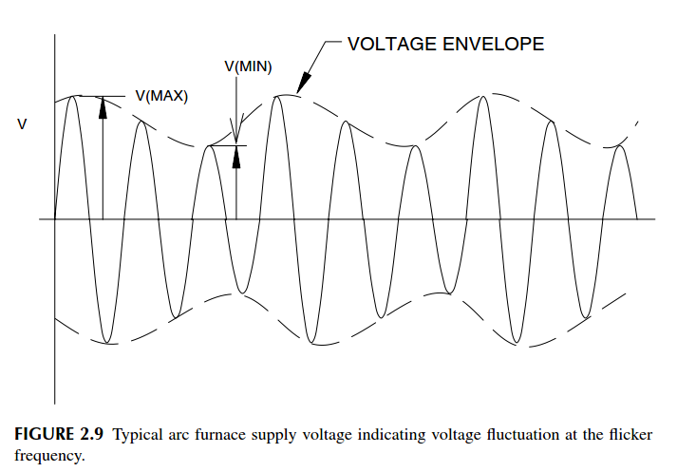
Problems caused by wind: Voltage fluctuation and flicker
Wind turbine (variable wind)-> rapid variations in load current can cause voltage variations i.e. flicker.
Caused by wind turbines, arc furnace, arc lamps, arcing welder and large load changes and other switching events
Cause protection malfunction and light intensity changes (disturb in lighting, TV and monitors), premature ageing, heating, malfunctioning of connected equipment
Cause problems to human health, irritation, headache, migraine
Solutions to power quality problems
Proper control of wind turbine
Filter
SVC or STATCOM
Stronger grid, bigger transformers

Slide 30
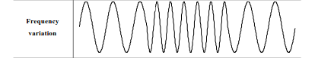
Problems caused by wind: Power frequency variations
The frequency depends on the balance between the load and the capacity of the available generation.
Can cause frequency or timing errors on power electronic devices that count zero crossings to derive frequency or time (PLL)
Can damage generator and turbine shafts

Slide 31
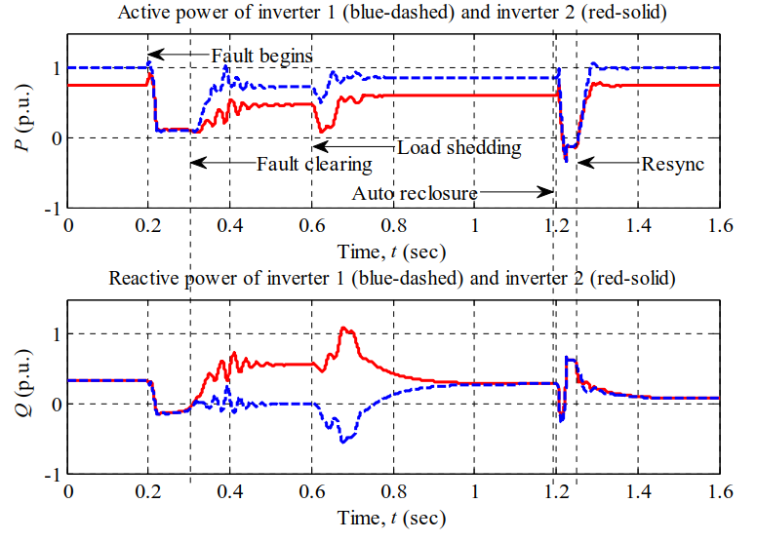
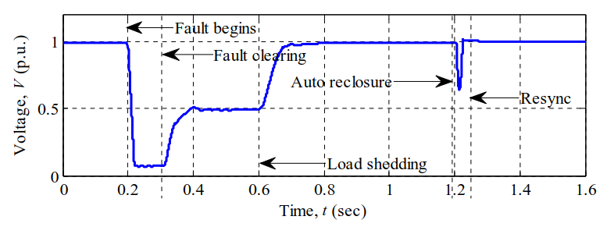
Change of power system caused by connection of renewable energy
Reactive power compensation - power factor control
Low voltage ride through requirements, grid control during interruptions based on Grid code
Island protection
Investment decisions: network extension and/or power compensation devices
Possibility to use hydropower as energy storage
Pros and cons of centralized/decentralized renewable power plants. What would be the good combination in grid stability point of view?

Slide 32
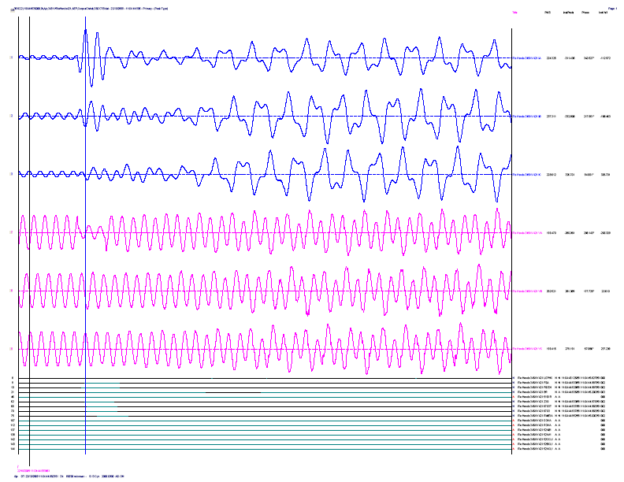
Examples of difficulties in connection of renewable power generation
1. “Harmonic resonance” in wind power plant
A single line to ground fault on an adjacent line caused a condition that placed two wind farms on a radial connection to a set of series capacitors.
The fault was recorded at the power converters of two 96 MW wind farms (345 kV). Fault was cleared in 2.5 cycles. 195 % over-voltages were experienced. Series capacitors were by-passed after 1.5 seconds.
Sub-synchronous currents were reported. Numerous failures to crow-bar circuits of wind farms were reported.
Series capacitors likely interacted with the wind farm controls
-> change in the control system of DFIG wind turbines
Belkin, P. (2010). Event of 10/22/09. CREZ TEchnical Conference, Electrical Reliability Council of Texas.

Slide 33
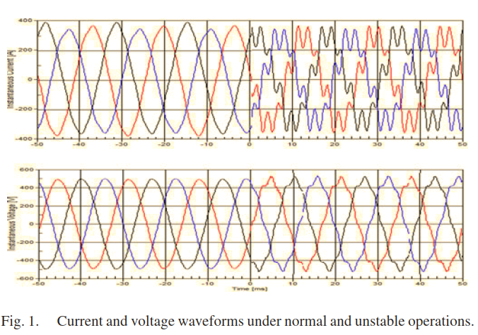
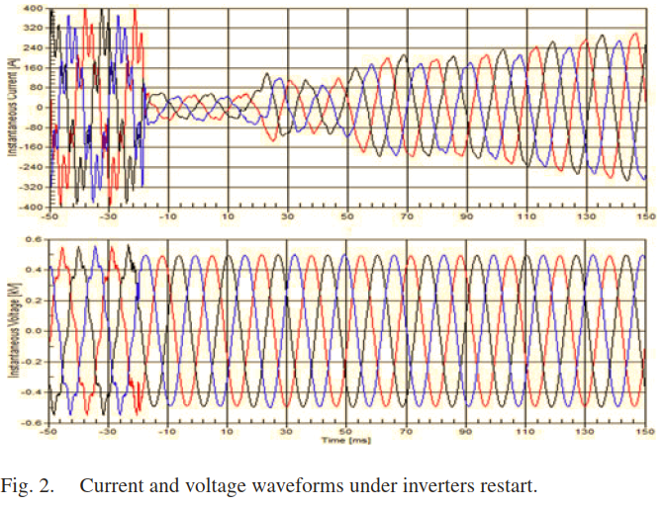
2. “Harmonic resonance” in photovoltaic plant
Excessive harmonic currents are reported in grid-connected PV plant in Canada, which leads to inverter disconnection from the grid.
30 parallel inverters connected to the grid using 600V/44kV step-up transformer. Seventh harmonic is amplified significantly.
Short-circuit ratio: SSC/Pnom > 200MVA/500kW = 400 -> Not a ”weak-grid” condition
Maybe caused by interaction between parallel-connected inverters?
The incidents were not caused by utility switching, outage or fault…
C. Li, "Unstable Operation of Photovoltaic Inverter from Field Experiences," in IEEE Transactions on Power Delivery, vol. 33, no. 2, pp. 1013-1015, 2018.

Slide 34
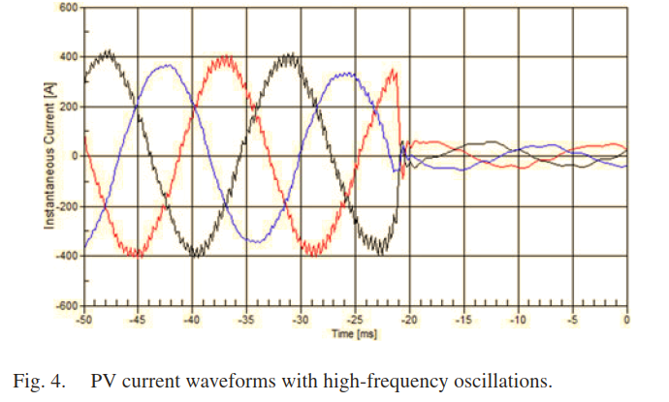
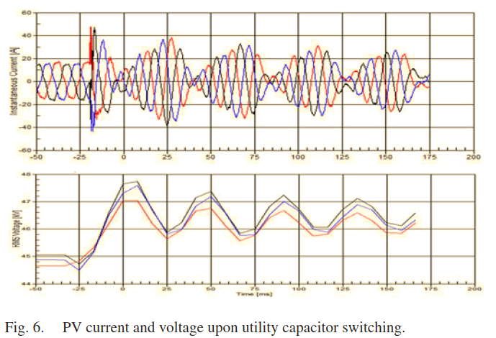
2. “Harmonic resonance” in photovoltaic plant
Both low and high-frequency oscillations were observed: 420 Hz, 780 Hz, 2370 Hz.
The high frequency problem vanishes after inverter restarts.
Weakly-damped subharmonics (20 Hz) were observed after a 30 MVAr/44 kV capacitor is energized at a substation.
C. Li, "Unstable Operation of Photovoltaic Inverter from Field Experiences," in IEEE Transactions on Power Delivery, vol. 33, no. 2, pp. 1013-1015, 2018.

Slide 35
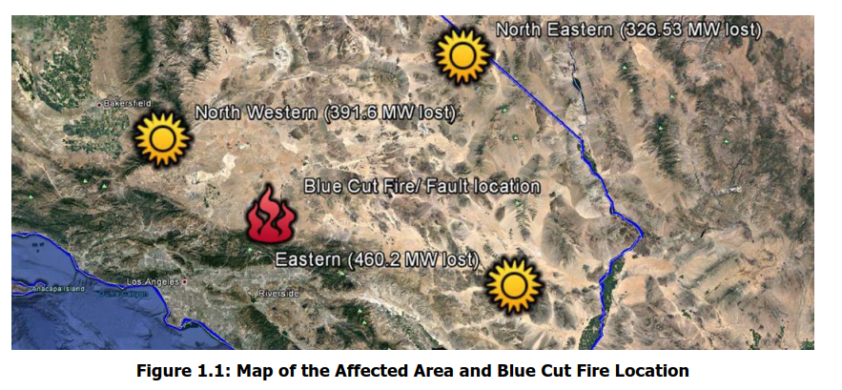
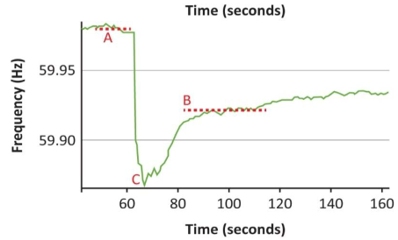
3. Loss of 1,200 MW generation capacity due to unwanted inverter disconnection
On August 16, 2016 wild fire broke out near three 500 kV lines. The fire caused 13 line faults. The most significant event was the unscheduled loss of 1,200 MW PV generation.
The frequency dropped down to 59.867 Hz and recovered after 420 seconds.
Technical Report, "1,200 MW Fault Induced Solar Photovoltaic Resource Interruption Disturbance Report,” North American Electric Reliability Corporation, June 2017.

Slide 36
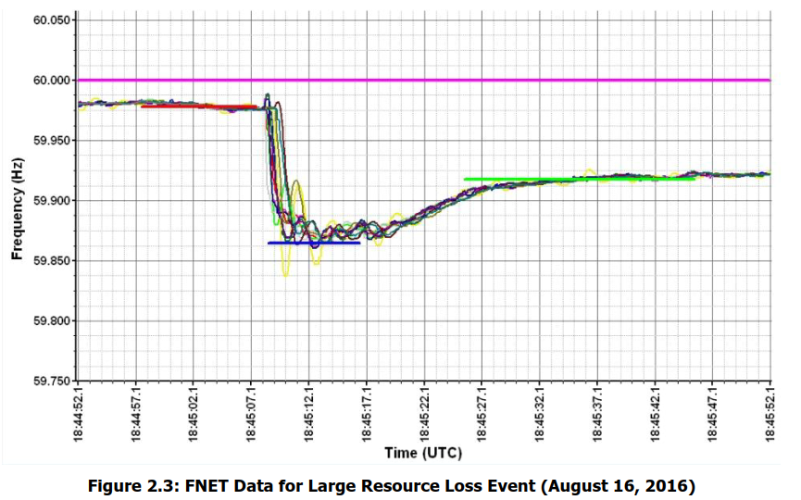
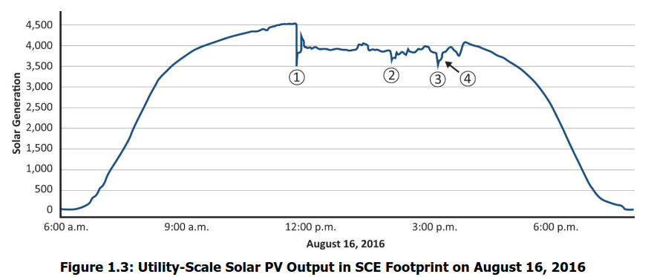
3. Loss of 1,200 MW generation capacity due to unwanted inverter disconnection
400 MW of PV generation did not return before the next day.
The recorded frequency did not go lower than 59.867 Hz. However, 700 MW of inverters disconnected, because their internal PLL detected frequencies below 57 Hz. The trip was instantaneous and there was no hold period programmed. This could have prevented the fault.
-> More accurate way to measure frequency using inverter than PLL (phase-locked-loop)
Technical Report, "1,200 MW Fault Induced Solar Photovoltaic Resource Interruption Disturbance Report,” North American Electric Reliability Corporation, June 2017.

Slide 37
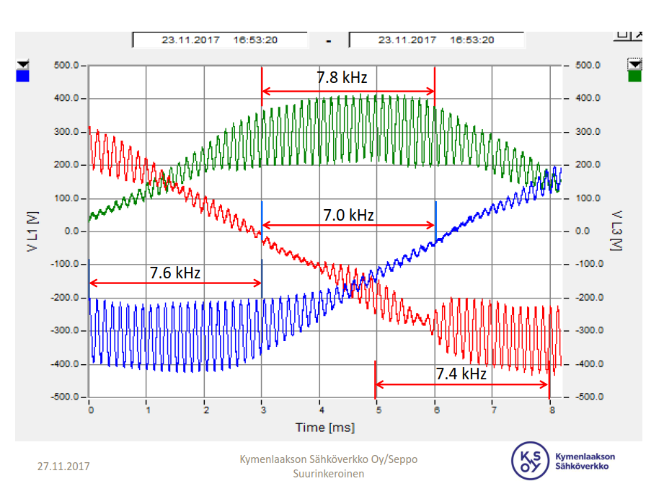
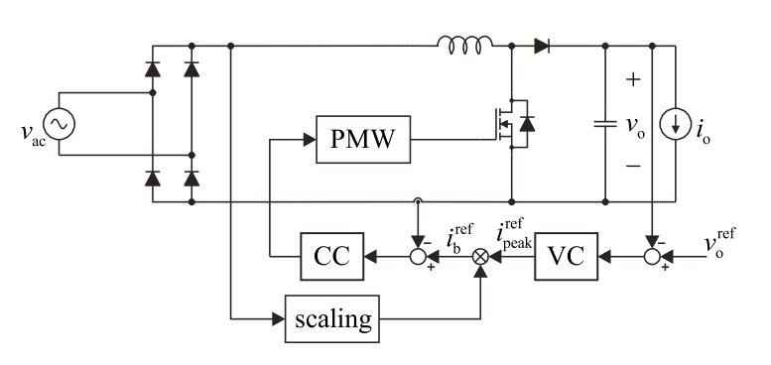
4. Sustained resonance in data-center due to non CE-marked single-phase converters
Multiple non-CE-marked single-phase rectifiers were installed to feed a data center, 2,4 kW each. Grid waveforms experienced sustained oscillation between 7 and 8 kHz.
The resonance was mitigated when lights of the facility were turned on. Apparently the lights have some input capacitance.
The converters are PFC-Boost AC-DC converters with isolated step-down output DC-DC converter
-> The input impedance of this topology is actually prone to series resonance!
J. Sun, ”Input Impedance Analysis of Single-Phase PFC Converters”, IEEE Transactions on Power Electronics, vol. 20, no. 2, pp. 308-314, 2005.

Slide 38
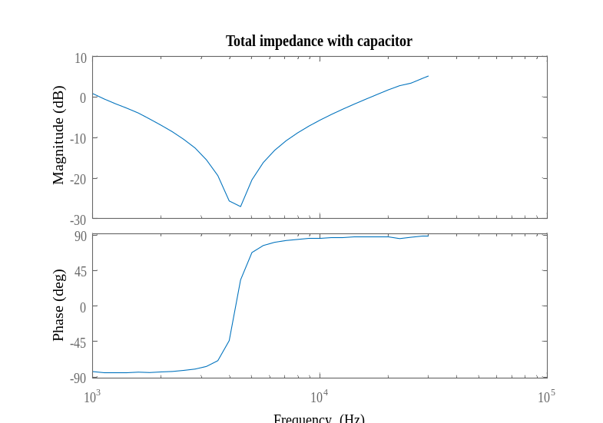
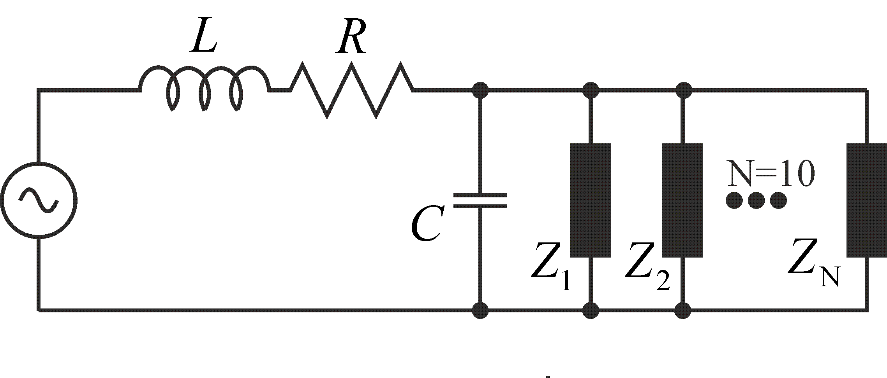
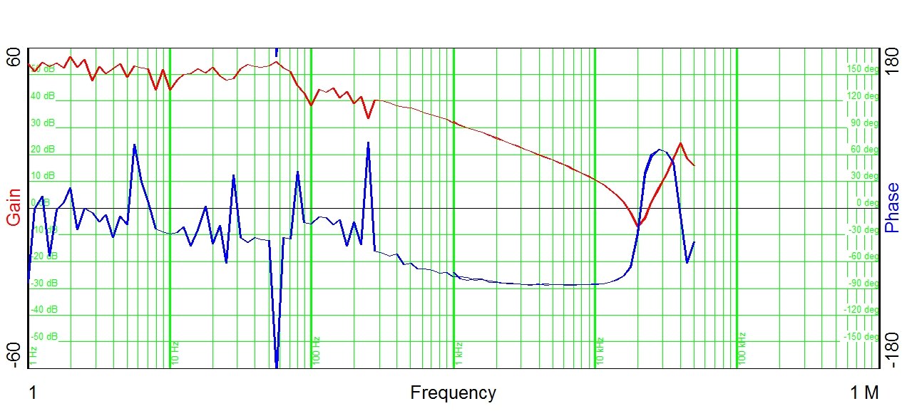
4. Sustained resonance in data-center due to non CE-marked single-phase converters
The input impedance of the converter was measured using frequency response analyzer. Results indicate series resonance at 20 kHz
The measured impedance was imported to MATLAB and 10 converters were assumed in parallel. Moreover, a line impedance L=10μH with X/R ratio of 10 was assumed as the grid impedance.
A parallel capacitor of 100 μF was added to approximate the effect of light units. The series resonance is shifted down to 5.5 kHz.
Measured input impedance.

Slide 39
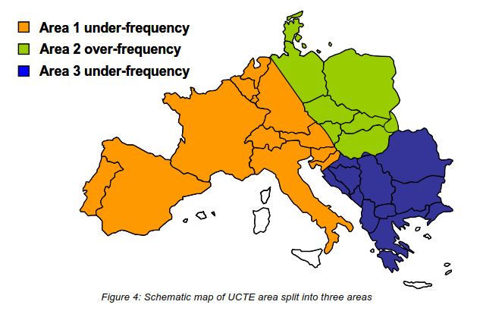
5. Blackout in Europe 4.11.2006
More than 15 million clients did not have access to electricity during about two hours.

Slide 40
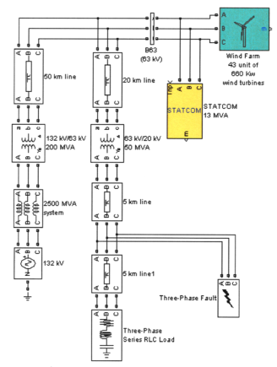
Grid codes
The grid code requires that the wind turbine system should stay connected with the grid and provide reactive power support under grid faults, which is also mentioned as the fault ride-through (FRT) requirement.
Frequency dependent active power supply
(active power control -> frequency control)
Voltage dependent reactive power injection/absorption
(reactive power control -> voltage control)

Slide 41
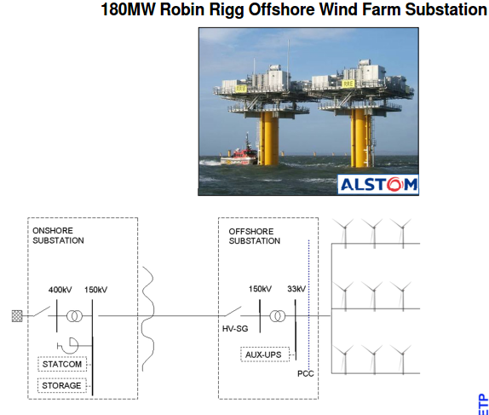
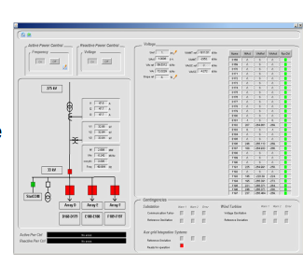
Grid requirements
Stability at grid faults
Power quality
Provision of inertia
(virtual inertia)

Slide 42
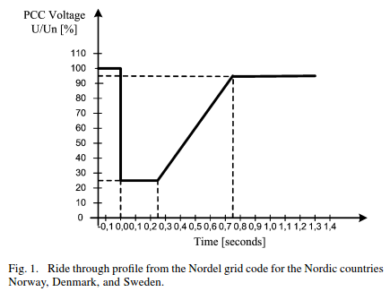
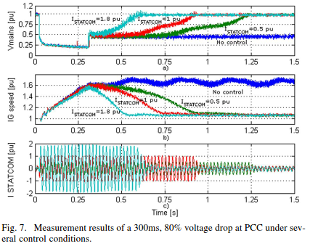
STATCOM with DFIG wind turbine
DFIG have limits in terms of achieving Grid Code compliance in several countries. The medium voltage STATCOM needs to be added to fulfill Grid Code, particularly the low voltage ride-through (LVRT) requirement.
The LVRT requirement basically demands that the windfarm remains connected to the grid for voltage dips as low as 5% retained voltage.
The compensating current of STATCOM does not depend on the voltage level of the PCC as with SVC. Thus the compensating current is not lowered as the voltage drops. STATCOM feeds capacitive reactive power into the network, increasing voltage at the PCC, so helping the DFIG to stay connected for as long as it takes to isolate the short circuit.
To help a DFIG ride through a fault event, over-load capability 10-20 seconds is crucial. An effective overload capability helps reduce the STATCOM’s installed power capability, which reduces its cost.

Slide 43
Reading
H. Akagi, E. H. Watanabe, M. Aredes: Instantaneous Power Theory and Applications to Power Conditioning, 379 pages, Wiley 2007
Bhim Singh, Ambrish Chanda, Kamal Al-Haddad: Power quality: Problems and Mitigation Techniques, Wiley, 2015, 596p.
R. Sastry Vedam and Mulukutla S. Sarma: Power quality – VAR compensation in power systems, CRC Press, 2008, 304p.
K.R Padiyar: FACTS controllers in power transmission and distribution, 2007
Narain G. Hingorani, Laszlo Gyugyi: Understanding FACTS: Concepts and technology of flexible AC transmission systems, Wiley- IEEE Press, 2000
Remus Teodorescu, Marco Liserre, Pedro Rodríguez: Grid converters for photovoltaic and wind power systems

Slide 44
Reading
A. Moreno-Munos: Power quality- Mitigation technologies in a distributed environment, Springer 2007, 438p. (basics)
Surajit Chattopadhyay, Madhuchhanda Mitra, Samarjit Sengupta: Electric power quality, Springer, 2011, 193p. (only about power quality, not compensation methods)
Mohammad A.S. Masoum and Ewald F. Fuchs: Power quality of power systems and electrical machines, 2nd edition
Xiao-Ping Zhang, Christian Rehtanz, Bikash Pal: Flexible AC transmission systems: Modeling and control, Springer, 2012, 569p. (Acha’s course)
C. Sankaran: Power quality
Chi-Seng Lam and Man-Chung Wong, Design and control of hybrid active power filters, Springer 2014, 168p. (difficult, e-library)
Roger C. Dugan, Surya Santoso, Mark McGranaghan, Mark F. McGranaghan, H. Beaty, H. Wayne Beaty: Electrical Power Systems Quality, 2002
Barry Kennedy: Power quality primer

Slide 45
Discussion about the electricity price
Tariff models
Regulation

Slide 46
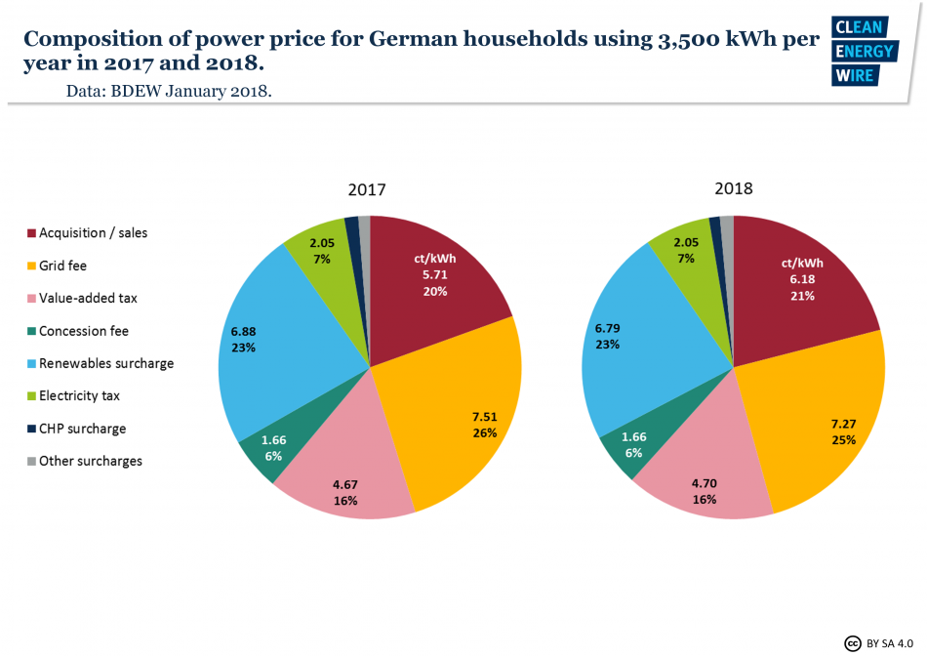
Tariff models
Renewable energy surcharge (23.1 %)
Pays the state-guaranteed price for renewable energy to producers.
Offshore liability levy (0.1 %)
Grid operators must pay damages if they fail to connect offshore wind farms in a timely manner in order to sell the power they produce.
Surcharge for combined heat and power plants (1.2 %)
Operators of CHP plants receive a guaranteed price on the electricity they sell.

Slide 47
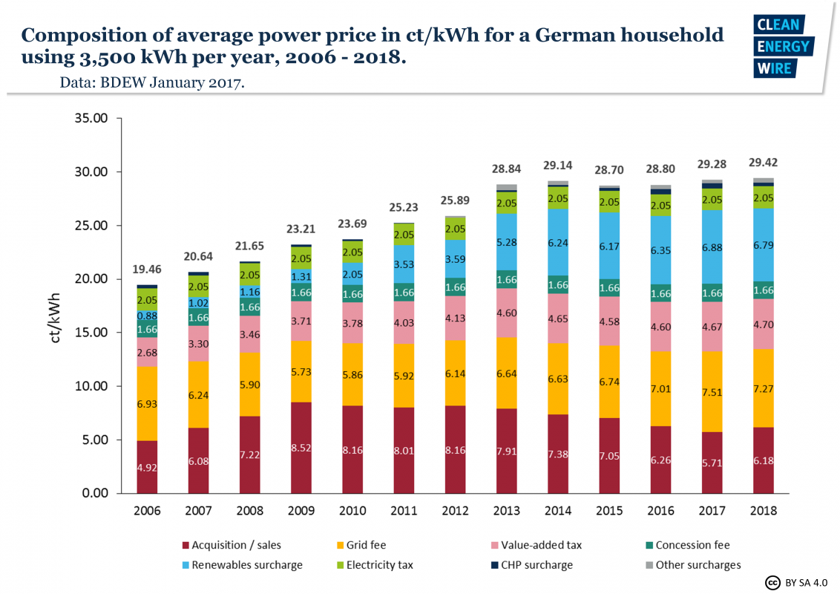

Slide 48


Slide 49


Slide 50


Slide 51


Slide 52
Technical challenges related to the future power grid
How the curricula needs to be changed in the university?
What research topics are interesting?

Slide 53
Research topics
Environmental effect
Energy management
More accurate prediction of loading conditions based on smart meters
Business models and peak shaving opportunities if electricity price varies every hour
Grid reliability – minimizing blackouts

Slide 54
Conclusion, discussion, comments and feedback

Slide 55

Recap
Did you learn something new or did you get some new way of thinking?
What was the most important thing?
What issues are not related to power system of Laos at all?
What kind of steps are needed in the future to move toward the future grid vision?

Slide 56
Feedback
https://goo.gl/forms/QxZYvFIKN9NvP3NJ3

