Slide 1
An Ontology of Bias? Observations on “Cultural Heritage Filters” in Aggregated Epistolary Metadata
Modelling Knowledge and Evolution of Science
The Max Planck Institute for the History of Science, Berlin, 10-13 October 2023
Ilona Pikkanen, the Finnish Literature Society
ilona.pikkanen@finlit.fi

Slide 2
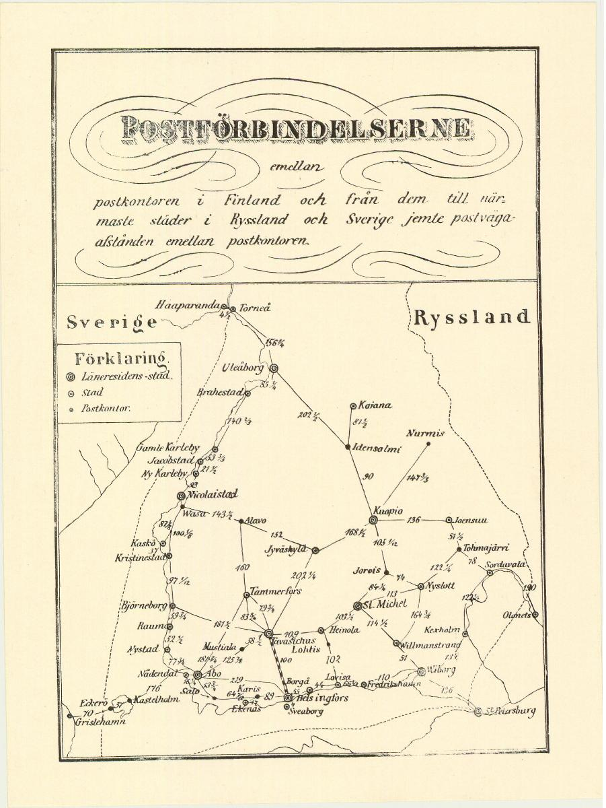
Project: Constellations of Correspondence: Large and Small Networks of Epistolary Exchange in the Grand Duchy of Finland (CoCo)
The Academy of Finland (decision numbers 339828, 340834 and 339918)
2021-25 (and beyond)
Letter catalogue metadata - no digitization of content!
Long 19th-century: 1789-1917
Materials also from 17th-18th c
https://coco.rahtiapp.fi/
Postal map, 1864
Source: Postal Museum, www.finna.fi

Slide 3
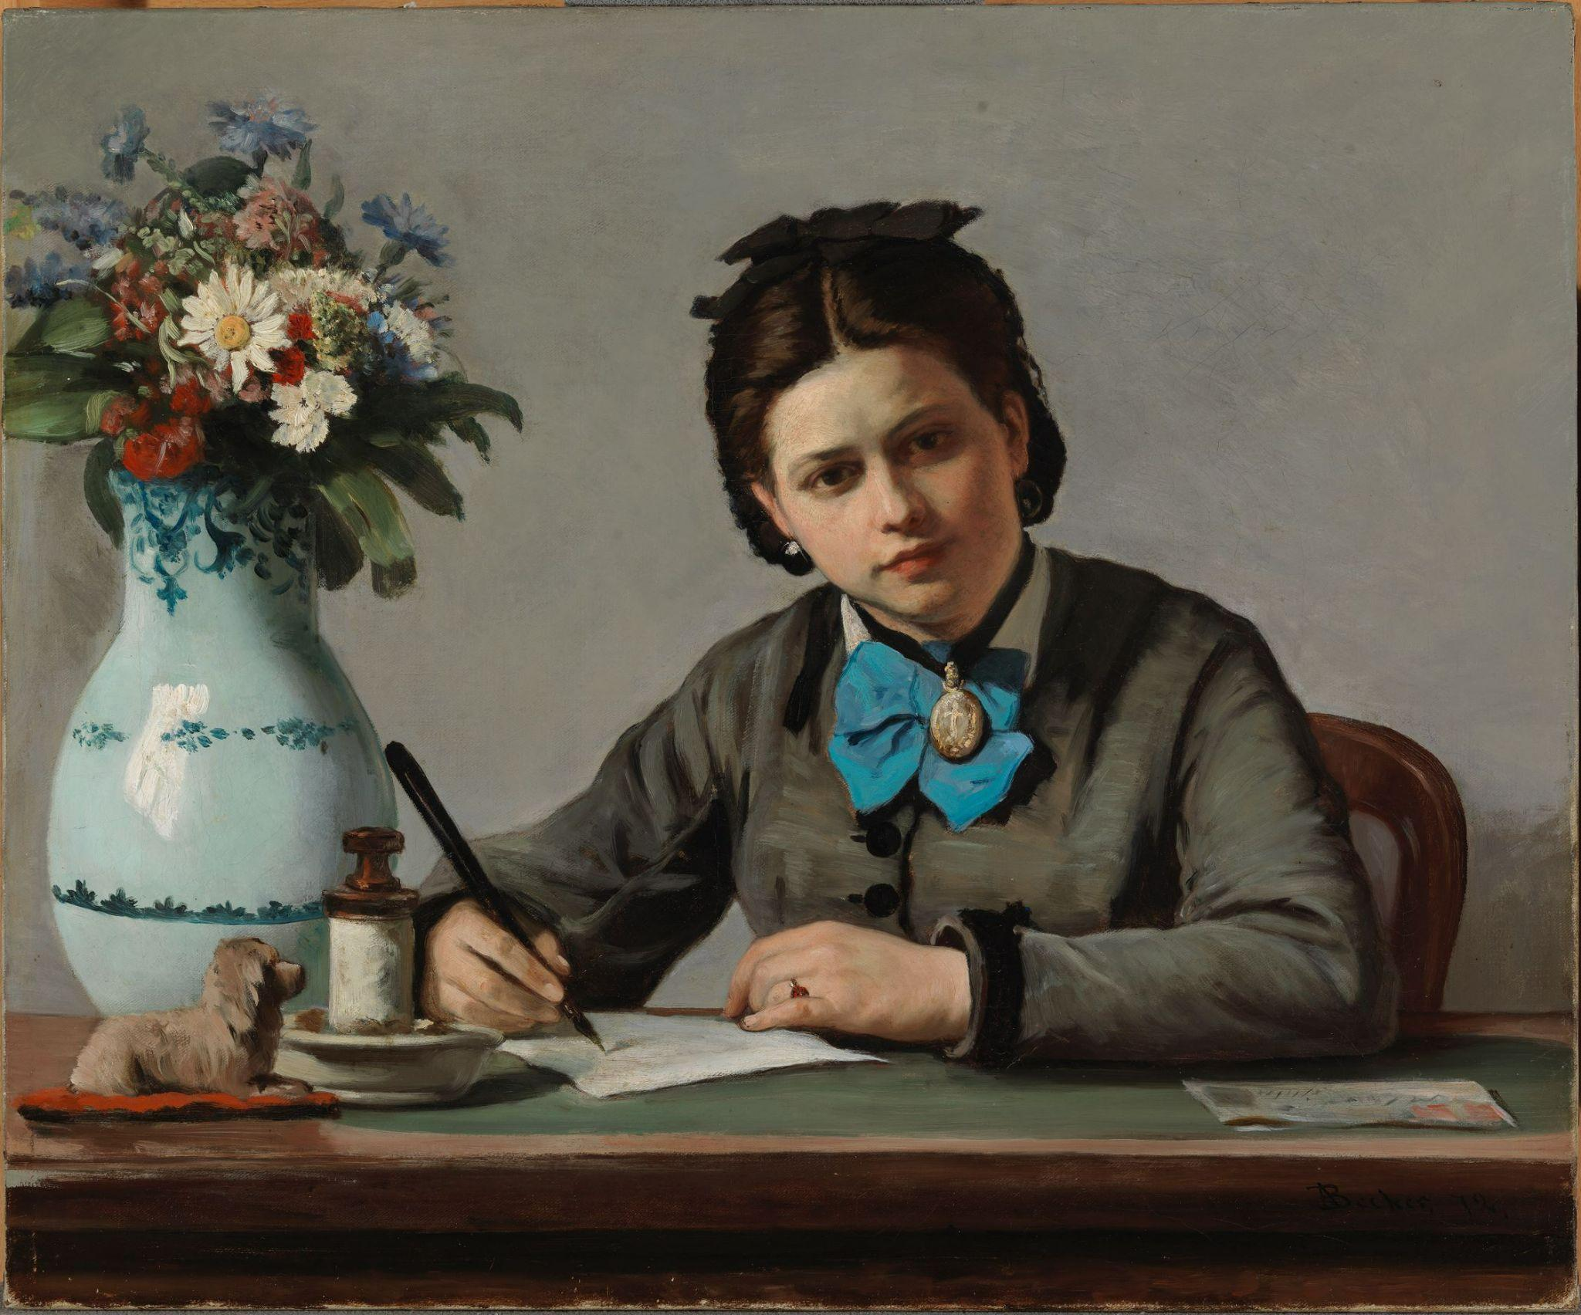
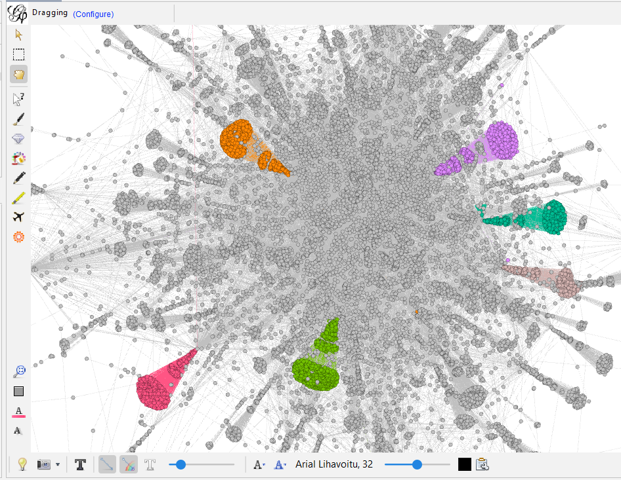
Today’s Presentation
Point of departure of the project
Some views of the data
How complete vis-à-vis the collections of the
GLAM sector
The importance of collection-level
metadata
Historical ontology and bias: when do certain
kinds of research questions become possible?
“Critical collection history” and next steps

Slide 4
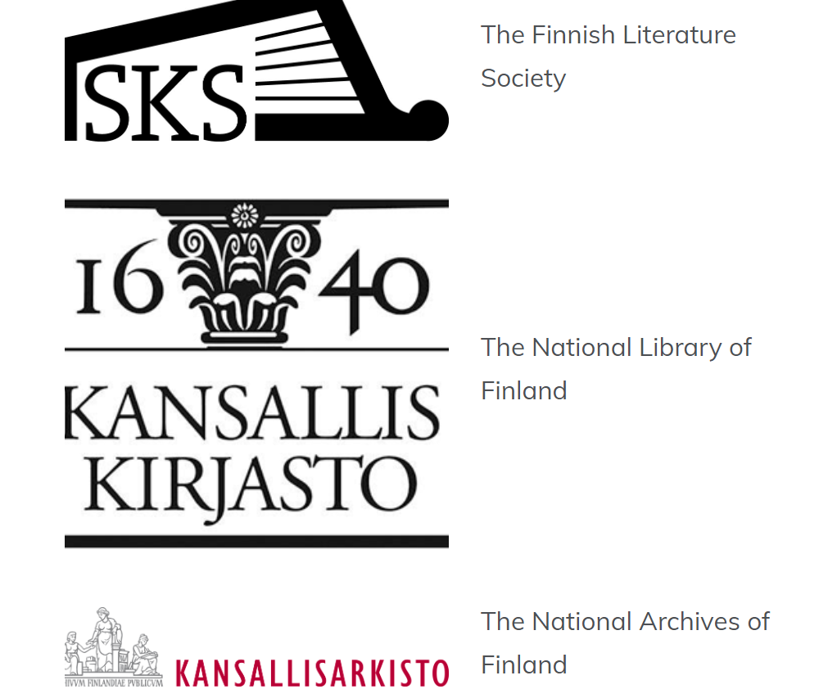
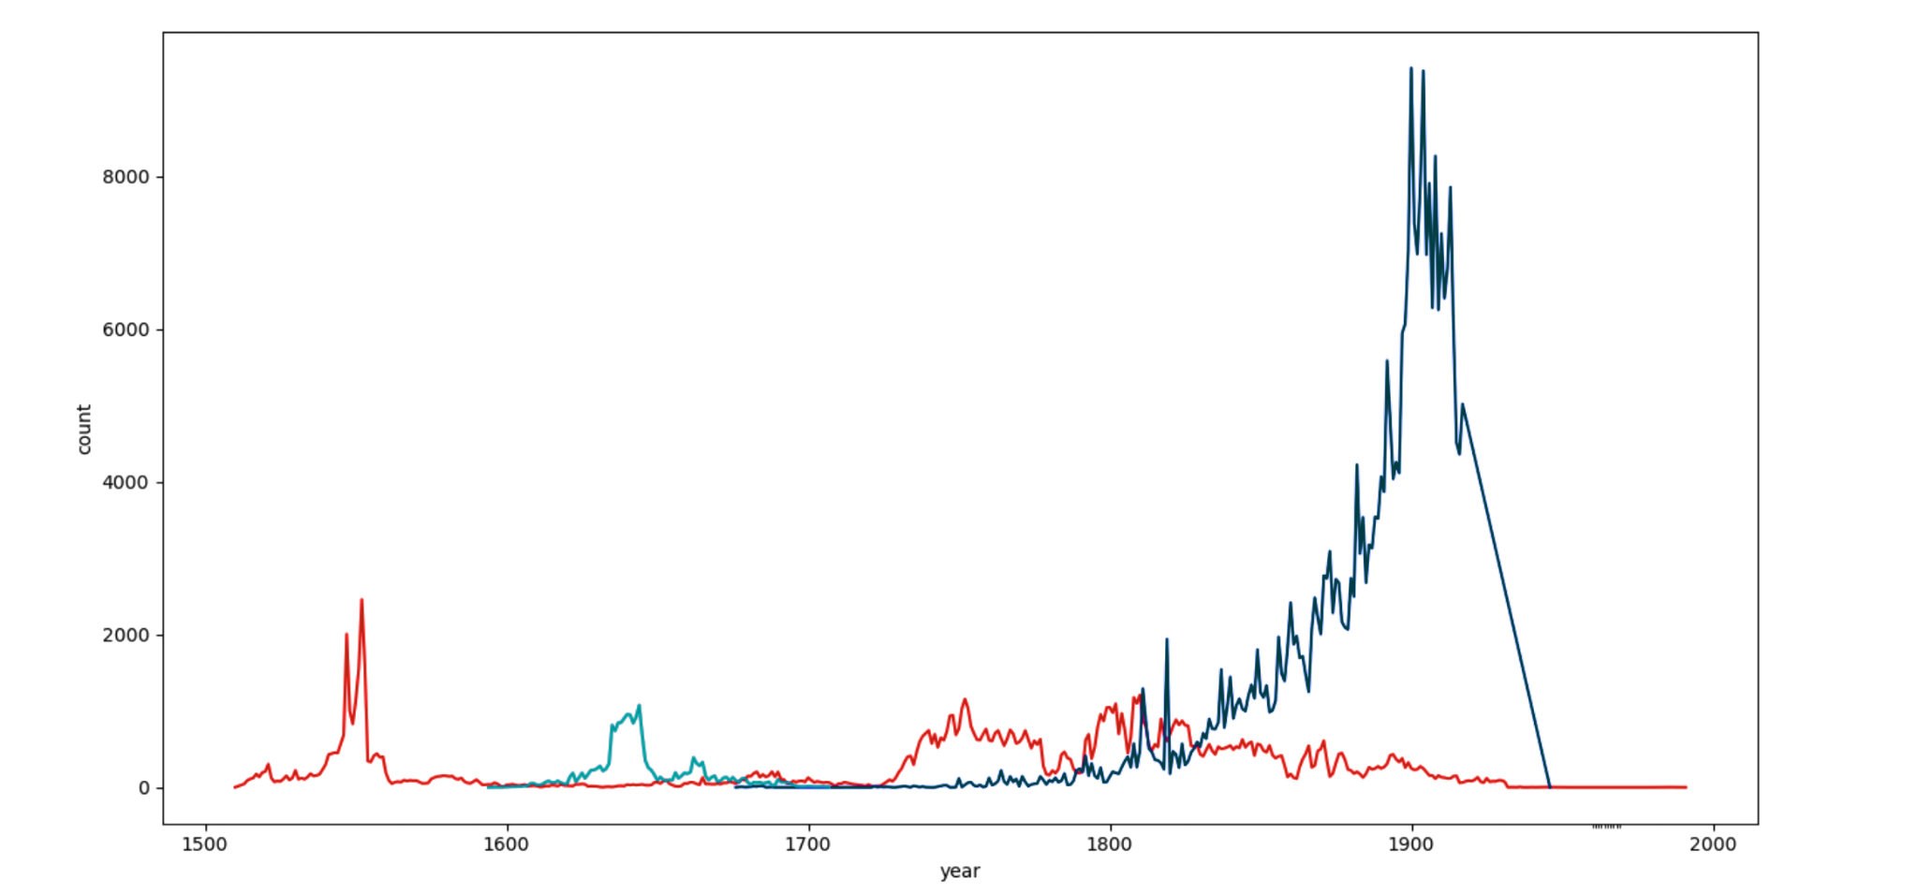
Letters and historical studies
A strong paradigm of close-reading
?

Slide 5
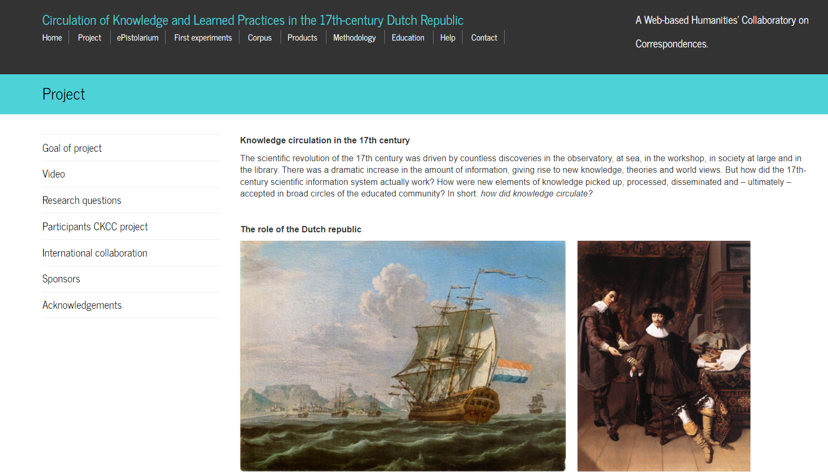
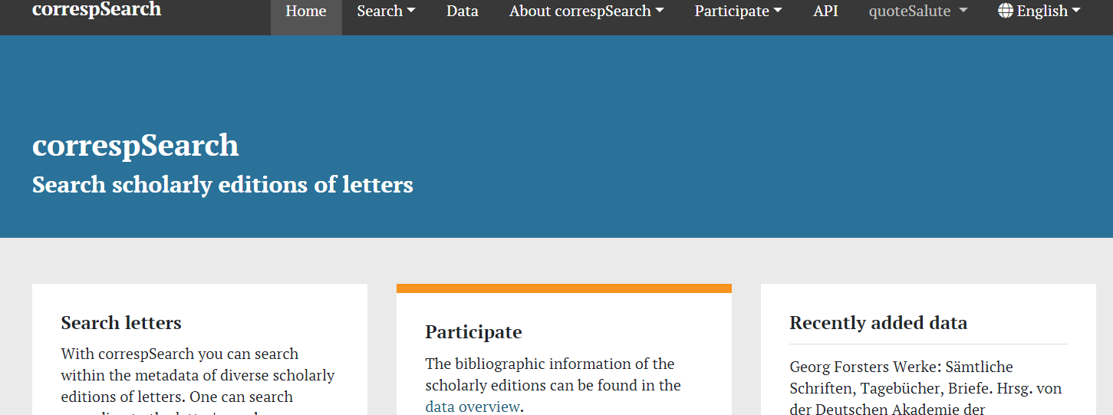
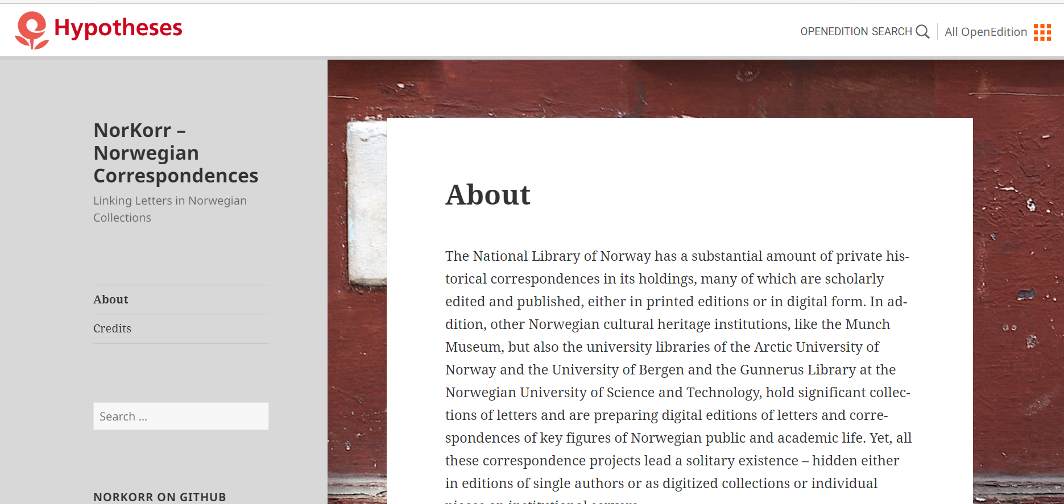
Other epistolary projects - precision vs recall?
CKCC: over 20 000 letters - 17th-c Dutch scholars (RofL)
correspSearch: over 220 000 letters - edited letter collections (16th c - 1930s)
NorKorr: key figures of public and academic life, digital and printed scholarly editions
Well-curated data, often from edited collections

Slide 6
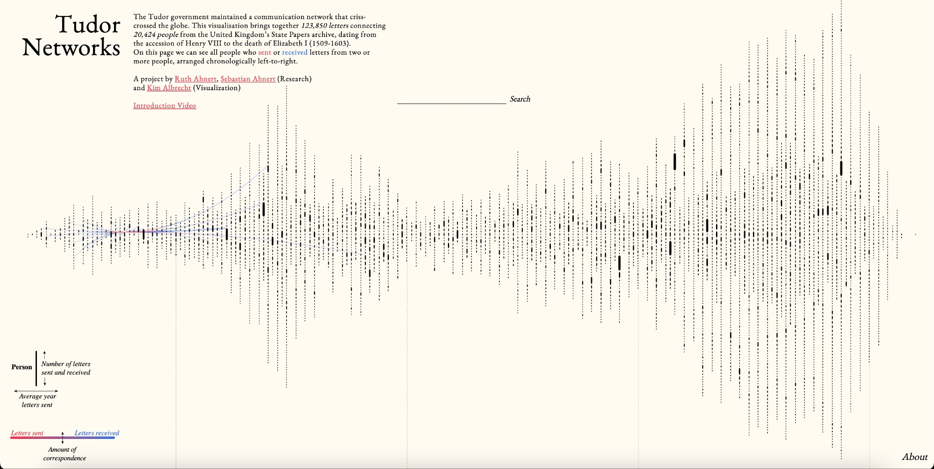
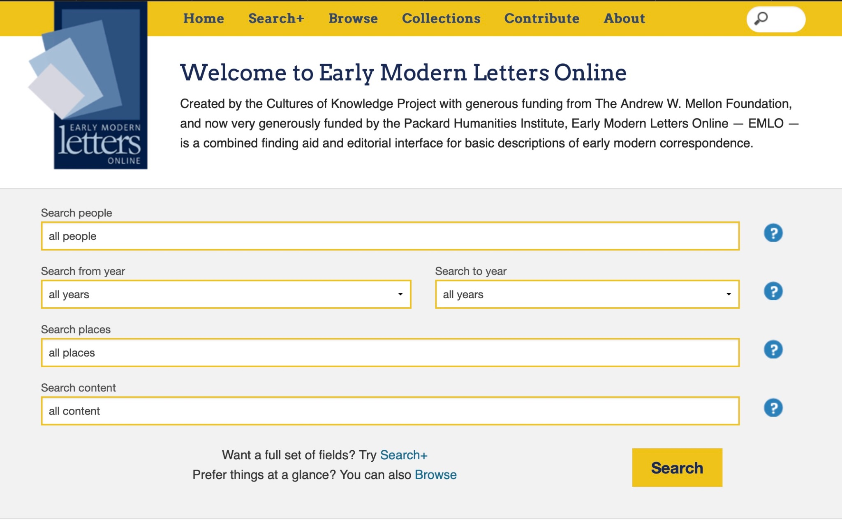
Other epistolary projects - collection models
EMLO (Early Modern Letters Online) - 34,193 people, 198,352 letters - some transcriptions, some just metadata. A ‘crowd-sourced’ project (i.e. individual researchers and projects contribute towards the project) and it is still growing!
Tudor Networks of Power - using metadata from the State Papers archives between 1509 and 1603 in England, including 20,424 people and 213,850 letters.

Slide 7
CoCo: 68 980 actors, metadata of 758 880 letters (October 2023) - over 1 million by 2025
An “inclusive archive” across the siloes/containers
No scholarly filters, instead “cultural heritage filters”
Quite exceptional but also data-related challenges
The vision:
“The aim of bringing together this consortium of humanists and researchers in digital humanities (DH) and computer science (CS), is to interrogate an unused treasure in the major Finnish cultural heritage institutions, namely the registered metadata of all letters, public and private, kept in the collections of archives, libraries, and museums, relating to the period of the Grand Duchy of Finland (1809–1917).”
“Fuzzy” dates: 50 letters, 1845-1872

Slide 8
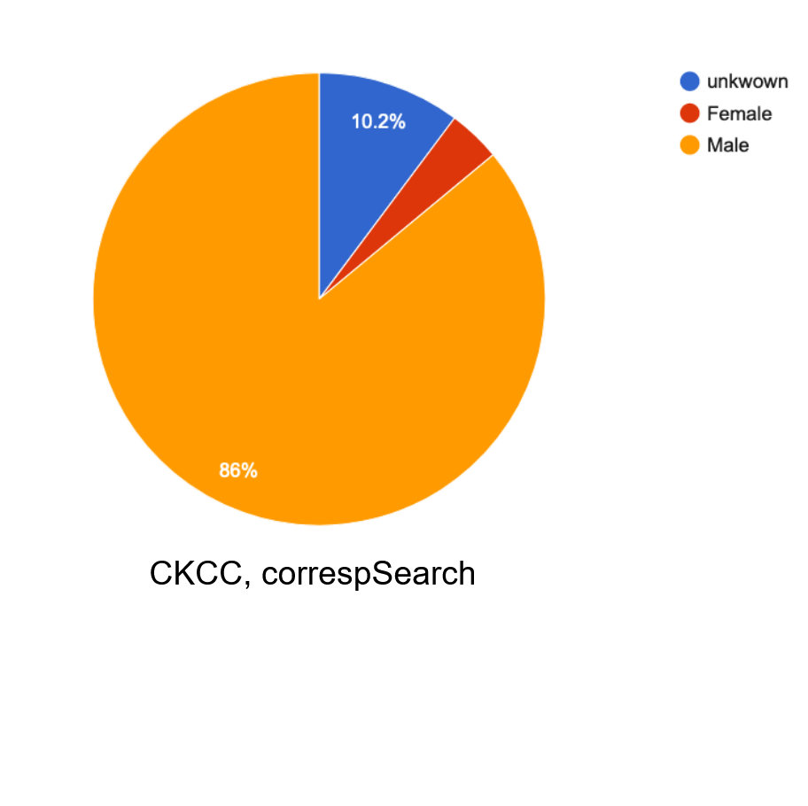
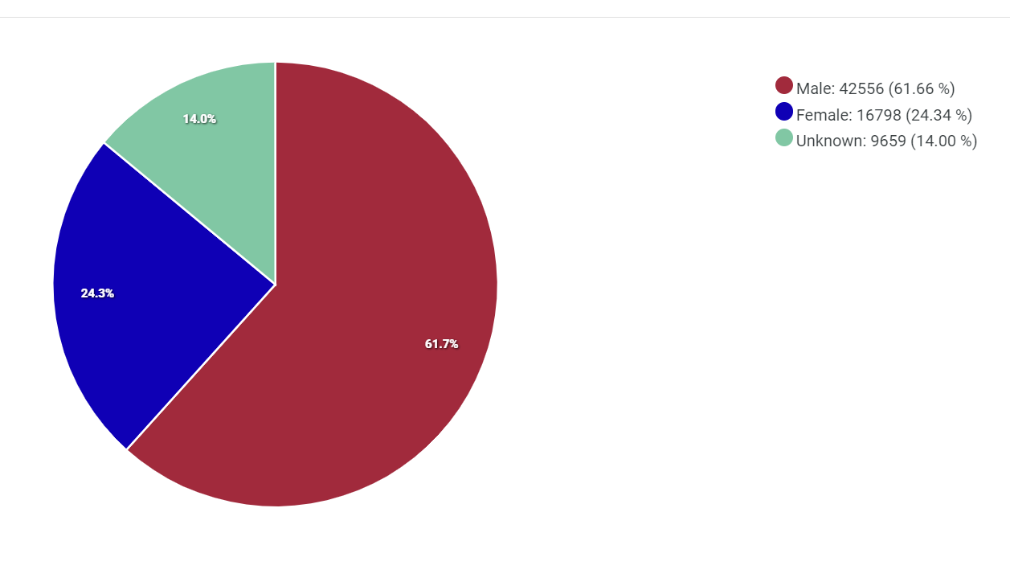
Finnish data, October 2023

Slide 9
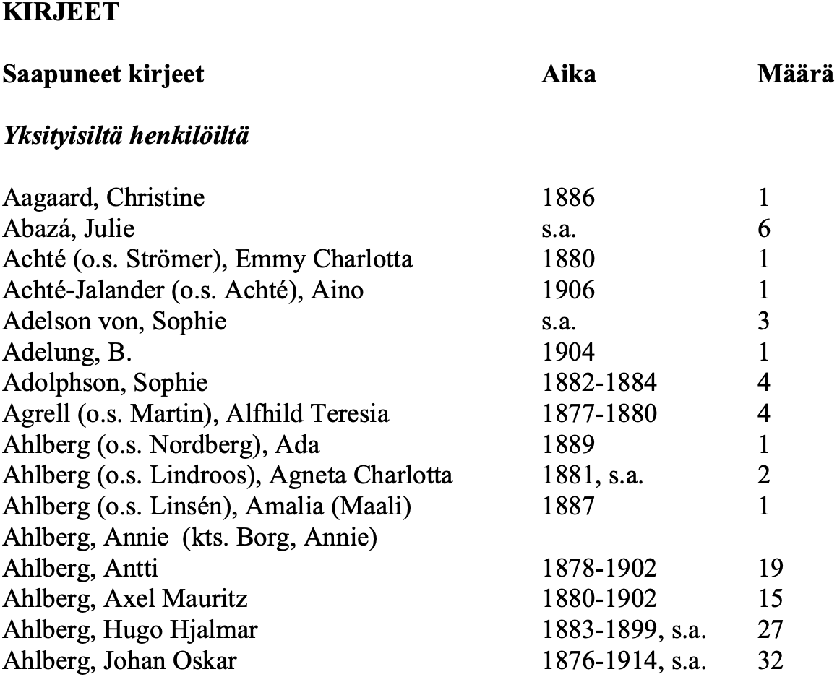
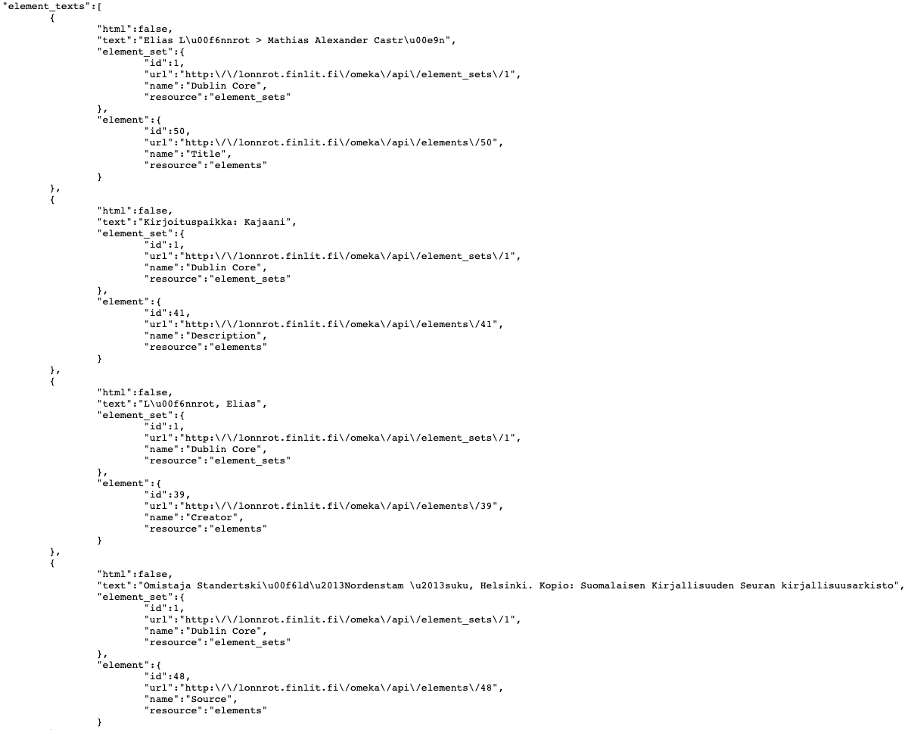
Letter Metadata Transformation Pipeline
DATASETS
Wikidata
Ontology of place names
AcademySampo
National Library of Finland
HarmonizationIntermediary RDF
BiographySampo
Occupation ontology
CoCo Data Model
Finnish Literature Society
Enrichment, Entity Disambiguation & Linking
Harmonized correspondence metadata
Deduplication
...
Notes:
Toistettava aineistojen muunnosputki:
yhteinen tietomalli ja formaatti,
toimijoiden, paikkojen ja kirjeiden yhteensovittaminen,
yhteinen tietomalli erilaisten kirjemetadatakokoelmien kuvaamiseen yhtenäisellä tavalla
Keskeisiä yhteisiä tietoja, kuten lähettäjä, vastaanottaja, lähetys/kirjoitus/”vastaanotto”paikka, lähetys/kirjoitusaika
Mallinnusvaihtoehtoja: dokumentti vs. tapahtuma
rikastaminen ulkoisilla lähteillä
Linking entities found in the text to Wikidata, Sampos
pulling information about people from them
Lopputuloksena eri kokoelmien metadata integroitu yhteen tietokantaan tutkijoita varten, mahdollistaa laajamittaisemman analyysin

Slide 10
The archive (/museum/ library)
Managing the collections (accepting / soliciting materials through decades)
Prioritizations regarding cataloguing (metadata production through decades)
No nation-wide standards/models/data systems
Digitization, publishing…
→ Discordant originating “data cultures”
Who do we and the previous generations of scholars perceive as interesting?
Biographies and other studies
Wikidata, Wikipedia …
Linked open data
Data enrichment
Bias

Slide 11
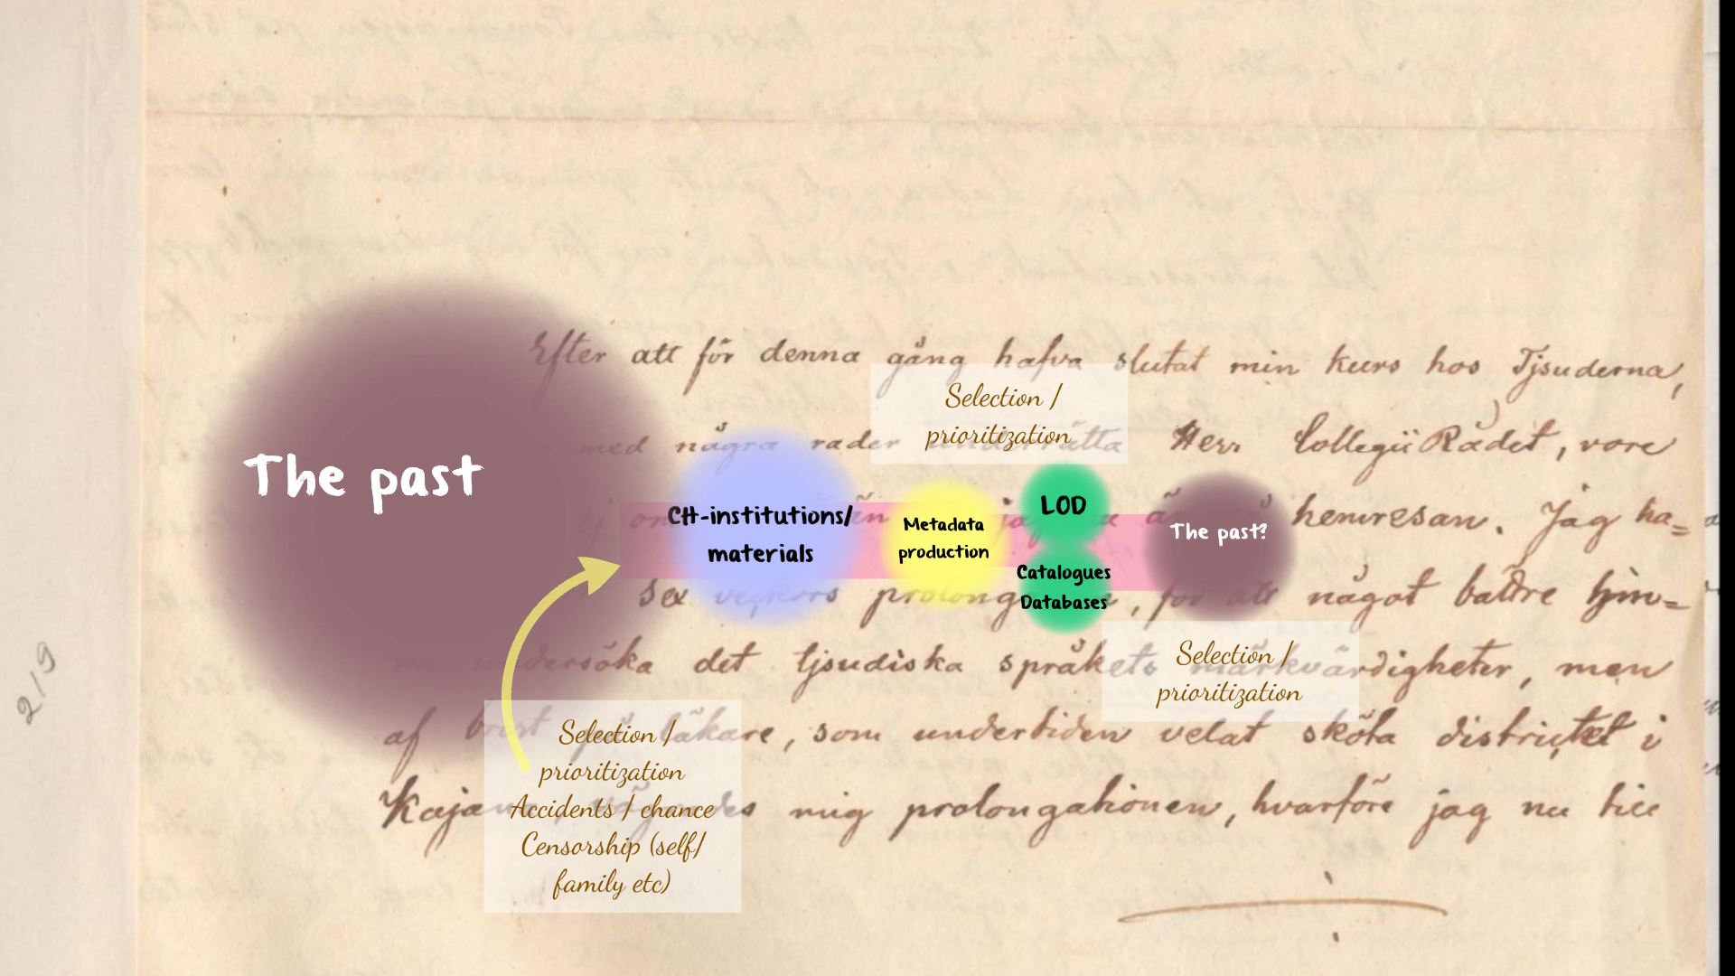
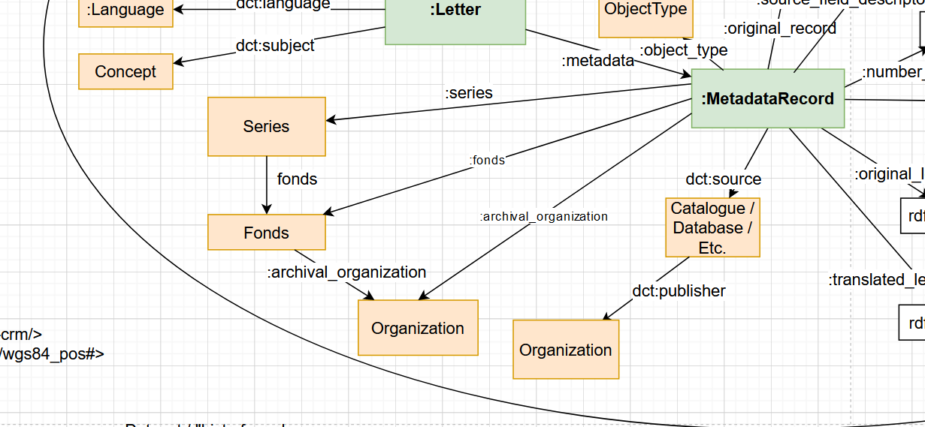
Formalising this process with epistolary metadata as a case study?

Slide 12
“All letters”? - aggregating epistolary metadata
How much 19th-century correspondence is there in the Finnish cultural heritage organisations - archives, libraries and museums? How much available metadata?
How to aggregate this information in a coherent manner? → Webropol metadata survey for Finnish CH organisations 2022–23
102 sent links + public web link / 53 responses (by the end of February 2023)
87 % of the respondents have or possibly have 19th-century letters in their collections
Over 80 % of the respondents governing 19th-century letter collections are interested in co-operation, i.e. submitting their letter metadata
Gathering metadata is work in progress, we have so far received metadata from 11 CH organisations, more material coming in 2023–24

Slide 13
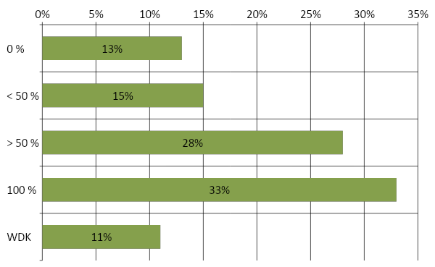
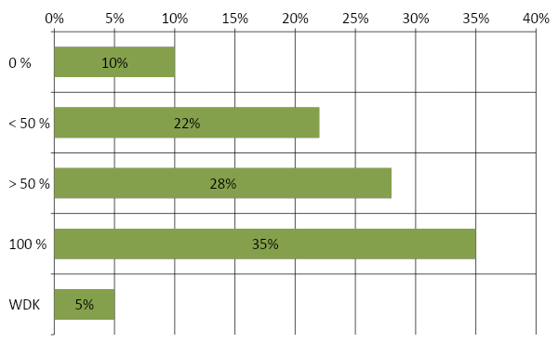
CoCo Webropol Survey
Proportion of catalogued letters in your organisation?
Respondents: 46
33% of organizations have catalogued 100 % of their letter collections
→ important to provide this contextual information for the users of the data!
Proportion of letters catalogued in electric form (e.g. database, excel, even word)?
Respondents: 40

Slide 14
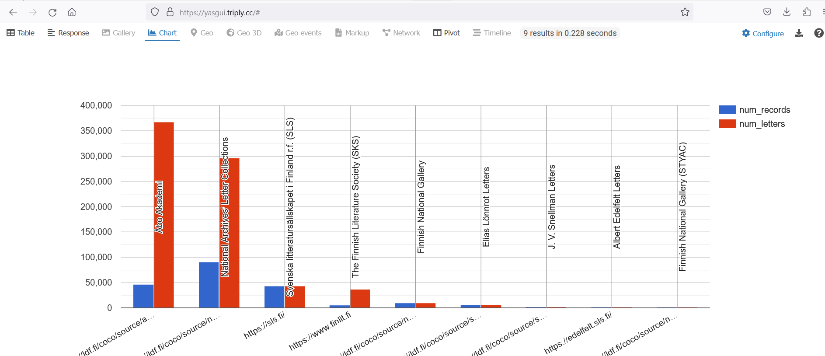
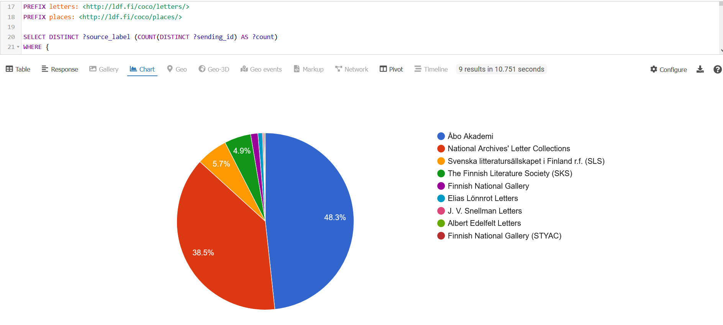

Slide 15
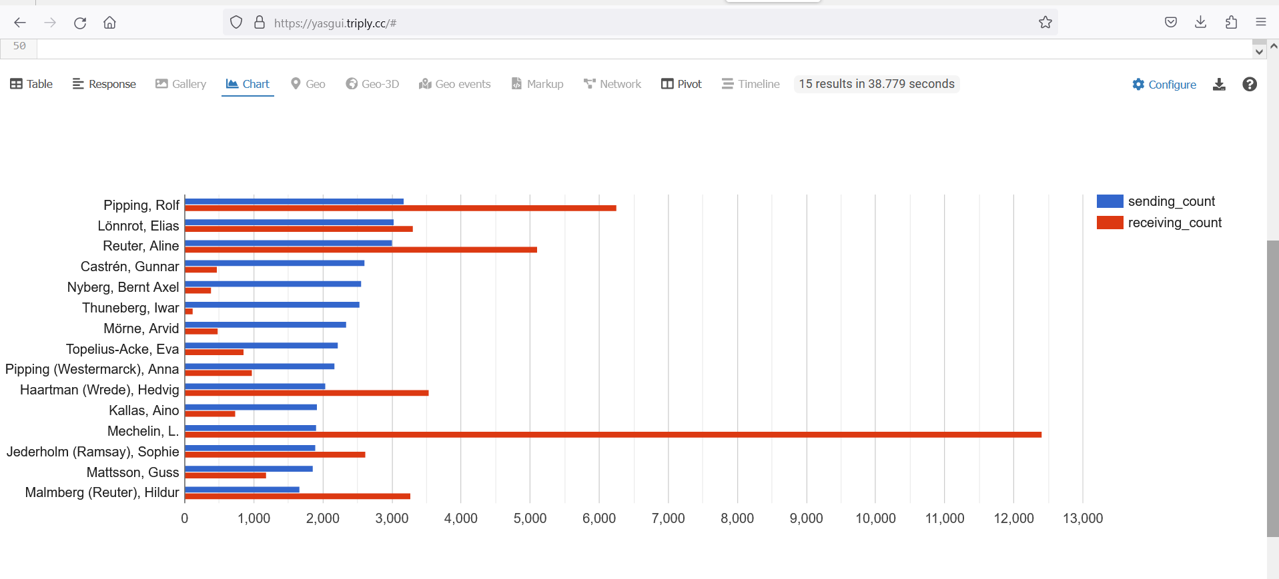
Who are the records creators / entities of origin?
“The corporate body, administrative unit, family, or individual that creates, receives, or accumulates a body of records, personal papers, or objects.”

Slide 16
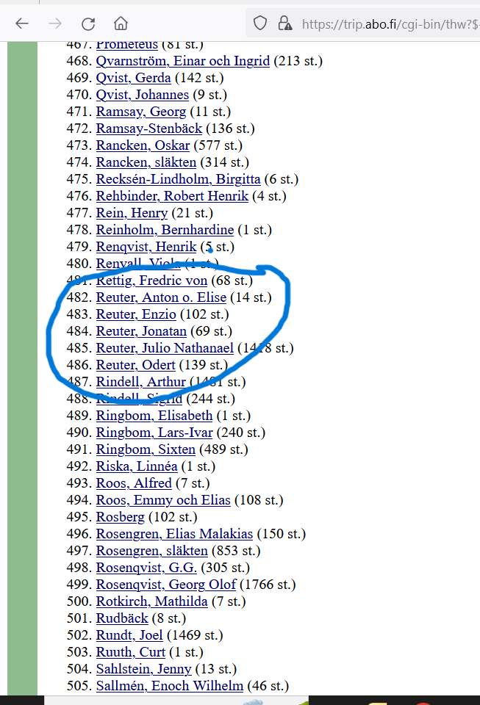
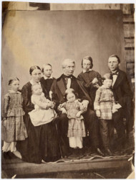
Aline Reuter (neé Procopé) (5000; 3000)
“Mother Aline, one of the most learned women of her time, also provided a good intellectual foundation for his studies.” (Enzio Reuter’s biography)
Why such an extensive collection?
Her own archive in the family archive
She wrote to people who a) considered the letters / correspondence important b) were important enough themselves
However, Aline Reuter is not a records creator at the Library of the Åbo Akademi
Image: Åbo Akademin arkistokokoelmat - Bildsamlingarna

Slide 17
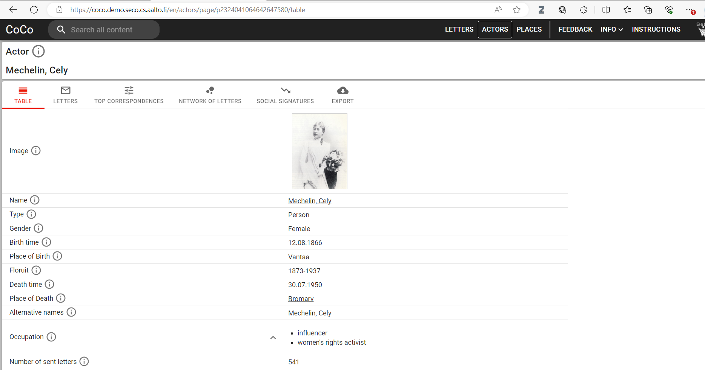
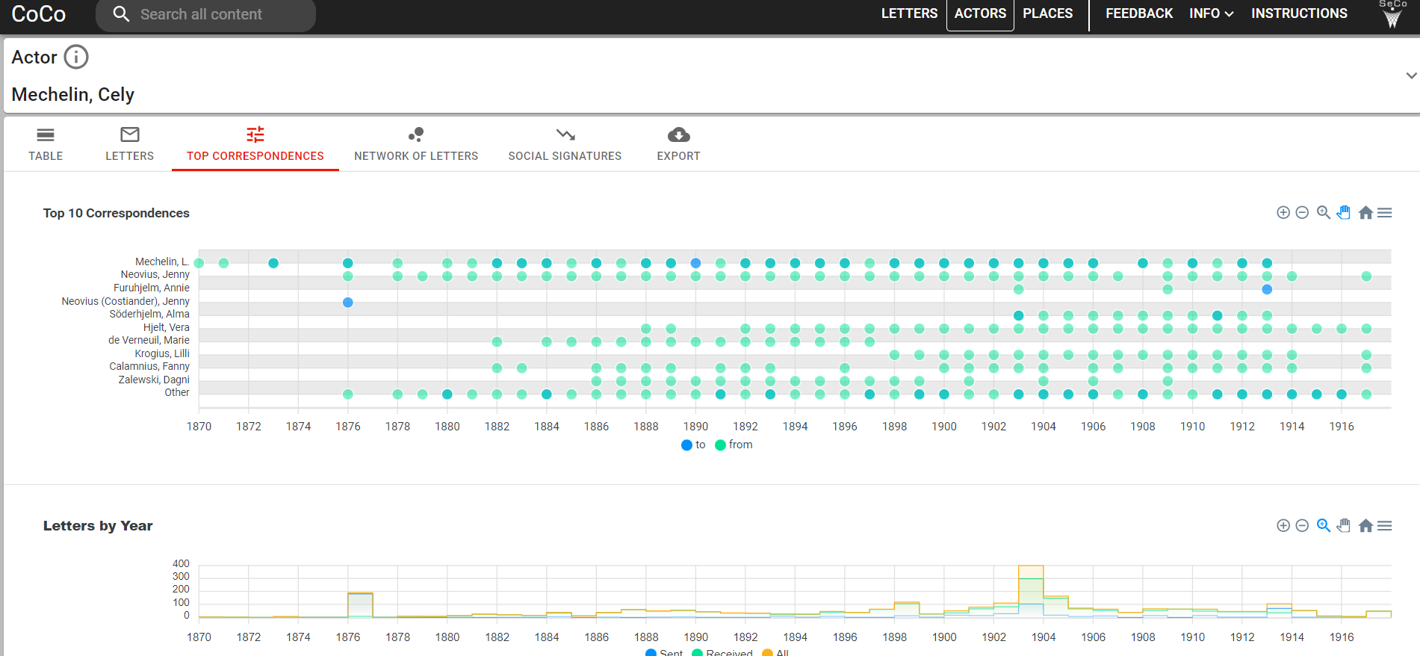
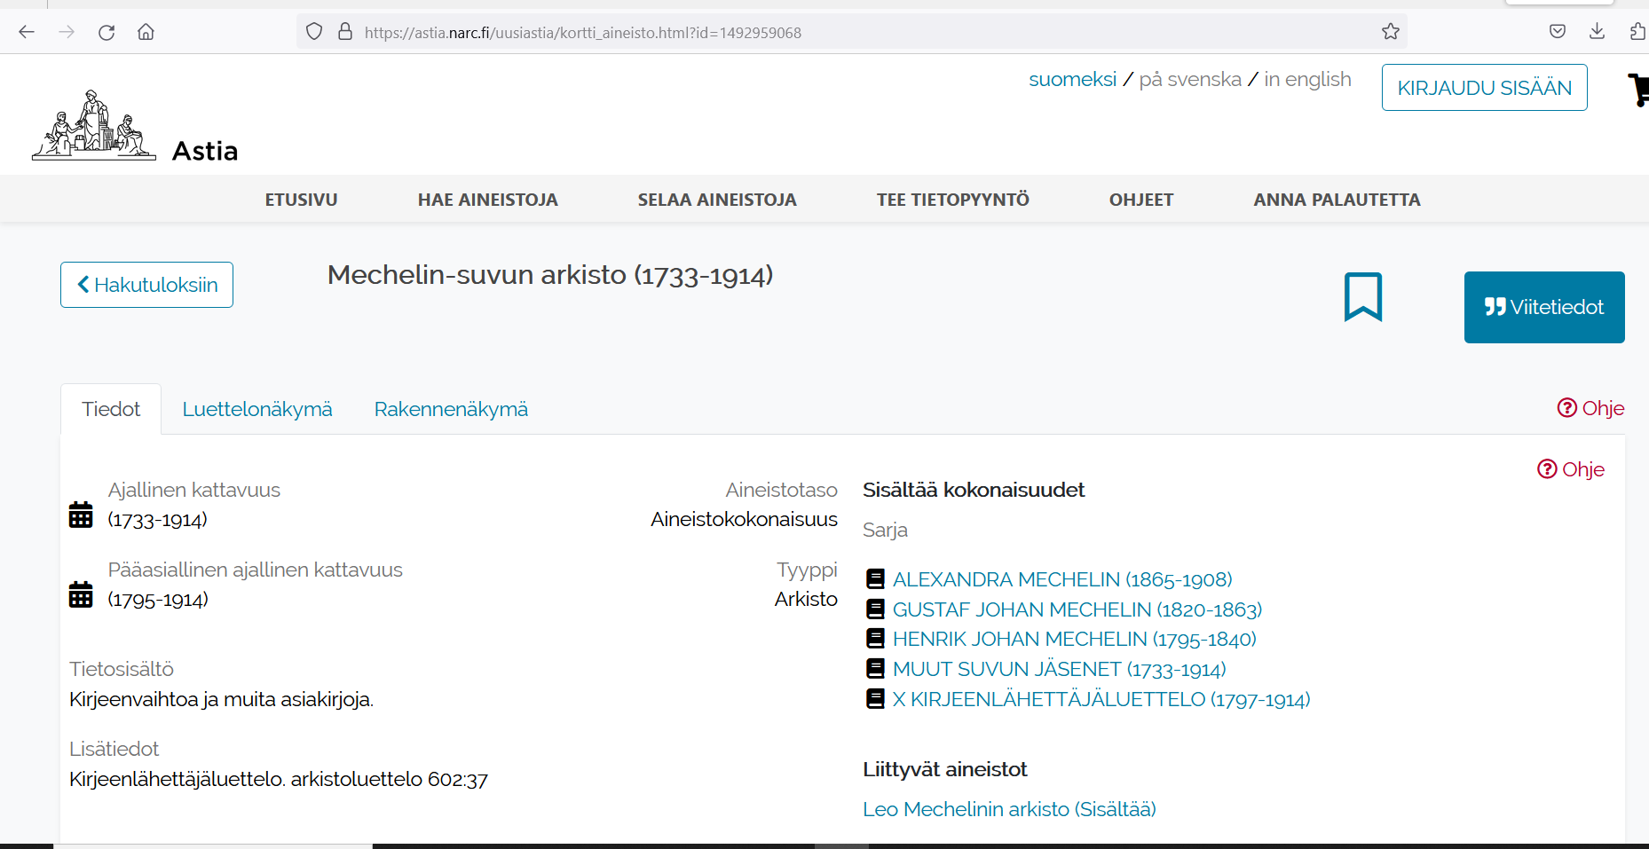
The perspective of the National Archive
vs
“The Archive of Women’s Movement”?
→ the situated process of data production
1
3
2

Slide 18
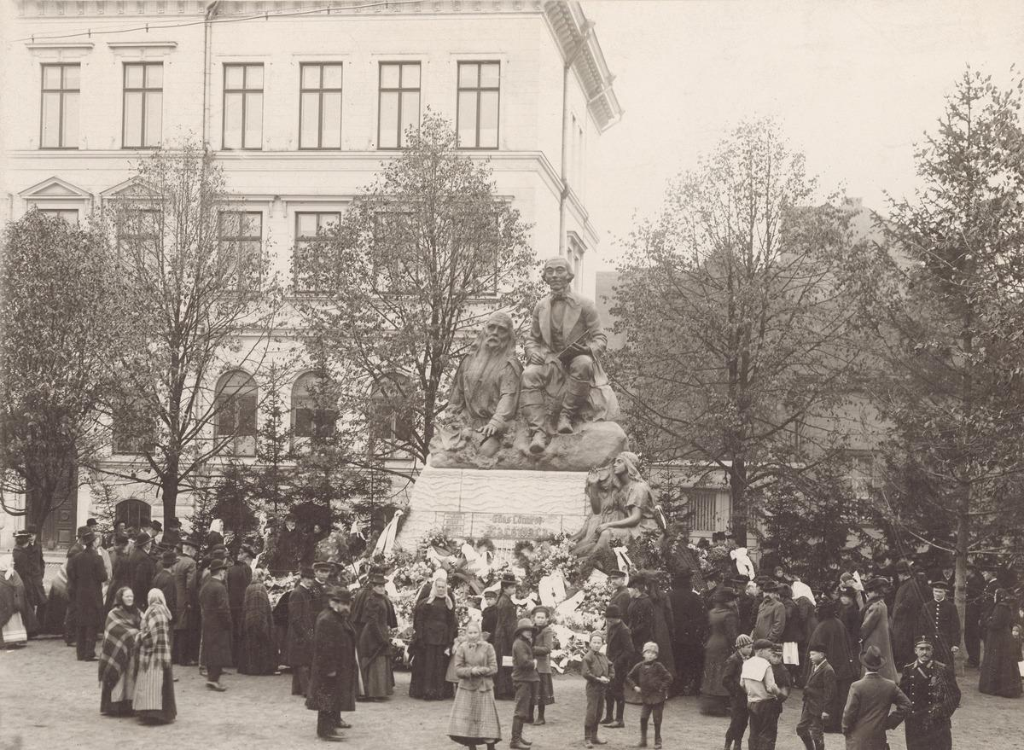
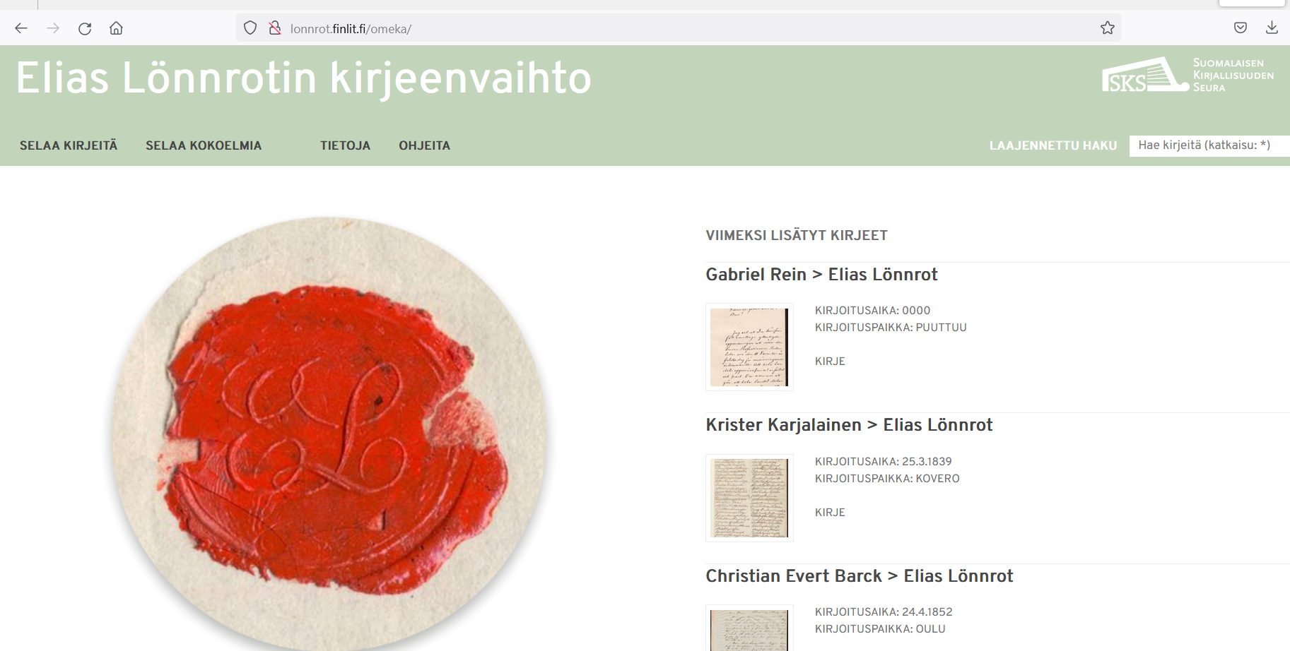
Elias Lönnrot (1802-1884) (ca. 3000; 3000)
the compiler of the Finnish national epic Kalevala, and more → a true cultural hero
heritagization: Lönnrot bequeathed his archive to the Finnish Literature Society; the letters written by Lönnrot were then collected through, among other things, newspaper advertisements, they were meticulously catalogued (later digitized) and a special fonds (collection) formed
Anomaly in our dataset
lonnrot.finlit.fi/omeka

Slide 19
Records creators
Provenance “is a fundamental principle of archives, referring to the individual, family, or organization that created or received the items in a collection.”

Slide 20
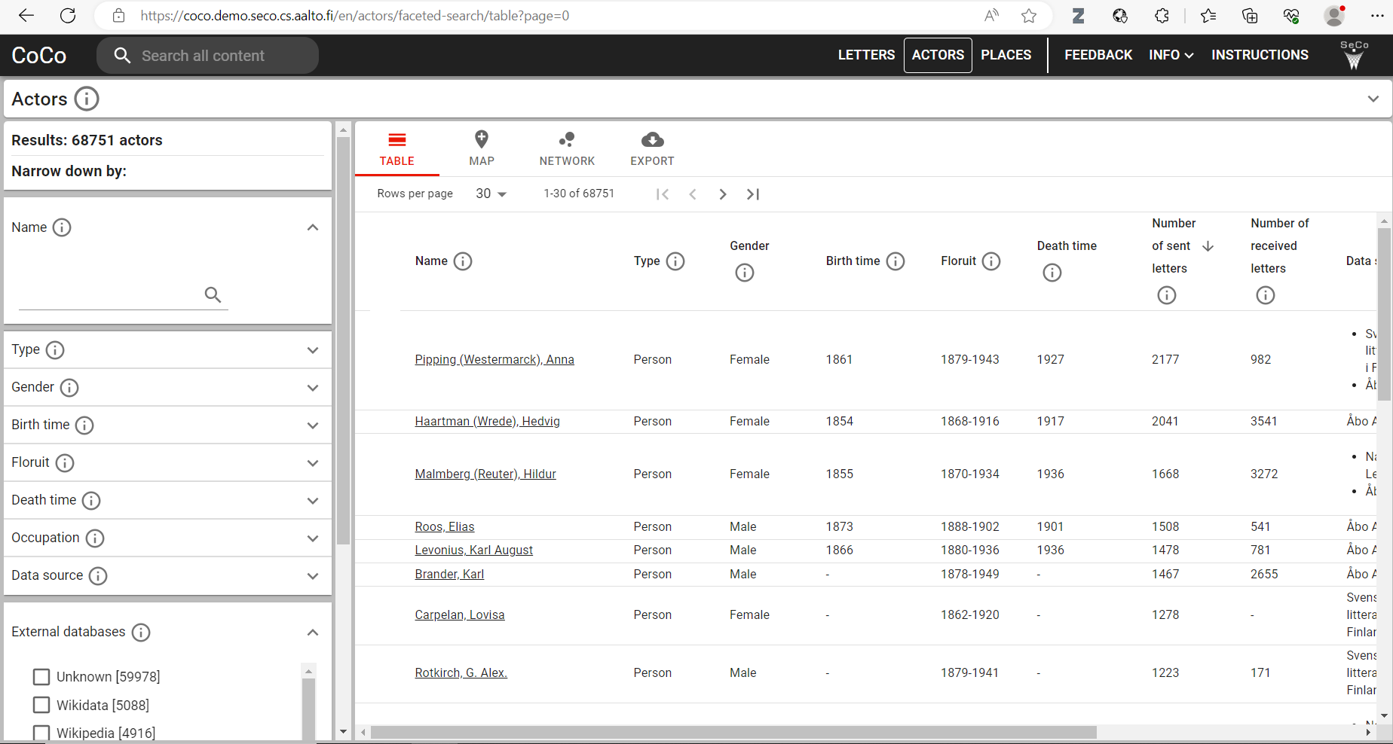
But their letters amount to 60 % of the collections!
13 % links to outside resources

Slide 21
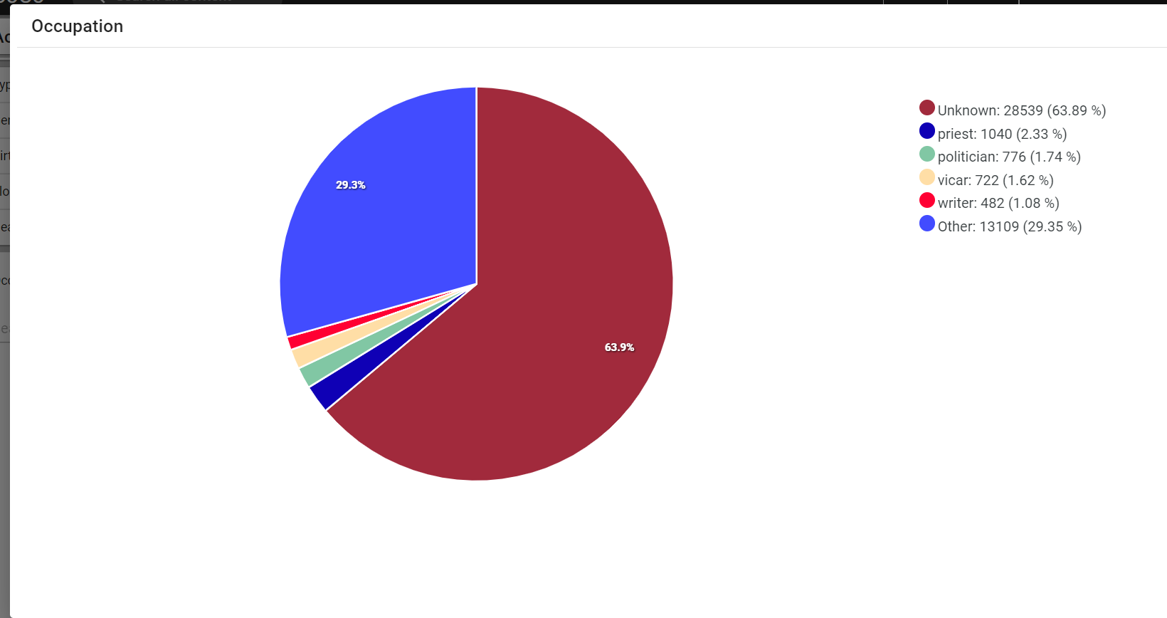
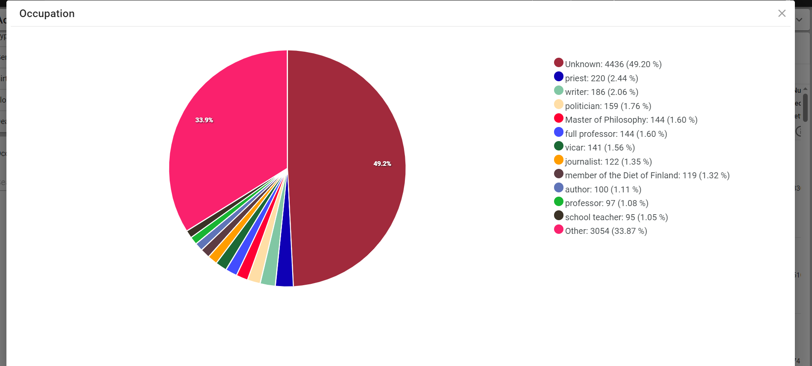
Occupations / Archives as social constructs
National Archives
The Finnish Literature Society
Priest, vicar, politician, writer…

Slide 22
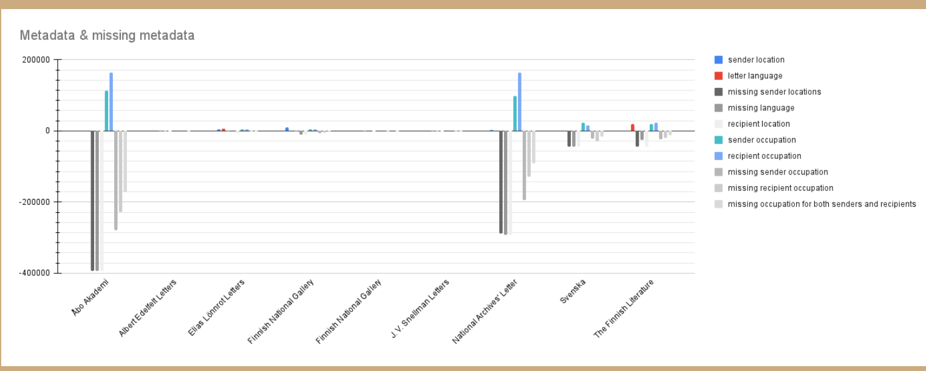
Image: DHH23 / Efthymios Kokordelis, Michele Stefani

Slide 23
Who is linked?
Who is worthy a biography?
Can we enhance such linking?
Whose letters have been catalogued?
Who are understood as records creators?
Occupations are not neutral either - who defines these? Historically-situated categories (plus ontologies used only in some of our LOD-resources)
13 %
“The problem starts with our language: the widely used term data set implies something discrete, complete, and readily portable. … We must rethink our terms and habits around public data by learning to analyze data settings rather than data sets. … I employ a variety of methods for studying data, which I collectively refer to as local readings.”
Yanni Alexander Loukissas: All Data Are Local: Thinking Critically in a Data-Driven Society (MIT Press, 2019)

Slide 24
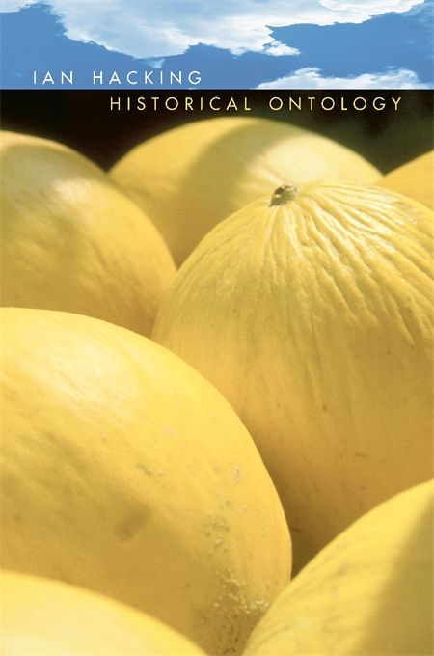
Ian Hacking: Historical Ontology
How things, classifications, ideas, people, kinds of people, institutions “come into being” as targets of research?
“One cannot speak of anything at any time…” (Foucault)
“Historical ontology is about the ways in which the possibility for choice, and for being, arise in history.” (p. 23)
How certain problems and research questions become possible? Societal & cultural change, new research environments, concepts, materials, technology….
Harvard University Press 2002

Slide 25
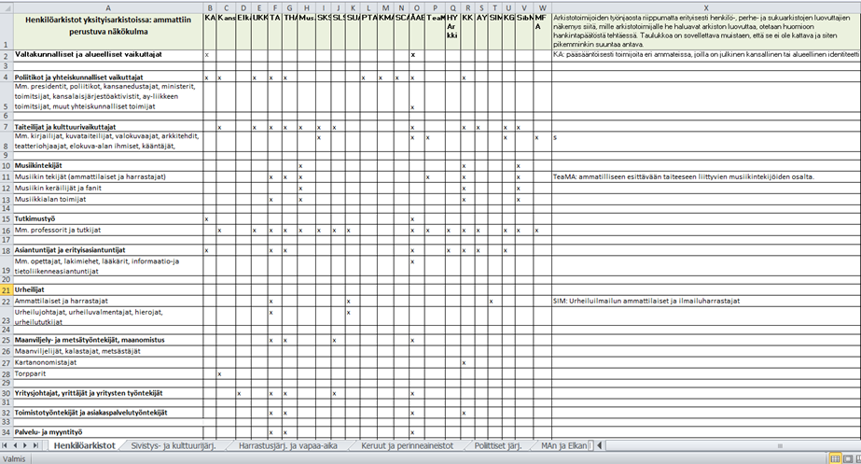
An ontology of bias
Historical situation:
Censorship (self/family) and other mechanisms of loss in a historical situation
The Archive:
Acquisition: deliberate / contingent
GLAM-sector / national division of labour
In Finland implemented in the 2000s but reflects historical collection profiles
Aggregated data can give a glimpse of the early history of the roles different organizations had
Politicians
Artists
Musicians
Professors
Athletes
Agricultural workers
…

Slide 26
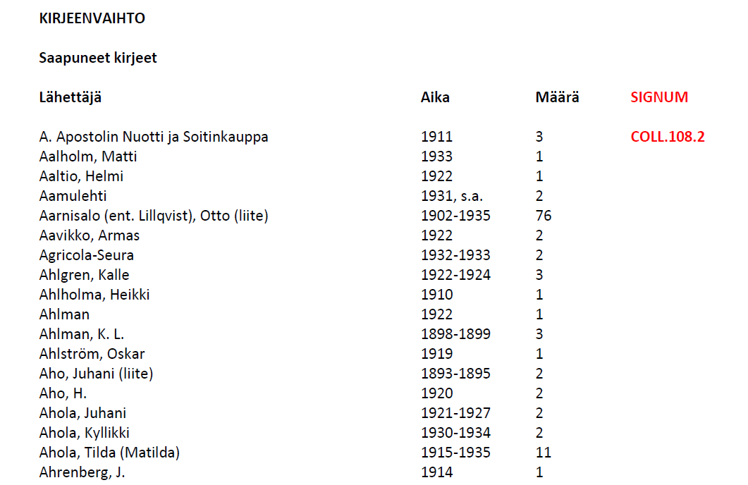
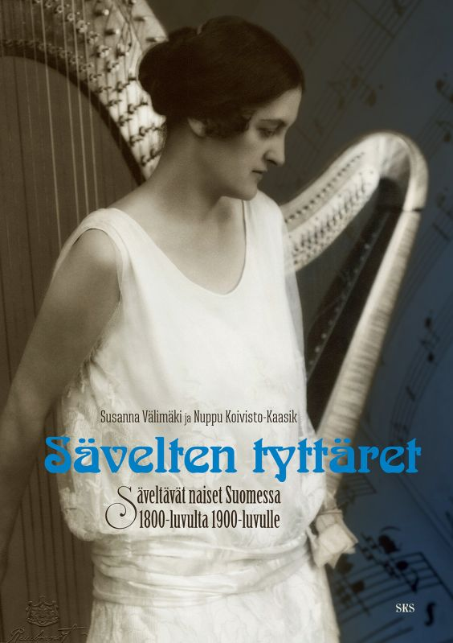
An ontology of bias
The Archive
Descriptive standards and “creative solutions”
“a collection of rules, practices, and guidelines that codify the kinds and structure of information used to represent materials in a finding aid, catalog, or bibliography” (Dictionary of Archives Terminology)
But all acquisitions / archives are different
The importance of the level of fonds (records creators)
Who decides how fonds are created?
Not expressed in a standard way in data dumps
Research and data infrastructures:
Data enrichment reveals (new) bias in research
Cf critical study of canons and grand narratives

Slide 27
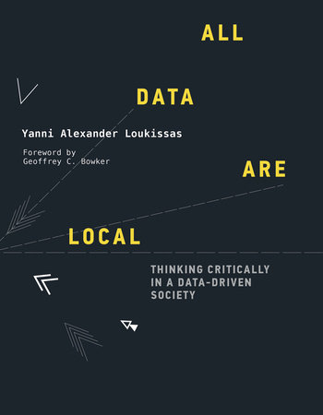
From bias to “Critical collection history”
Understanding bias and the local settings of data are at the core of critical collection history.
However, bias is visible only in comparative perspective, when data are drawn together from disparate origins. However, where to compare the aggregated data as an entity?
(“Systematic/aggregate source criticism”?)
“As a mode of engagement that illuminates biases and assumptions we might otherwise unconsciously adopt, a critical approach is imperative for data studies and practice. But critical reflection has its own limits; it can be detached rather than responsible, analytic rather than affective, or conceptual rather than hands-on.” (Loukissas, p. 9)

Slide 28
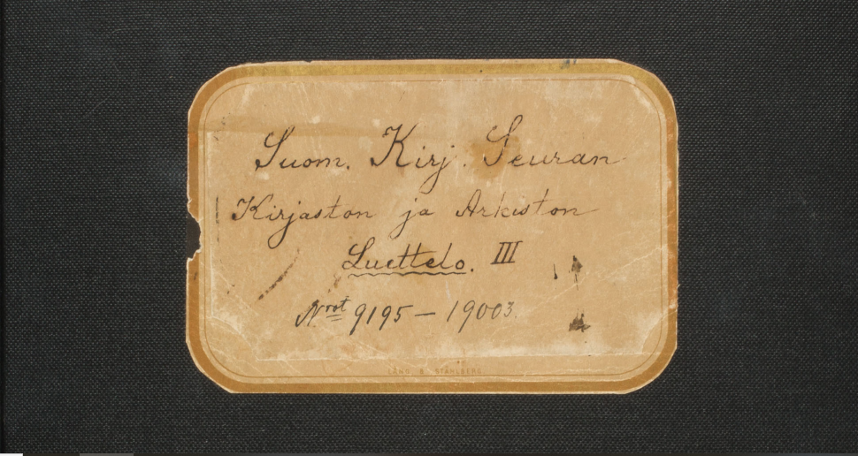
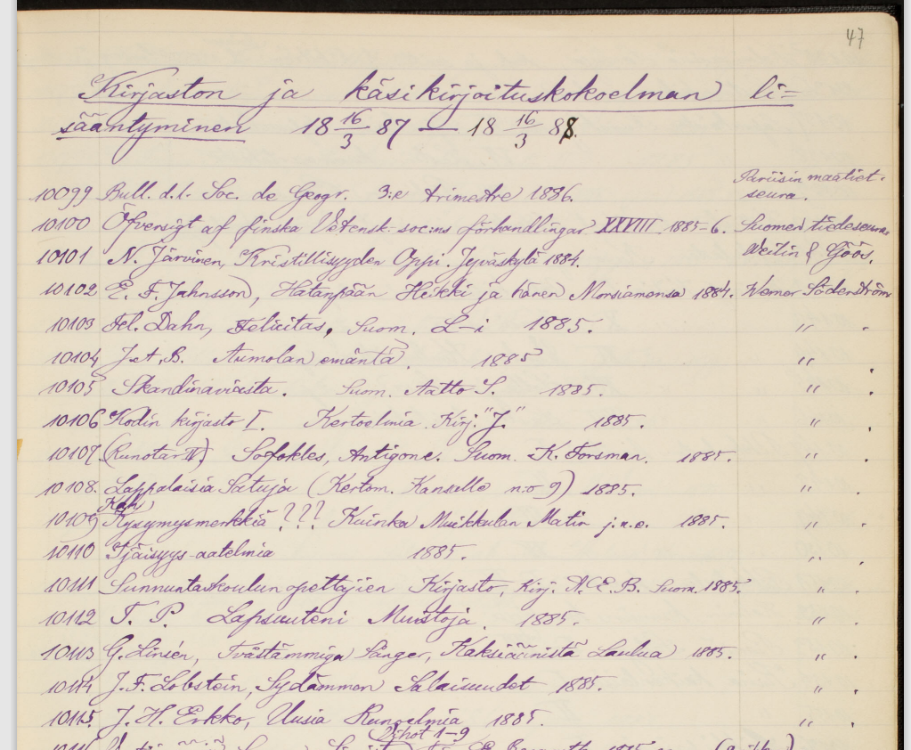
“Critical collection history”
Diverse bias will shed light on values and assumptions each dataset embodies; they have peculiar “fingerprints”
How to index the heterogeneous sources / local conditions in published data?
These “local conditions” become a research object / topic as much as the historical questions that scholars have in mind when they use such collections (as “sources”)
The critical examination of cataloguing categories
To create virtual archives/fonds and scholarly perspectives on published data
Aline Reuter’s fond, Cely Mechelin’s fond…
Queer studies?
We don´t have historical paradata in a machine-readable format!
each “collection fingerprint” is ahistorical, a still image that lacks temporal layers
Accession register, SKS
Next step…

Slide 29
?

Slide 30
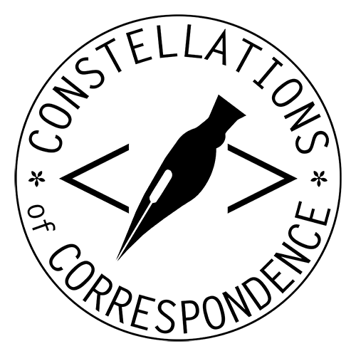
Thank you!
ilona.pikkanen@finlit.fi
https://coco.rahtiapp.fi

