Slide 1
Digital look at the history of fiction in Finland in the 19th century: Challenges and future prospects
Veli-Matti Pynttäri
University of Eastern Finland
veli-matti.pynttari@uef.fi

Slide 2
Digital History for Literature in Finland (Research Council of Finland,2022-2026)
WP1 Literary history
Literary history in the long 19th century Finland
PI Kati Launis / University of Eastern Finland
WP 2 Data Science
Bibliographic data science
PI Leo Lahti / University of Turku
WP 3 Data and outreach
Digital Resources
PI Osma Suominen/ National Library of Finland

Slide 3
View of Literary History in Finland 1809-1917
”The Great unread” -Margaret Cohen
-> need to know more
Necessity of bibliographic data
-> Bibliographies and collections as necessary windows to history
Mesoanalysis
-> micro- and macroanalysis
Critique of canonical literary histories already in e.g. feminist, transnational, postcolonial studies
-> often microanalysis
Systematic survey of ”everything everywhere all at once”
-> macroanalysis

Slide 4
Present situation – curating the (meta)data
Fiction in Fennica 1809-1917
(+9000 titles)
Library location markings (signum)
Why not UDC?
- fiction
- language (Finnish or Swedish)
- genre (novel, lyric, drama, short stories)
- translations and childrens literature excluded
Filtered set of fiction in
Fennica 1809-1917
(≈4500 titles)
Curated set of fiction in Fennica 1809-1917
(≈3000 titles)
Manual cleaning
Exclusion of
- reprints
- anthologies
- collected works
- translations
- broadsheet literature
First editions of fiction in book form published originally in Finnish or Swedish

Slide 5
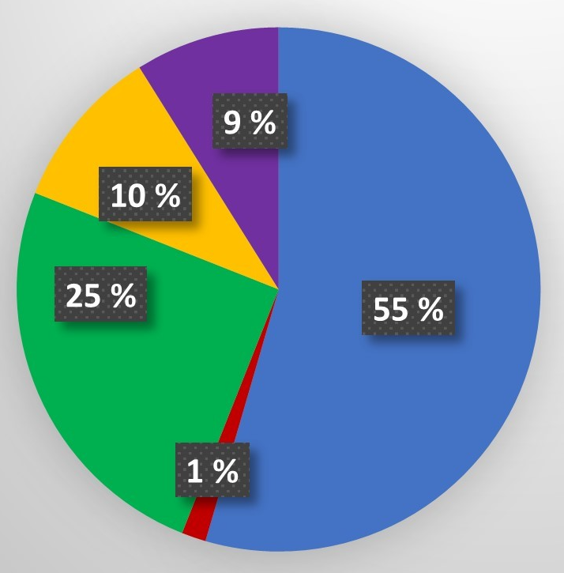
Division of fiction (excluding children’s literature) in Fennica 1809-1917
In National languages (Finnish or Swedish)
In Other languages
Translations to national languages (Finnish or Swedish)
Translations to other languages
Unclear
Data: Satu Niininen (National Library)
Chart: Julia Matveeva (University of Turku)

Slide 6
Goals
New knowledge from/of
Improving the metadata
- authors and literary works
- bibliography and collections
- literary system in 19th century
- harmonising the metadata
- corrections and supplements to metadata
Enhancing the method
- mesoanalytical approach
- algorithmic analysis of metadata
Building a model of literary system in 19th century

Slide 7
Challenges today
Nature of metadata
- inadequte data especially in relation to source language, number of editions, pseudonyms or mistaken identities
Nature of collections
- uncatalogued titles
- cataloging is subjective process that has taken place and continues to take place in historical circumstances
Nature of 19th century history
- bilingual culture
- transnational reality -> question of nationalities
- undefined publishing environment (especially first half of the century)
Nature of subjective component
- how to define fiction, different genres or literature?
- how to be consistent?

Slide 8
Future prospects – Digitised Literature of Finland in 1809-1917
Litteraturbanken?
1. editions (≈ 3000 titles)
Full text availability for the curated set of fiction in Fennica 1809-1917
National library is the main actor
Infrastructure already in place, question of funding and resources
Enables statistical analysis in variety of ways
SKS ?
SLS ?
Project Gutenberg ?
National Library
(≈ 700 titles)
Project Runeberg ?
Notes:
Finnish Literature Society
Svenska Litteratursällskapet i Finland, Society of Swedish Literature in Finland

Slide 9
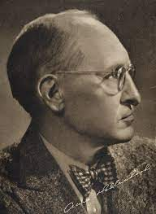
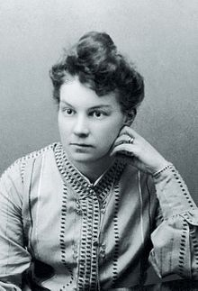
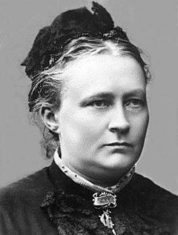
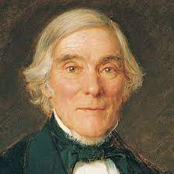
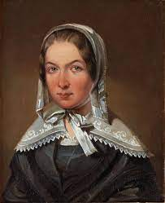
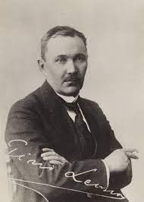
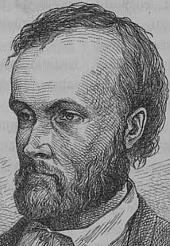
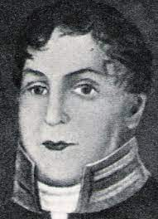
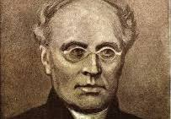
More future prospects – ”Database”
Runoja
Mirdja
”Scholarly edition of literary system” – Katherine Bode
Työmiehen vaimo
Teckningar utur hvardagslifvet
Kalevala
1908
1916
1885
1917
1896
1849
Bibliography
Full text
Critical archive
Biography
Analytical tools
Usability/outreach
1831
1870
1809
1810
1832
Maaliskuun lauluja
Kirjoituksia Jak. Juteinilda
Seitsemän veljestä
Elgskyttarne

Slide 10
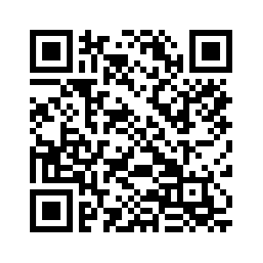
Thank you!
Veli-Matti Pynttäri
University of Eastern Finland
veli-matti.pynttari@uef.fi
+358400492277
https://sites.utu.fi/digital-history-literature-finland/

