Slide 1
Getting started with DH
Veli-Matti Pynttäri
University of Eastern Finland
8.4.2024

Slide 2
Digital History for Literature in Finland (Research Council of Finland, 2022-2026)
WP1 Literary history
Literary history in the long 19th century Finland
PI Kati Launis / University of Eastern Finland
WP 2 Data Science
Bibliographic data science
PI Leo Lahti / University of Turku
WP 3 Data and outreach
Digital Resources
PI Osma Suominen/ National Library of Finland

Slide 3
Goals
New knowledge from/of
Improving the metadata
- authors and literary works
- bibliography and collections
- literary system in 19th century
- harmonising the metadata
- corrections and supplements to metadata
Enhancing the method
Building a model of literary system in 19th century
- ”The great unread”
- mesoanalytical approach
- algorithmic analysis of metadata

Slide 4
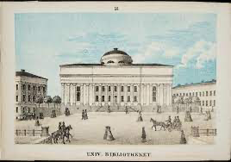
Defining Fennica
Building Fennica entailed definition of what is ”Finnish literature”
Pipping: Everything published in Finland and everything published by a Finn
Sven Gabriel Elmgren (1865):
All items published in Finnish regardless of the place of publishing
Everything published in Finland regardless of language
Every publication by a Finn or someone who has lives in Finland regardless of language
Georg Schauman (1913):
In addition to Elmgren everything that handles Finland, its citizens, history or languages regardless of place of publication

Slide 5
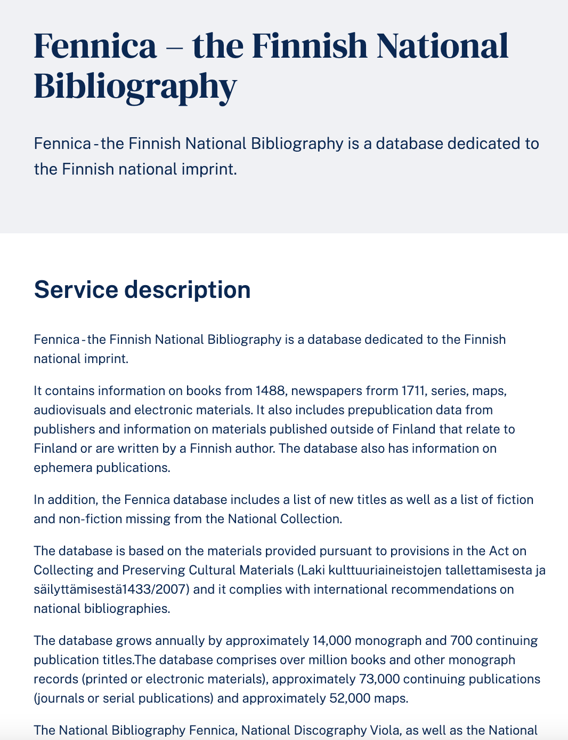
Fennica today
https://www.kansalliskirjasto.fi/en/services/fennica-finnish-national-bibliography
Information on books from 1488 and newspapers from 1711 (+other material)
Currently Fennica holds information on
1,216,737 items in total
1,060,937 books
228,868 fiction in book form
54,266 books in 1809-1917

Slide 6
Looking for fictive literature in Fennica
Library location markings (signum)
Fiction in Fennica 1809-1917
(+9000 titles)
Why not UDC?
- fiction
- language (Finnish or Swedish)
- genre (novel, lyric, drama, short stories)
- translations and childrens literature excluded
Filtered set of fiction in
Fennica 1809-1917
(≈4500 titles)
Curated set of fiction in Fennica 1809-1917
(≈3000 titles)
Manual cleaning
Exclusion of
- reprints
- anthologies
- collected works
- translations
- broadsheet literature
First editions of fiction in book form published originally in Finnish or Swedish

Slide 7
Challenges today
Nature of metadata
- inadequte data especially in relation to source language, number of editions, pseudonyms or mistaken identities
Nature of collections
- uncatalogued titles
- cataloging is subjective process that has taken place and continues to take place in historical circumstances
Nature of 19th century history
- bilingual culture
- transnational reality -> question of nationalities
- undefined publishing environment (especially first half of the century)
Nature of subjective component
- how to define fiction, different genres or literature?
- how to be consistent?

