Slide 1
Lost and Found in the 19th Century Finnish Literature. Archives, Bibliographies and Digital Methods
Veli-Matti Pynttäri
University of Eastern Finland

Slide 2



Digital History for Literature in Finland
(Research Council of Finland, 2022-2026)
WP1 Literary history
Literary history in the long 19th century Finland
PI Kati Launis / University of Eastern Finland
WP 2 Data Science
Bibliographic data science
PI Leo Lahti / University of Turku
WP 3 Data and outreach
Digital Resources
PI Osma Suominen/ National Library of Finland

Slide 3
Goals
New knowledge from/of
Improving the metadata
- authors and literary works
- bibliography and collections
- literary system in 19th century
- harmonising the metadata
- corrections and supplements to metadata
Enhancing the method
Building a model of literary system in 19th century
- ”The great unread”
- mesoanalytical approach
- algorithmic analysis of metadata

Slide 4
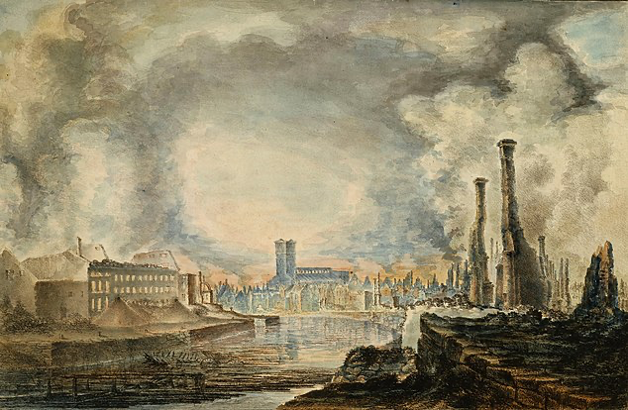
The Great Fire of Turku
4 September, 1827
Fire effaced much of the Medieval past of Turku
Of 12 000 inhabitants, 11 000 lost their homes
Compared to Fire of London in 1666
Beginning of the end of Turku as capital of Finland

Slide 5
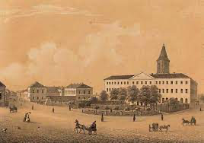
Royal Academy of Turku
Founded in 1640 by Queen Kristina of Sweden as the third university of the Kingdom
The First printing shop in Finland was established in 1642 by Peder Walde
By the time of Turku Fire, the library of the Academy consisted of appr. 40 000 titles
Only 830 titles were saved
Destruction of the first collection of early Finnish literature

Slide 6
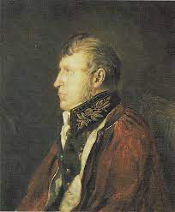
Fredrik Wilhelm Pipping (1783-1868)
Librarian in Academy of Turku, and later chief librarian in Imperial Alexander University, Helsinki
Was tasked to re-collect the destroyed collection of Academy of Turku library
In 20 years the collection in Helsinki was as big as the one destroyed in Turku.
As a librarian Pipping was old school: he organized the collection by the size of the volume
The only exception was Fennica – the collection of Finnish Literature – that was collected and organized by thematic criteria

Slide 7
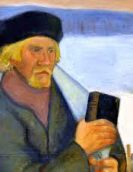
Matti Pohto (1817-1857)
Uneducated peasant and shepherd, later a bookseller, and an ardent lover of books
Collected Finnish literature one by one from estates, households and book sellers around Finland.
Donated the books to Pipping contributing massively to Fennica
When Pipping published his bibliography of Fennica in 1856-57 it mentioned appr. 5000 books, 3000 of these where owned or collected by Matti Pohto

Slide 8
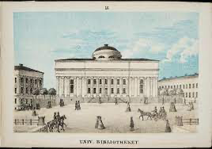
Defining Fennica
Building Fennica entailed definition of what is ”Finnish literature”
Pipping: Everything published in Finland and everything published by a Finn
Sven Gabriel Elmgren (1865):
  All items published in Finnish regardless of the place of publishing
  Everything published in Finland regardless of language
  Every publication by a Finn or someone who has lives in Finland regardless of language
Georg Schauman (1913):
  In addition to Elmgren everything that handles Finland, its citizens, history or languages regardless of place of publication

Slide 9
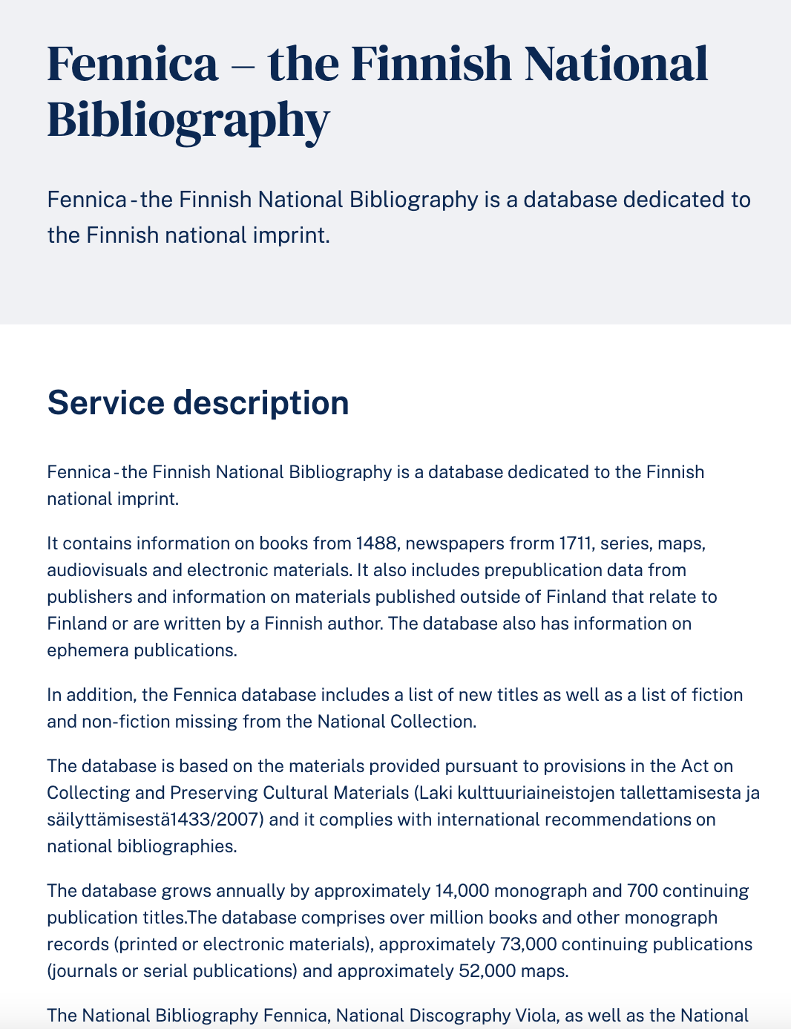
Fennica today
https://www.kansalliskirjasto.fi/en/services/fennica-finnish-national-bibliography
Information on books from 1488 and newspapers from 1711 (+other material)
Currently Fennica holds information on
  1,216,737 items in total
  1,060,937 books
  228,868 fiction in book form
  54,266 books in 1809-1917

Slide 10
Looking for fictive literature in Fennica
Library location markings (signum)
Fiction in Fennica 1809-1917
(+9000 titles)
Why not UDC?
- fiction
- language (Finnish or Swedish)
- genre (novel, lyric, drama, short stories)
- translations and childrens literature excluded
Filtered set of fiction in
Fennica 1809-1917
(≈4500 titles)
Curated set of fiction in Fennica 1809-1917
(≈3000 titles)
Manual cleaning
Exclusion of
- reprints
- anthologies
- collected works
- translations
- broadsheet literature
First editions of fiction in book form published originally in Finnish or Swedish

Slide 11
Challenges today
Nature of metadata
- inadequte data especially in relation to source language, number of editions, pseudonyms or mistaken identities
Nature of collections
- uncatalogued titles
- cataloging is subjective process that has taken place and continues to take place in historical circumstances
Nature of 19th century history
- bilingual culture
- transnational reality -> question of nationalities
- undefined publishing environment (especially first half of the century)
Nature of subjective component
- how to define fiction, different genres or literature?
- how to be consistent?

Slide 12
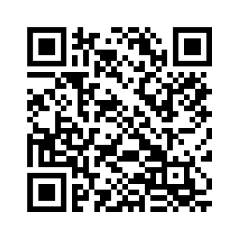
Thank you!
Veli-Matti Pynttäri
University of Eastern Finland
veli-matti.pynttari@uef.fi
+358400492277
https://sites.utu.fi/digital-history-literature-finland/

