Slide 1





Automating data curation for the Finnish national bibliography Fennica
Julia Matveeva, Osma Suominen, Leo Lahti
Joensuu, 10.12.2024

Slide 2
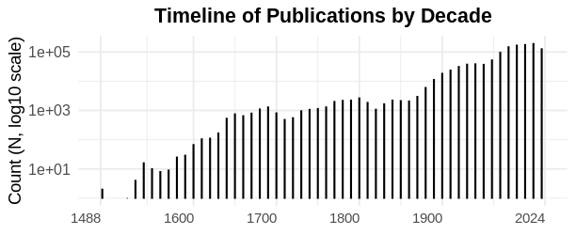
The Finnish National Bibliography: Fennica
N = 1,200,261

Slide 3
Motivation
How can we support literary scholars to create a list of first edition books published by Finnish authors in 1809-1917 by using Fennica?
Tasks to create ”the list” automatically:
Refine the data
Create subset for 1809-1917
Select ”first editions” based on certain criteria

Slide 4
Automated workflow
MARC21
R Pipeline
GitHub
CSC Rahti
Online Book

Slide 5
Data science methods
Data Cleaning and Refinement
Scalability and Automation
Statistical Analysis and Modeling
Data Integration

Slide 6
Harmonized fields
Author’s name
Author’s date
Language
Publication years
Publishers
Publication places
Title fields
UDCN
Signum
Genre
Content types

Slide 7
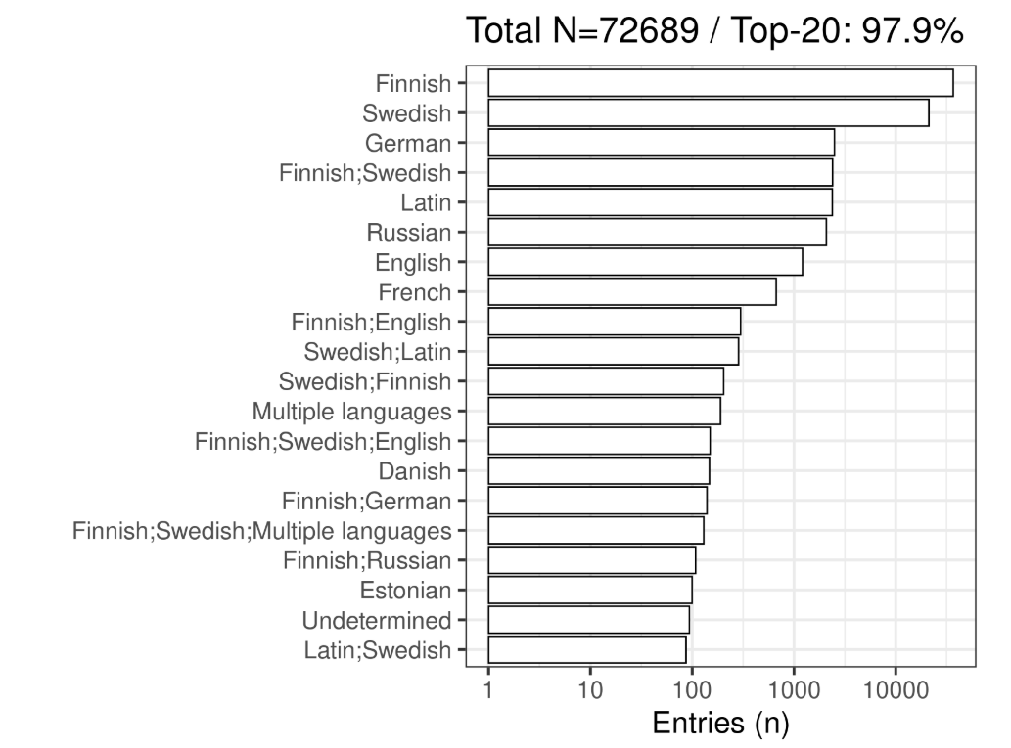
Subset for 1809–1917
Title count per language

Slide 8
Manual vs Automated subset selection
to explore the boundaries of both approaches and investigate the underlying reasons for observed differences
to propose improved subset selection strategies by combining manual and automated methods.

Slide 9
Primary criteria
1809-1917
Finnish and Swedish as original language
Right type of signum to only pick Finnish and Swedish language fiction books
Remove literature for children and translations

Slide 10
Automated Manual
68 128 3696 4435
9211 4468 2788
From Fennica raw data (1,2M)
1809-1917
Finnish/Swedish
Fiction signum
No children
No translations
Only language material
Enriched with UDCN and genre info
Only the earliest title taken
From librarian’s list using their internal software
1809-1917
Finnish/Swedish
Fiction signum
Manual removal of literarture for children
and translations
Manual search for first editions

Slide 11
Results
Automated approach is faster and more transparent
Manual approach is more detailed when it comes to identifying first editions
Less human error in the automated approach
There is a number of books in the manualy created list which cannot be found in our data set
There are ambigious info on signum, udcn and genre (mismatch in those for the same book)

Slide 12
THANK YOU

