Slide 1
Finnish Genetic Heritage
Origins: Small group of people post-Ice Age Lived in isolation due to geographical location
Genetic Composition: Influenced by isolation and population bottlenecks
Medical Genetics: Easier to identify genetic variants in Finland compared to other regions

Slide 2
Benefits of Genetic research in Finland
Imputation is more effective in founder populations
Genetic research affects efficacy and safety of medicines and helps in identifying drug targets

Slide 3
Biobank Act
Biobank Act (688/2012): Permits use of samples for research
Samples serve broad research needs Genomic data returned to biobanks post-project

Slide 4
Sample Collection and Collaboration
Samples provided by Finnish biobanks
All biobanks in Finland collaborate with FinnGen

Slide 5
Phases of FinnGen
Phase 1 (2017): Collection of research data from biobanks
Phase 2: 330,000 new participants genotyped Integration of health, lab, and pharmaceutical data
Phase 3: Merging lab results with Kanta register data Focus on genetic factors in disease progression

Slide 6
FinnGen Data Repository
Unique Repository which combines genetic and health data and is the largest medical biobank research in Finland
Over 520,000 participants
Higher incidence of illness cases

Slide 7
Participant Categories
200,000 individuals from studies since the 1980s
300,000 samples from hospital biobanks
58,000 samples from Finnish Blood Service

Slide 8
Future Genetic Research
Facilitates better-informed decisions and treatment plans
Minimizes risks
Benefits everyone
Improves accuracy in identifying disease risks and drug responses

Slide 9
Daily Operations and Tools
PheWeb Browser:
Genome-wide association analysis (GWAS) results
Over 2,000 disease endpoints
Risteys Portal:
Access to clinical endpoints

Slide 10
Computational Tools and Funding
Developed tools to analyze large genomic datasets
Translated Finnish ICD codes to OMOP-CDM standard
Funding:
Business Finland and 14 international pharmaceutical companies
Total funding ~EUR 150 million

Slide 11
Collaborative Research Project:
Finnish universities,
wellbeing services counties,
biobanks,
international pharmaceutical companies
Coordinated by the Institute for Molecular Medicine Finland (FIMM) at the University of Helsinki

Slide 12
Consortium Agreement
14 international pharmaceutical companies
15 Finnish academic or public sector entities
Each organization designates a representative to the steering group and scientific management team

Slide 13
Governance Structure
Steering Group Leads the research project
Scientific Committee and Project Managers:
Share responsibility for executing the research project
Report to the Scientific Director and the Steering Group

Slide 14
Local Analysis Support
Southwest Finland
Uusimaa
Central Finland
Pirkanmaa
Savo
North Ostrobothnia

Slide 15
Sources of Health Data
Hospital records
Specialized medical care and primary health care registers
Cancer registry
Medicine purchase and reimbursement registers
Population register
Statistics Finland
Genetic data from biobanks
Laboratory results
Disease-specific special samples

Slide 16
Extension Areas and Pilot Studies
Specific diseases (EA3)
Data from questionnaires (EA2)
Early-stage Alzheimer's research (EA6)
Proteomics
Single-cell sequencing
Immune profile determination

Slide 17
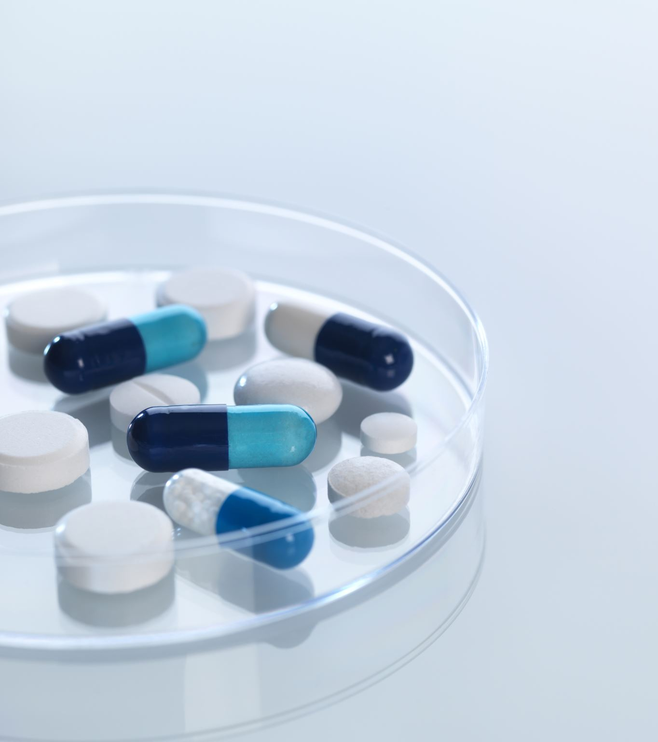
Health Data
Comprehensive health information from register initiation to recent updates
Encompasses all health events throughout an individual's life
Decades of health event data
Diagnostic codes, drug purchase records, transaction dates, lab results, vaccine information

Slide 18
Permission to use health register
National registries include all Finnish citizens
Data used under the Act on the Secondary Use of Health Data (552/2019)
Permissions sought from relevant national registers

Slide 19
Data Collection Overview
Data freezes recorded at intervals
Approximately 52,000 new data points on every Data Freeze
Data Freeze 12 Includes all current data within FinnGen
Allows revisiting previous studies with unchanged data

Slide 20
Current Data Freeze (DF12)
DF12 – November 4, 2024:
282,064 women and 218,284 men
500,348 participants
21,311,644 variants
2,502 endpoints

Slide 21
DNA Sample Analysis
Analysis subcontracted to a company outside Finland
ThermoFisher Axiom Custom Chip Array (v2):
Over 700,000 probes
Covers more than 660,000 genetic markers

Slide 22
Genetic Markers
Key GWAS markers
Numerous coding variants prevalent in Finland
Specific markers in the HLA/KIR region
ClinVar variants
Pharmacogenomic variants
Markers selected by partners

Slide 23
Genotyping with Chip Versions
Version v1:
Over 120,000 samples genotyped
Version v2:
More than 320,000 samples genotyped

Slide 24
Legacy Genotypes
Produced from biobank samples before FinnGen
Genotyped using different versions of the Illumina GWAS chip
Primarily from the biobank of the National Institute for Health and Welfare

Slide 25
Imputation
Enhance utility of genotypes identified with FinnGen chip and previous genotypes
Imputed all samples from Finnish whole genome sequences
Used reference data from approximately 8,700 individuals

Slide 26
Imputation
Computational technique to infer missing genotypes
Based on heritability and linkage disequilibrium of variants

Slide 27
Imputation
Generated computational genome sequence
Enabled analysis of ~21 million variants per individual

Slide 28
Accuracy of Imputation
Finland's demographic structure enhances imputation accuracy
Higher accuracy compared to genetically diverse populations
High accuracy extends to relatively rare variants
Includes numerous disease mutations specific to the Finnish genome

Slide 29
Compliance and Oversight
Reviewed documentation for compliance with data protection legislation
Submitted a statement on 25 June 2020
Annual reports submitted to keep the office informed

Slide 30
Data Protection and Security
Information Security and Data Protection Officer oversees data protection of research subjects
Specialized external parties evaluate data protection and security measures
In line with protection level III of the National Security Audit Criteria (KATAKRI)

Slide 31
Secure User Environment (Sandbox)
The data is stored in a secure user environment (sandbox)
Complies with legal requirements and statutory regulations
Prevents saving or copying of contents
Strictly controlled access rights
Users log in through a web browser
Audited for compliance with FinData's regulations
Certificate issued on 20 April 2022, valid for five years

Slide 32
Data security
Successful completion of the certification process
Registered by the National Supervisory Authority for Welfare and Health (Valvira)
Several million euros invested in developing the sandbox

