Slide 1
​
​Geography Section, University of Turku​
​
Research Director, Professor Jussi S. Jauhiainen
Researcher PhD Hanna Heino​
Researcher PhD Miriam Tedeschi​
Trainee Meiju Marttila
​
In cooperation with:​
Professor Andrea Resmini, Halmstad University​
Psychologist Antti Klemettilä​, THL
2020 – 2021 ​
https://sites.utu.fi/lumodi/en
hanna.heino@utu.fi
miriammtedeschi@utu.fi
LUMODI​​ ​​ Luontosuhde ​​
maahanmuuttajien ​​ hyvinvoinnin tekijänä ​​ fyysisessä ja digitaalisessa ​​
ympäristössä​
The relationship between nature and well-being of immigrants in physical and digital environments

Slide 2
Background
LUMODI – research project about the relationship between nature and well-being of immigrants in physical and digital environments – focus on the city of Turku, Finland
Carried out in 2021–2022 at the Division of Geography (UTU)
Funded by the Turku Urban Research Programme
Turku Urban Research Programme tasks are:
Preventing segregation
Increasing inclusiveness
Strengthening integration and increase multicultural interaction
Using digital services to promote health and well-being

Slide 3
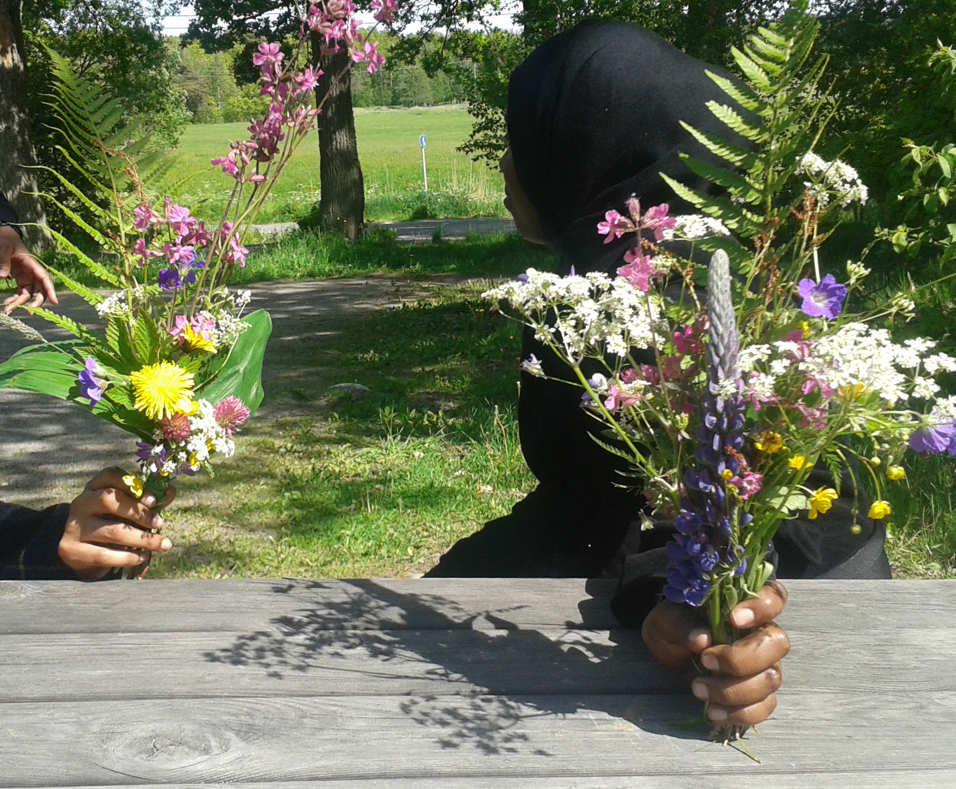
LUMODI project
Nature supports people’s health, integration, and well-being
The LUMODI project studied immigrants' free time activities in the nature for connected, meaningful, cohesive, and healthy urban life.
Target groups were Arabic-, Somali- and Russian-speaking residents of Turku, a town of 195,000 inhabitants in south-western Finland
Photo by Antti Klemettilä

Slide 4
Research questions
How do the first-generation immigrants in Turku experience nature?
How does nature contribute to their integration and well-being?
What are the barriers to access the nature?
How should the existing digital services and solutions be enhanced to better support nature experience and well-being?

Slide 5
Materials and methods
Survey
304 respondents
Arabic-speaking 84, Russian-speaking 89, Somali-speaking 131
Observation
7 nature trips with immigrants
In-depth interviews
18 persons
Probes (ethnographic method allowing for distant observation)
13 persons providing information about their everyday environment
Two-week period in 2021

Slide 6
Results
Photo by Antti Klemettilä

Slide 7
Social, emotional, cultural and physical barriers exist to access the nature
Social
Emotional
Cultural
Physical
alone vs company
fear vs safety
no "idea" of nature and well-being
seasons and weather
segregation vs integration
feeling at home vs feeling lost
own vs new country language
distance & accessibility
old & new social habits
wilderness vs urban nature
everyman’s rights
appropriate gears and outfit
Designed by Andrea Resmini

Slide 8
Nature-based integration (Gentin et al. 2019)
Three types of integration:
Interactive integration: friendships and social interactions
Identificational integration: emotional bonds to new groups and places
Cultural integration: acquisition of new knowledge and competences, cultural aspects, common practices, general rules of behaviour
Nature can be a means to integration and well-being, and a resource equally accessible to all.

Slide 9
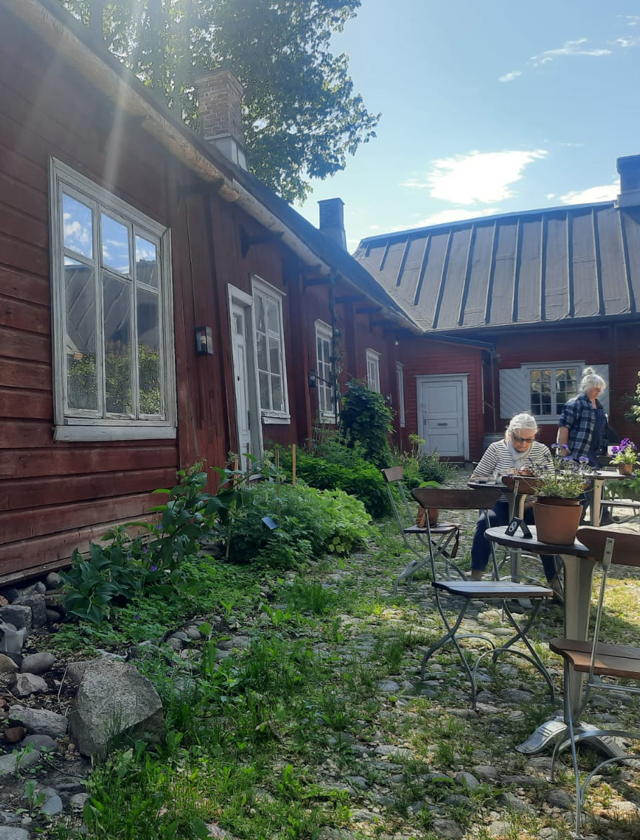
Three dimensions of
immigrants’ nature experiences
emerged from the research
Social dimension: nature as a community experience, with a purpose
Emotional dimension: nature as mirror of memories from the former home country
Normative dimension: nature as an ordered, rather than a wild element
Photo by Vadim Bessonoff

Slide 10
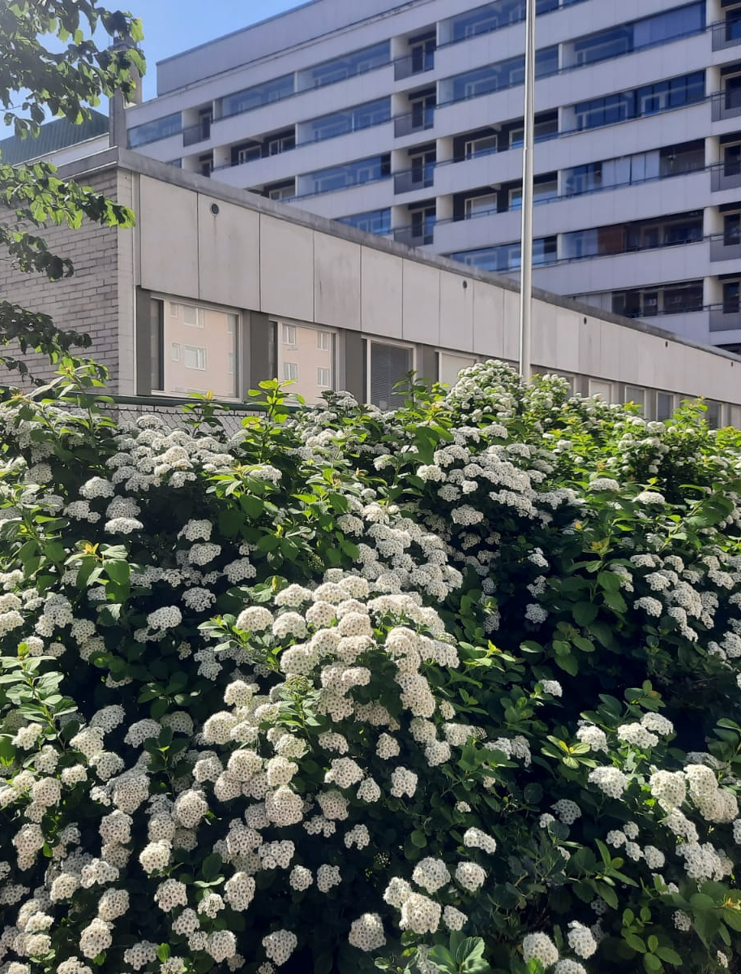
Towards nature-based integration of immigrants
Social dimension
supporting interactive integration
Emotional dimension
supporting identificational integration
Normative dimension
supporting cultural integration
Photo by Vadim Bessonoff

Slide 11
Respondents’ use of digital services to promote nature and well-being
Graph by Andrea Resmini

Slide 12
References
Gentin, S., Chondromatidou, A.M., Pitkänen, K., Dolling, A., Præstholm, S., Pálsdóttir, A.M., 2018. Defining nature-based integration–perspectives and practices from the Nordic countries. Reports of the Finnish Environment Institute, 16. Retrieved on August 5th, 2021, from http://hdl.handle.net/10138/236244.
Gentin, S., Pitkänen, K., Chondromatidou, A.M., Præstholm, S., Dolling, A., Palsdottir, A.M., 2019. Nature-based integration of immigrants in Europe: A review. Urban Forestry and Urban Greening, 43 (September 2018), 126379. https://doi.org/10.1016/j.ufug.2019.126379
Jabbar, M., Yusoff, M.M., Shafie, A., 2021. Assessing the role of urban green spaces for human well-being: A systematic review. GeoJournal, 1–19. https://doi.org/10.1007/s10708-021-10474-7
Jay, M. Schraml, U., 2009. Understanding the role of urban forests for migrants—Uses, perception and integrative potential. Urban Forestry & Urban Greening, 8(4), 283–294. https://doi.org/10.1016/j.ufug.2009.07.003
Kaplan, R., Kaplan, S., 1989. The Experience of Nature: A Psychological Perspective. Cambridge, UK: Cambridge University Press.
Leikkilä, J., Faehnle, M., Galanakis, M., 2013. Promoting interculturalism by planning of urban nature. Urban Forestry and Urban Greening, 12(2), 183–190. https://doi.org/10.1016/j.ufug.2013.02.002
Pitkänen, K., Oratuomi, J., Hellgren, D., Furman, E., Gentin, S., Sandberg, E., Øian, H., Krange, O., 2017. Nature-based integration: Nordic experiences and examples. Hørsholm: Nordic Council of Ministers.

