Slide 1
Laser Cleaning
MALAMA project lectures
Nikhil Kamboj, Postdoctoral Researcher
Heidi Piili, Adjunct Professor
Eetu Valtonen, Research Assistant
Department of Mechanical and Materials Engineering

Slide 2
Laser Cleaning
Laser cleaning is a complex physicochemical process
Green, environmentally friendly, and has efficient features
It will gradually replace the traditional cleaning processes such as mechanical, chemical, and ultrasonic
Three methods of laser cleaning process:
laser dry cleaning
liquid-assisted laser cleaning
laser shock wave cleaning

Slide 3
Traditional cleaning methods and issues
Methods
Sand blasting
Chemical solutions
Shot blasting
Hydro blasting
2. Issues
Health and safety
Consumables
Logistics
Waste
Environment

Slide 4
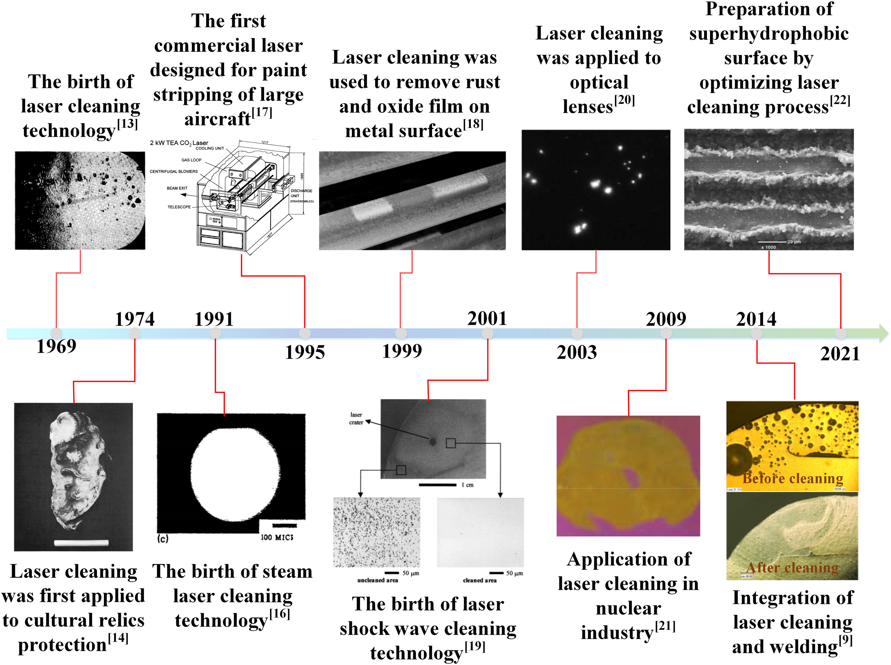
Timeline for laser cleaning technology
The birth of laser cleaning technology
The 1st commercial laser designed for paint stripping of large aircraft
Laser cleaning was used to remove rust and oxide film on metal surface
Laser cleaning was used to optical lenses
Preparation of superhydrophobic surface by laser cleaning process
Laser cleaning was 1st time applied to cultural relics preservation
The birth of laser steam cleaning technology
The birth of laser shock wave cleaning technology
Application in nuclear industry
Integration of laser cleaning and welding

Slide 5
Comparison of cleaning techniques
 | Laser cleaning | Chemical cleaning | Mechanical cleaning | Dry ice | Ultrasonic cleaning
Cleaning method | No contact | Chemical contact | Mechanical abrasion | No contact | Chemical and vibration
Damage to the part | No harm | With damage | With damage | No harm | No harm
Efficiency | High | Low | Low | Medium | Medium
Consumables | Electricity | Chemical agent | Abrasive | Dry ice | Special cleaning agent
Effectiveness | Excellent | Medium | Medium | Excellent | Excellent
Precision | High control | Low control | Low control | Low control | Medium control
Environment | No pollution | Contamination | Contamination | No pollution | No pollution
Operational | Easy | Complex | Complex | Easy | Easy

Slide 6
Pulse laser cleaning
Laser cleaning is done with a variety of mechanisms, mainly including thermal ablation, stress vibration, thermal expansion, evaporation, phase explosion, evaporation pressure, and plasma shock
Depends on the optical penetration depth and thermal diffusion length
It is necessary to select the appropriate laser source
Critical process parameters include laser beam: energy density, wavelength, pulse length, pulse frequency, angle of incidence, etc., to achieve the best cleaning

Slide 7
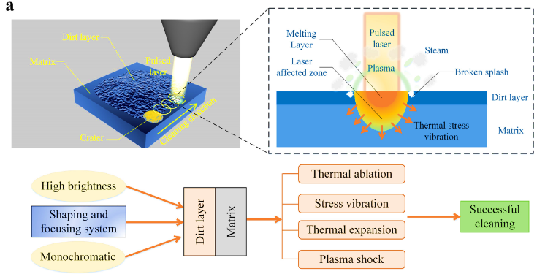
Dry laser cleaning mechanism
1st
Track
2nd
Track
Laser beam interaction zone
1
2
3
4
5
6
7
8
Pulsed laser beam
Steam/
plume
Heat affected zone
Plume
Origin of splash
Dirt layer
Thermal stress vibrations
Base material

Slide 8
Factors influencing dry laser cleaning
Laser intensity
Laser wavelength
Laser pulse length
Laser incidence angle

Slide 9
Liquid-assisted laser cleaning
Compared with dry laser cleaning, liquid film-assisted cleaning can reduce the thermal effect caused by laser exposure
The central adhesion of microparticles (dirt) on wet surfaces is capillary force and van der Waals force
Force exerted on the particles by the explosive vaporization of water > greater than the adhesion force of the microparticles

Slide 10
Laser shock wave cleaning
Indirect laser cleaning technology since it uses shock waves
Laser shock cleaning effectively removes organic and inorganic particles
Usually dry, non-contact, and large-area cleaning technology
Advantageous technology for the photosensitive material like silicon wafer when compared to the direct irradiation of the laser since:
Minimal thermal effect
Less local stress

Slide 11
Lasers used in laser cleaning
CO₂
M:YAG (M = Er, Nd, Yb)
GaAlAs diode
XeCl
KrF excimer
Nd:Van
Ti:Sa
Fibre laser (YB, Er, Tm)
Notes:
Tm on thullium

Slide 12
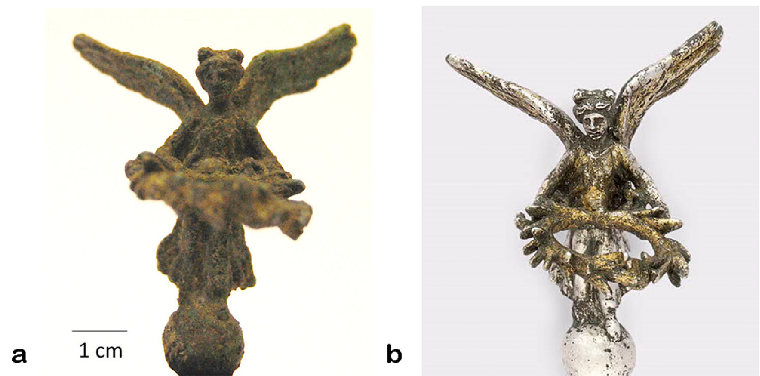
Cleaning metal artefacts
Copper
Iron
Silver
Zinc
Lead
Aluminium
Silver artefact cleaning

Slide 13
Other materials for laser cleaning
Material | Cleaning
Oxide | OK
Resin | OK
Stains | OK
Dirt | OK
Coatings | OK
Painting | OK
Rust
Resin
Stains
Coatings
Uranium
Notes:
Resin = hartsi

Slide 14
Applications and industry
Rust and corrosion removal - Used to remove rust from small machines or materials kept outdoors for a long time
Paint cleaning - It allows to remove paint of all kinds on metal surfaces
Restoration - In the restoration process, laser cleaning has been used with satisfactory results in, for example, stone preservation
Welding cleaning - Preparing the material for welding processing in the steel industry is vital. Laser cleaning systems can be integrated into production lines
Notes:
Restoration = entisöinti

Slide 15
Conclusions
The laser cleaning mechanism is closely related to the laser wavelength
The laser thermal ablation mechanism and the laser thermal stress mechanism are the most common ones
By selecting suitable laser process parameters and the appropriate laser equipment, surface damage can be completely avoided
Laser cleaning has unique advantages in many industrial fields

Slide 16
References
Marimuthu, Sundar, Hüsein Kürşad Sezer, and Alhaji M. Kamara. "Applications of laser cleaning process in high value manufacturing industries." In Developments in surface contamination and cleaning: applications of cleaning techniques, pp. 251-288. Elsevier, 2019
Bertasa, Moira, and Capucine Korenberg. "Successes and challenges in laser cleaning metal artefacts: A review." Journal of Cultural Heritage 53 (2022): 100-117
Zhu, Guodong, Zhenhai Xu, Yang Jin, Xi Chen, Lijun Yang, Jie Xu, Debin Shan, Yanbin Chen, and Bin Guo. "Mechanism and application of laser cleaning: A review." Optics and Lasers in Engineering 157 (2022): 107130
Salimbeni, Renzo. "Laser techniques for conservation of artworks." Archeometriai Műhely 3, no. 1 (2006): 34-40.

Slide 17
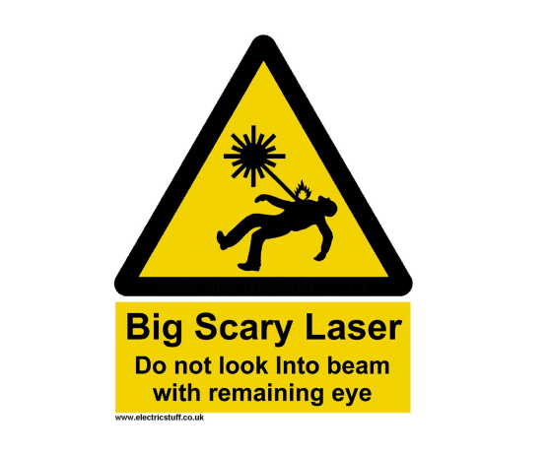
Precaution note

