Slide 1
Laser Polishing
MALAMA project lectures
Nikhil Kamboj, Postdoctoral Researcher
Heidi Piili, Adjunct Professor
Eetu Valtonen, Research Assistant
Department of Mechanical and Materials Engineering

Slide 2
Introduction
High precision polishing of surfaces of various materials can be done using high power laser beam based process
When laser beam hits the material surface, the surface starts to melt due to the high beam intensity
The molten material relocates from the ‘peaks to valleys’ under the multidirectional action of surface tension
By varying the process parameters such as laser power, energy density, beam diameter, and process speed, different rates of surface roughness can be achieved

Slide 3
Conventional polishing methods
The conventional methods are:
Mechanical (manual or automated)
Electro-chemical
These methods demand more time and high cost
They require highly qualified workers polish the surface
Always a multi-step process when compared to single-step laser polishing

Slide 4
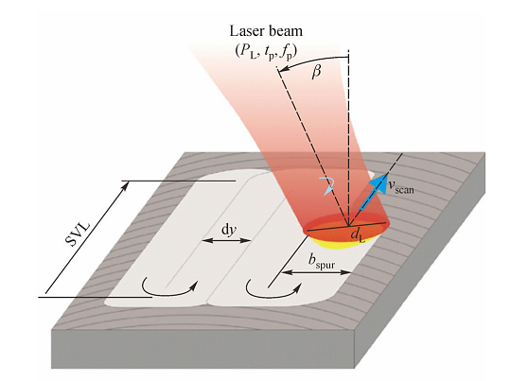
Principle of laser polishing
Symbol | Parameter | Unit
P_{L} | Laser power | W
v _{scan} | Beam scanning speed | mm/s
d_{L} | Laser beam diameter | mm
d_{y} | Track spacing | mm
b_{spur} | Width of track | mm
t_{p} | Pulse length | s
f_{p} | Pulse frequency | Hz
n | Number of repetitions
SVL | Scan vector length | mm
β | Angle of incidence | º
Temmler et al., 2012

Slide 5
Types of laser polishing
Macro polishing
mainly done with a continuous wave laser beam
The polishing allows a range of 10–80 µm to be polished with continuous re-melting of the top surface layer
Normally, fiber-coupled lasers are used with laser power in range of 100–300 W
Micro polishing
mainly done with a pulsed laser beam
discrete process with a re-melting depth in the range of 0.5–5 µm

Slide 6
Continuous wave laser polishing
Continuous wave lasers are mainly used for macro surfaces
Continuous wave lasers produce continuous power, where power is on all the time.
The melt pool for melting process is affected by the laser beam diameter, the average laser power and process speed.
Usually continuous wave lasers are used in the case of surfaces having Ra (surface roughness) of 2–16 µm
Prone to surface oxidation unless protected with shielding gas

Slide 7
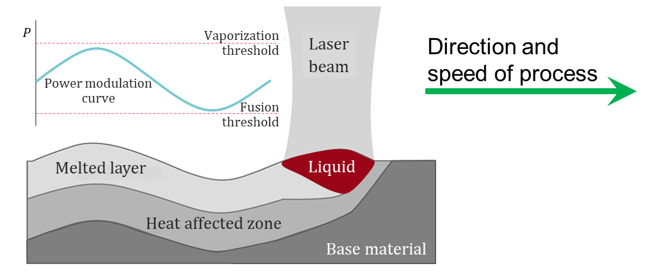
Laser polishing mechanism
Laser polishing are mainly done at three levels:
Polishing by large area ablation in which large surfaces undergo polishing
Polishing by localized ablation in which only rough surfaces are melted to reach a surface level
Polishing by re-melting
Image based on: Perry et al., 2007

Slide 8
Pulsed laser polishing
Pulsed laser beams are discrete beams which hit the metal surface
Laser pulse at a fluence that causes surface melting from 10 to 100 nm inside and out, with insignificant removal of the material
Because of liquefying of the surface, the surface tension work to smooth surface severities
Image based on: Temmler et al., 2012

Slide 9
Applications of laser polishing
In biomedical engineering, the laser is used for polishing of biomedical devices and surgical instruments to decrease defects, surface ridges, and even sharp edges that would favour contamination with bacteria
Adoption of laser polishing for implant with complex geometry can lead to a reduction both in costs and the lead time of component, even up to 30%.
Significant reduction of the environmental impact
No need for qualified personnel for hand polishing

Slide 10
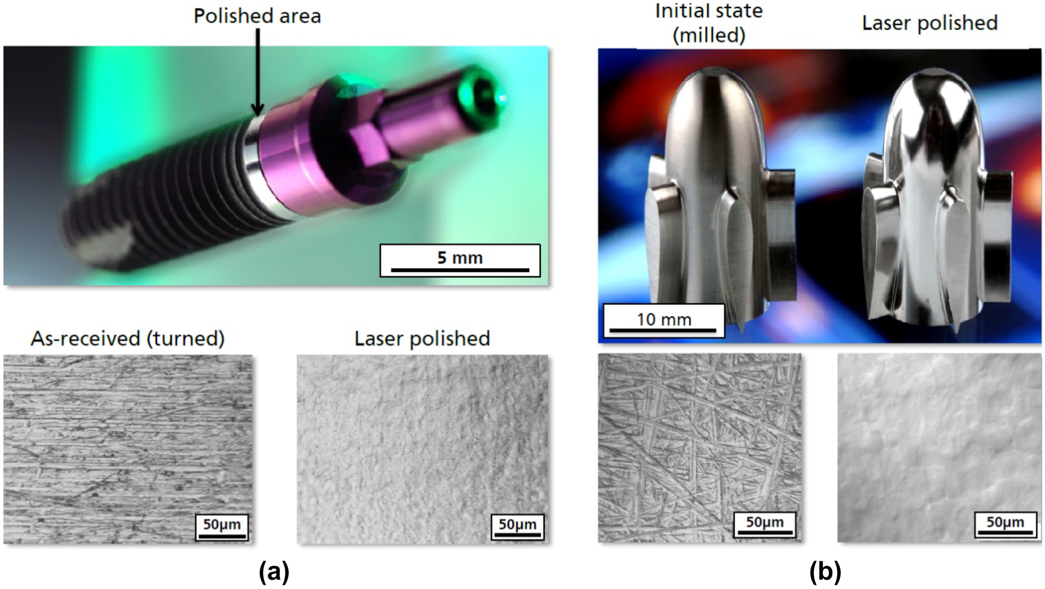
Polishing of dental implants and stents
Examples of laser polishing:
dental implant
ventricular assist device (VAD)

Slide 11
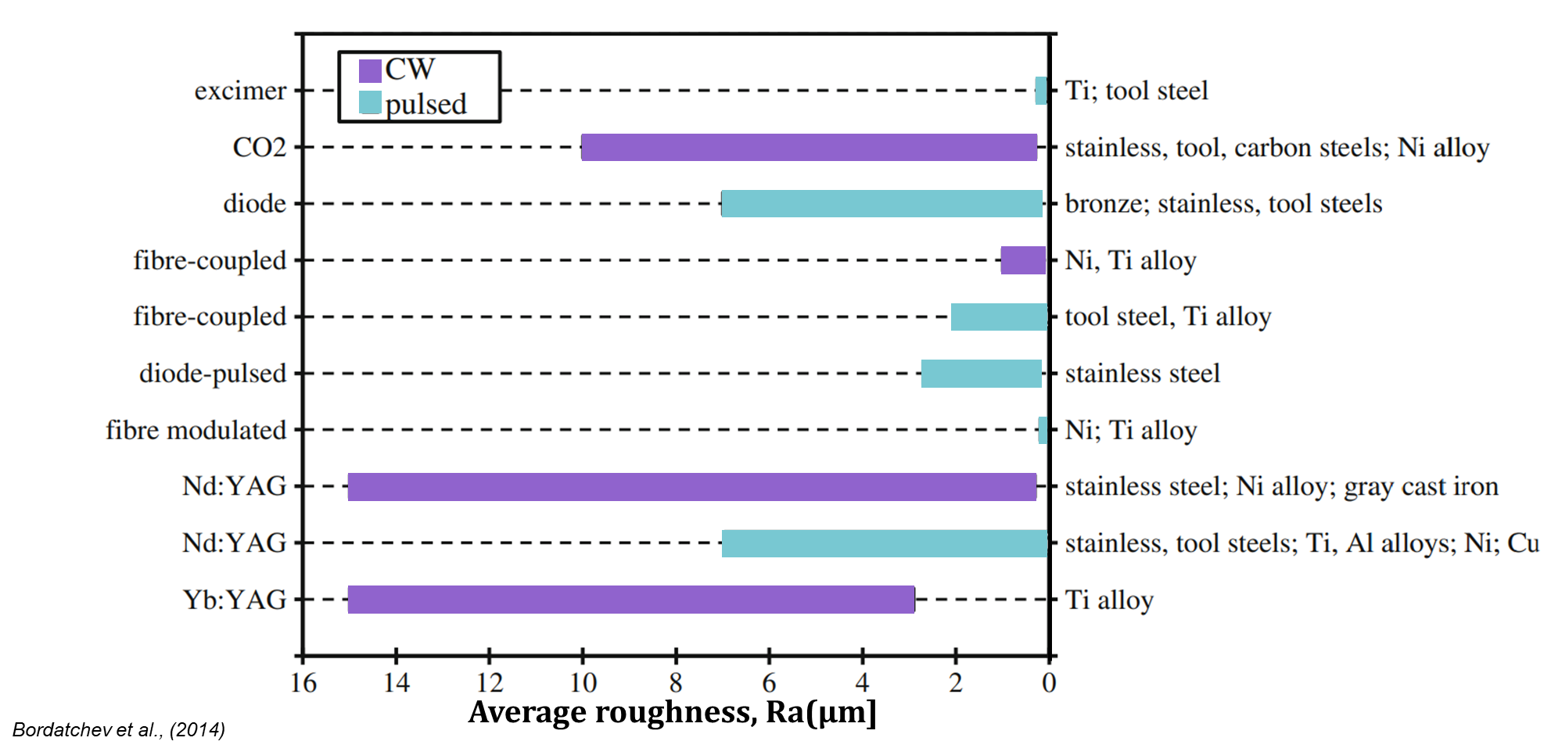
Ra values achieved with LP by literature

Slide 12
Advantages of laser polishing
No pollution
Milled, eroded, turned, and ground surfaces can be polished using laser polishing
The processing speeds are high when compared to conventional polishing methods
Lasers deliver beam size which can even be concentrated on specific areas and laser polishing of selective regions is possible ( < 1 mm² )
No requirement for skilled labour

Slide 13
Challenges in laser polishing
Some of the key challenges in the metal structures while doing laser polishing are:
Larger area polishing
Greater operating distance
Removal of debris
Higher production rate
Oxidation of metal surface when polishing carried out in the normal atmosphere

Slide 14
Conclusions
Pulsed lasers are much more preferred considering economic feasibility as low power pulsed lasers can do the polishing process
The polishing process results in surface damage by the formation of cracks due to surface oxidation
It can be also widely used in many industrial fields

Slide 15
References
Arun, K. & Fang, F., Review on mechanism and process of surface polishing using lasers. Frontiers of Mechanical Engineering 14 (2019): 299-319
Basha, S. M., Bhuyan, M., Basha, M.M., Venkaiah, N. & Sankar, M.R., Laser polishing of 3D printed metallic components: a review on surface integrity. Materials Today: Proceedings 26 (2020): 2047-2054
Bordatchev, E.V., Hafiz, A.M.K. & Tutunea-Fatan, R.O., Performance of laser polishing in finishing of metallic surfaces. Int J Adv Manuf Technol (2014) 73:35–52 DOI 10.1007/s00170-014-5761-3
Gisario, A., Barletta, M. & Veniali, F., Laser polishing: a review of a constantly growing technology in the surface finishing of components made by additive manufacturing. The International Journal of Advanced Manufacturing Technology 120, no. 3 (2022): 1433-1472
Jiejing, L. & Zuo, D., Laser polishing of additive manufactured Ti6Al4V alloy: a review. Optical Engineering 60, no. 2 (2021): 020901-020901
Perry, T.L., Werschmoeller, D., Li, X., Pfefferkorn, F.E. & Duffie, N.A., Micromelting for laser micro polishing of meso/micro metallic components. In: Proceedings of ASME 2007 International Manufacturing Science and Engineering Conference. Atlanta: ASME, 2007, 363–369
Temmler, A., Willenborg, E., Wissenbach, K., Laser polishing. SPIE 8243, Laser Applications in Microelectronic and Optoelectronic Manufacturing (LAMOM) XVII, 2012, 82430W

Slide 16
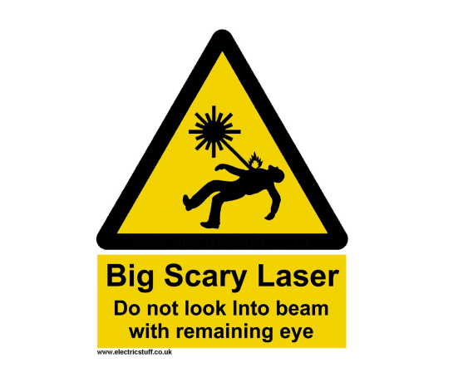
Precaution note

