Slide 1
Laser Drying
New field of application for laser e.g. in e-mobility
Nikhil Kamboj, Postdoctoral Researcher
Heidi Piili, Adjunct Professor
Eetu Valtonen, Research Assistant
Department of Mechanical and Materials Engineering

Slide 2
Introduction
Direct and high energy input to the material by laser
Heating mechanism by laser beam in wavelengths above 980 nm
The direction of the heat input is always from the outside of the material
Applications include electrode drying for energy storage applications, and ink drying
2

Slide 3
Laser Drying
Focus the thermal energy input into precise sections of the workpiece
The ability to guide laser energy accurately offers the option to focus on the specific points for drying
Due to flexibility in heating pattern shape and precise process control, laser drying can be scaled for industry-scale production
3
Figure: von Horstig et al., 2022

Slide 4
Other drying methods
Convection drying
Infrared drying
Microwave drying
Joule heating drying (induction)
4

Slide 5
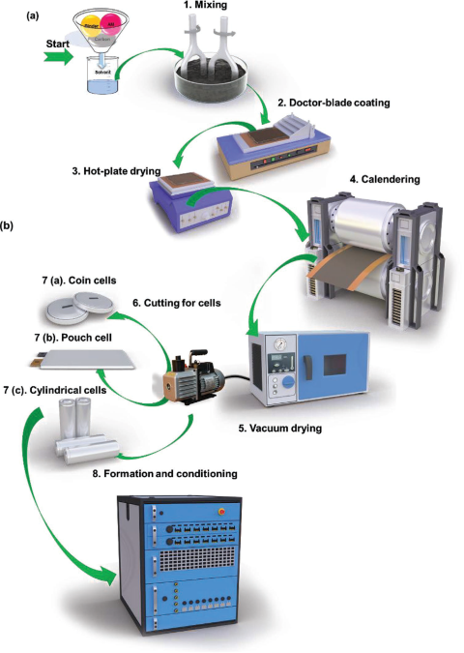
Case: Battery electrode drying
The production stages:
Mixing the coating material in liquid phase
Doctor-blade coating of electrode (Cu / Al)
Hot-plate drying (The stage in question)
Calendering
Vacuum drying
Cutting for cells (often with laser)
Assembly of cells
Formation and conditioning
Zhang et al., 2022
5

Slide 6
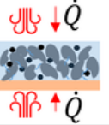
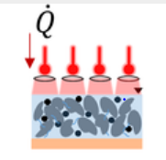
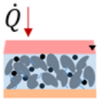
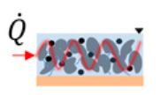
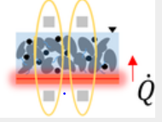
Cross-comparison of drying technologies
Case: Electrode drying
 | Convection | Laser | Infrared | Microwave | Joule heating
Principle, Q = thermal energy
Heating mechanism | Convection | Monochromatic radiation wave-length, e.g., 980,1070 nm | Radiation wavelength IR 0.75–100 μm NIR 0.75–1.2 μm | Radiation narrow-band wavelength, e.g., 12.24 cm | Contact heating
Direction of energy input | Above and below | Above* | Above* | Inside | From substrate
Current applications | Electrode drying | Electrode drying, ink drying | Electrode drying, food drying | Food drying, wood drying | Food drying, adhesive curing
* Also below if bottom material is transparent for wavelength used.
6
von Horstig et al., 2022
Miksi valo ei voi tulla toiselta puolelta?
Jos vaikka aallonpituus läpäisee alla olevan materiaalin.
Otin laserista leikkauksen ja ”structuring” pois kun ovat vähän muita prosesseja
Otin Joule heatingista metallin pois kun on myös muu prosessi

Slide 7
Advantages of laser over convection drying
Case: Electrode drying
Higher drying rates
Process flexibility - Improved controllability of the drying process due to the low switch-on times and thus reducing machine ramp-up
Homogenous drying
Direct drying method
However, in the literature most of the papers are dedicated to convection drying and is mostly applied in the industries
7

Slide 8
Comparison of drying methods
Case: Electrode drying
8
von Horstig et al., 2022

Slide 9
Comparison of drying methods
Case: Electrode drying
Infrared-, laser-, and induction-drying have the potential to be up-scaled easily
For microwave drying the radiation protection is a challenge for the scale-up
Infrared dryers are cheap, efficient, and have short ramp-up times, but their energy output cannot be controlled as precisely as laser drying
For better drying of the electrode, the combination of the drying methods must be used
9

Slide 10
In practice
Case: Electrode drying
Drying time reference: 70s convection oven drying
Drying time laser/convection: 3.6s laser + 22.5s convection = 26.1s hybrid drying
10
Eltze et al., 2024

Slide 11
References
Eltze, A., Britten, S., Hendel, R., Haustov, E., Laser systems for energy-efficient drying of battery electrodes. AILU Workshop: Laser Applications in E-Mobility, 11 July 2024
https://www.laserline.com/en-int/laser-drying/
von Horstig, M-W., Schoo, A., Loellhoeffel, T., Mayer, J.K., & Kwade, A., A Perspective on Innovative Drying Methods for Energy‐Efficient Solvent‐Based Production of Lithium‐Ion Battery Electrodes. Energy Technology 10, no. 12 (2022): 2200689.
Neb, D., Kim, S., Clever, H., Dorn, B., & Kampker, A., Current advances on laser drying of electrodes for lithium-ion battery cells. Procedia CIRP 107 (2022): 1577-1587
Zhang, Y.S., Courtier, N.E., Zhang, Z., Liu, K., Bailey, J.J., Boyce, A.M., Richardson, G., Shearing, P., Kendrick, E., & Brett, J.L., A Review of Lithium‐Ion Battery Electrode Drying Mechanisms and Metrology. Advanced Energy Materials, 2022, 12. DOI: 10.1002/aenm.202102233
11

Slide 12
Precaution note
12

