Slide 1
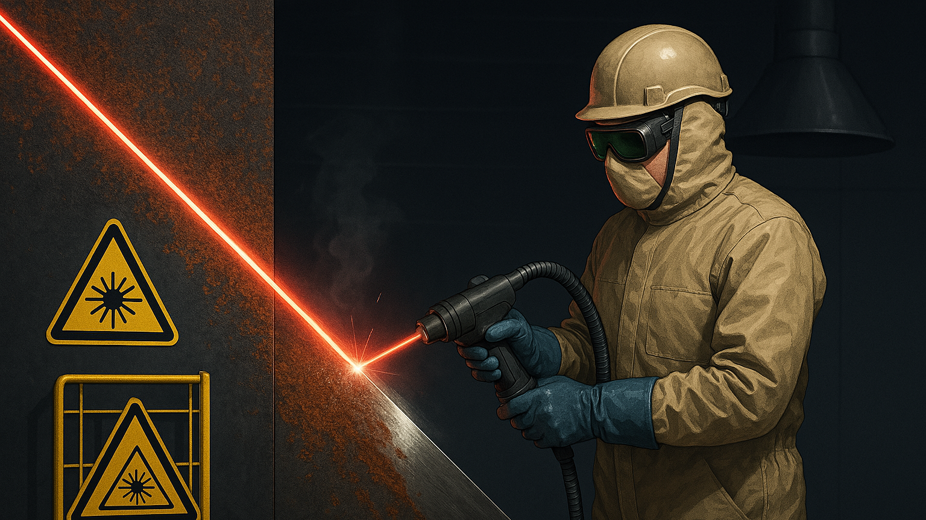

Laser Cleaning and Safety
Presented by: Heidi Piili
Senior Scientist Sr., Mechanical Engineering
Adjunct Professor, Materials Engineering
Senior Research Scientist, D.Sc. (Tech.) | Adjunct Professor

Slide 2
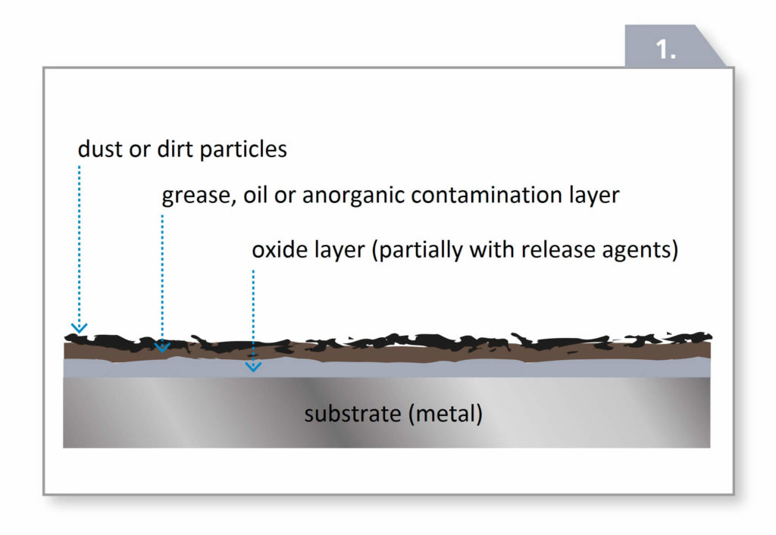
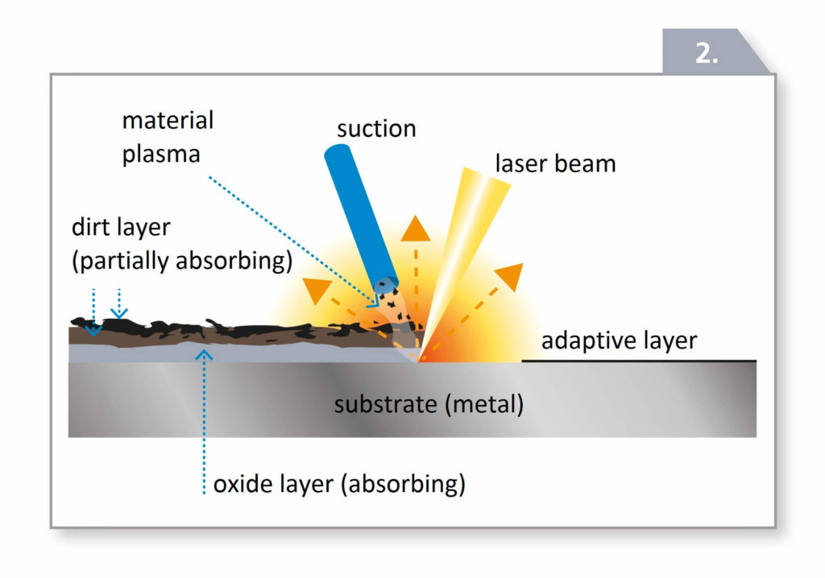
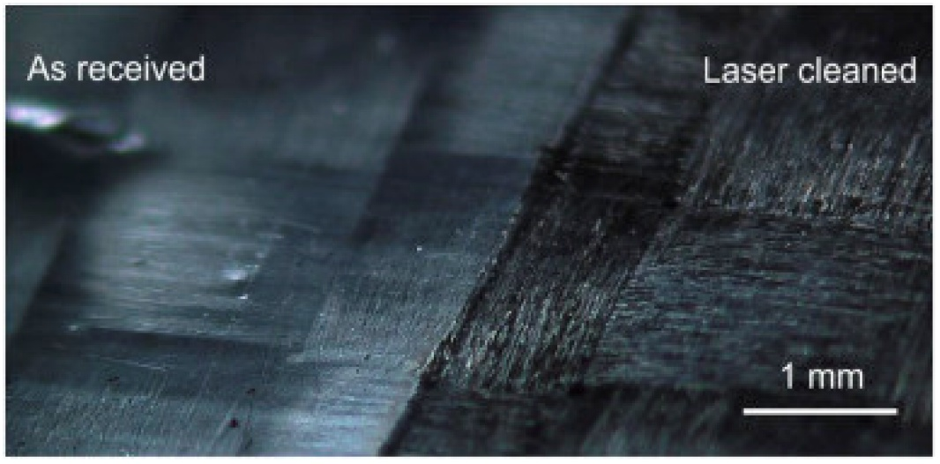
Introduction to laser cleaning
Laser cleaning is an advanced, non-contact method for removing surface contaminants like rust, paint, grease, oxides, and residues. It leverages highly focused laser beams to ablate or vaporize unwanted materials based on their optical absorption characteristics.
Compared to traditional methods such as sandblasting or solvent cleaning, laser cleaning offers advantages in precision, environmental sustainability, reduced maintenance, and automation compatibility.
It is widely applied in aerospace, automotive, manufacturing, electronics, nuclear maintenance, and art restoration [1].
The Fundamental Mechanisms of Laser Cleaning Technology and Its Typical Applications in Industry
Function Principle cleanLASER - How the Clean Laser Process Works

Slide 3
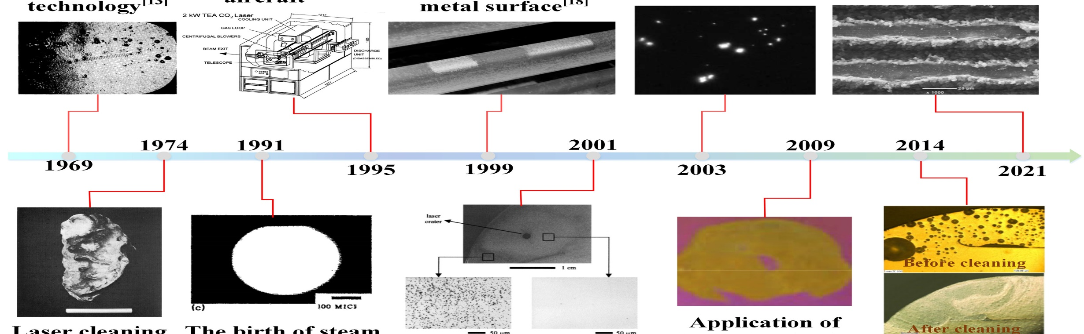

Timeline for laser cleaning technology
The birth of laser cleaning technology
The 1st commercial laser designed for paint stripping of large aircraft
Laser cleaning was used to remove rust and oxide film on metal surface
Laser cleaning was used to optical lenses
Preparation of superhydrophobic surface by laser cleaning process
Laser cleaning was 1st time applied to cultural relics preservation
The birth of laser steam cleaning technology
The birth of laser shock wave cleaning technology
Application in nuclear industry
Integration of laser cleaning and welding

Slide 4
Comparison of cleaning techniques
 | Laser cleaning | Chemical cleaning | Mechanical cleaning | Dry ice | Ultrasonic cleaning
Cleaning method | No contact | Chemical contact | Mechanical abrasion | No contact | Chemical and vibration
Damage to the part | No harm | With damage | With damage | No harm | No harm
Efficiency | High | Low | Low | Medium | Medium
Consumables | Electricity | Chemical agent | Abrasive | Dry ice | Special cleaning agent
Effectiveness | Excellent | Medium | Medium | Excellent | Excellent
Precision | High control | Low control | Low control | Low control | Medium control
Environment | No pollution | Contamination | Contamination | No pollution | No pollution
Operational | Easy | Complex | Complex | Easy | Easy

Slide 5
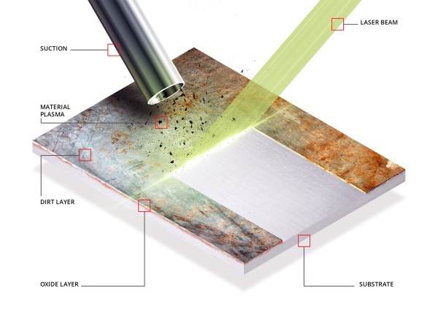



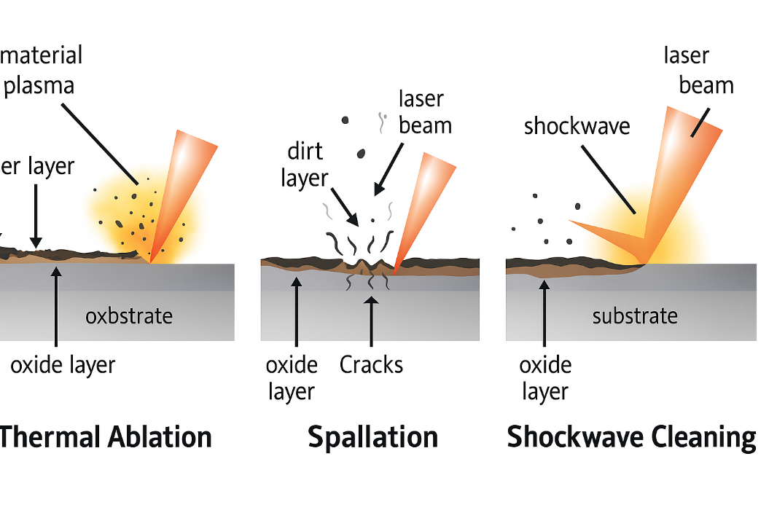
How laser cleaning works
Thermal Ablation
Absorbed laser energy raises contaminant temperature
beyond vaporization threshold, ejecting material.
Thermal Stress (Spallation)
Pulsed laser causes rapid expansion and contraction,
Cracking and lifting the contaminant.
Plasma-Induced Shockwave
How Laser Cleaning Works | P-Laser
High fluence ionizes surrounding air, generating plasma
Whose shockwave mechanically removes debris.
Selection of the cleaning mechanism depends on factors like:
Substrate thermal conductivity
Coating thickness and absorption
Pulse duration and repetition rate [2]

Slide 6
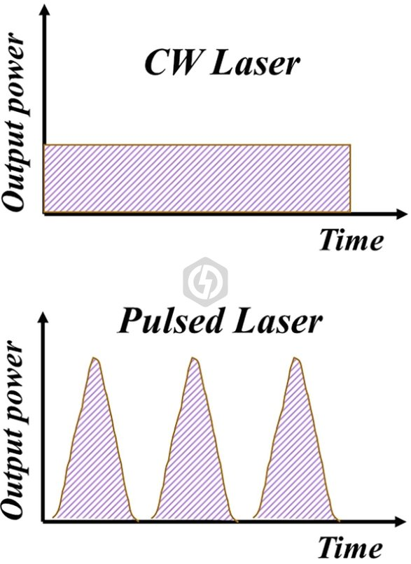
Laser types and parameters
Pulsed Fiber Lasers
Nanosecond pulses with high peak power for precision ablation with minimal substrate heating.
Continuous-Wave (CW) Fiber Lasers
Deliver sustained output, suitable for large-area or robust surface cleaning.
Key parameters:
Wavelength
Yb-fiber lasers (1064 nm), effective on metals.
Pulse Duration
ns/ps/femtosecond range for thermal control.
Fluence & Spot Size
Difference between Pulse laser and Continuous laser (CW Laser) - blog
Dictates cleaning depth and efficiency.
Repetition Rate
Affects ablation rate and thermal load.

Slide 7
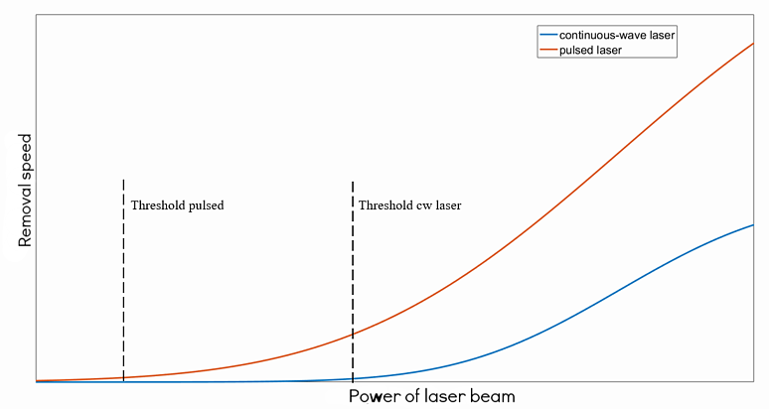
Removal speed: Pulse vs CW
Pulsed lasers are more efficient and precise, especially at lower powers. They're better suited for delicate surfaces or applications needing fine control.
CW lasers are more appropriate when cleaning large, robust surfaces [4]. where thermal effects are tolerable.
How Does Laser Cleaning Work in 5 Steps | Laserax

Slide 8
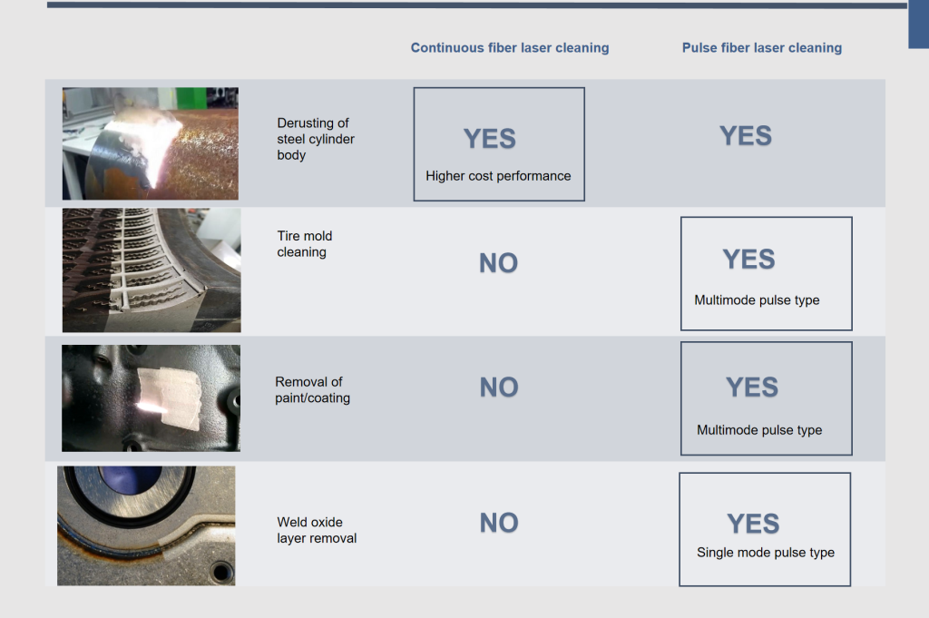
Application Suitability : CW vs Pulse fiber laser
Continuous vs Pulsed Laser Cleaning: Choose the Right Machine

Slide 9




Industrial applications
Aerospace
Automotive
Weld seam cleaning,
galvanized sheet prep
Paint removal, corrosion control,
composite prep
Restoration
Mold & Tool Maintenance
Rust/paint removal
for reconditioning
Cleans rubber molds
without damage
Aerospace Applications:
Paint/Coating Removal: Automated depainting of aircraft fuselage
Corrosion Control: Strips oxides from aluminum and titanium parts
Composite Surface Prep: CFRP surfaces prepared for bonding without chemical primers
Jet Engine Cleaning: Removes deposits from blades, vanes, and seals
Case Study: U.S. Air Force reduced chemical solvent use by 85% with robotic laser depainting [8]

Slide 10
Industrial applications
Aerospace
Automotive
Paint removal, corrosion control,
composite prep
Weld seam cleaning,
galvanized sheet prep
Restoration
Mold & Tool Maintenance
Rust/paint removal
for reconditioning
Cleans rubber molds
without damage
Automotive Applications:
Weld Seam Cleaning: Pre- and post-weld oxide and lubricant removal
Galvanized Sheet Prep: Eliminates zinc before joining
Rust/Paint Restoration: Localized bodywork reconditioning

Slide 11
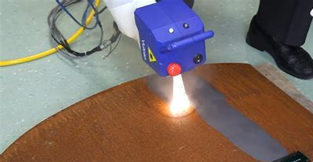
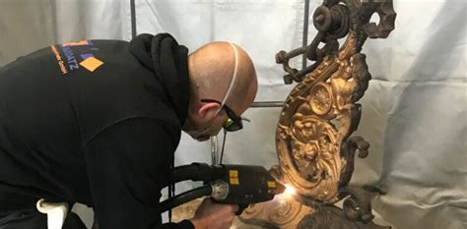
Industrial applications
Aerospace
Automotive
Paint removal, corrosion control,
composite prep
Weld seam cleaning,
galvanized sheet prep
Restoration
Mold & Tool Maintenance
Rust/paint removal
for reconditioning
Cleans rubber molds
without damage
Heavy Fabrication
Art & Cultural Heritage
Mill scale, oxide, and paint removal
on structural steel
Precision removal of encrustation and pollution
from sculptures

Slide 12
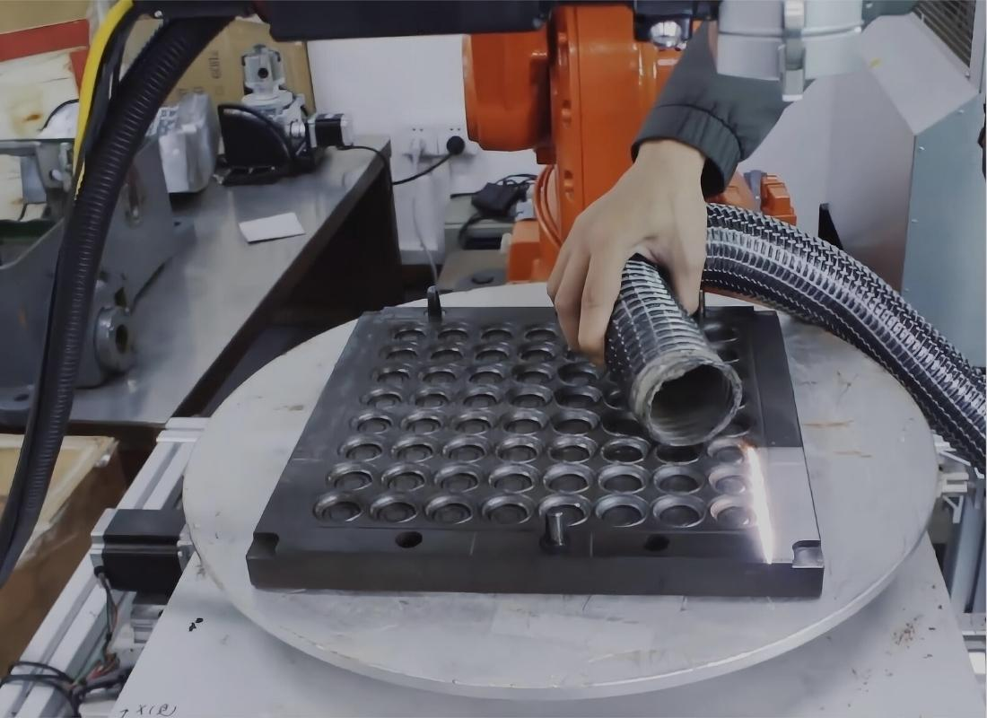
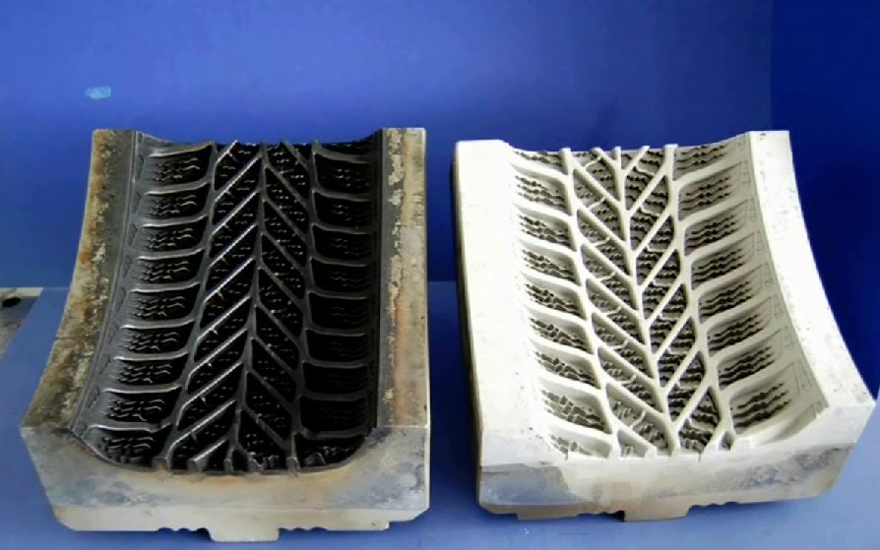
Industrial applications
Aerospace
Automotive
Paint removal, corrosion control,
composite prep
Weld seam cleaning,
galvanized sheet prep
Restoration
Mold & Tool Maintenance
Rust/paint removal
for reconditioning
Cleans rubber molds
without damage
Injection Mold Cleaning Laser
Tire Mold Cleaning Using Laser Ablation

Slide 13




Safety Protocols
Laser Safety Officer (LSO)
Oversees procedures, training, and incident prevention
Controlled Areas
Interlocked barriers, warning lights/signs, beam enclosures
PPE Requirements
Specialized protection equipment
Mandatory SOPs and Logbooks
Documentation of training, maintenance, and
exposure control

Slide 14

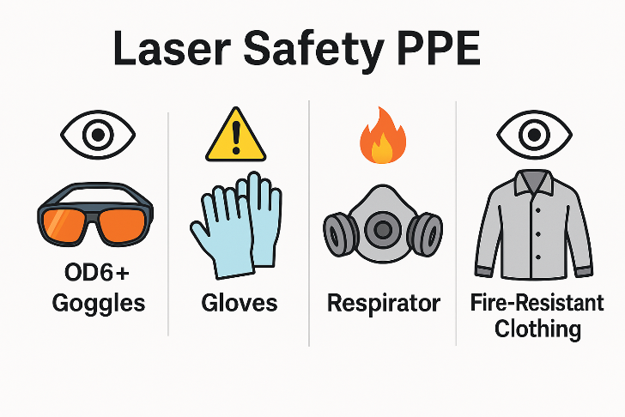
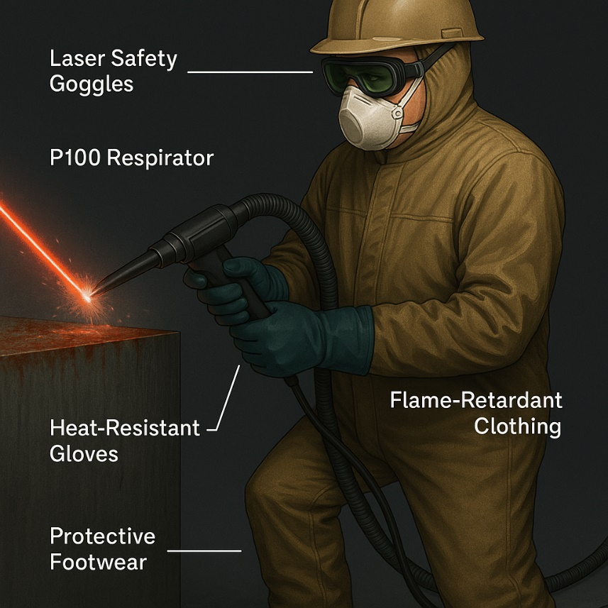
Safety Personal Protective Equipment (PPE)
PPE Requirements:
Personnel must wear laser safety goggles or eyewear to protect their eyes from direct or reflected laser beams, as well as protective clothing to avoid burns.
Laser-rated goggles (OD 6+ for 1064 nm)
Flame-retardant gloves, coats, full-coverage apparel
Respirators for fume-heavy applications
To meet ANSI Z136.1 and OSHA standards [6].
Key Takeaway: One-size-fits-all laser safety gear does not work!
Personal Protective Equipment (PPE) for laser welding – Safety First - THEO Laser Inc.

Slide 15
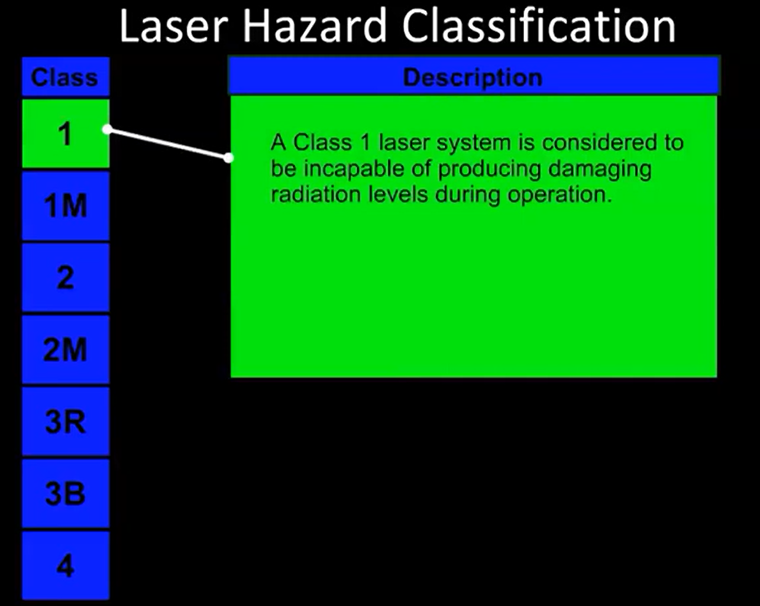
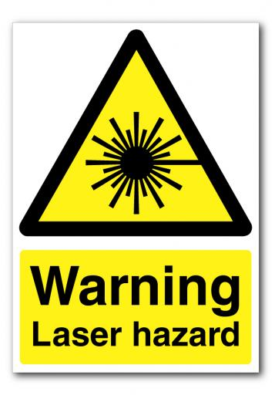
Laser Safety Video

Slide 16
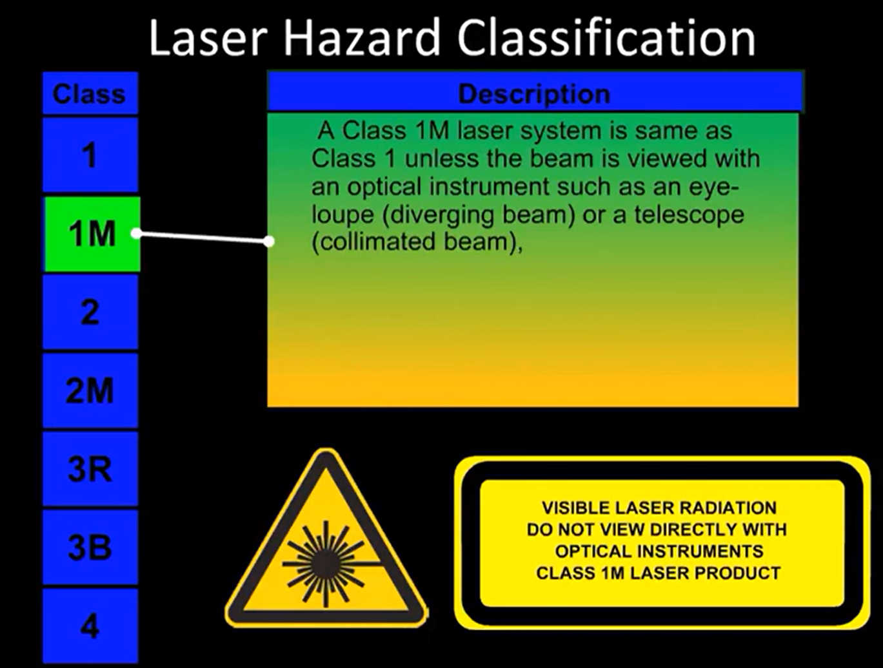
Laser Safety Video

Slide 17
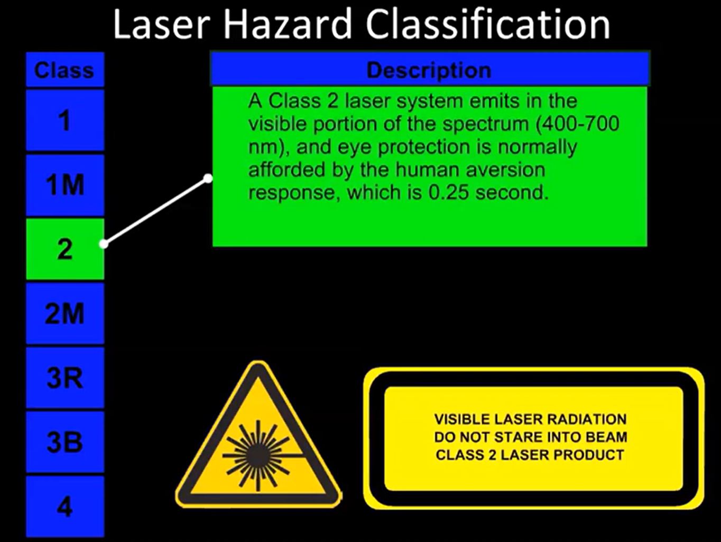
Laser Safety Video

Slide 18
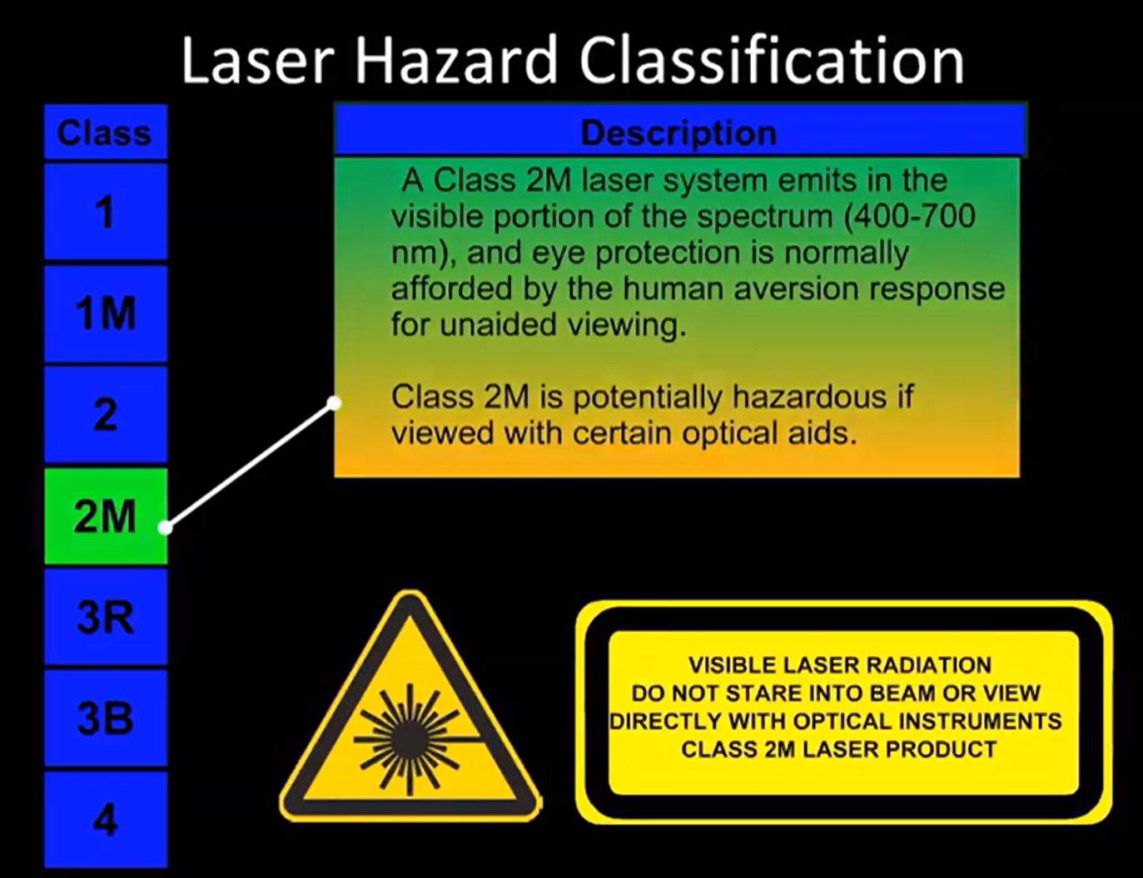
Laser Safety Video

Slide 19
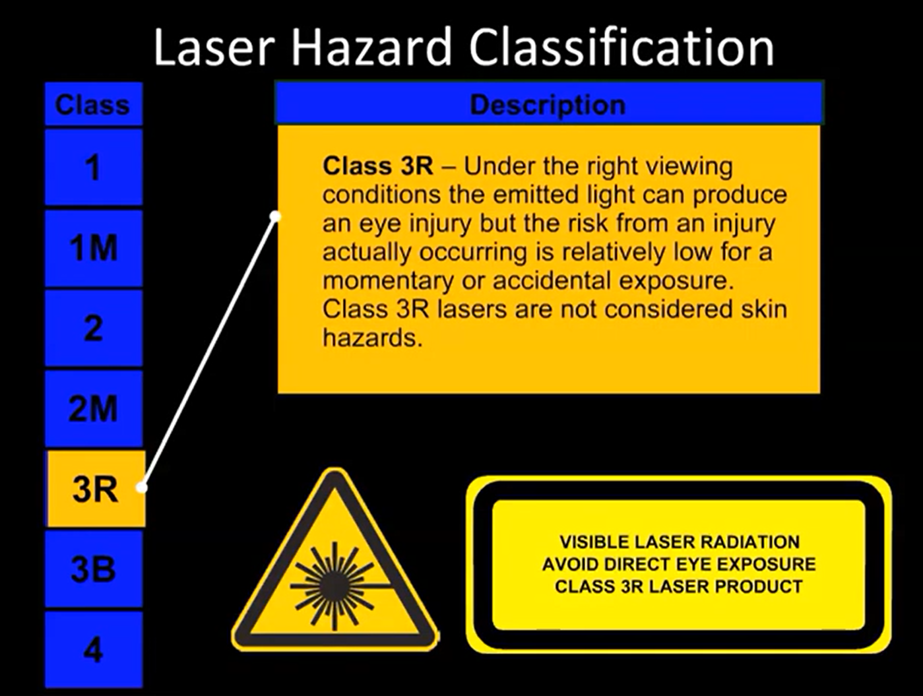
Laser Safety Video

Slide 20
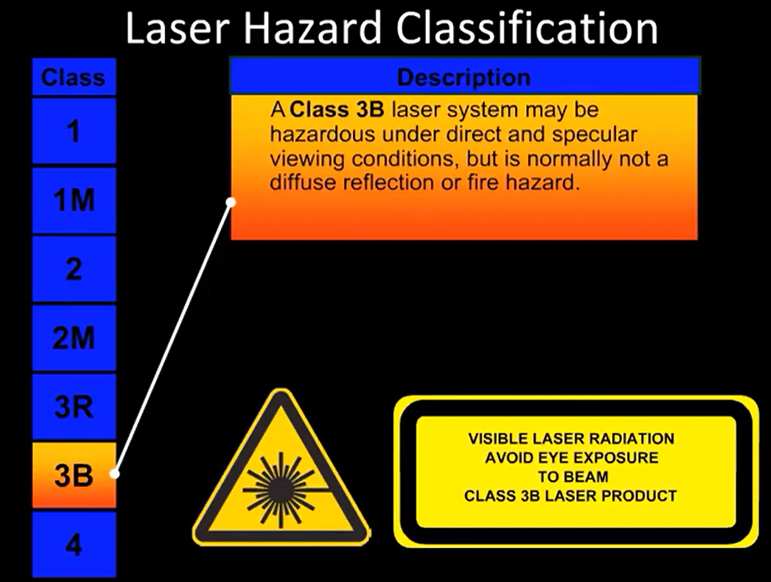
Laser Safety Video

Slide 21
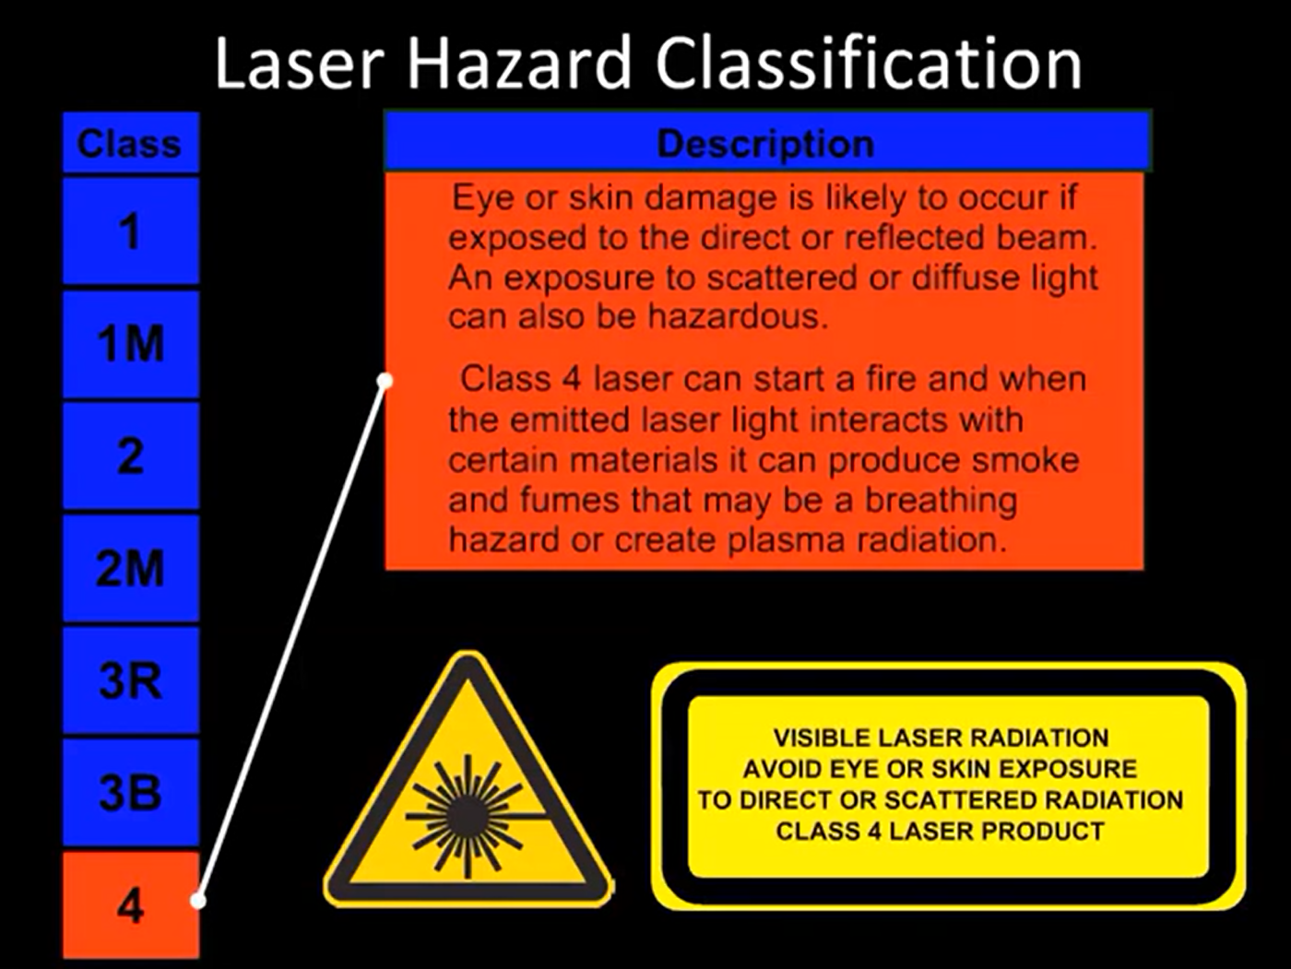
Laser Safety Video

Slide 22





Poor Practices and Accidents
Demo Without PPE
No Ventilation
Operator burned by diffuse reflection while "showing the laser on skin"
Fume accumulation triggered asthma incident in enclosed room
Bypassed Interlocks
Reflected Beam Injury
Resulted in unauthorized beam exposure to bystanders
Stainless steel reflection caused retinal burn 7 m from beam origin

Slide 23
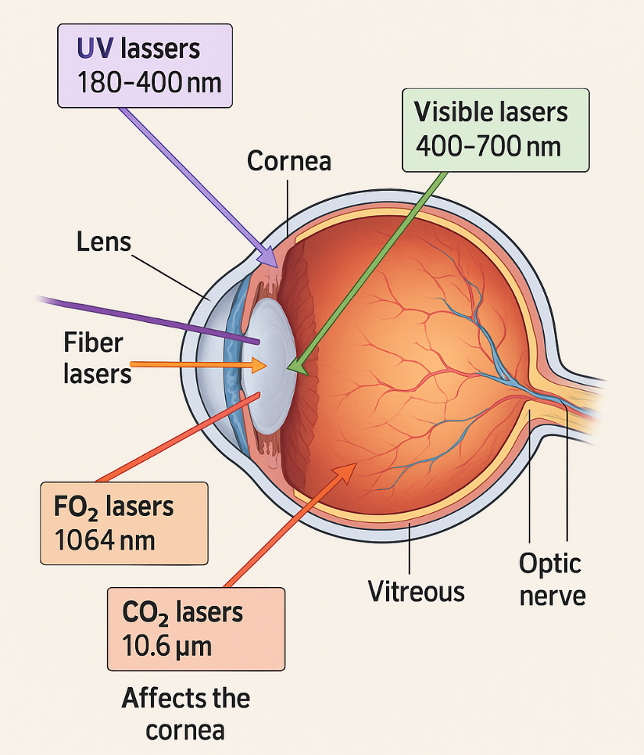
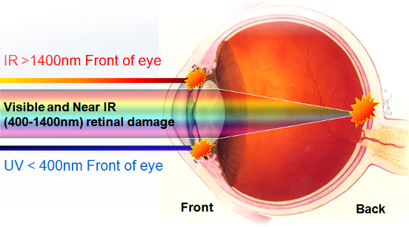
Laser Wavelength vs. AffectedEye Region & Injury Type
Key Notes:
Fiber lasers are especially hazardous due to retinal focusing and invisible beam — requires OD6+ IR-blocking goggles.
CO₂ lasers don’t reach the retina, but corneal burns are still serious.
Near-IR lasers (700–1400 nm) can be invisible but deadly — no blink reflex!
Fiber Laser 1064 nm
Laser Type | Wavelength (nm / µm) | Eye Structure Affected | Common Injury | Example Use Case
UV Lasers | 180–400 nm | Cornea, Lens | Photokeratitis, Cataracts | Semiconductor Lithography
Visible Lasers | 400–700 nm | Retina | Retinal Burns | Laser Pointers, Shows
Fiber Lasers | ~1064–1080 nm | Retina | Retinal Burns, Vision Loss | Laser Cleaning, Metal Marking
Nd:YAG (Old) | 1064 nm | Retina | Retinal Burns | Surgery, Welding
CO₂ Lasers | 10,600 nm (10.6 µm) | Cornea | Surface Burns, Pain | Laser Cutting, Skin Resurfacing
Er:YAG Lasers | 2940 nm | Cornea, Aqueous Layer | Thermal Damage | Dentistry, Dermatology
[15].

Slide 24
Estimated and published incidents insights
Prevalence of Laser Beam Exposure and Associated Injuries:
A study published by Statistics Canada reported that among individuals who experienced injuries from laser products:​Statistics Canada
Approximately 59.1% reported injuries to their eyes.
About 41.3% reported injuries or discomfort to their skin.
Around 49.5% indicated experiencing at least two occurrences of such injuries in the past 12 months.
Laser-Related Accidents in the U.S. Department of Energy (DOE) Complex
According to a report, approximately 69 laser-related accidents occurred within the DOE complex since 2000, with only nine resulting in injuries. ​Photonics
Laser Safety Occurrences (2005-2011):
An analysis of laser safety occurrences reported that of 31 laser-related incidents, four resulted in injuries. Notably, one injury was reported in each of the last three years of the study period. ​efcog.org
Laser Illumination Incidents in Aviation:
The Federal Aviation Administration (FAA) reported that laser illumination incidents rose from 46 in 2004 to a peak of 7,703 in 2015, with a decline to 5,663 incidents in 2018. ​Laser Incidents

Slide 25
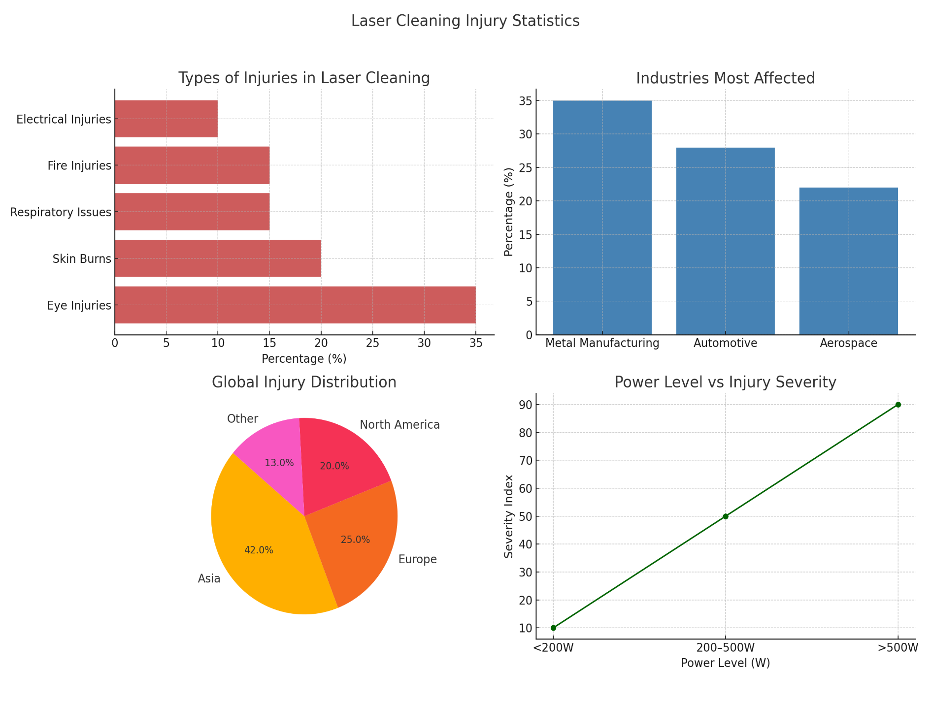
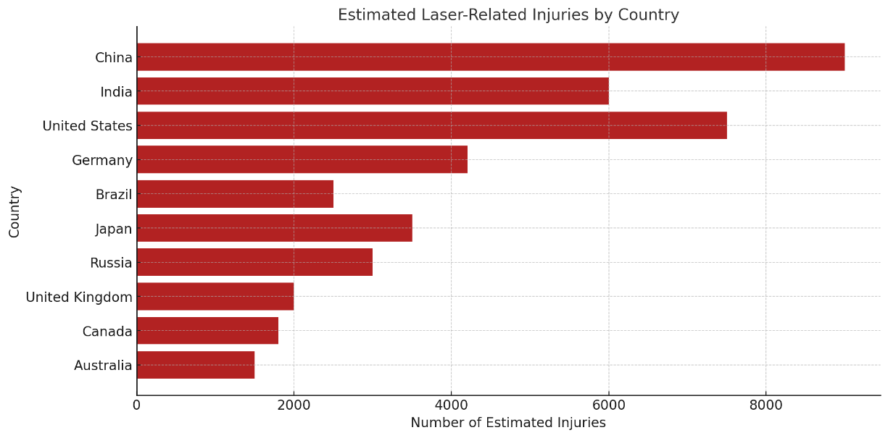
Estimated and
Published
incidents
insights

Slide 26
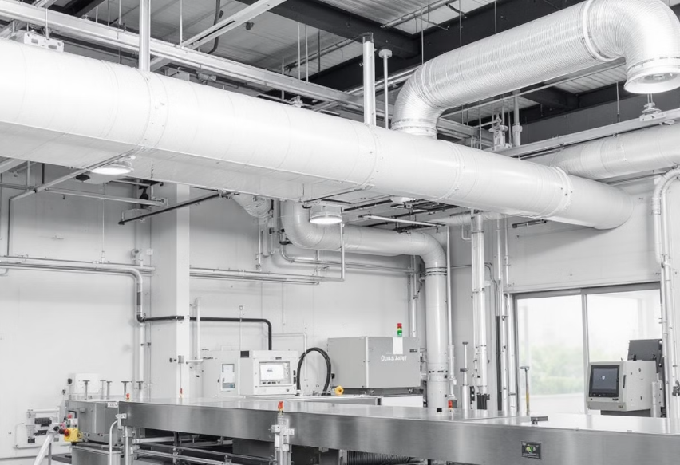
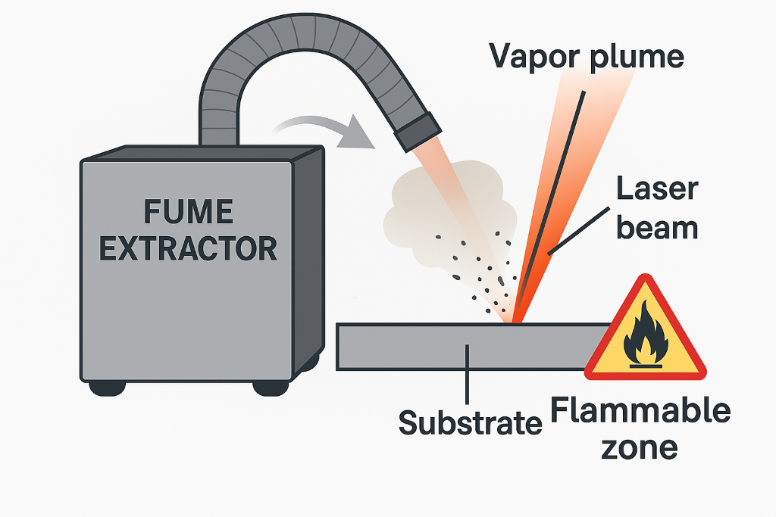
Fume Extraction and
Fire Safety
Laser-Generated Air
Contaminants (LGACs):
Hexavalent chromium
Nickel oxides
Aluminum particulates
VOCs
Ventilation Systems:
HEPA + activated carbon filters
Ducted hoods
Downdraft tables
Fire Risk Controls:
Eliminate nearby combustibles
Integrate flame arrestors
Fire-rated materials around work zone
Incident Stats: 12% of industrial laser accidents in 2021 were fire-related [7]

Slide 27
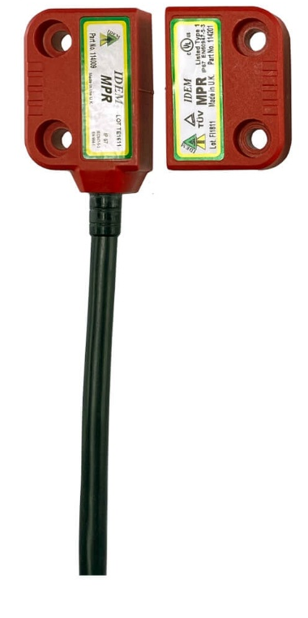
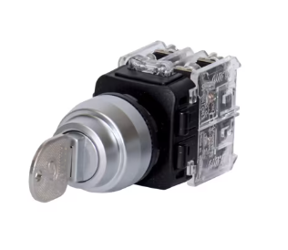


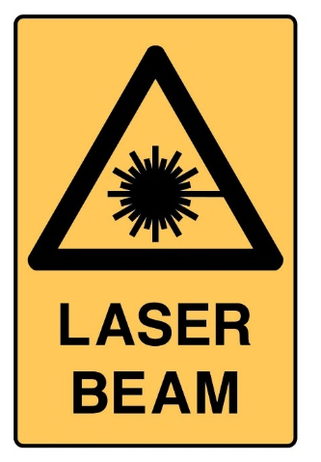

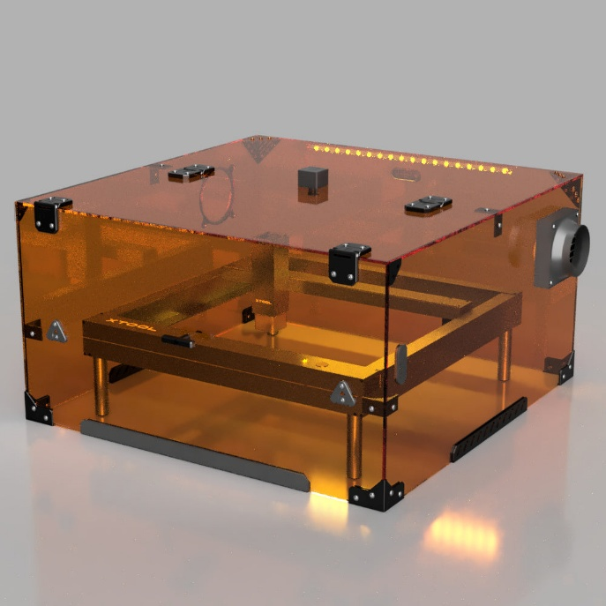


Engineering Controls
Beam Enclosures
Black anodized or ceramic panels absorb strays
Interlocks and Key Switches
Interrupt beam if area breached
Warning Systems
Audible/visual indicators when armed or firing
Remote-Control Operation
Limits direct exposure, especially for mobile systems
Emergency Protocols
Clearly marked kill switches, operator reset buttons [13]

Slide 28










Conclusion
Success
Powerful and safe asset across industries
Key Components
Robust design, trained workforce, compliance
Safety Benefits
Prevents exposure through advanced architecture
Process Benefits
Reduces damage, extends part life, enables automation
Technology
High-precision photonics with green, dry-cleaning
capabilities
Laser cleaning is reshaping surface treatment [14]

Slide 29
References
J. Lawrence, D. Waugh, and H. Zhang, "Laser Cleaning in Industry: Applications and Developments," Optics and Lasers in Engineering, vol. 78, pp. 123–135, 2016.
G. R. Fowles, "Laser Ablation Mechanisms in Cleaning Systems," Applied Surface Science, vol. 256, no. 12, pp. 3934–3941, 2010.
M. Hahn and C. Schroeder, "Comparison of Pulsed and CW Fiber Lasers for Industrial Cleaning," Journal of Laser Applications, vol. 27, no. 3, pp. 032006-1–6, 2015.
R. Fernandez et al., "Energy Efficiency in Laser Cleaning of Rusted Steel," Optics Express, vol. 24, no. 5, pp. 4890–4897, 2016.
ANSI Z136.1, American National Standard for Safe Use of Lasers, Laser Institute of America, 2020.
B. Rockwell, "Laser Safety Practices in Industry," Health Physics, vol. 100, no. 3, pp. 278–285, 2011.
J. Bartels and M. Szymanski, "Hazards of Laser-Generated Air Contaminants," Industrial Hygiene Journal, vol. 76, pp. 240–250, 2014.
S. Mills, "Laser Depainting in Aircraft Maintenance," Aerospace Maintenance Journal, vol. 82, no. 4, pp. 32–38, 2018.
D. Kim, "Laser Cleaning for Automotive Manufacturing," SAE Technical Paper 2017-01-1234, 2017.
N. Patel et al., "Laser Cleaning for Heritage and Semiconductor Applications," Micromachines, vol. 9, no. 2, pp. 78–88, 2018.
OSHA Case Report 412, "Laser Eye Injury from Handheld Cleaning Device," U.S. Dept. of Labor, 2019.
OSHA Technical Manual, Section III, Chapter 6: Laser Hazards, 2020.
LIA Guidelines, "Laser Facility Design Guide," Laser Institute of America, 2021.
D. Paul and R. Yang, "Safe and Efficient Laser Cleaning: Process Integration in Manufacturing," Manufacturing Review, vol. 5, pp. 223–230, 2019.
https://www.lasersafe.co.uk/laseradvice3.php

Slide 30

Webinar about industrial laser cleaning!
Scan me!

Slide 31
Additional Resources
Laser Institute of America (LIA) – Laser Safety in Industrial Applications. https://www.lia.org
OSHA (Occupational Safety and Health Administration) – Laser Hazards and Workplace Incident Reports. https://www.osha.gov/laser-hazards
Texas Department of Insurance (TDI) – Lasers and Eye Safety in the Workplace. https://www.tdi.texas.gov
IPG Photonics – Laser Cleaning System Safety Guidelines. https://www.ipgphotonics.com
TRUMPF GmbH – Laser Safety in Sheet Metal Processing. https://www.trumpf.com
SAE International – D. Kim, “Laser Cleaning for Automotive Manufacturing”, SAE Technical Paper 2017-01-1234
Statistics Canada – Health Reports: Discomfort and injuries from lasers, 2021. https://www150.statcan.gc.ca
Photonics Media – What Counts as a Laser Accident. https://www.photonics.com
Market research reports on global laser equipment usage (e.g., MarketsandMarkets, Precedence Research)

