Slide 1
Toipumisen lukeminen: Toipumisen kertomuksia kulttuurissa, lääketieteessä ja yhteiskunnassa (nº 26081229) 8. maaliskuuta 2024 Avril Tynan Humanistinen terveyden ja sairauden tutkimus: lähestymistapoja, menetelmiä, käsitteitä

Slide 2
Project background
Covid-19 and the “return to normal”
→ the “new normal”
Long Covid as a framework for understanding the entanglements of illness and “health” (Tynan 2021a, b).
Reading Recovery: Narratives of Recovery in Culture, Medicine, and Society (NarRec) / Toipumisen lukeminen: Toipumisen kertomuksia kulttuurissa, lääketieteessä ja yhteiskunnassa

Slide 3
Afterlives of illness and injury
“Continuing bonds” (Silverman and Klass 1996)
Illness and injury leave “impressions” (Ahmed 2004)
Caregiver narratives

Slide 4
Cf. Recovery as Rebirth, Restoration, and Return
Cf. Samuel Tuke: “restored to the state he was in, previous to the attack”
Cf. Charles Baudelaire: “return towards childhood”
Cf. Graeme Mercer Adam and Agnes Ethelwyn Wetherald: “like being again a very little child”
Anthony: “Recovery is a deeply personal, unique process of changing one’s attitudes, values, feelings, goals, skills, and/or roles. It is a way of living a satisfying, hopeful, and contributing life even with the limitations caused by illness. Recovery involves the development of new meaning and purpose in one’s life as one grows beyond the catastrophic effects of mental illness.” (1993: 527).
Carel (2007): “living well with illness”

Slide 5
Narratives of Recovery
Recovery is not neutral
Recovery narrative as genre (Woods et al. 2022)
Recovery-as-policy
Tragedy to triumph (Voronka and Grant 2022)
Where does the recovery narrative begin? Or end?

Slide 6
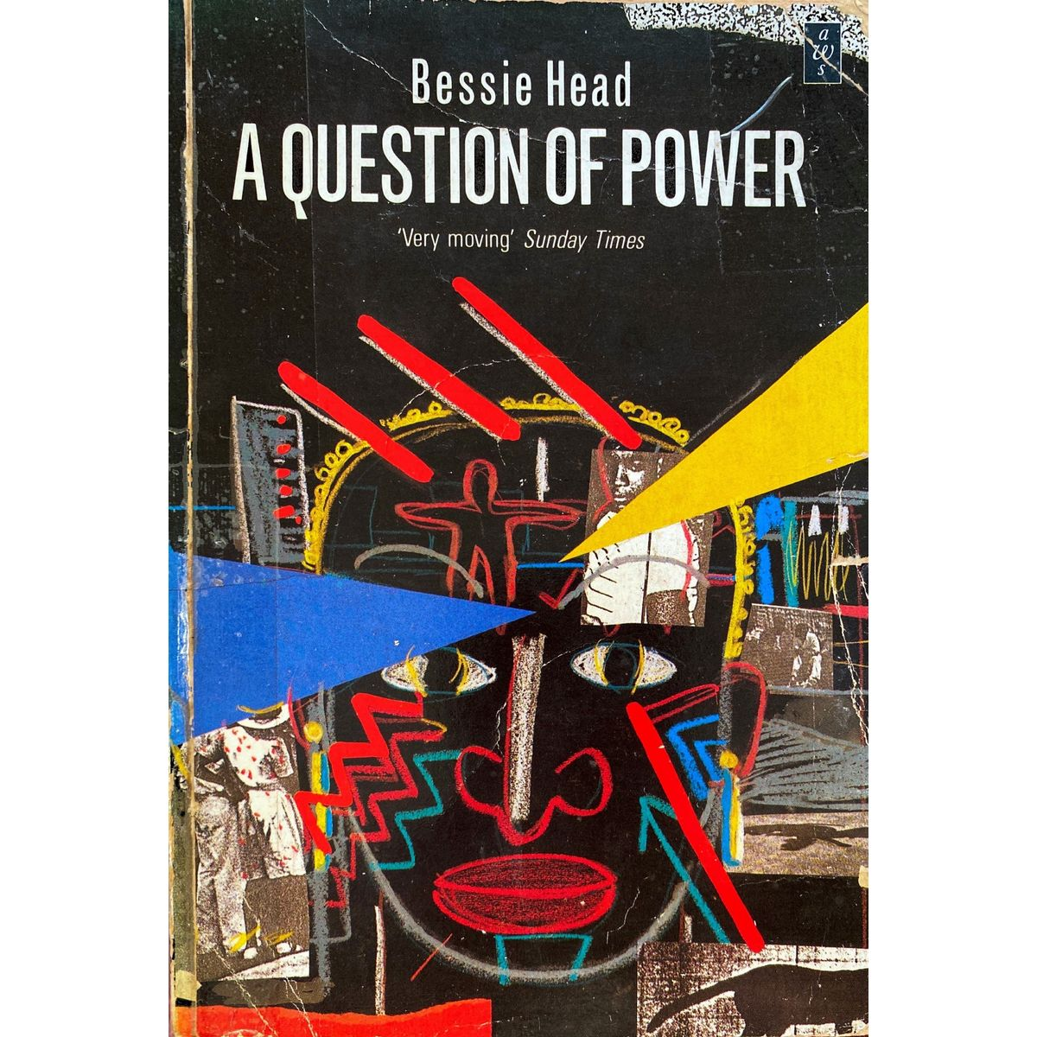
Recovery narratives (?)

Slide 7
Works cited
Ahmed, Sara. 2004. The Cultural Politics of Emotion. Edinburgh: Edinburgh UP.
Anthony, William. 1993. ”Recovery from Mental Illness: The Guiding Vision of the Mental Health Service System in the 1990s.” Psychosocial Rehabilitation Journal 16: 11-23.
Carel, Havi. 2007. ”Can I be Ill and Happy?” Philosophia 35(2): 95-110.
Silverman, Phyllis R., and Dennis Klass. 1996. “Introduction: What’s the Problem?” In Continuing Bonds: New Understandings of Grief, edited by Dennis Klass, Phyllis R. Silverman, and Steven L. Nickman, 3–27. Washington DC: Taylor and Francis.
Tynan, Avril. 2021a. ‘Life After Covid-19: Entanglements of Illness and Recovery.’ Synapsis: A Health Humanities Journal, 25 January.
Tynan, Avril. 2021b. ‘The Future is Convalescence: Rethinking Recovery and the End of Covid-19.’ Medical Humanities, 7 January.
Voronka, Jijian, and Jill Grant. 2022. “Service User Storytelling in Social Work Education: Goals, Constraints, Strategies, and Risks.” Social Work Education 41(5): 977-992.
Woods, Angela, Akiko Hart, and Helen Spandler. 2022. “The Recovery Narrative: Politics and Possibilities of a Genre.” Culture, Medicine and Psychiatry 46: 1-27.

